Slide 1
Tables, Charts, and Graphs
with Examples from History, Economics, Education, Psychology, Urban Affairs and Everyday Life
REVISED: MICHAEL LOLKUS 2018

Slide 2
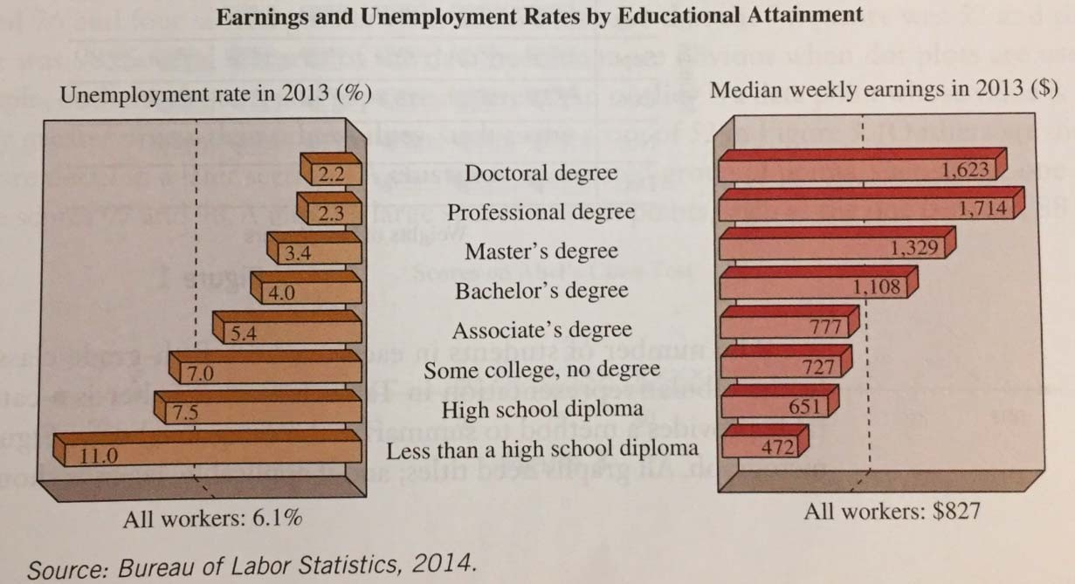

Slide 3
Tables, Charts, and Graphs Basics

Slide 4
▶ We use charts and graphs to visualize data.
▶ This data can either be generated data, data gathered from an experiment, or data collected from some source.
▶ A picture tells a thousand words so it is not a surprise that many people use charts and graphs when explaining data.

Slide 5
Types of Visual Representations of Data

Slide 6
Table of Yearly U.S. GDP by Industry (in millions of dollars)
Source: U.S. Bureau of Labor Statistics
Year | 2010 | 2011 | 2012 | 2013 | 2014 | 2015
All Industries | 26093515 | 27535971 | 28663246 | 29601191 | 30895407 | 31397023
Manufacturing | 4992521 | 5581942 | 5841608 | 5953299 | 6047477 | 5829554
Finance, Insurance, Real Estate, Rental, Leasing | 4522451 | 4618678 | 4797313 | 5031881 | 5339678 | 5597018
Arts, Entertainment, Recreation, Accommodation, and Food Service | 964032 | 1015238 | 1076249 | 1120496 | 1189646 | 1283813
Other | 15614511 | 16320113 | 16948076 | 17495515 | 18318606 | 18686638

Slide 7
The chart below is called a pie chart. It shows what percent “of the pie” a particular category occupies out of the whole.
If total GDP in 2015 is the entire pie, then manufacturing makes up 19% of that pie and finance makes up 18%. Notice that visually speaking, since 19% and 18% are so close to each other in value, their respective slices of the pie are similarly sized.
2015 U.S. GDP (in millions of dollars)
Manufacturing
19%
Finance, insurance, real estate, rental, and leasing
59%
18%
Arts, entertainment, recreation, accommodation, and food services
Other
4%

Slide 8
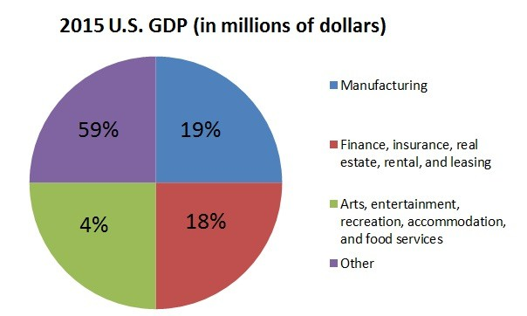
▶ Pie charts can be misleading when the slices do not
correspond with the percent contribution to the whole pie.
▶ Notice the pie chart below is not very intuitive.

Slide 9








Example from Everyday Life
The following chart shows how a family spends its yearly income of $31,000. How much money does this family spend on transportation?
Family Budget of $31,000
19%
25%
Other Recreation Transportation Clothing housing
Food
10%
26%
15%
5%

Slide 10
Solution
▶ The chart indicates that 15% of the income is spent on transportation. We must answer the question: 15% of
$31,000 is what?
▶ Writing as an equation and solving, we get
▶ n = 0.15 x 31,000 = 4650
▶ So the family spends $4650 on transportation yearly.

Slide 11
The graph below is called a bar graph.
It shows each of the variables independent of each other, each with its own bar.
2015 GDP for all industries was $31.397023; looking at the graph, the bar for all industries is just above $30.
One is still be able compare each variable with the other by comparing bars.
2015 GDP (in trillions of dollars)
Other
Arts, entertainment, recreation, accommodation, and food services
Finance, insurance, real estate, rental, and leasing
Manufacturing All industries
0
5
10
15
20
25
30
35
Dollars

Slide 12
The graph below is called a line graph. It shows how a variable evolves with respect to another variable. In the line graph below, we show how GDP has evolved by year.
Yearly Total GDP (in trillions of dollars)
35
30
25
20
Dollars
15
Yearly Total GDP
10
5
0
1947
1950
1953
1956
1959
1962
1965
1968
1971
1974
1977
1980
1983
1986
1989
1992
1995
1998
2001
2004
2007
2010
2013
Year

Slide 13
When to use a Line Graph, Pie Chart, or Bar Graph?
▶ We use the pie chart here to compare parts of a whole. In our example, we compared components of US GDP.
▶ The line chart is useful when you want to show how a variable changes over time. For our purposes, we used it show how GDP changed over time.
▶ Bar graphs are good for comparing different groups of variables. We used it to compare different components of US GDP. We did the same with the pie chart; depending on your purposes you may choose to use a pie chart or a bar graph.

Slide 14
If given a table of data, we should be able to plot it. Below is some sample data; plot the data with x on the x-axis and y on the y-axis.
x | y
0 | 0
1 | 3
2 | 6
3 | 9
4 | 12
5 | 15
6 | 18
7 | 21
8 | 24

Slide 15
Below is a plot of the data on the table from the previous slide. Notice that this plot is a straight line meaning that a linear equation must have generated this data.
What if the data is not generated by a linear equation? We can fit the data using a linear regression and use that line as an approximation to the data. Regressions are beyond the scope of this workshop.
30
25
20
15
10
5
0
0
1
2
3
4
5
6
7
8

Slide 16
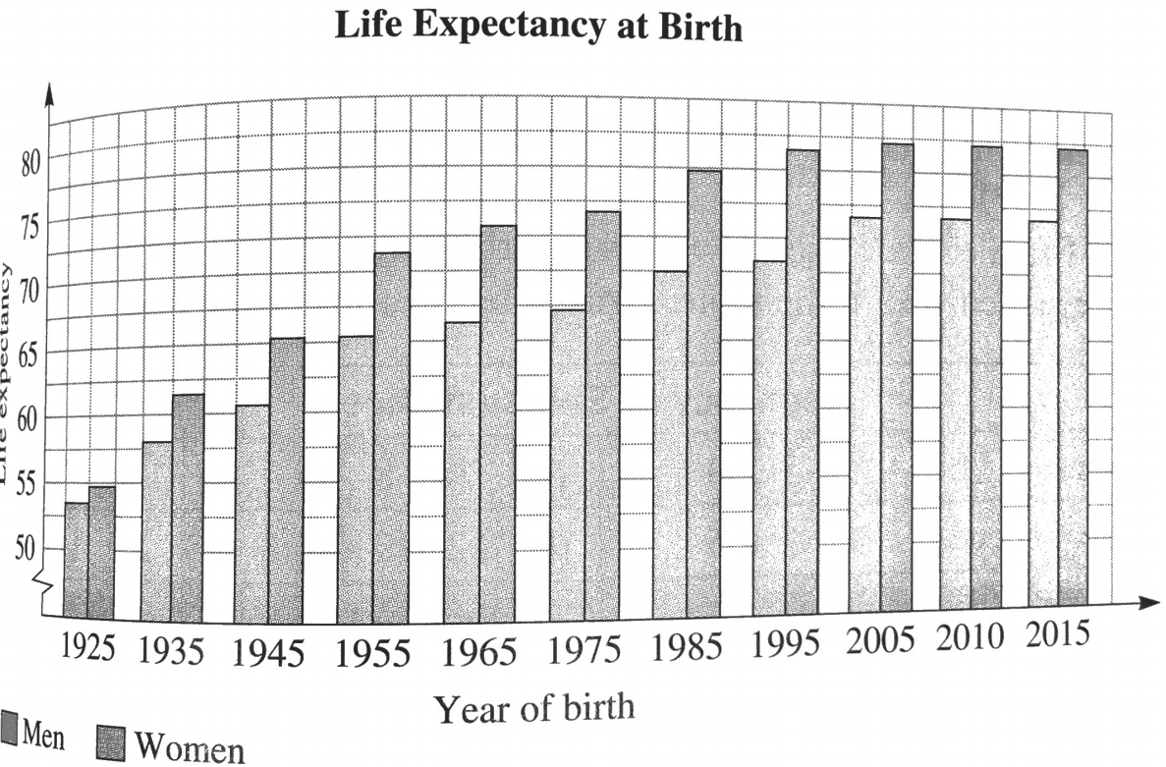
Example from Urban Affairs
▶ What kind of bar graph is this?
▶ Whose life expectancy has changed the most since 1925?
▶ In 1925, about how much longer was a woman expected to live than a man?

Slide 17
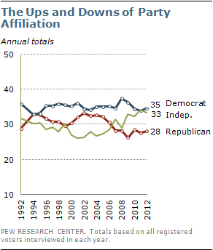
Example from History
In what years were the affiliations for Republicans and Independents the same?
During what time period did the party affiliations have the most change?

Slide 18
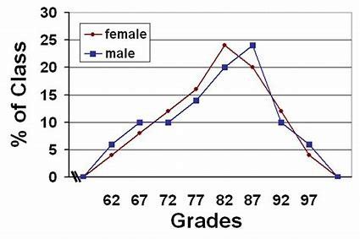
Example from Education
What percent of the total class received grades of 72 or 77?
Which grade showed the largest difference between males and females?

Slide 19
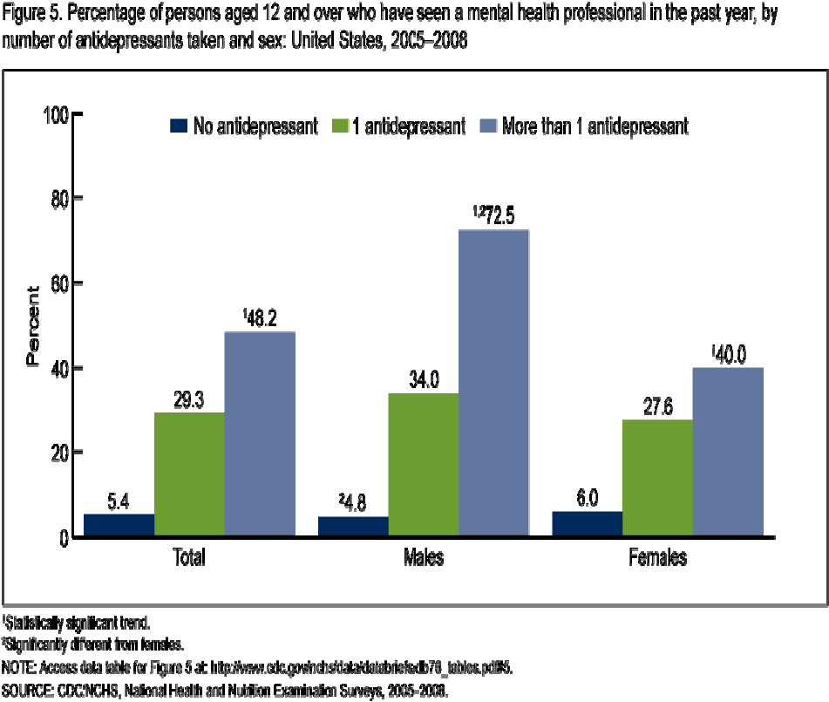
Example from Psychology
What do you notice is different in this graph than the others reviewed so far?

