Slide 1
Final Project: Solar Wind Delay
Prudvi Gadireddy

Slide 2

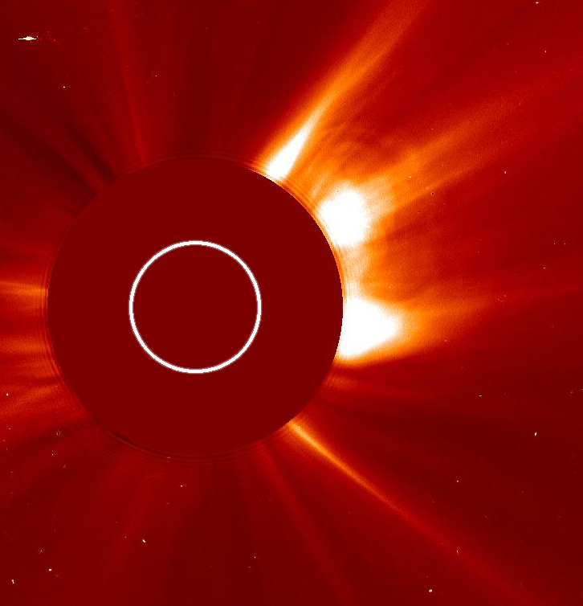
Domain & Objective
Solar Wind
Plasma coming from the sun
Affects space weather
Can cause geomagnetic storms = fried satellites, electronics
Must be studied and forecasted
Predict when a given solar wind section will reach Earth (propagation delay)

Slide 3

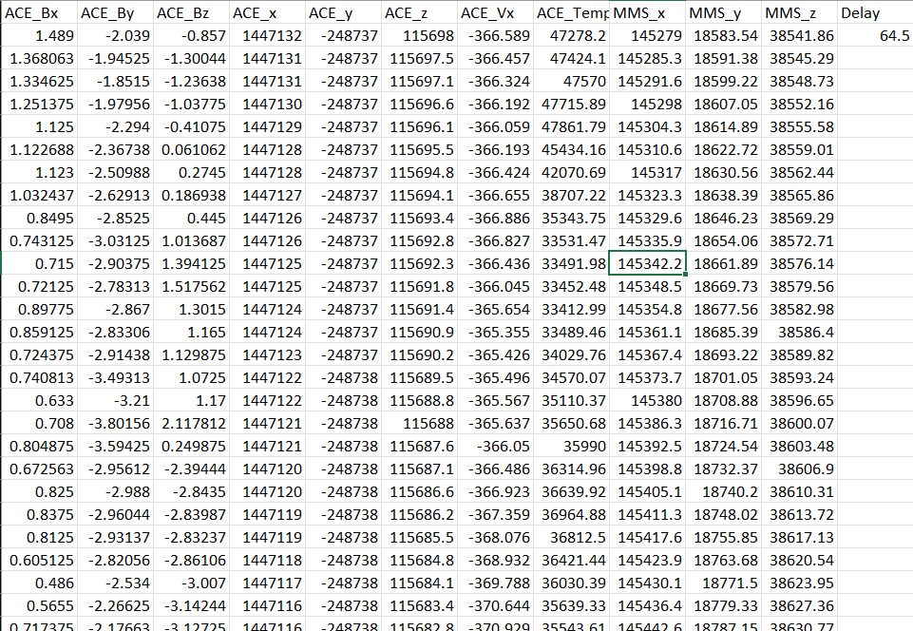

The Data
Measure solar wind attributes over time
1 Block = A solar wind time-series
80 records
698 Blocks, 56538 records total
Each block has a delay value
5Vs
Volume – Many records to process
Variety – Each record has many attributes
Velocity – In real-time, data is streamed from a satellite
Variability – Data is chaotic, no pattern
Value – Can help prevent potential blackout/damage

Slide 4
Preprocessing
Already was very clean
No duplicates or nonsense elements
Preprocessed by Dr. Samira Tasnim and team
Data combined from multiple files into 1
Removed headers
Removed a few blocks with missing records

Slide 5
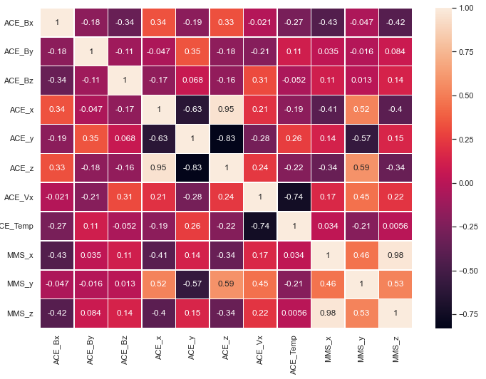
Model Selection and Feature Analysis
Data is
Strictly Numerical
No obvious categories
Linear regression chosen
Simple to implement
Modified Approach: predict delay for each record and average
Tested varied train/split ratios (20%, 50%, 70%)
Feature Selection
Heatmap to identify correlations

Slide 6
Metrics
Accuracy
Model Score
Percentage-wise how close the predicted values are on average
Root Mean Squared Error
Measure overall predictor quality
Measures variance of predicted values

Slide 7

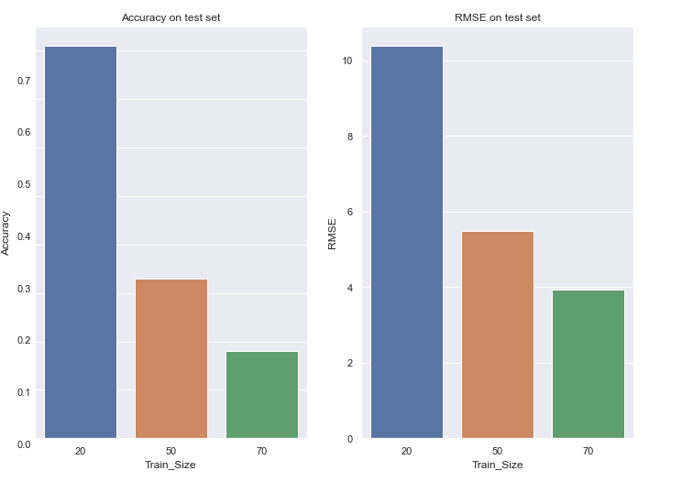
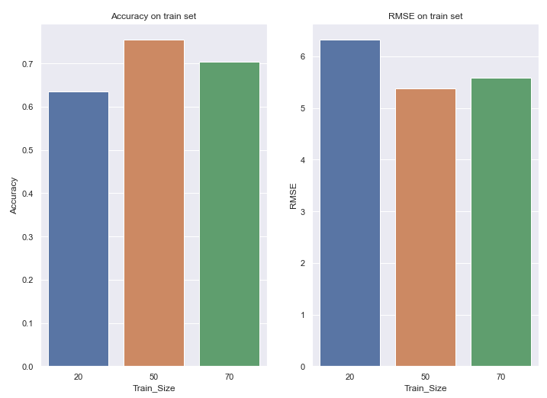

Metrics

Slide 8
Conclusion
Did not work that well
Lowest RMSE was 4
Not good, since accuracy is important
Future implementations
Classification – Put delay ranges into predefined buckets
Neural Net – Best suited to deal with this scenario (resolving 2-D input to a number)

