Slide 1


CATCH THE FISH. SELL YOUR HAUL. ENHANCE YOUR EQUIPMENT.
Liam · Saxon · Harrison · David
Notes:
FSHING is a fishing game where the lake is also a marketplace.
[Sources]
- In-game lake environment: src/assets/lake-chart.png
- Project wordmark: src/assets/fshing-wordmark.png

Slide 2

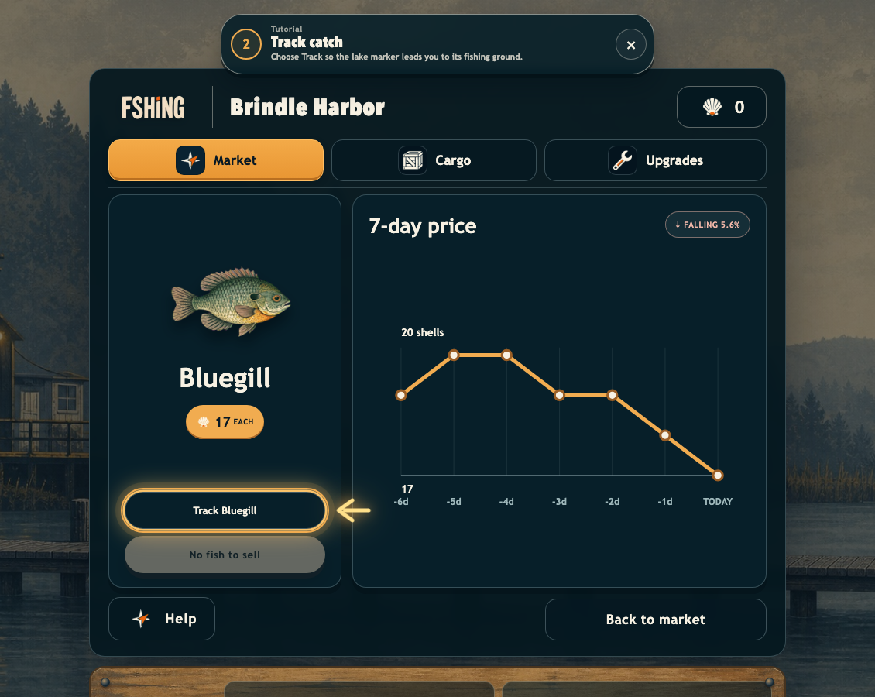
THE IDEA
Every trip begins with a price.
Compare the current fish prices across the market. Choose what you want to catch.
Notes:
You do not just catch fish. You read today's quote and choose a target before leaving the harbour.
[Sources]
- Current game screenshot: Docs/incursion/screenshots/04-market-detail.png
- Game rules: Docs/Game-Brief.md

Slide 3
The game loop
➤
⌁
$
↑
↻
→
→
→
→
SAIL
FISH
SELL
UPGRADE
REPEAT
Capacity, speed, depth, and reel control change what the next trip can achieve.
Notes:
The systems support one another: the market creates a route, fishing creates cargo, and upgrades change the next trip.
[Sources]
- Core loop and upgrades: Docs/Game-Brief.md

Slide 4
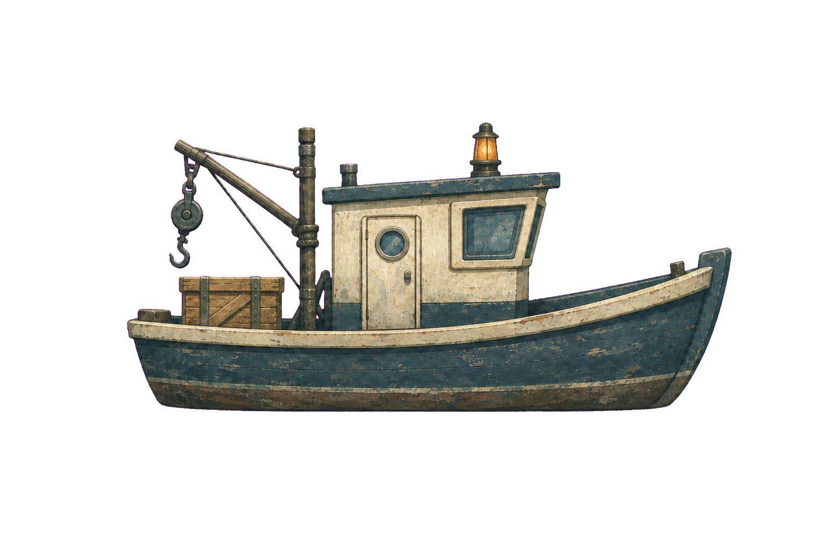
MAIN CHARACTER
Your small beginner boat. Lots of upgrades to make.
CARGO CAPACITY
ENGINE SPEED
LINE DEPTH
REEL POWER
ENGINE BOOST
Notes:
The boat is the visible player character. Its crane, crate, and lantern show what it does before the player reads a rule.
[Sources]
- Production boat: src/assets/player-boat.png
- Transparent presentation derivative: Docs/incursion/assets/working-boat-transparent.png

Slide 5
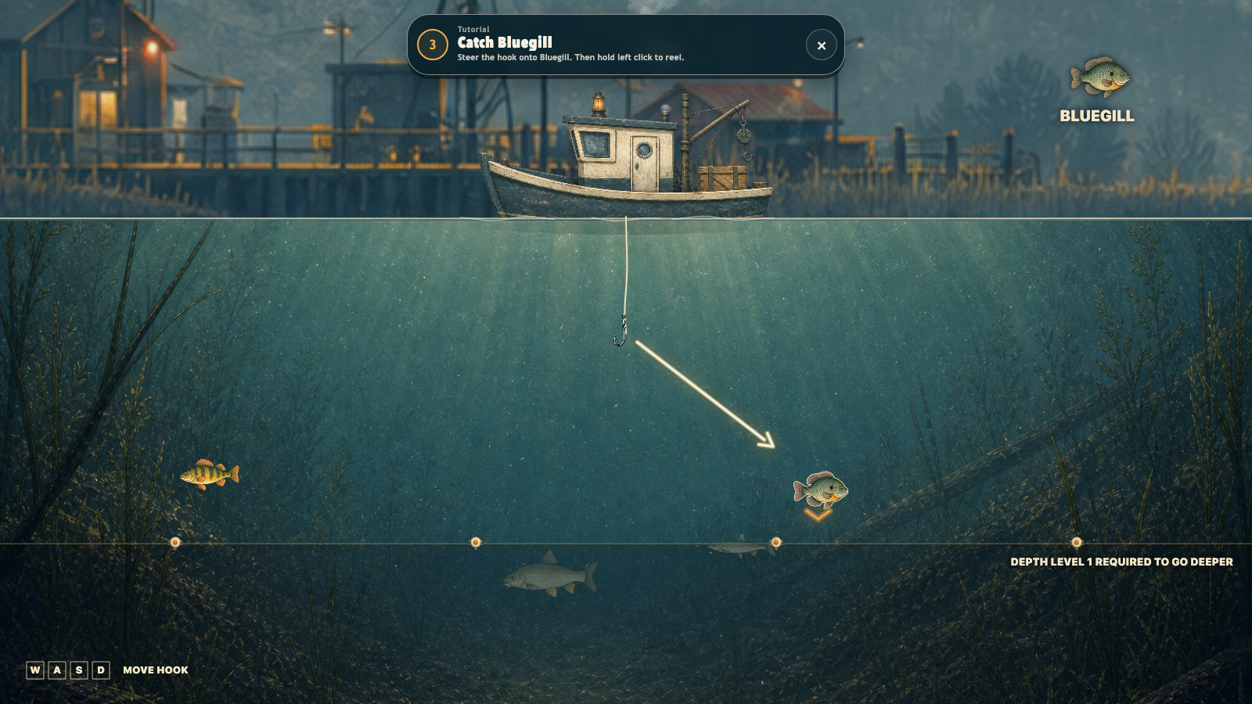
THE FIGHT
Fight for your catch.
Our dynamic line system curves, tightens, and changes colour as tension rises. Stronger fish demand better timing and upgraded gear.
ALL IMAGES ARE CAPTURED IN GAME
Notes:
Fishing is not a hold-to-fill meter. The fish runs, the line tightens, and the player must release to let it take line.
[Sources]
- Current game screenshot: Docs/incursion/screenshots/08-fishing.png
- Fishing rules: Docs/Game-Brief.md

Slide 6
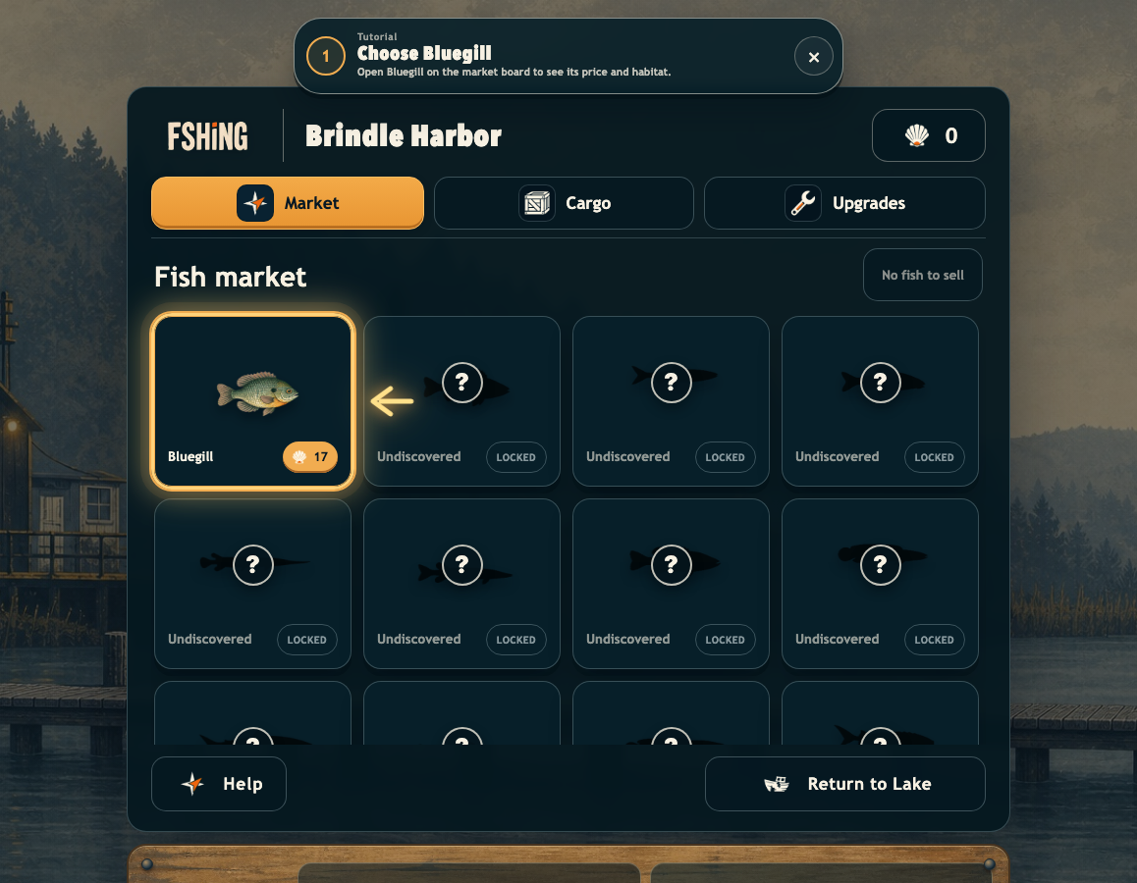
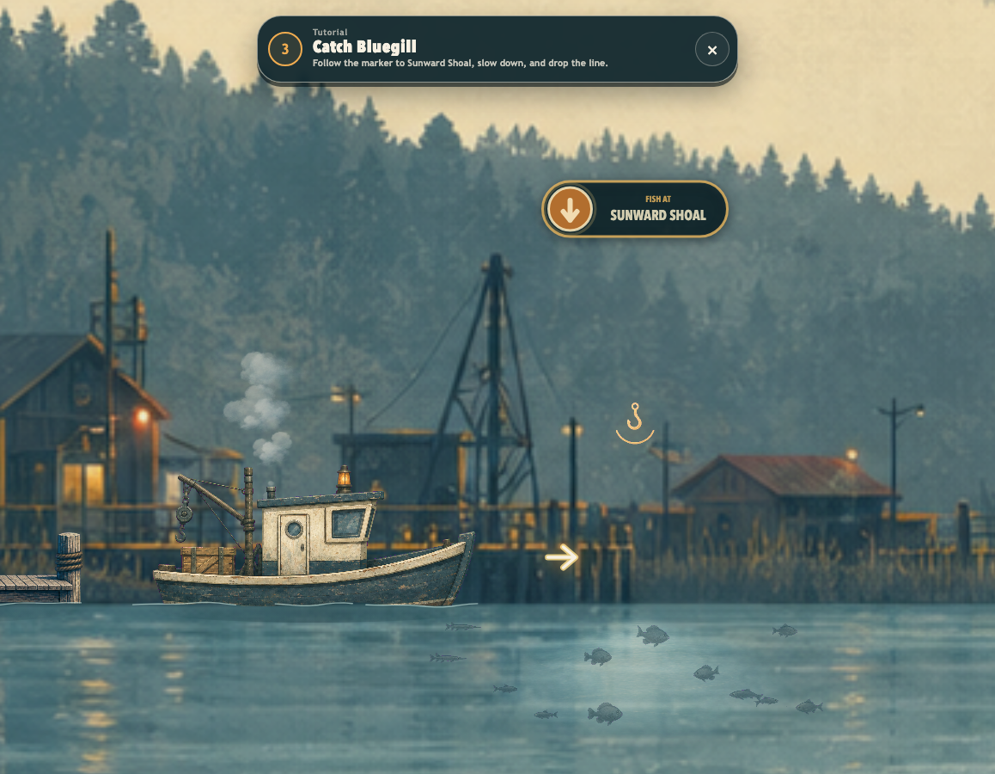
A market you can sail across.
READ
TRAVEL
CATCH
FSHING turns observation, timing, and trade-offs into one short browser loop.
Notes:
FSHING teaches through consequence: read the market, act on the information, and see whether the trip paid off.
[Sources]
- Current game screenshots: Docs/incursion/screenshots/03-market.png, 07-tracked-sailing.png, 08-fishing.png
- Project wordmark: src/assets/fshing-wordmark.png

