Slide 1

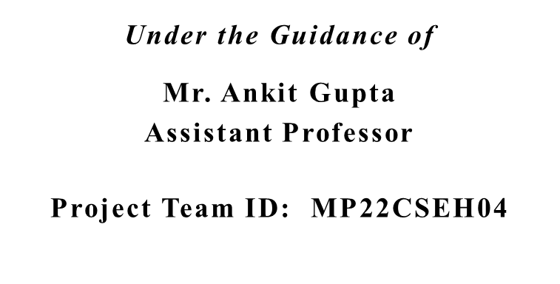
MACHINE LEARNING ENABLED INTERVIEW APPLICATION
Akshat Jain 1918006
Anjali Pathak 2018006
Bhupendra Singh Shahi 1918017
Muskan Goyal 1918088

Slide 2
Introduction and Problem Statement
An end-to-end Interview taking application, consisting of Resume Shortlisting, Video Call, Code Editor, Screen sharing, Remote Desktop Control using Machine Learning (NLP), ReactJS, Socket, WebRTC
In a company, selecting an employee is most difficult task.
Reading Resumes is the most difficult task, the best way to eliminate applicants is to shortlist them based on their Resumes.
In Video Call, Code Editor and Remote Desktop Control will make an interactive interview experience.

Slide 3
Literature Survey
PyResparser is used to extract user's information from the Resume
PDFMiner is used to extract Resume PDF into Text, I used

Slide 4
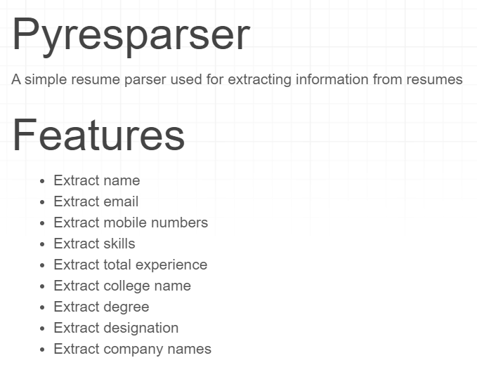

Slide 5
Objectives
To develop an authentication system for admin and users.
To develop a video call system to take the interview virtually.
To develop a code editor inside the interview management system , so that coding problems can be solved during the interview, without using any third-party code editor.
To integrate the resume scrapper which we have already developed, into the interview management system.
To develop the feature of screen sharing during the interview.

Slide 6
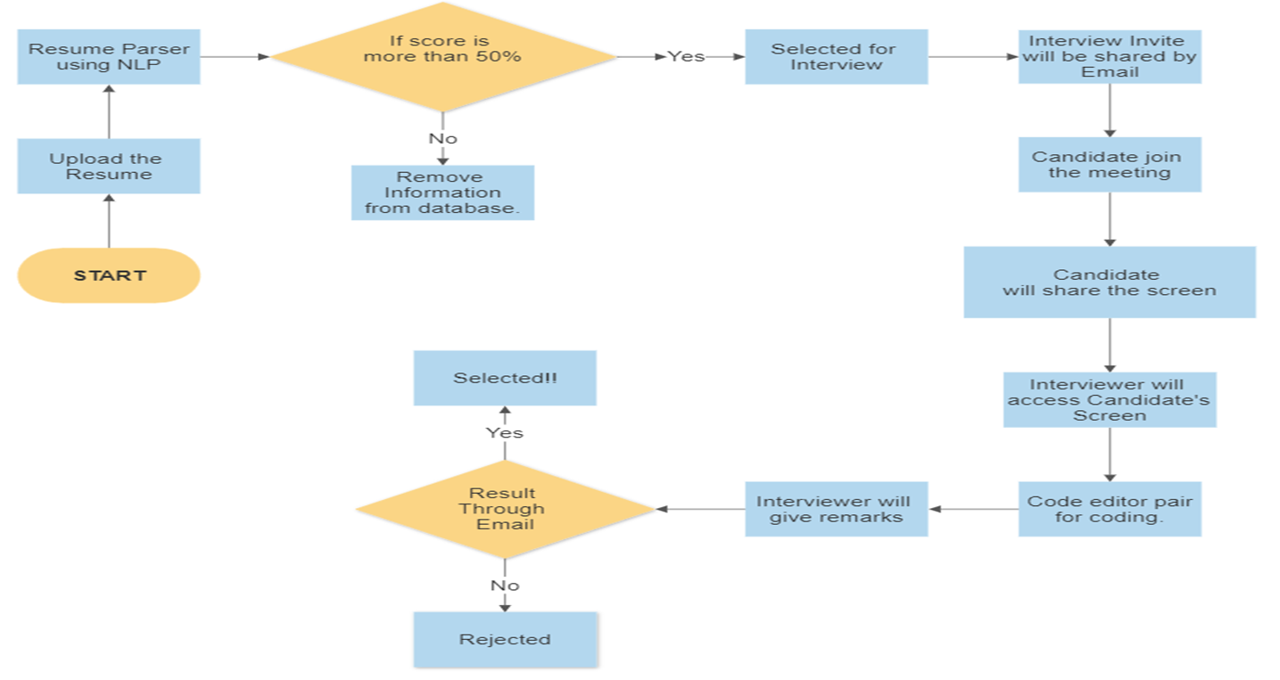

Project Work Carried Out

Slide 7
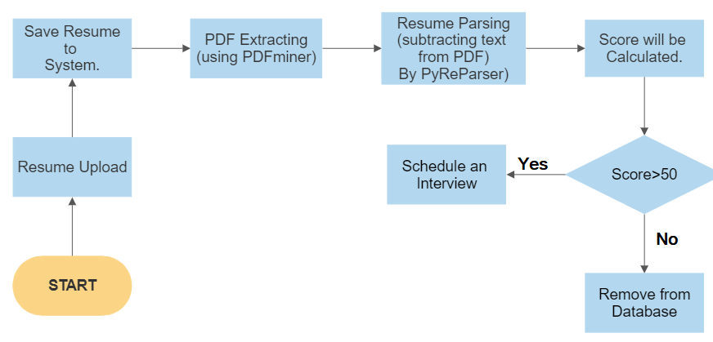
UML Diagram of Resume Parser

Slide 8
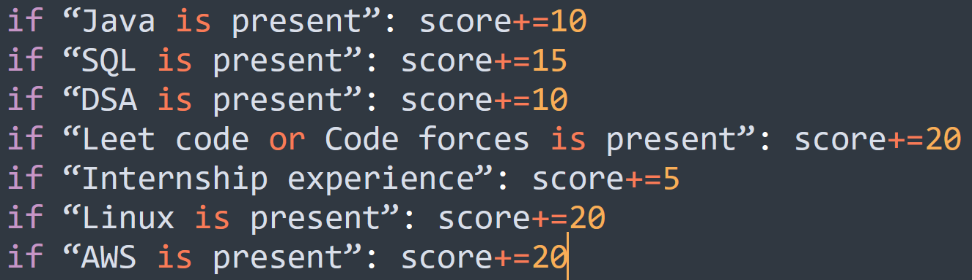
How is score calculated?
Based on Job Description, Keywords will be extracted.
Out of 100, score is calculated.

Slide 9
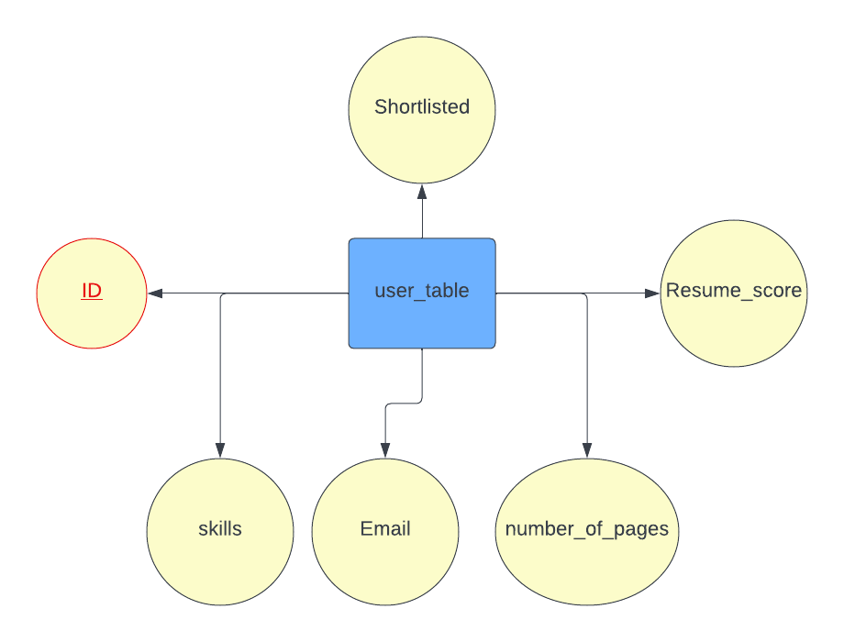
ER Diagram for Resume Parser

Slide 10
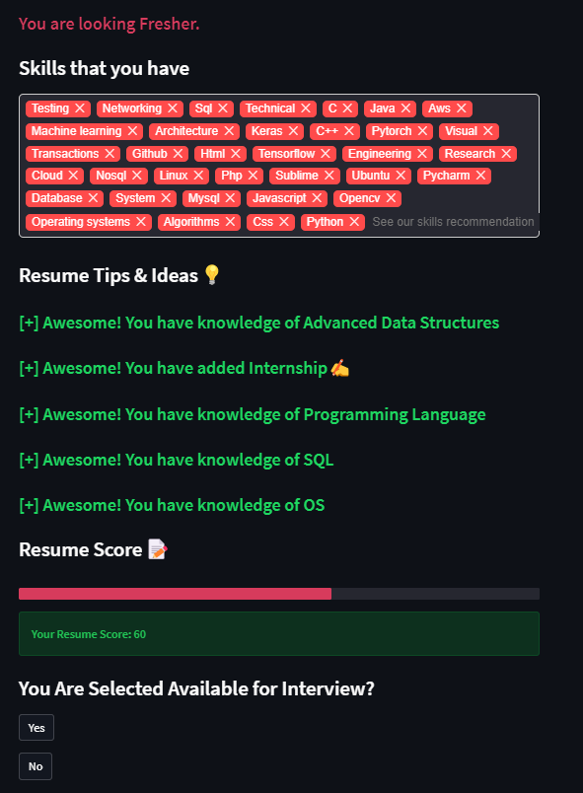
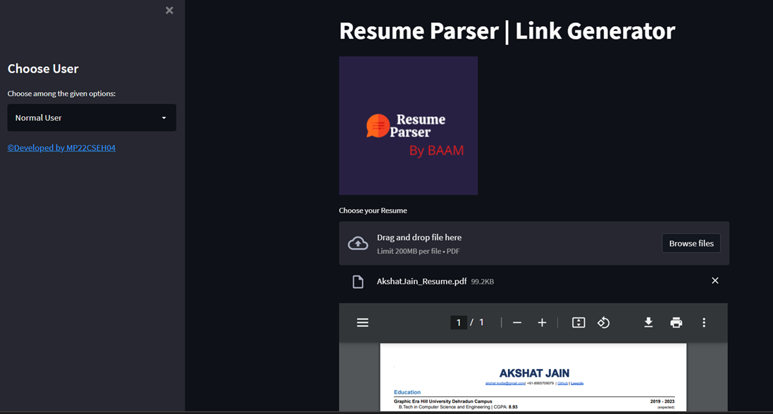
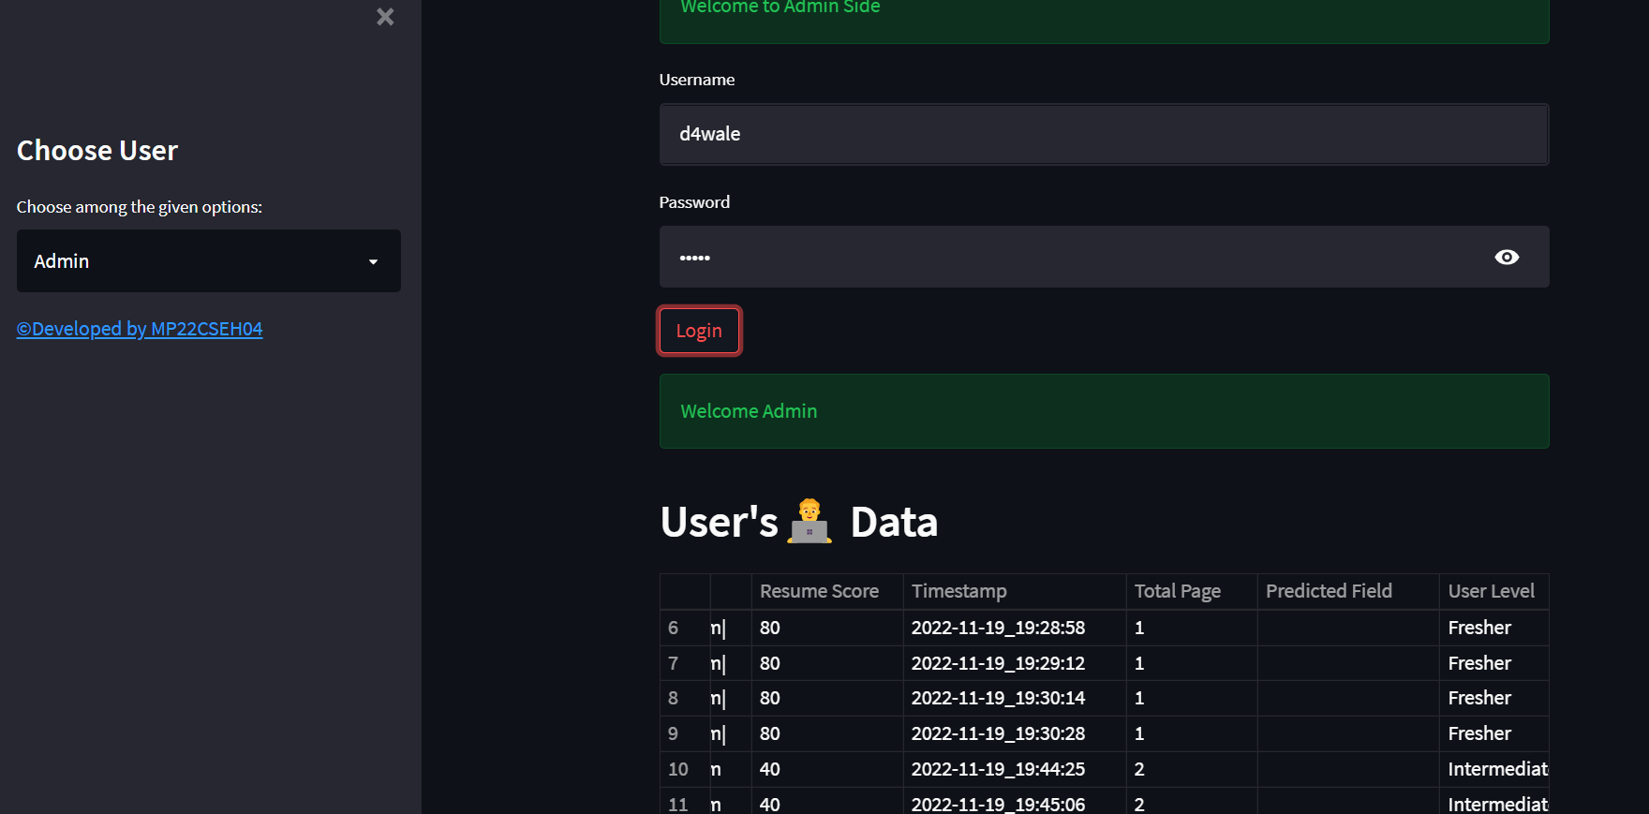
Output of Resume Parser

