Slide 1
Eyeballs Tracking

Slide 2
Objective
Know user’s focus on the screen when showing video player

Slide 3
Requirement
- opencv
- haarcascade model
- numpy

Slide 4
Process
- Use Haar-cascade to detect the face
- Divide the face into half and then detect the eyes using Haar-cascade model
- Cut the eyebrows
- remove the edge of the eyes
- Extract the eyeball

Slide 5
Next step
- Tracking the focus of the eye
- Detecting the reflection of the screen on the cornea

Slide 6

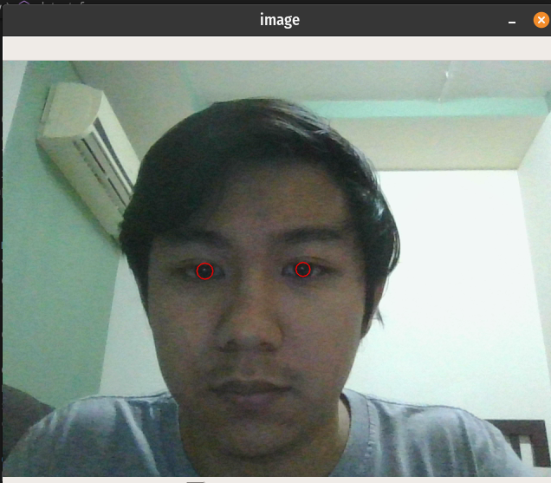

Slide 7
Result
- Be able to track where the attention of the person is on the video
- Pause the video when the user’s focus is not on the screen

