Slide 1
PROGRESS
H
C
I
5912046 Prutchakorn Ngamsuanplu
HOME
CONTROLLER
5913094 Soravis Varayuththasawad
INFRARED

Slide 2
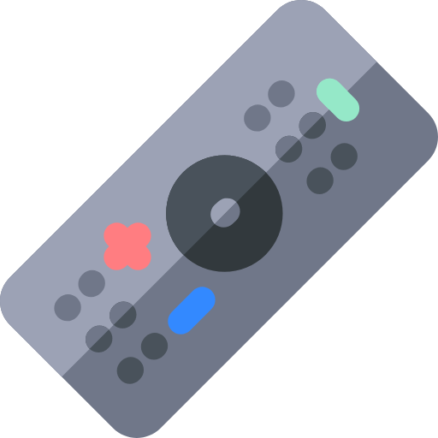
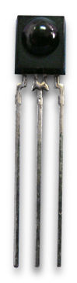
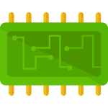
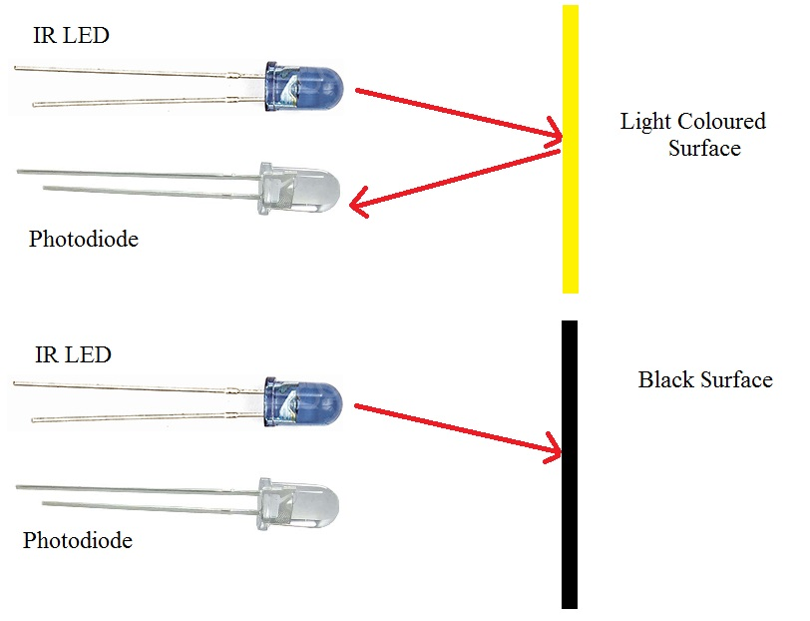
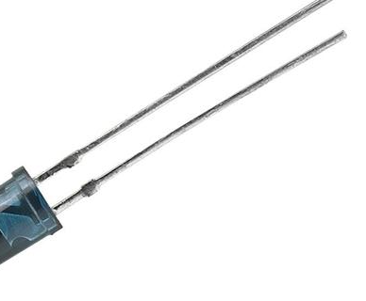

HCI
CLONE
CODE
PROGRESS
SIGNAL
SIGNAL
CODE
esp32
REMOTE
RX
PUSH DATA
1
Notes:
The first phase is cloning the signal code from a remote controller and save signal code and device name in Firebase.

Slide 3
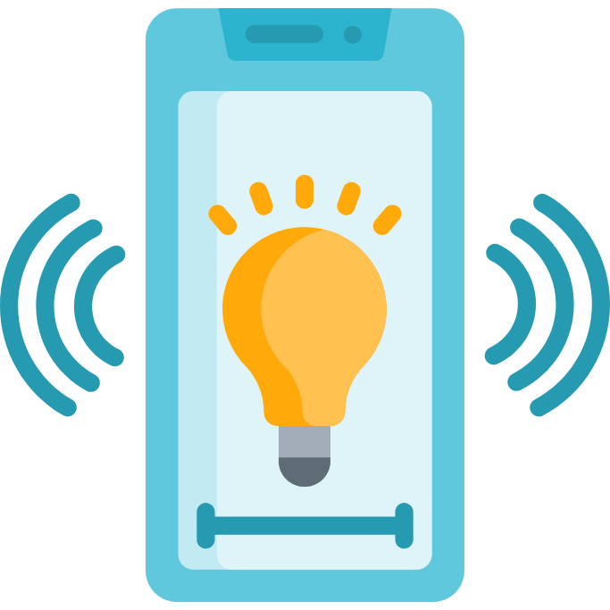



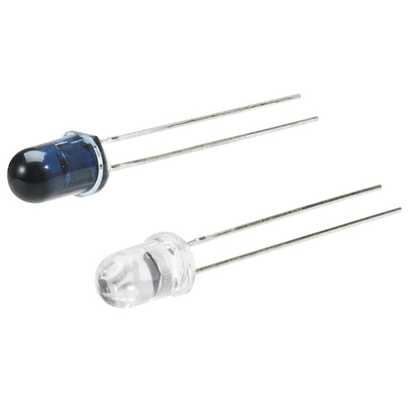
HOME
AUTOMATION
HCI
CONTROL
DEVICES
PROGRESS
PROGRESS
REQUEST
RESPONSE
netpie
AIR CONDITIONER
TV
APPLICATION
CONTROL
TURN ON/OFF
QUERY AND GET
CODE → SIGNAL
esp32
TX
2
Notes:
The second phase is controlling devices by using Blynk application. Blynk is the application that use to control the microcontroller, so we can control devices when we are outside.

Slide 4


HOME
AUTOMATION
CONTROL
DEVICES WITH OTHER MICROCONTROLLER
HCI
PROGRESS
PROGRESS
TURN ON/OFF
RX
SIGNAL
CODE → SIGNAL
esp32
TX
3
Notes:
The third phase is controlling devices with other microcontroller. We want one microcontroller as a broker and send the signal code to client microcontroller to control devices at another room.

Slide 5
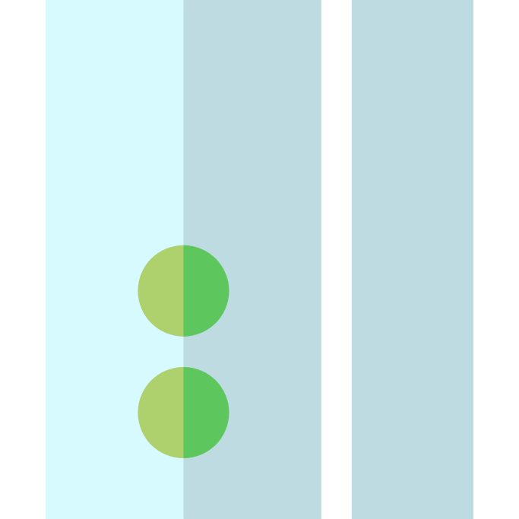
HOME
AUTOMATION
HCI
DETECTION
PROGRESS
PROGRESS
TURN ON/OFF
SIGNAL → CODE
CODE → SIGNAL
TX
DOOR SENSOR
4
Notes:
The last phase is detection. We don't only use infrared sensor to send data. We can detect object that pass to infrared light. So we want to detect human go inside the room and turn on air conditioner and TV.
So this is our project Thank you

Slide 6
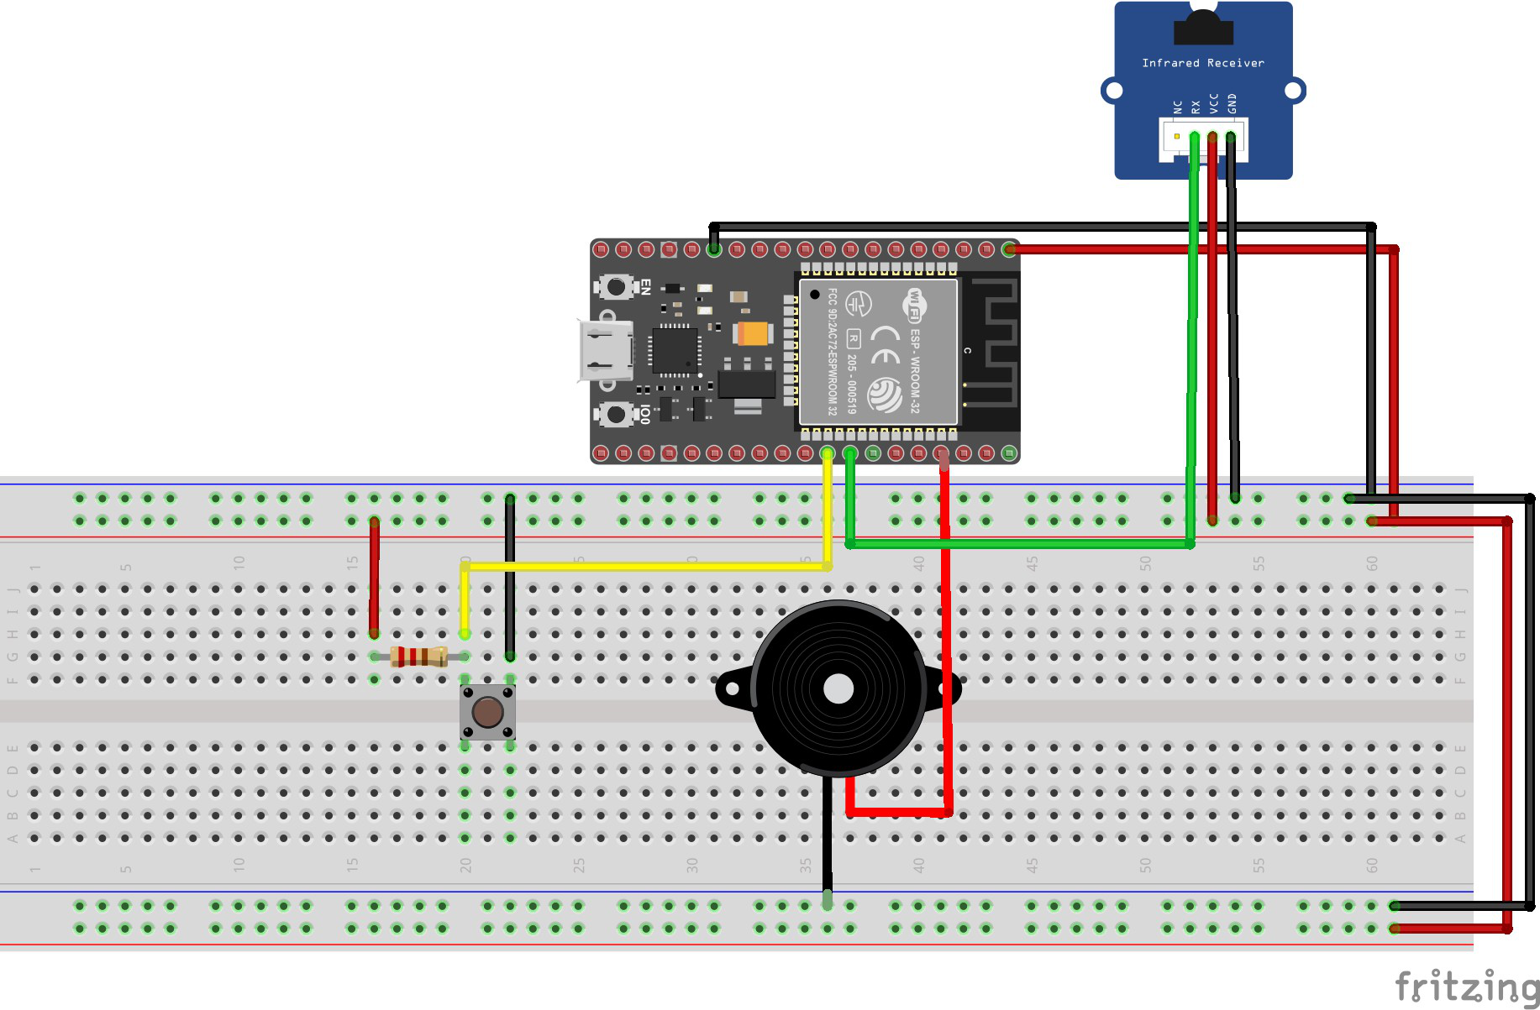
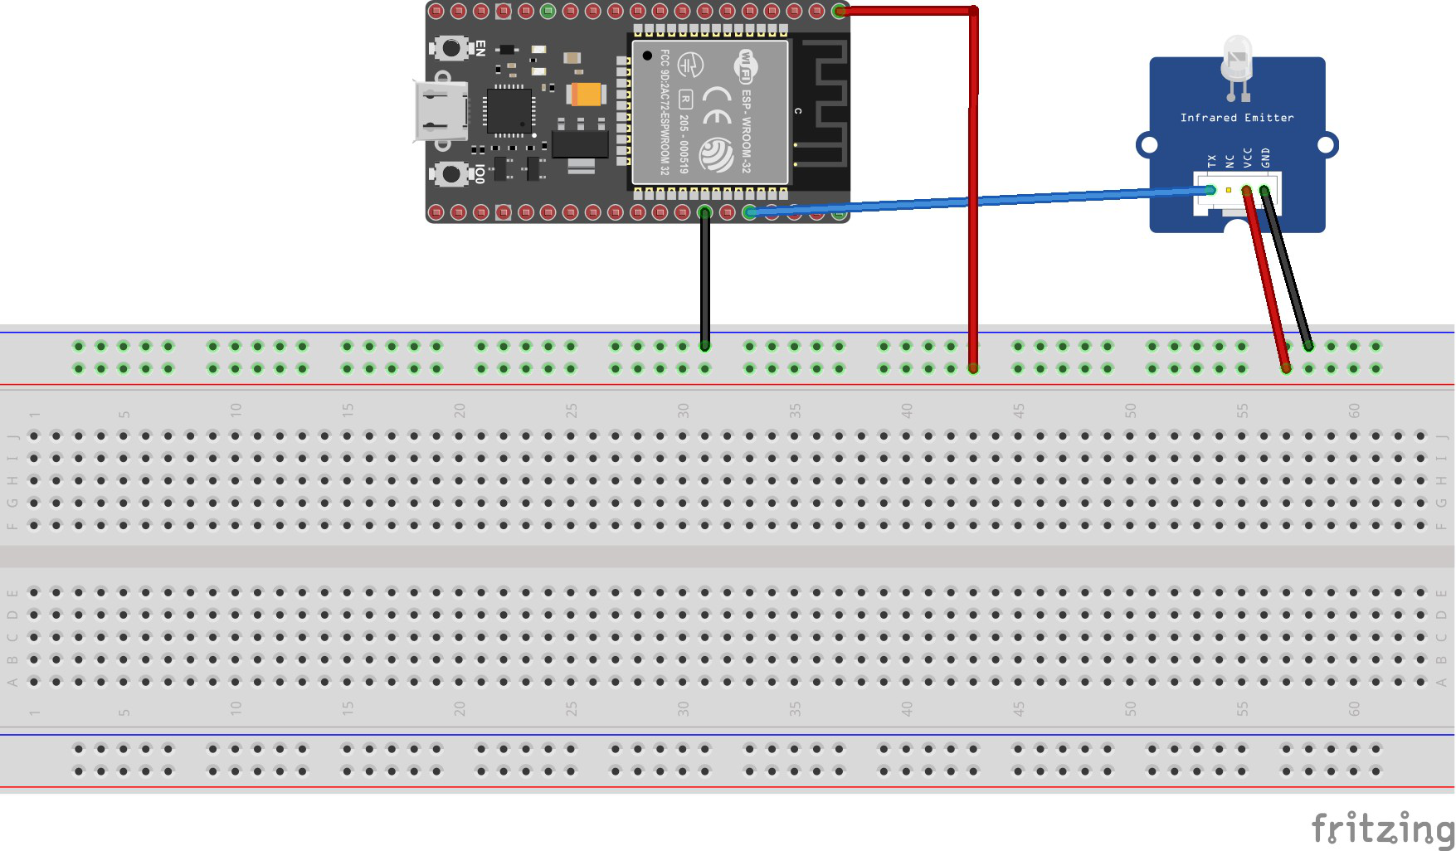
HCI
CIRCUIT
PROGRESS

Slide 7
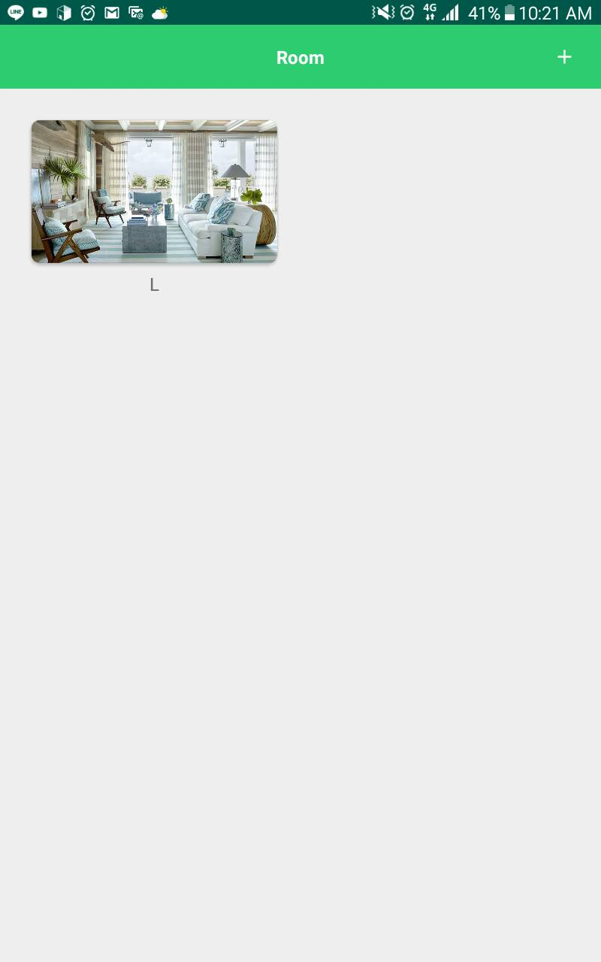
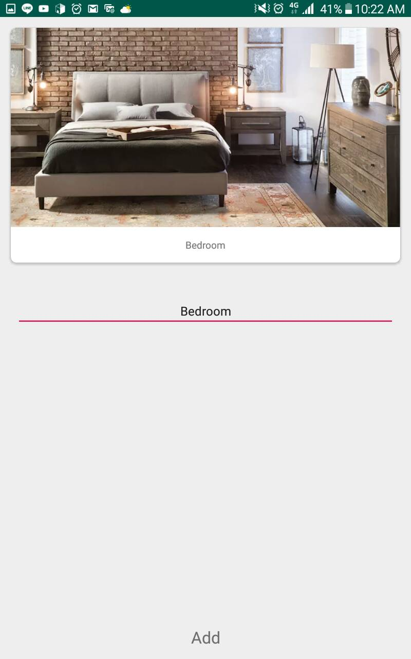
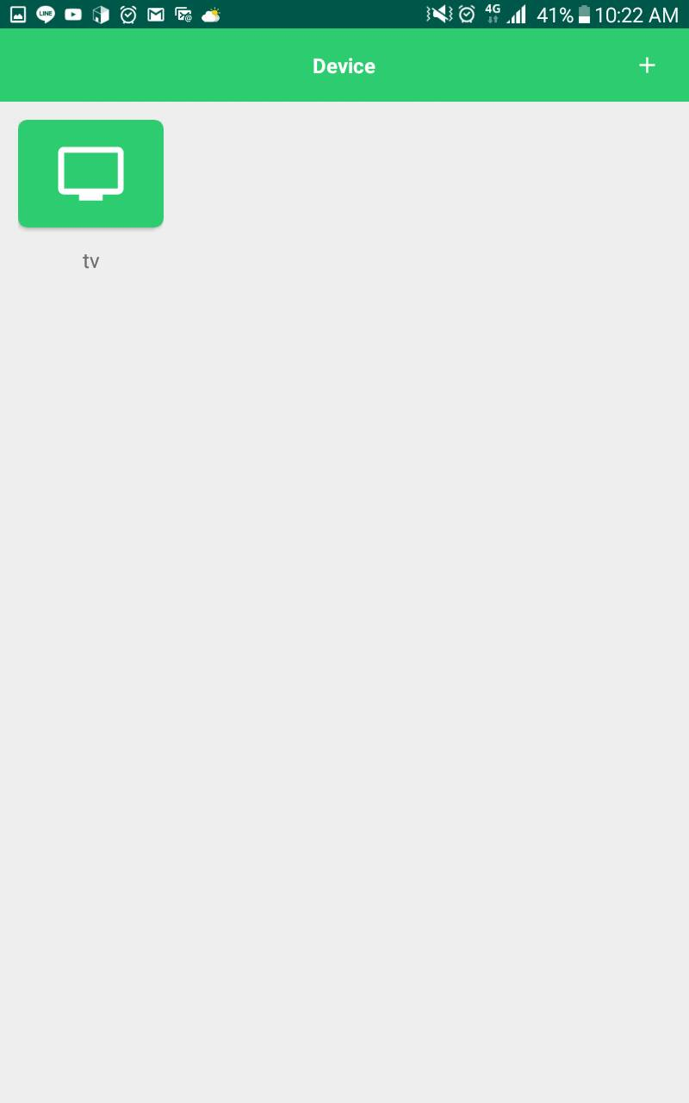
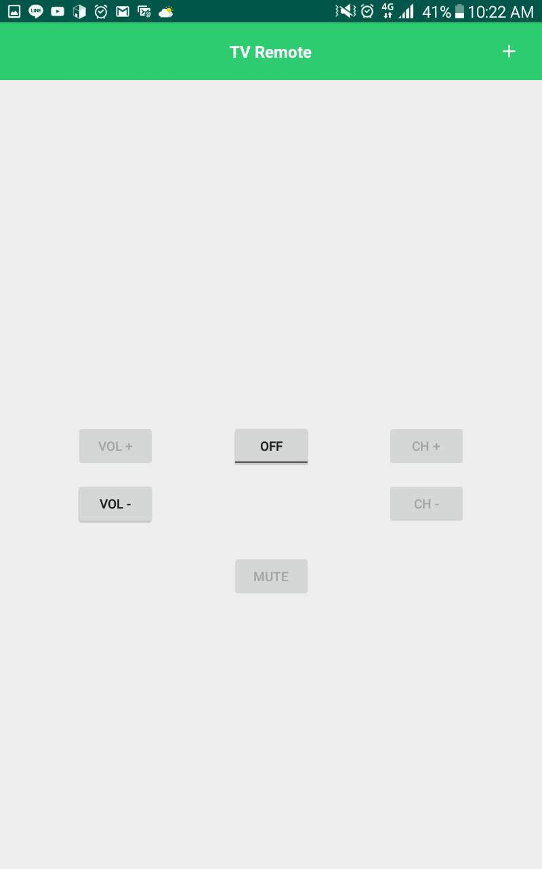
HOME
AUTOMATION
HCI
APPLICATION
PROGRESS
PROGRESS

