Slide 1
HOME AUTOMATION
INFRARED
5912046 Prutchakorn Ngamsuanplu
5913094 Soravis Varayuththasawad
Notes:
Hello my name is Pruchakorn and this is Soravis. Our project is Home Automation using Infrared sensor

Slide 2
HOME
AUTOMATION
OBJECTIVE
INFRARED
using infrared to control regular devices: air conditioner, TV, etc..
involving infrared sensors: receiver and sender
be able to control device through mobile application
Notes:
Our objective we want use the infrared sensor to control devices that are in our room such as air conditioner, TV or device that can be controlled by infrared sensor. There are 2 type of infrared sensor; receiver and sender. We want to control devices outside with mobile application

Slide 3
HOME
AUTOMATION
TOOLS
INFRARED
IR LED (Tx)
Resistor
Jumper
Photodiode (Rx)
Relay
LCD
Arduino
Blub
ESP32
Notes:
Our tools that we gonna use for this project

Slide 4
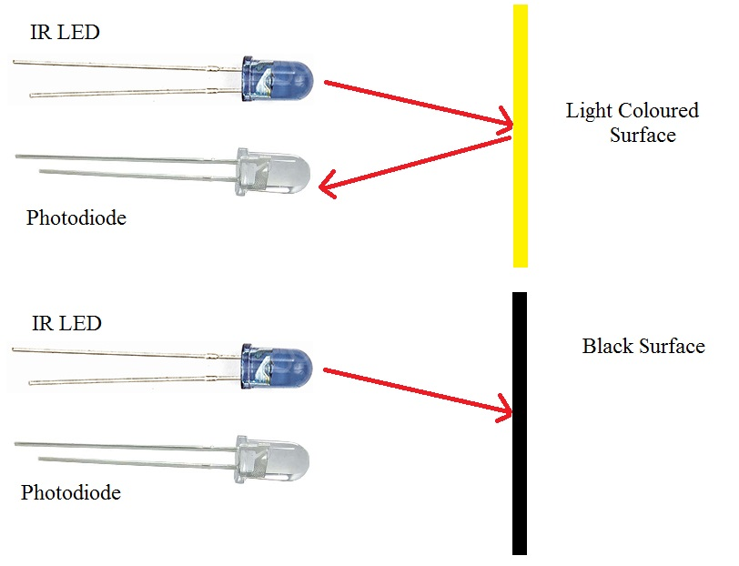
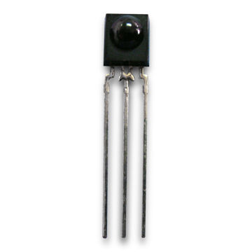
HOME
AUTOMATION
INFRARED
SENSOR
INFRARED
Notes:
how the infrared sensors work IR LED is a sender and Photodiode is a receiver IR LED will send the signal to the photodiode by using infrared light but you cannot see it because it cannot seen by your eyes normally. Infrared light can reflect a object which has a light colored surface. In contrast, infrared light cannot reflect a object which has a dark colored surface.

Slide 5
STEPS
Notes:
There are 4 phases that we want to do.

Slide 6


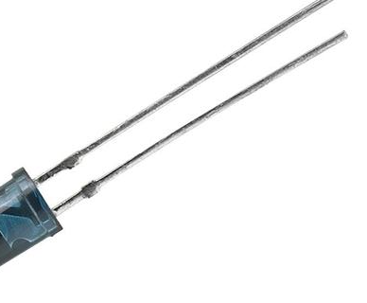

HOME
AUTOMATION
CLONE
CODE
INFRARED
SIGNAL
SIGNAL
CODE
REMOTE
RX
PUSH DATA
1
Notes:
The first phase is cloning the signal code from a remote controller and save signal code and device name in Firebase.

Slide 7
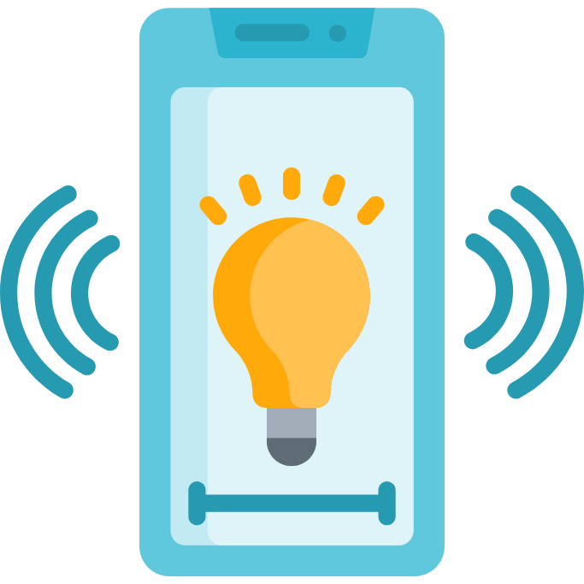



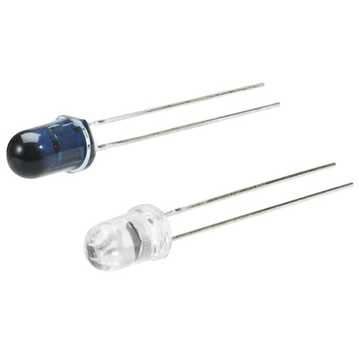
HOME
AUTOMATION
CONTROL
DEVICES
INFRARED
REQUEST
RESPONSE
AIR CONDITIONER
TV
APPLICATION
CONTROL
TURN ON/OFF
QUERY
CODE → SIGNAL
GET
TX
2
Notes:
The second phase is controlling devices by using Blynk application. Blynk is the application that use to control the microcontroller, so we can control devices when we are outside.

Slide 8
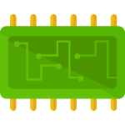
HOME
AUTOMATION
CONTROL
DEVICES WITH OTHER MICROCONTROLLER
INFRARED
AIR CONDITIONER
TV
TURN ON/OFF
RX
esp32
SIGNAL
CODE → SIGNAL
TX
3
Notes:
The third phase is controlling devices with other microcontroller. We want one microcontroller as a broker and send the signal code to client microcontroller to control devices at another room.

Slide 9
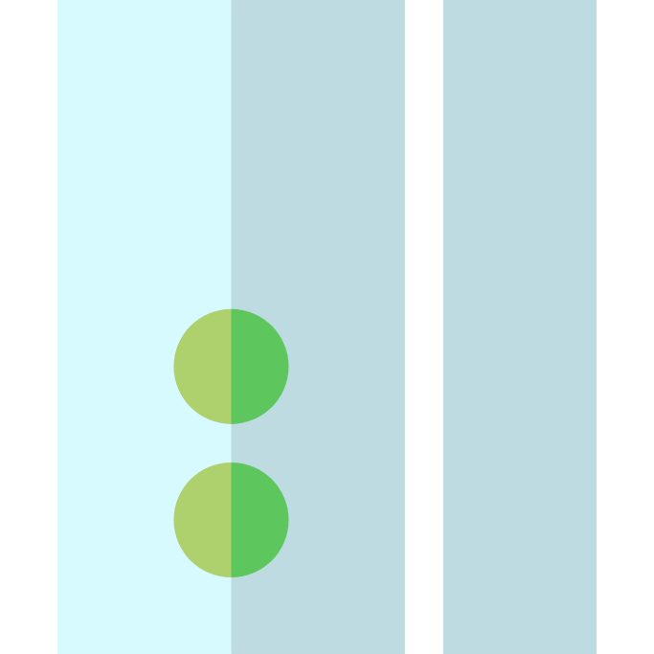
HOME
AUTOMATION
DETECTION
INFRARED
AIR CONDITIONER
TV
TURN ON/OFF
SIGNAL → CODE
CODE → SIGNAL
TX
DOOR SENSOR
4
Notes:
The last phase is detection. We don't only use infrared sensor to send data. We can detect object that pass to infrared light. So we want to detect human go inside the room and turn on air conditioner and TV.
So this is our project Thank you

