Slide 1


EXPLORING SCALABILITY CHALLENGES IN R USING H2O
OPIM 5503: DATA ANALYTICS USING R

Slide 2


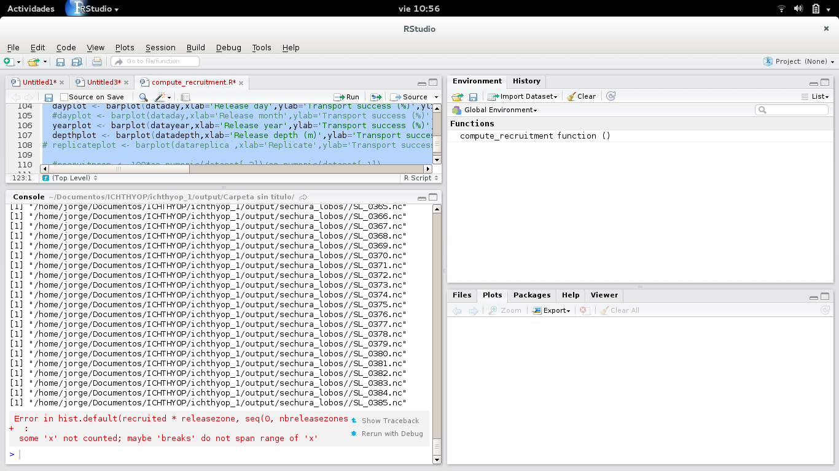




PROBLEM STATEMENT/OBJECTIVES
Handling Large Volumes of Data
Processing Speed
Model Optimization

Slide 3





WHY H2O?
Best of Breed Open Source Technology
Data Agnostic Support for all Common Database and File Types
Massively Scalable Big Data Analysis
In-Memory Processing Responsiveness
Real-time Data Scoring

Slide 4
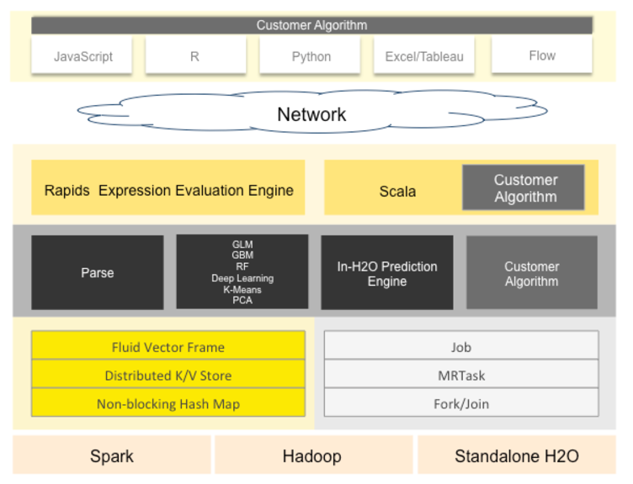
H2O ARCHITECTURE
User Defined Algorithm
User Defined
Algorithm
User Defined
Algorithm
Source: http://docs.h2o.ai/h2o/latest-stable/h2o-docs/architecture.html

Slide 5
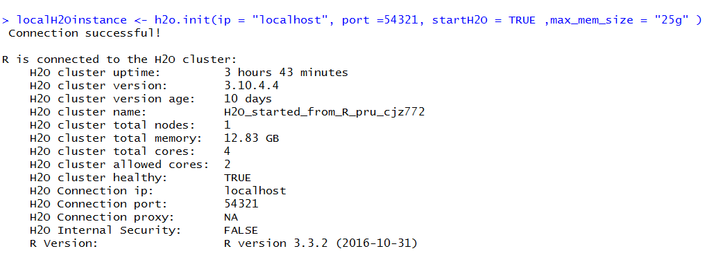



GETTING STARTED WITH H2O
INITIATES
ENVIRONMENT
SETUP
CLUSTER
FORMATION

Slide 6
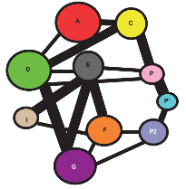
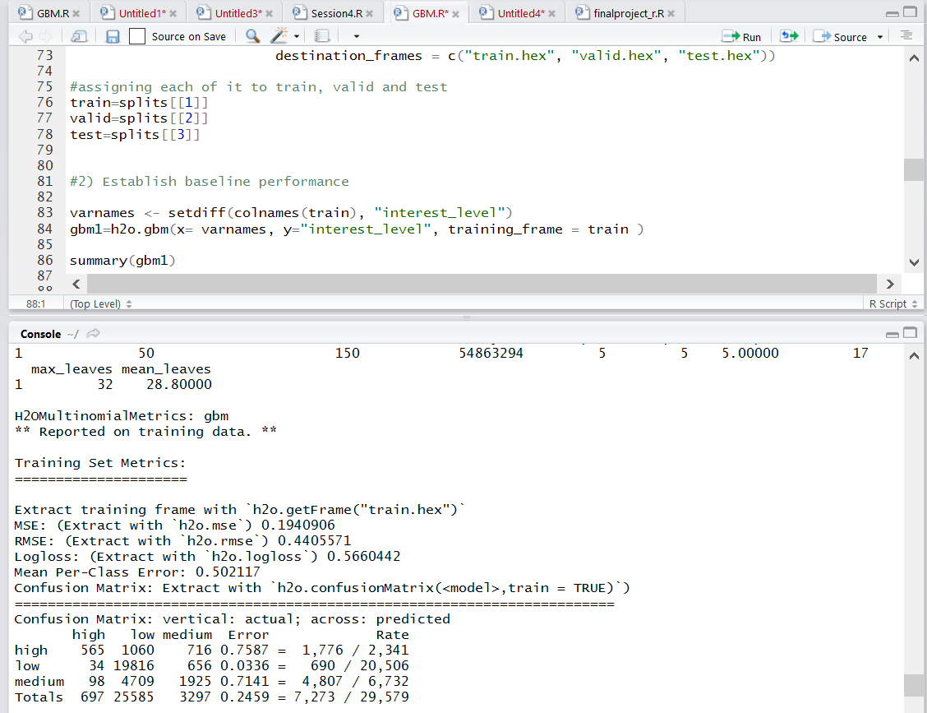
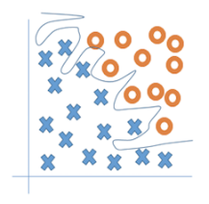

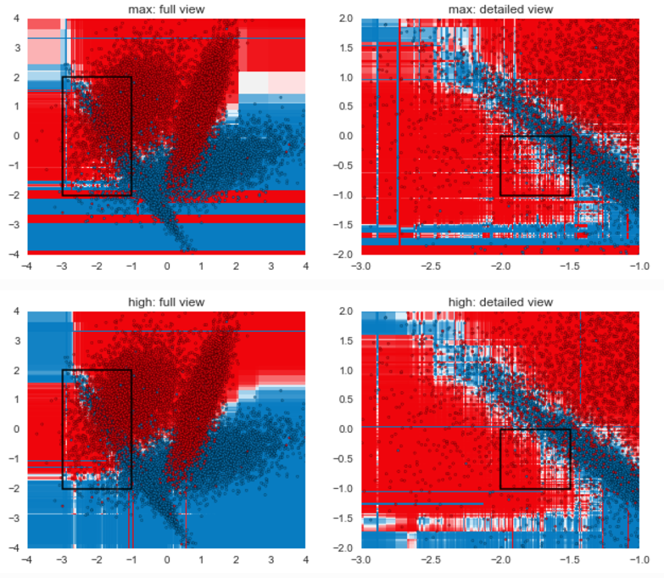

IMPLEMENTATION ON H2O
HYPER-PARAMETERIZATION/GRID SEARCH
OPTIMISED CLUSTERING ALGORITHMS
RANDOM FOREST MODELS
GRADIENT BOOSTING MODELS
DEEP LEARNING ALGORITHMS

Slide 7





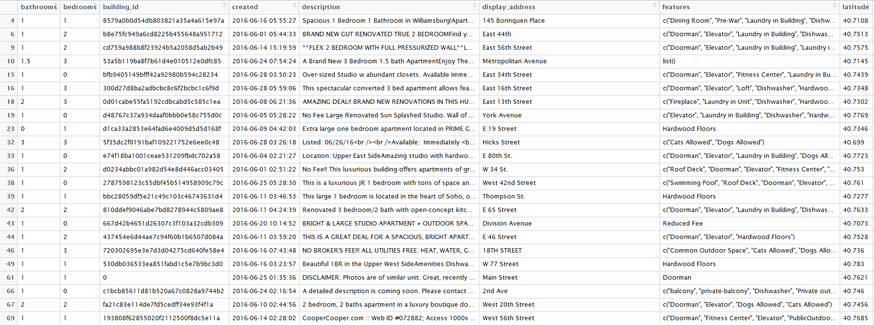
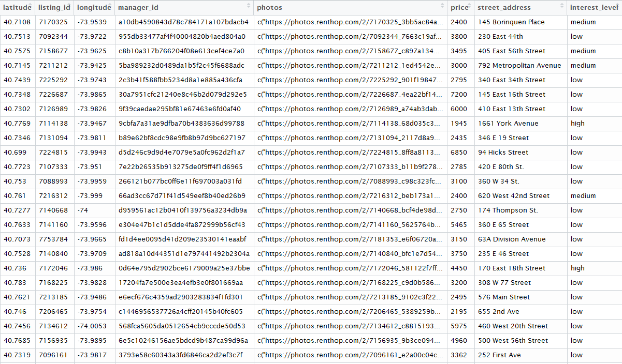
PROOF OF CONCEPT- RENTHOP DATASET
78 GB of Data
15 Variables and 49,352 Observations
> 500,000 Rental Listing Images
Target Variable

Slide 8
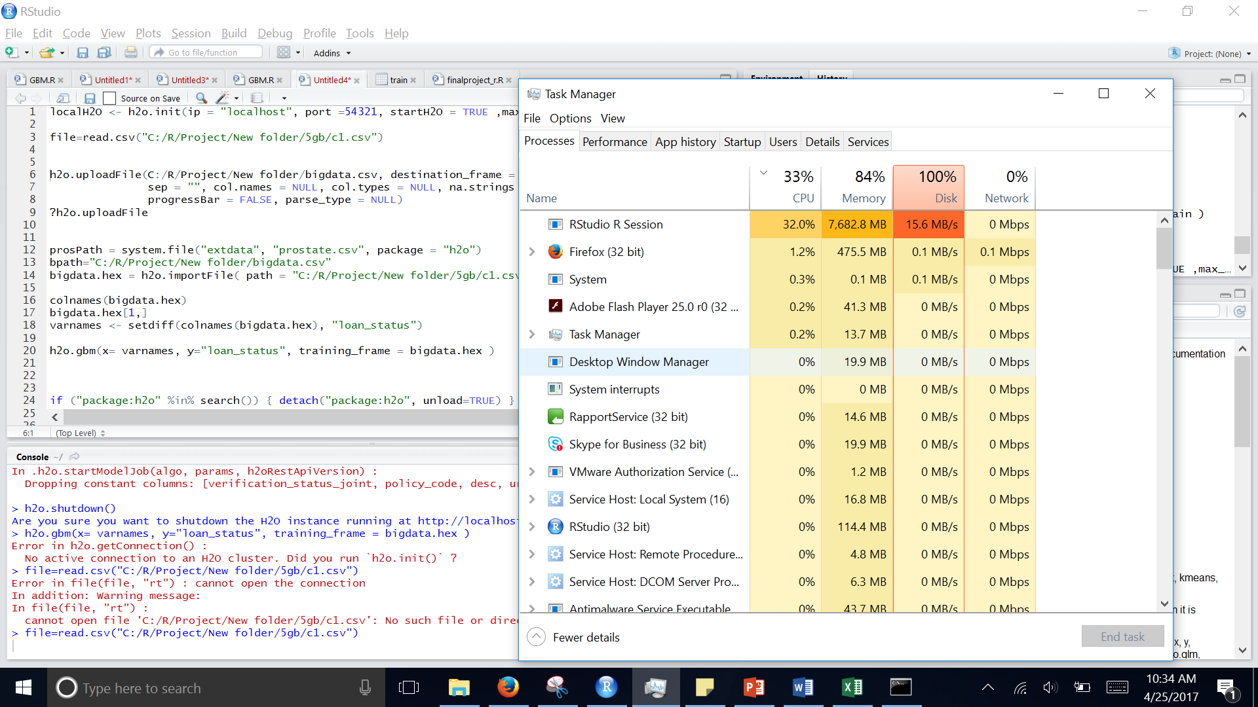
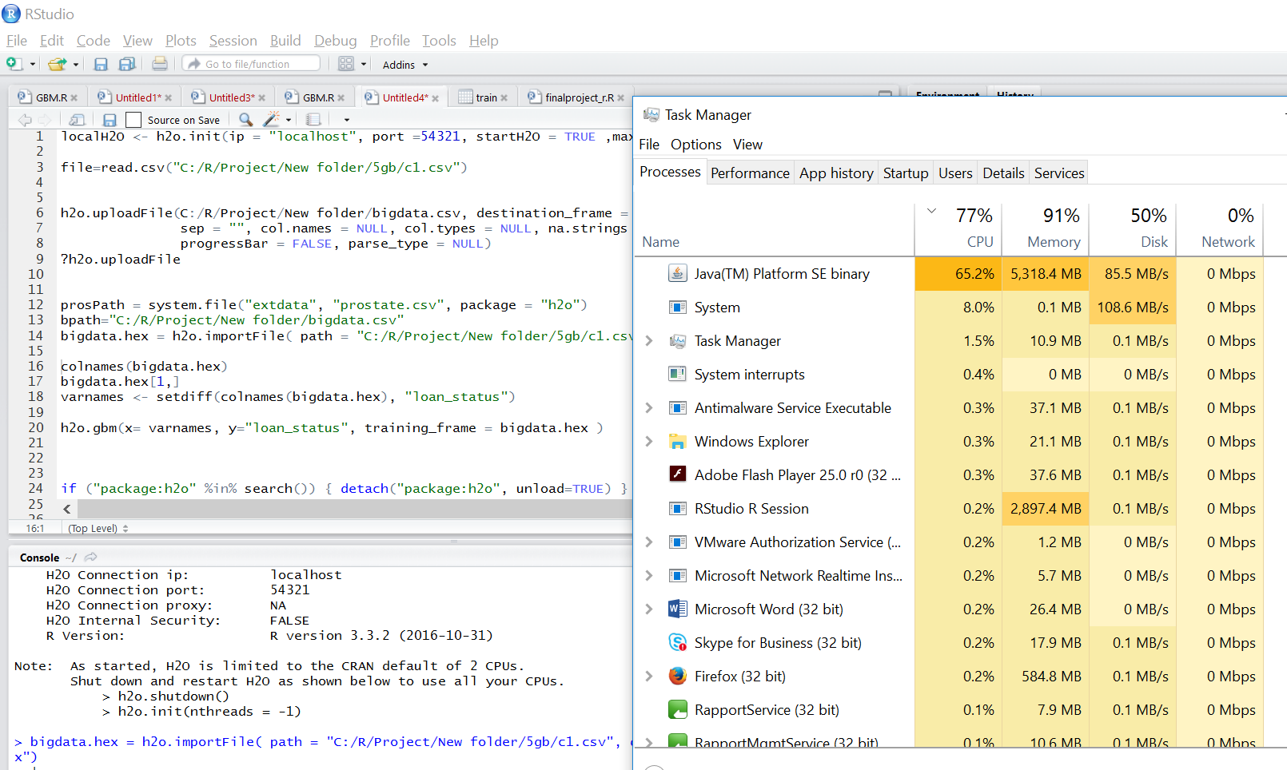


BENCHMARKING H2O
Basic R-Studio
R-Studio using H2O

Slide 9




THINGS TO EXPLORE WITH H2O
Running H2O on Rstudio server on AWS environment
Integration with Hadoop:
Working on datasets from HDFS
Caution: Performance Issues working with lower volumes of data on H2O

Slide 10


