Slide 1
CSE7302 - INTERNSHIP Review-4 Presentation UDYOG SAARTHI CONNECT DEVELOPMENT
Student Details
Name | Pruthvi B S
Roll No | 20221ISE0088
Section | 8-ISE-02
Under the Supervision of,
Mr. Sunil Kumar Sahoo
Associate Professor
Presidency School of CSE
Presidency University
Name of the Program: B .Tech
Name of the HoD: Dr. Gopal Krishna Shyam
Name of the Program Internship Coordinator: Dr . Sreehari T M
Name of the School Internship Coordinator: Dr. Md Ziaur Rahman

Slide 2
Content
About Company or Organization
Working domain or the technology
About your team and reporting Manager
Challenges Faced in Internship
Objectives of the work
Literature Review
Proposed System
Problem Statement
System Requirements
Advantages of Proposed System/Work
Internship Roadmap
System Design
System Implementation
System Testing
Conclusion
References
Github Link

Slide 3
About Company or Organization
Qapture Nexus is a technology startup registered in 2025 as an MSME-certified organization, focused on developing user-centric and high-performance web applications that address real-world digital requirements.
What Makes Us Different:
Focus on user-centric design and performance optimization
Uses Agile development methodology for rapid and efficient delivery
Leadership & Vision:
Mentored by Founder & CEO Ms. Gayathri, the company aims to deliver innovative, scalable, and reliable digital solutions that bridge the gap between business needs and technology.

Slide 4
Working domain or the technology
Udyog Saarthi Connect App, This technology bridges the gap between traditional websites and native mobile apps, offering an app-like experience directly through a web browser.
Technologies & Concepts Involved
Web-based application architecture
Role-based access control (Admin and User)
Responsive and accessible UI design
Frontend–backend system integration
Core Technologies
Frontend: Built using HTML5 for semantic structure, CSS3 for responsive styling and JavaScript for core logic and interactivity.
Data Management: Operates entirely on the client side using local Storage, eliminating the need for a complex backend server while ensuring data persistence across sessions.

Slide 5
About your team and reporting Manager
Role: Web Application Developer Intern
Reporting Manager: Ms. Gayathri (Founder & CEO)
Team Type: Small, agile startup development team
Contribution:
Developed responsive user interfaces using HTML5, CSS3, and JavaScript
Assisted in implementing role-based dashboards for Admin and User modules
Integrated frontend components with backend APIs for data handling
Improved UI accessibility and usability across devices
Contributed to building and maintaining the company web application

Slide 6
Challenges Faced in Internship
Understanding real-world business requirements and project expectations
Designing a system with multiple user roles (Admin and User) and managing role-based access
Translating problem statements into effective technical and logical solutions
Managing application data and state for smooth and consistent performance
Balancing learning and implementation while working in a startup environment

Slide 7
Objectives of the work
To design and develop a user-centric web application that meets real-world business requirements
To implement a multi-role system supporting Admin and User functionalities
To build responsive and accessible user interfaces using modern web technologies
To integrate frontend components with backend systems for efficient data handling
To follow an Agile development approach for iterative improvement and timely delivery
To develop scalable and maintainable digital solutions for organizational use

Slide 8
Literature Review
Global Unemployment: Statistics show that Persons with Disabilities (PwDs) face a 64% unemployment rate due to inaccessible recruitment platforms.
Government Mandates: The Indian RPwD Act (2016) mandates a 4% job reservation, but a centralized tool is needed to help candidates find these specific roles.
Accessibility Standards: Research highlights that following WCAG 2.1 guidelines (screen readers, high contrast) is essential for inclusive digital portals.
Technological Shift:PwDs and parents often unaware of training opportunities.
Identified Gaps: Existing portals like LinkedIn lack specialized filtering by "disability type," proving the need for a dedicated system like Udyog Saarthi.

Slide 9
Proposed System / Work
Current Development Progress
Index Module: Created the main landing page that acts as the "home base" for the app, featuring a responsive design and clear navigation for all users.
Registration Module: Built the signup system where users can create an account and specify their disability type to get personalized job matches.
Login Module: Developed the secure sign-in page that verifies user credentials and directs them to their specific dashboard .
Admin Module: Created the admin dashboard where the admin can post a job &view applications
Data Handling: Successfully linked these forms to Local Storage so user information is saved and remembered by the browser.

Slide 10
Problem Statement
This do not provide clear visibility of government-mandated 4% reserved job opportunities. These platforms lack of design, structured role management, and transparency in recruitment processes.
This leads to:
Limited access to suitable job opportunities for PwDs
Difficulty in navigating job portals due to poor accessibility support
Lack of awareness about legally reserved employment options
Reduced transparency in application status and employer feedback
Increased unemployment and underrepresentation of PwDs in the workforce

Slide 11
System Requirements
Software Requirements
OS: Windows 10/11, macOS, or Linux.
Editor: Visual Studio Code (VS Code).
Tech Stack: HTML5, CSS3, JavaScript and Typescript..
Browsers: Chrome, Edge, or Firefox (latest versions).
Database: Browser Local Storage API for data persistence.
Hardware Requirements
Any standard laptop or PC for development and testing.
Internet connection

Slide 12
Advantages of Proposed System/Work
For Users: The system provides a simple and intuitive interface that allows users to access features easily across devices. It improves overall user experience through responsive design, faster navigation, and reduced complexity while interacting with the application.
For Admins: Administrators gain better control over system operations, including user management and workflow monitoring. The system reduces manual effort by offering structured dashboards, enabling efficient data handling, quicker decision-making, and improved operational efficiency.
For Society: The platform promotes digital accessibility and inclusiveness by encouraging the use of user-friendly and scalable web solutions. It supports digital transformation for organizations, leading to improved service delivery

Slide 13
SYSTEM DESIGN
USER DASHBOARD
Udyog Saarthi Connect career portal where users enter their email and password to acess their account.
The user registration portal where users enter personal details, contact info, and upload a disability certificate to create an account.
In user dashboard a user can apply jobs,so that user can view the progress of it ,and upload Resumes for any queries user can post user feedback to admin.
ADMIN DASHBOARD
the admin to post new job listings by entering company details, job role, qualifications, salary, and requirements.
The portal displays user feedback, where admins can view queries and respond directly to users.
It also includes user management features where admins can track applications and approve or reject candidates.

Slide 14
SYSTEM IMPLEMENTATION
Login Page
Users and Admin enter email & password
System validates credentials
Redirects based on role (Admin/User)
Displays error for invalid login
Registration Page
New users create an account
Enter personal details (Name, Phone, DOB, Gender, Email, Aadhaar)
Select disability type & upload certificate
Data is stored for future login

Slide 15
User Dashboard
View available job listings
Apply for jobs
Track application status (Applied/Approved/Rejected)
Send queries/feedback to admin
Admin Dashboard
View total users & job statistics
Post new job opportunities
View and manage user applications
Approve or reject candidates
Respond to user queries

Slide 16
Job Management Module
Admin creates job posts
Jobs are displayed in user dashboard
Users apply and data is stored
Admin monitors applicants
Feedback & Query System
Users submit questions/issues
Admin views queries
Admin sends replies directly
System Flow Summary
Registration → Login → Role Check → Dashboard Access
Admin manages jobs & users
Users apply and interact with system

Slide 17
SYSTEM TESTING
Verify complete system functionality (Login, Registration, Admin & User modules)
Test valid and invalid inputs for all forms
Check job posting, application, and approval process
Ensure all pages are properly connected and working
Confirm system works correctly without major errors
All modules successfully integrated.

Slide 18
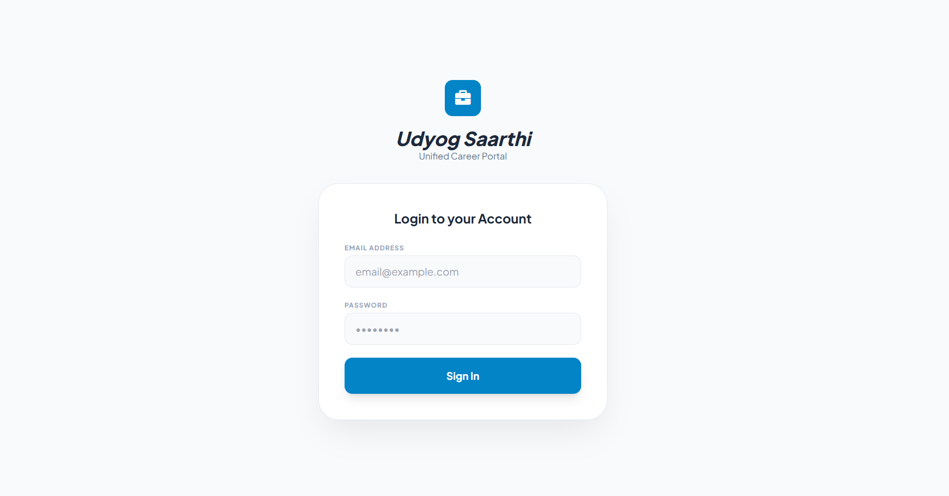
OUTPUTS – Login page

Slide 19
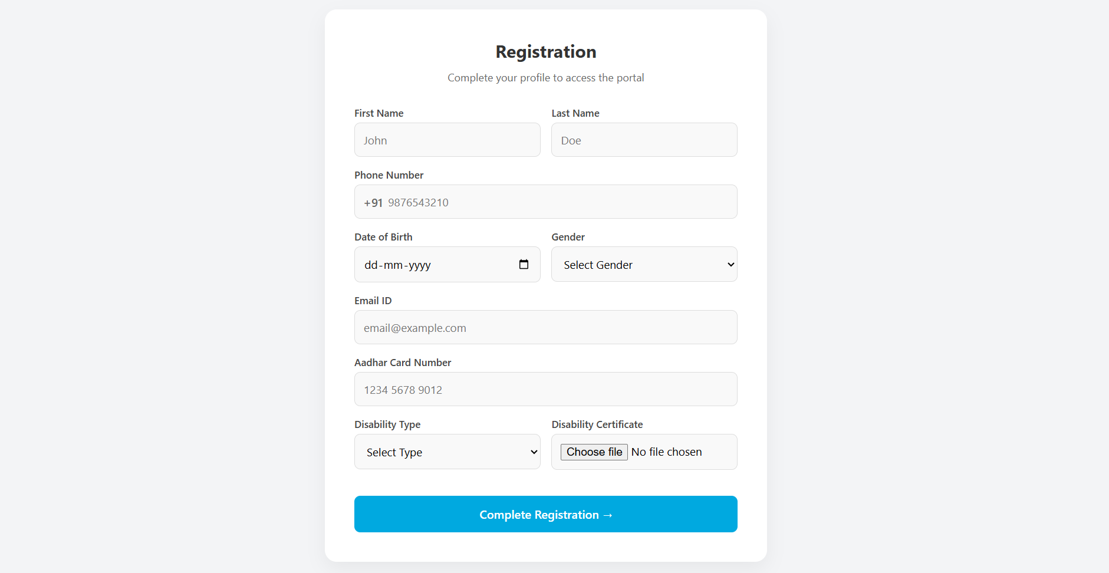
Registration page

Slide 20
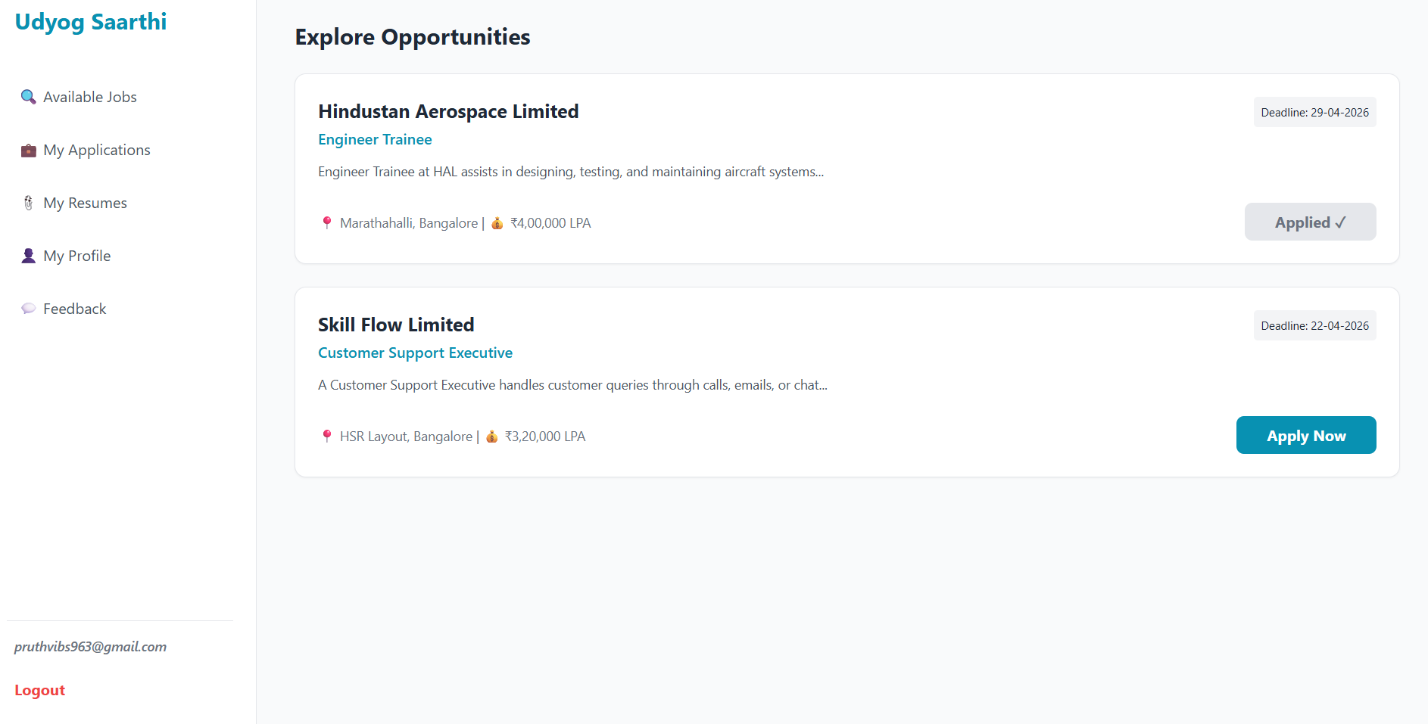
User Dashboard

Slide 21
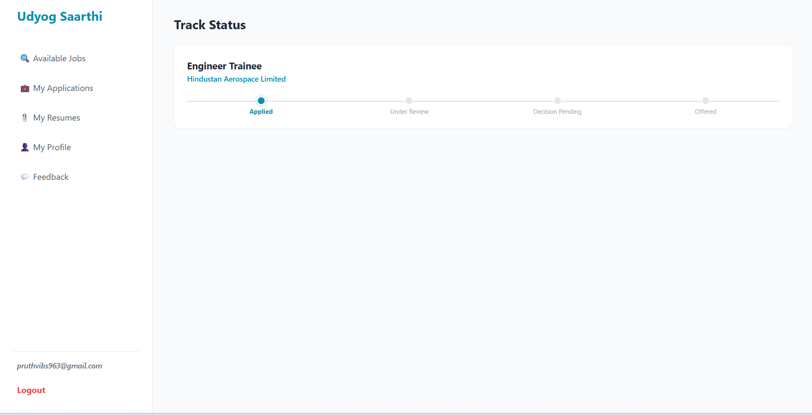

Slide 22
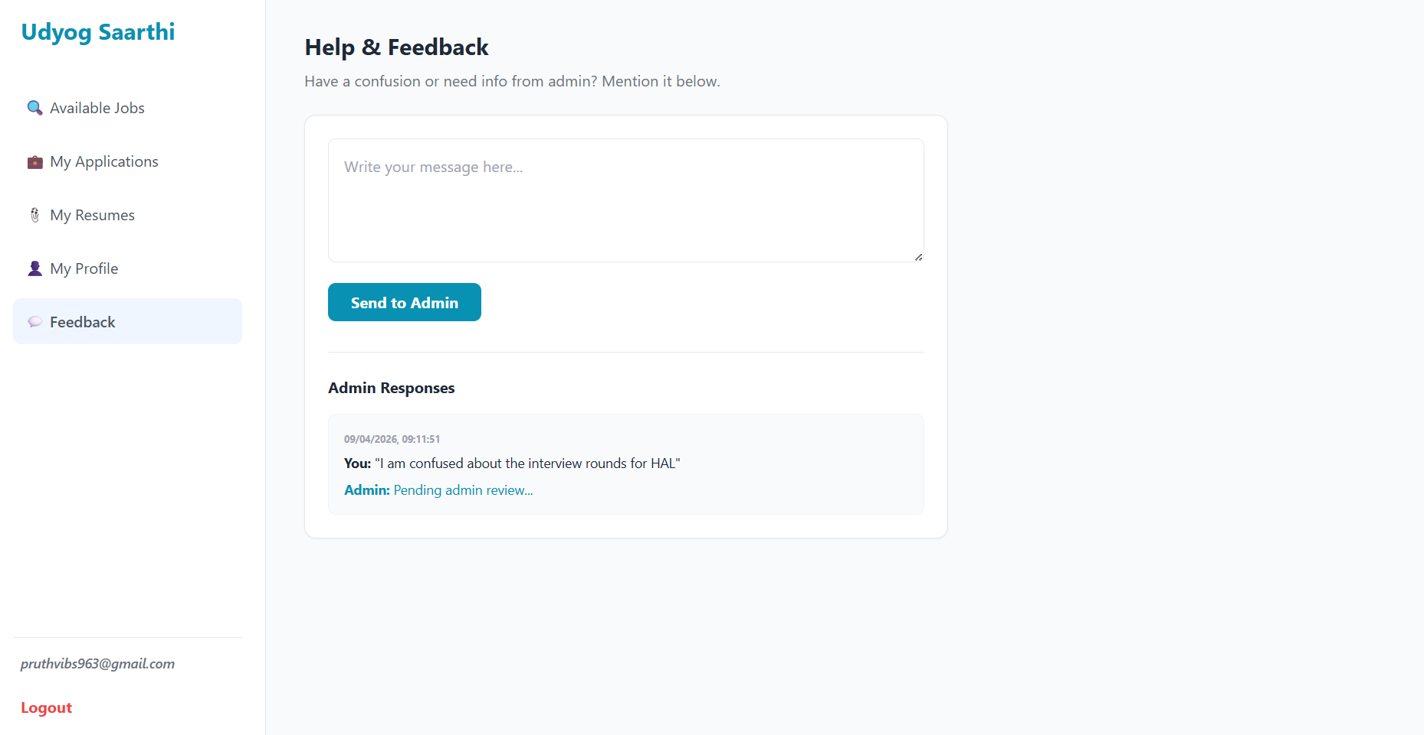

Slide 23
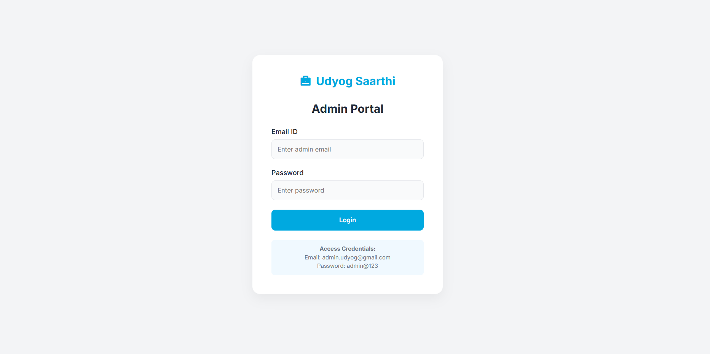
Admin Dashboard

Slide 24
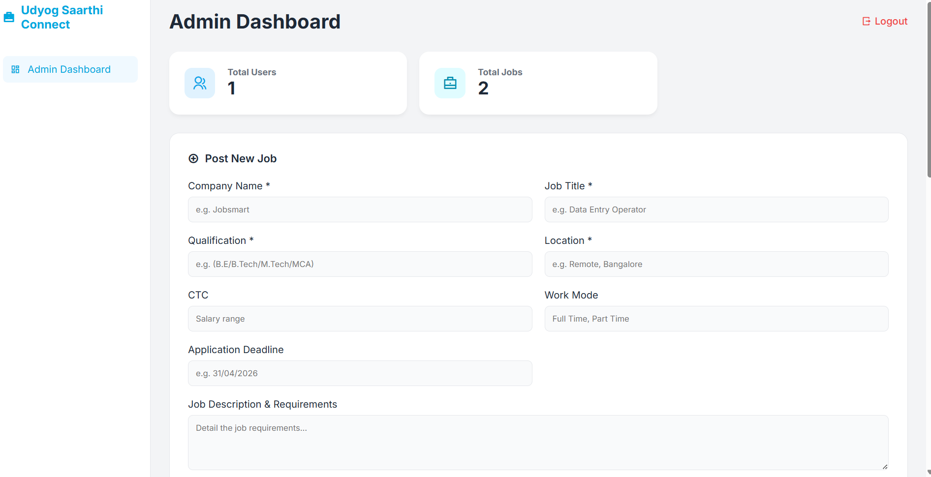

Slide 25
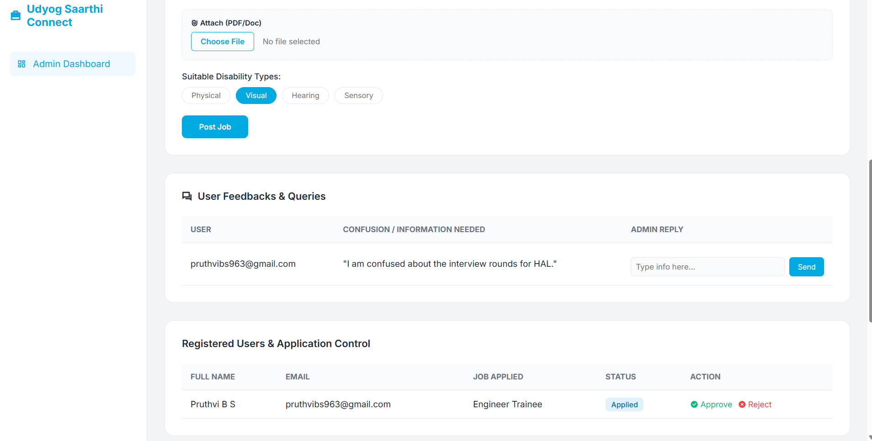

Slide 26
CONCLUSION
Core Objective: Bridged the employment gap for Persons with Disabilities by creating a specialized, accessible, and inclusive job-matching ecosystem.
Integrated Solutions: Delivered a dual-functional platform featuring a user-friendly job portal and a robust Admin Dashboard for streamlined job posting and applicant tracking.
Transparency & Support: Enhanced the recruitment experience through a Feedback Management System, ensuring clear communication and dignity in every application outcome.
Impact: Promoted financial independence and social inclusion by transforming the hiring process into an equitable journey based on talent, not limitations.
Future Vision: A scalable foundation built for AI-driven matching and global corporate partnerships to foster a diverse and representative workforce.

Slide 27
REFERENCES
[1]K. Sharma and R. Gupta, “Design and Development of Online Job Portal System,” International Journal of Computer Applications, vol. 180, no. 25, pp. 15–18, 2018.
[2] A. Verma and P. Singh, “Web-Based Recruitment System,” International Journal of Advanced Research in Computer Science, vol. 9, no. 2, pp. 45–49, 2018.
[3] M. Patel and K. Shah, “Online Job Portal Using Web Technologies,” International Journal of Engineering Research & Technology (IJERT), vol. 7, no. 5, pp. 234–238, 2019.
[4] R. Kumar et al., “A Study on Online Recruitent Systems,” International Journal of Scientific Research in Computer Science, vol. 6, no. 3, pp. 12–16, 2020.
[5] Sharma, S. K., & Gupta, R. (2018). Design and development of online job portal system. International Journal of Computer Applications, 180(25), 15–18.
[6] Verma, A., & Singh, P. (2018). Web-based recruitment system. International Journal of Advanced Research in Computer Science, 9(2), 45–49.

Slide 28
Github Link
https://github.com/Pruthvi23330/CSE7302.git

Slide 29
Thank you !!

