Slide 1
AI Interviewer App
Team: Team 11
Student’s SRNs: R22EF053,R22EN060,R22EN065
Course Name: AI Application Development (B22EFS626)
Date: 15/05/2025

Slide 2
Problem & Opportunity
Candidates often struggle with interview preparation.
Current solutions lack personalized feedback and domain-specific question sets.
Real-time evaluation is missing, leading to inconsistent performance.
Opportunity to leverage AI for tailored, data-driven interview preparation.

Slide 3
Our AI Solution
Multi-step interview preparation platform built with Streamlit, Whisper, and Groq API.
Focused on practicing job interview questions for real-world roles.
Key Features:
Multi-step user interface with voice recording.
Personalized domain-specific questions.
Real-time transcription and feedback using Whisper.
Adaptive learning through AI-driven evaluation.

Slide 4
Architecture / Demo
Architecture Overview:
User Input (Intro, Domain, Preferences)→Voice Capture & Transcription (Whisper)→ Question Generation & Evaluation (LLM via Groq API) → Real-time Feedback & Scoring Engine → Output for Interviewer Questions → Progress Dashboard & Performance Tracking (Streamlit UI)

Slide 5
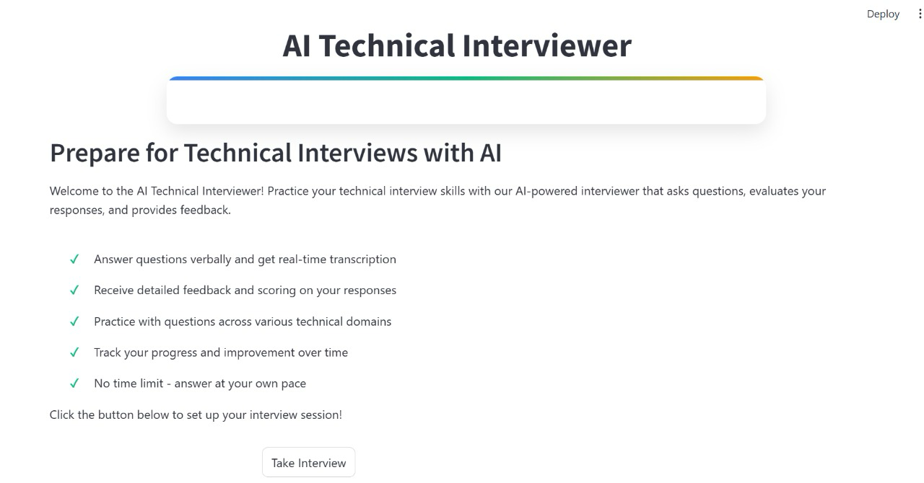
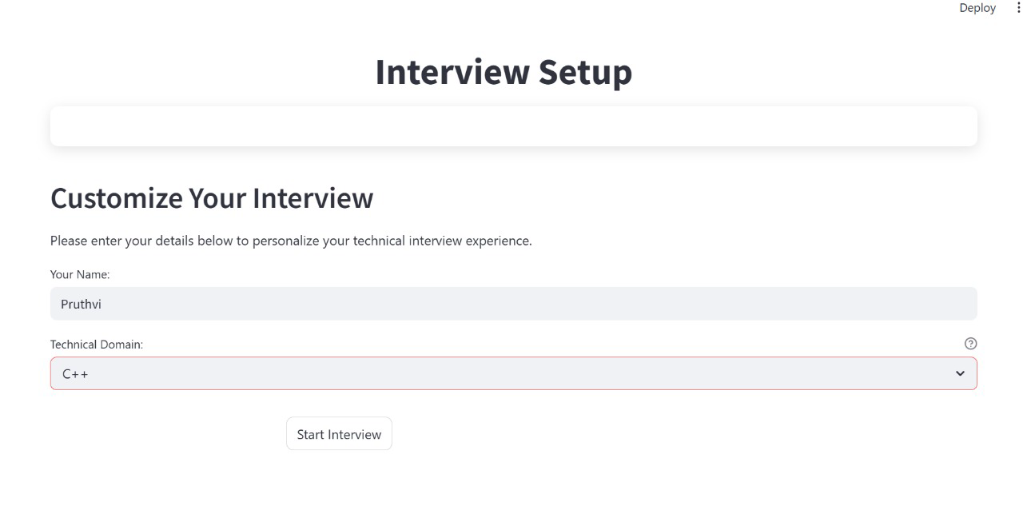

Slide 6
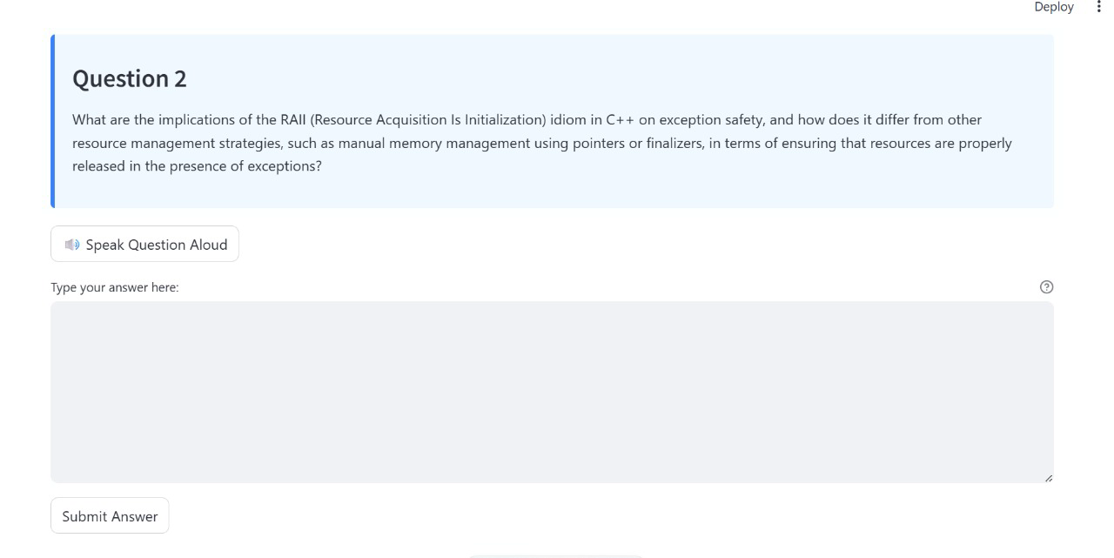
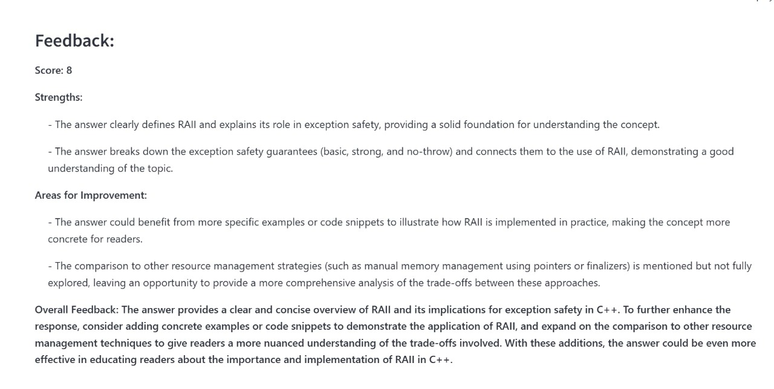

Slide 7
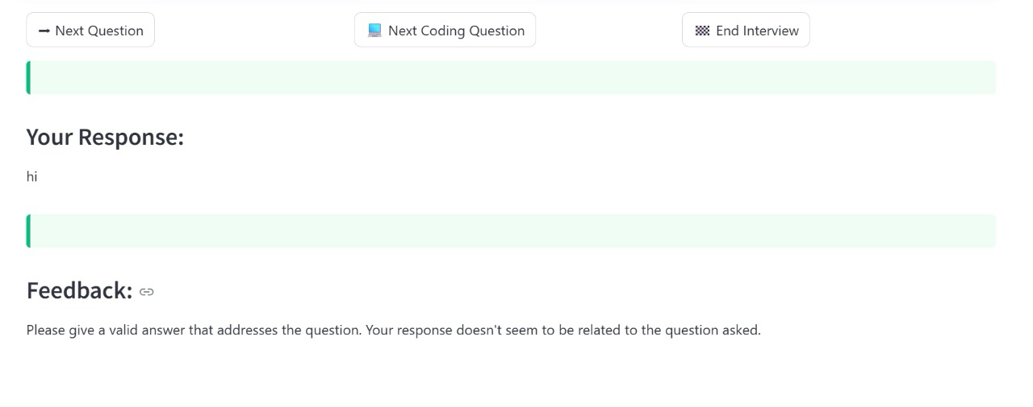
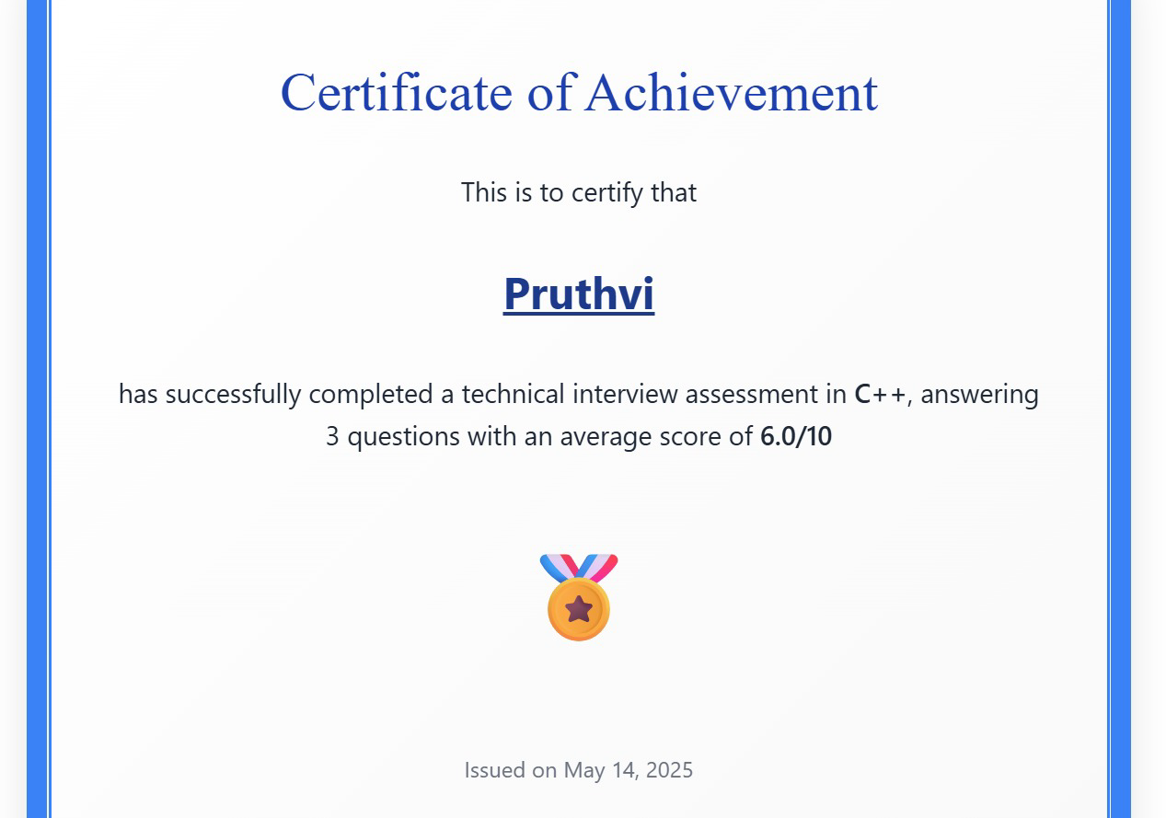
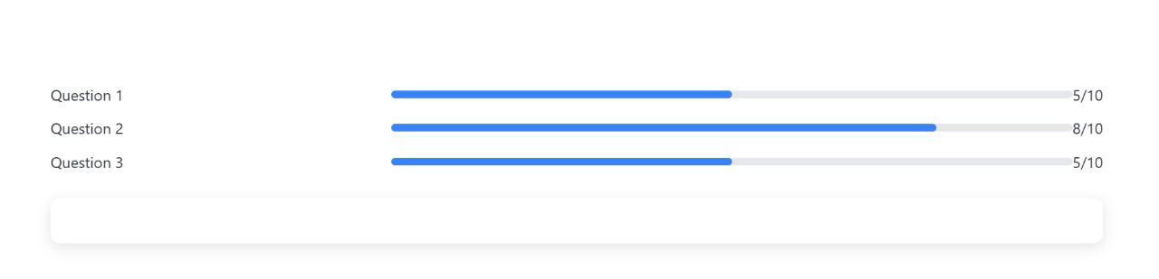

Slide 8
Impact, Learnings, and Future Steps
Impact:
60% faster preparation time compared to traditional methods.
Improved user confidence through personalized practice.
Learnings:
Accurate transcription is critical for real-time feedback.
Diverse accents pose challenges for natural language understanding.

Slide 9
Next Steps:
Enhance feedback precision with deeper NLP integration.
Expand domain coverage.
Ask:
Seeking mentorship, collaboration opportunities, and beta testers to refine our platform and meet real-world needs.

