Slide 1


3D Point Cloud
Weichun Xu
Yutian Gui
Florida Institute of Technology

Slide 2
Content
Problem statement
Test procedures
Results
Conclusion

Slide 3
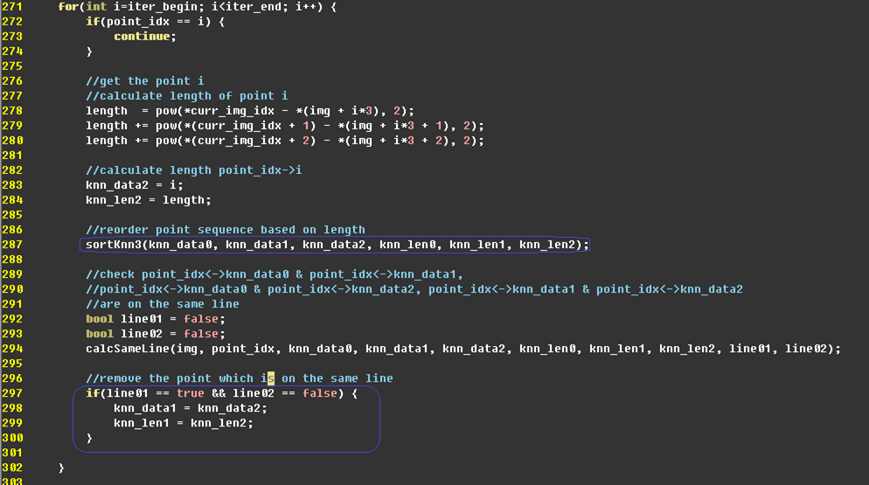
Problem statement
To reduce branch divergence, optimize the algorithm in KNN
After optimizing, sortKnn3 has 2 branch divergence and checking points on the same line has 1 branch divergence

Slide 4
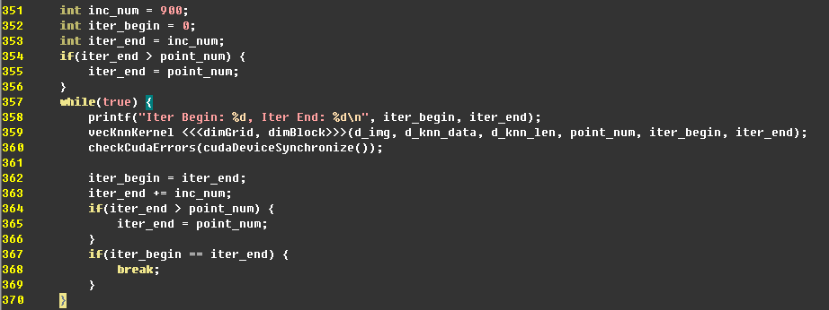
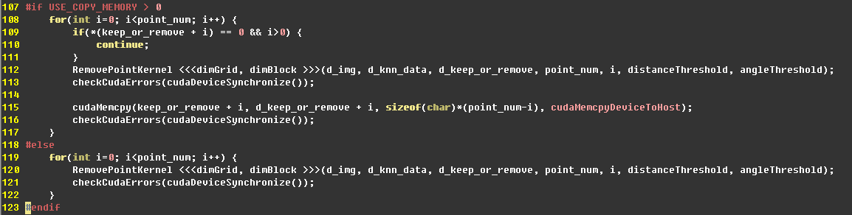
Problem statement
Separate data set into several segments when calling kernel function due to CUDA timeout
Call kernel function for each point due to the sync among blocks

Slide 5
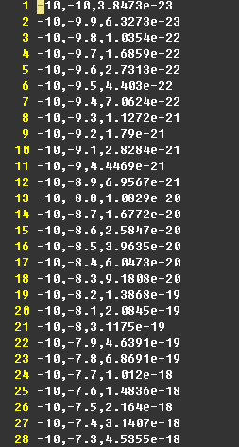
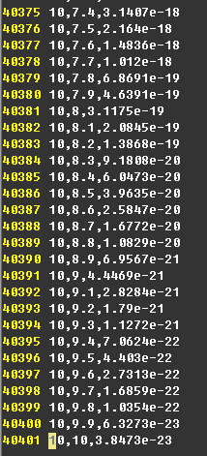
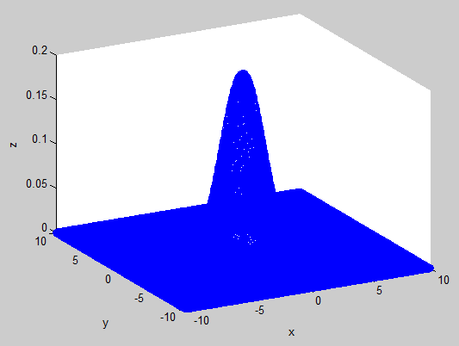
Test procedures
Use matlab to generate a data set of 3D image and write the data set to a file

Slide 6
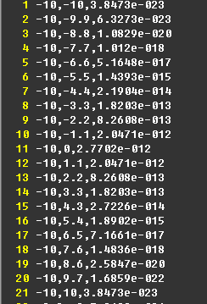
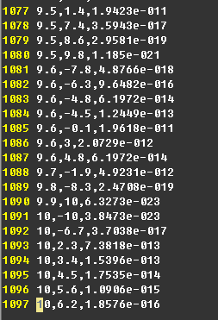
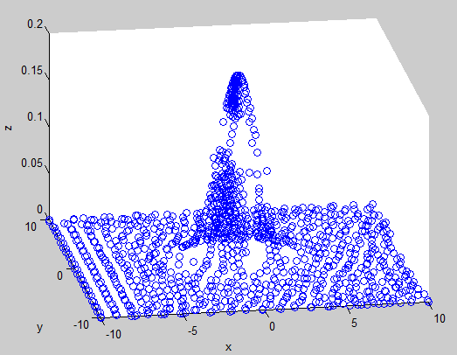
Test procedures
Use our program to read the file generated by matlab and use our program to calculate 3D Point Cloud
A file with reduced 3D Point Cloud will be outputted and matlab is used to display the image

Slide 7
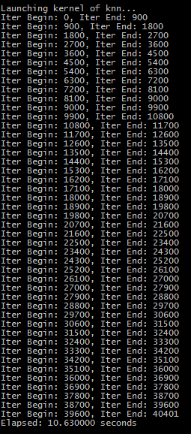
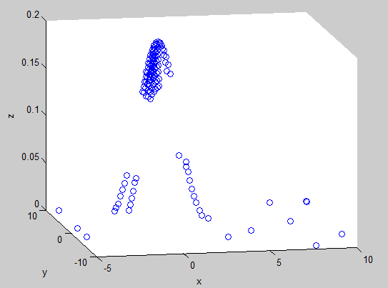
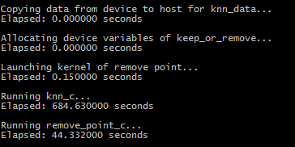
Test procedures
CPU algorithm is also used to compare with GPU based algorithm
Time used in each step of the program will be displayed, which can be used to compare the time between CPU and GPU

Slide 8
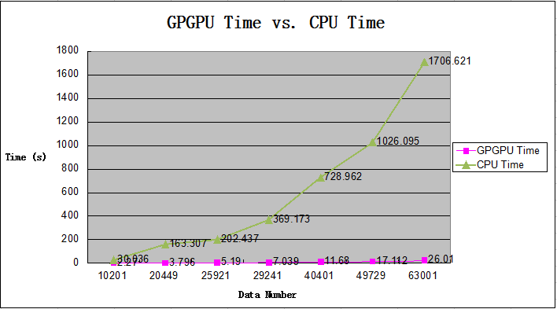
Results

Slide 9
Conclusion
Use GPGPU parallel computing reduce execution time significantly
Use GPGPU to extract 3D Point Cloud is accurate and feasible

Slide 10
Q & A
Thank you

