Slide 1
3D Point Cloud
Weichun Xu
Yutian Gui
Florida Institute of Technology

Slide 2
Problem statement
Test procedures
Results
Conclusion

Slide 3
Problem statement
Use CPU to extract 3D Point Cloud is time consuming, especially when the image is getting larger
Data processing of 3D Point Cloud is independent
Use GPGPU parallel computing to reduce execution time is possible

Slide 4
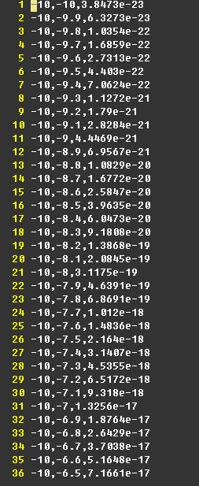
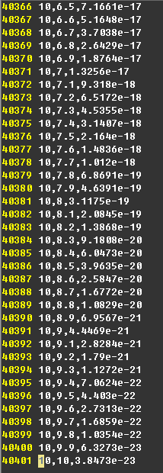
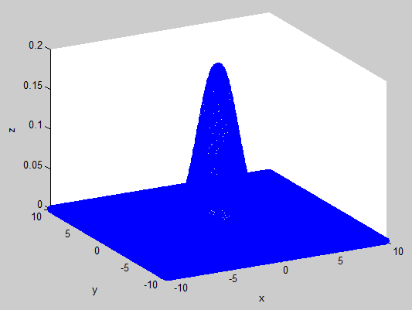
Test procedures
Use matlab to generate a data set of 3D image and write the data set to a file

Slide 5
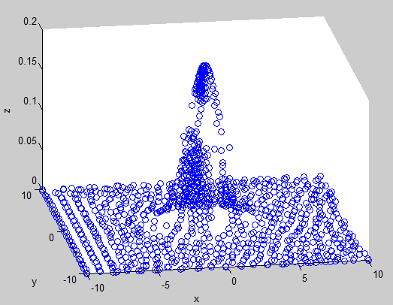
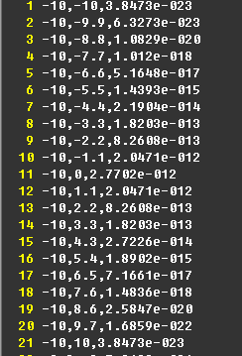
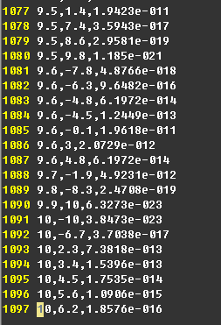
Test procedures
Use our program to read the file generated by matlab and use our program to calculate 3D Point Cloud
A file with reduced 3D Point Cloud will be outputted and matlab is used to display the image

Slide 6
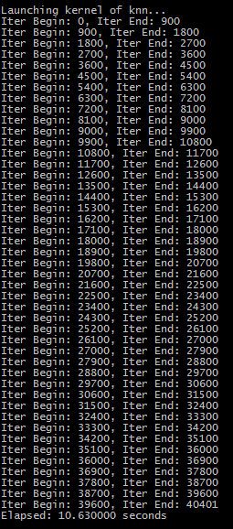
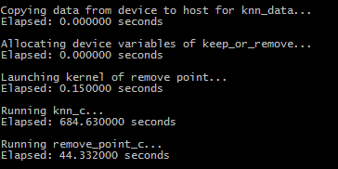
Test procedures
Time used in each step of the program will be displayed, which can be used to compare the time between CPU and GPU

Slide 7
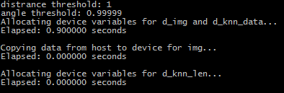
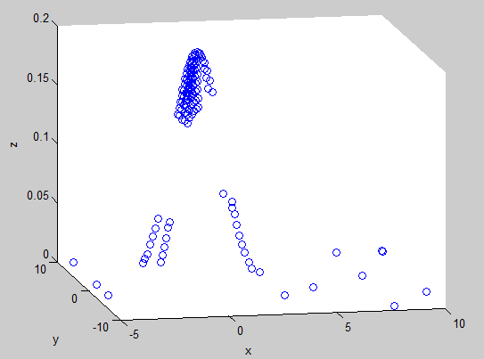
Results
GPGPU based computing takes 12 seconds
CPU based computing takes > 700 seconds

Slide 8
Conclusion
Use GPGPU parallel computing reduce execution time significantly
Use GPGPU to extract 3D Point Cloud is accurate and feasible

Slide 9

Q & A

Slide 10
Thank you☺

