Slide 1

BAN240 – Business Analytics Consulting Capstone Project
Telecommunication industry
Customer Churn Analysis on Telco Dataset: A Big Data Perspective
Section: NBB
Professor : Stephen Perelgut
Presented by : Group 1
Pratik Andrade (106837206)
Ronn Kurien Kollamana (165680190)
Tanviben Becharbhai Patel (126904200)
Laher Gregory Pereira (106873201)
Pruthviben Jaimin Patel (139602205)

Slide 2

AIM OF THE PROJECT
To analyze customer churn in Telco dataset and make actionable insights to identify the factors that affect customer churn.

Slide 3

OBJECTIVES
Identify the factors that affect customer churn in the Telco dataset.
Predict customer churn using an ML model.
Identify particular customers who are at the risk of churning.
Suggest some actions based on insights from the customer churn analysis.

Slide 4

INDUSTRY OVERVIEW
Most valuable market in the world: Asia Pacific region
From 2021 to 2024, the worldwide telecom services industry to rise at a CAGR of 5.4 %
Top competitors: AT&T Inc, Verizon Communications Inc., Nippon Telegraph & Telephone Corp, Deutsche Telekom AG, T-Mobile US Inc, etc.

Slide 5

CHALLENGES
Growing amount of data especially due to remote working and IoT devices
Upgrade existing infrastructure and create opportunities for new coming generations of technology
How to provide better quality of service at affordable rates?

Slide 6

RESEARCH QUESTIONS
What are the factors affecting customer churn?
Is it possible to predict customer churn using an ML model?
Which specific customers are at risk for churning?
What are the actionable insights from the customer churn analysis?

Slide 7

DATA COLLECTION
Dataset: Telco dataset from Kaggle; 7043 customers data, 21 features (not region specific)
The high number of features available to explore
A high usability and no missing values
Target column “Churn” used for classifying the customers into two categories, customers who were retained and those who were not.
Will help us to determine if the customer is unhappy with the support, the competition

Slide 8

METHODOLOGY
The data collection – research and finalizing data
Data Preprocessing – data cleaning, transformation, Features grouping
Visualization – Correlation between churn and other features
Model Training – Scaling and one hot encoding, Machine learning models: Logistic Regression and catBoost
Identifying feature importance

Slide 9
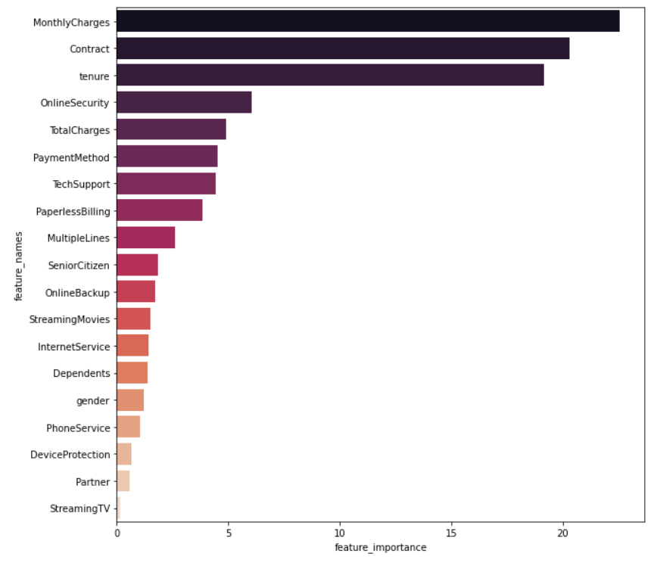
FINDINGS
Using predictive scores of model, important features identified are:
Monthly service charges
Length of contract
Tenure

Slide 10
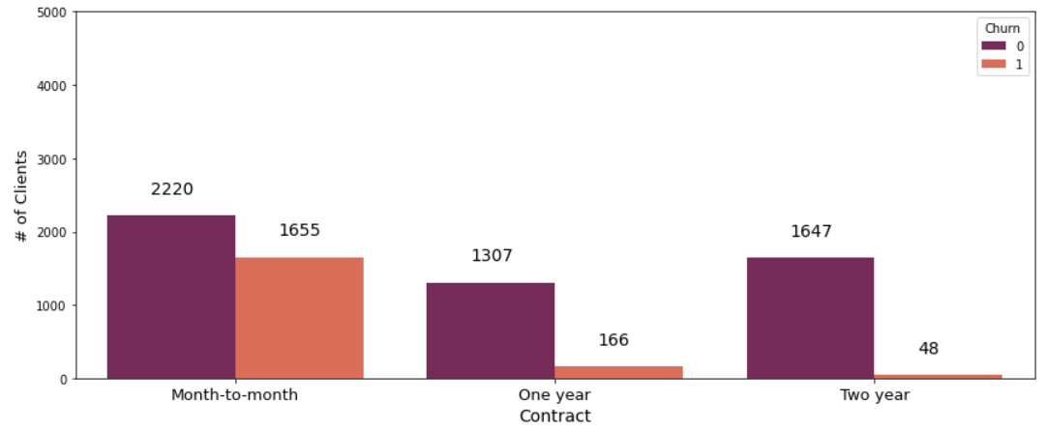
VISUALIZATIONS AND INSIGHTS
Contract vs. Churn
Month to month churn rate is higher compared to yearly contracts

Slide 11
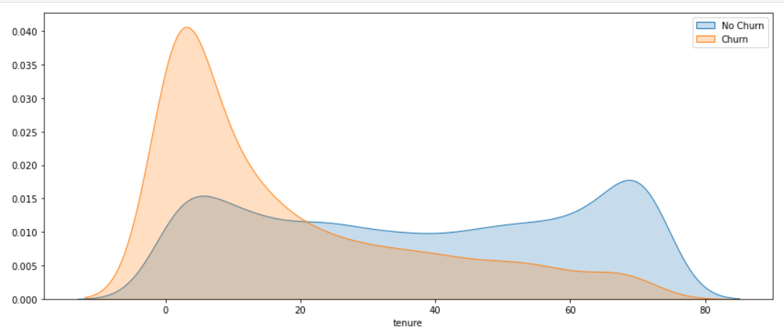
VISUALIZATIONS AND INSIGHTS
Tenure vs. Churn
Churn rate decreases with increase in length of tenure

Slide 12
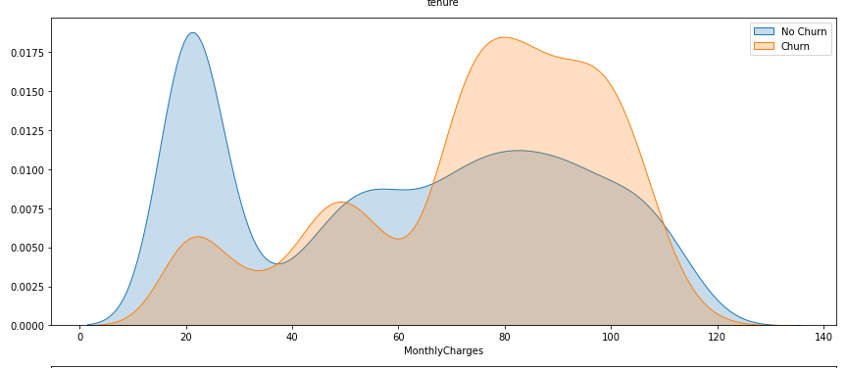
VISUALIZATIONS AND INSIGHTS
MonthlyCharges vs. Churn
High monthly charges cause customers to defect

Slide 13

RECOMMENDATIONS
Factors affecting the churn rate: monthly charges, contract, and tenure
Monthly charges
Companies to offer a good continued service for the customers
Create surveys to check for the customer satisfaction scores
Contract
Company to try promote longer contracts to customers by offering them better deals
Offers in comparison with the prices for month-to-month contract
Tenure
Company to check for customer satisfaction and match the pricing of the competitors
Quality of Service

Slide 14

LIMITATIONS
Very limited data which makes the model results limited. If more data, better accurate prediction.
Use a quantitative method for data collection because of the time constraint.
The results of the models could be improved by adding more features such as region wise customer segmentation.
Not focused on a particular telecom company, focusing on the aspects of a company will make the model more usable.

Slide 15
CONCLUSION
Predictive modelling could be used to predict customer churn.
Major three factors affecting churn are monthly charges, contract, and tenure.
Loyal customers who have been using the service for a longer period of time, who have yearlong contracts and pay low monthly charges are likely to be retained.
OnlineSecurity, InternetServices, TechSupport are also important to retain customers.

Slide 16
REFERENCES
Dataset: https://www.kaggle.com/blastchar/telco-customer-churn
“Top 10 Trends That Will Dominate the Telecom Industry in 2021 | Ringover Blog.” Ringover, www.ringover.com/blog/telecom-industry-trends-2021. Accessed 2 June 2021.
Zacks. “In Telecom, Wireless Still the Key - Industry Outlook.” Nasdaq, 11 Sept. 2014, www.nasdaq.com/articles/in-telecom-wireless-still-the-key-industry-outlook-2014-09-11.
Asamoah, D. A., Sharda, R., Kalgotra, P., & Ott, M. (2016). Who renews? Who leaves? Identifying customer churn in a telecom company using big data techniques. Journal of Information Systems Education, 27(4), 223–.
Mohammad, N., Ismail, S., Kama, M., Yusop, O., & Azmi, A. (2019). Customer Churn Prediction In Telecommunication Industry Using Machine Learning Classifiers. Proceedings of the 3rd International Conference on Vision, Image and Signal Processing, 1–7. https://doi.org/10.1145/3387168.3387219
Ullah, Irfan, et al. “A Churn Prediction Model Using Random Forest: Analysis of Machine Learning Techniques for Churn Prediction and Factor Identification in Telecom Sector.” IEEE Access, vol. 7, IEEE, 2019, pp. 60134–49, doi:10.1109/ACCESS.2019.2914999.

Slide 17
THANK YOU !
ANY QUESTIONS ?

