Slide 1
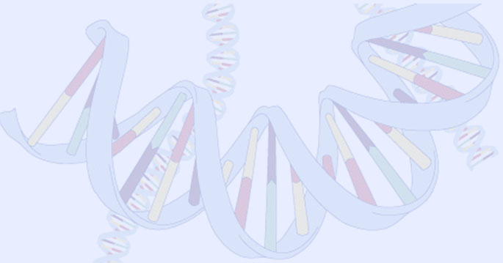
Genetic Algorithm
(Knapsack Problem)
Ujjwal Garad
Pruthvij Thakar

Slide 2
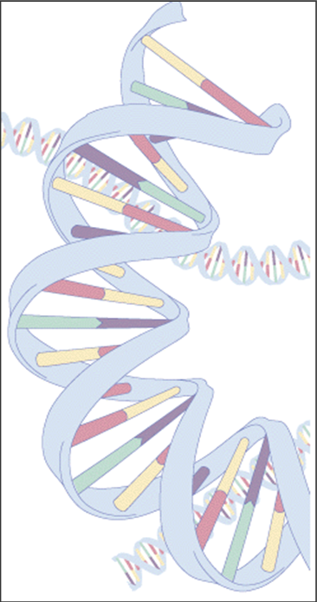
Genetic Algorithm
What is Genetic Algorithm?
Follows steps inspired by the biological processes of evolution.
Follow the idea of SURVIVAL OF THE FITTEST- Better and better solutions evolve from previous generations until a near optimal solution is obtained.

Slide 3
Genetic Algorithm (Cont)
Genetic Algorithms are often used to improve the performance of other AI methods.
The method learns by producing offspring that are better and better as measured by a fitness function.

Slide 4

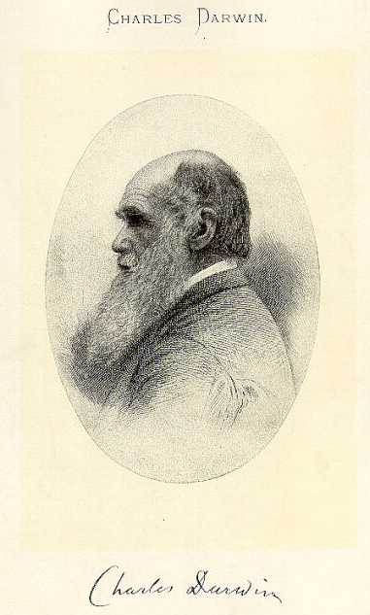
Knapsack Problem
Problem Description:
Each Chromosome has a weight and a benefit or value.
There is a capacity limit on the weight total capacity of knapsack
There is mutation probability whether mutation will happen in certain generation.
probability of deciding whether crossover will take place between two chromosomes

Slide 5

Knapsack Problem
Example:
Item: 1 2 3 4 5 6 7
Benefit: 5 8 3 2 7 9 4
Weight: 7 8 4 10 4 6 4
Knapsack holds a maximum of 22 pounds
Fill it to get the maximum benefit

Slide 6

Genetic Algorithm
Outline of the Basic Genetic Algoritm
[Start]
  Encoding: represent the individual.
  Generate random population of n chromosomes (suitable solutions for the problem).
[Fitness] Evaluate the fitness of each chromosome.
[New population] repeating following steps until the new population is complete.
[Selection] Select the best two parents.
[Crossover] cross over the parents to form a new offspring (children).

Slide 7
Genetic Algorithm
Outline of the Basic Genetic Algoritm Cont.
[Mutation] With a mutation probability.
[Accepting] Place new offspring in a new population.
[Replace] Use new generated population for a further run of algorithm.
[Test] If the end condition is satisfied, then stop.
[Loop] Go to step 2 .

Slide 8
Basic Steps
Start
Encoding: 0 = not exist, 1 = exist in the Knapsack
  Chromosome: 1010110
  => Items taken: 1, 3 , 5, 6.
Generate random population of n chromosomes:
  0101010
  1100100
  0100011
Item. | 1 | 2 | 3 | 4 | 5 | 6 | 7
Chro | 1 | 0 | 1 | 0 | 1 | 1 | 0
Exist? | y | n | y | n | y | y | n

Slide 9
Basic Steps Cont.
Fitness & Selection
✗
0101010: Benefit= 19, Weight= 24
1100100: Benefit= 20, Weight= 19.
0100011: Benefit= 21, Weight= 18.
Item | 1 | 2 | 3 | 4 | 5 | 6 | 7
Chro | 0 | 1 | 0 | 1 | 0 | 1 | 0
Benefit | 5 | 8 | 3 | 2 | 7 | 9 | 4
Weight | 7 | 8 | 4 | 10 | 4 | 6 | 4
✓
✓
=> We select Chromosomes b & c.

Slide 10
Basic Steps Cont.
Crossover & Mutation
Parent 1
1 1 0 0 1 0 0
Parent 2
0 1 0 0 0 1 1
Child 1
1 1 0 0 0 1 1
Child 2
0 1 0 0 1 0 1
Mutation
0 1 0 0 1 0 0

Slide 11
Basic Steps Cont.
Accepting, Replacing & Testing
Place new offspring in a new population.
Use new generated population for a further run of algorithm.
If the end condition is satisfied, then stop. End conditions:
  Number of populations.
  Improvement of the best solution.
Else, return to step 2 [Fitness].

Slide 12
Genetic Algorithm
Conclusion
GA is nondeterministic – two runs may end with different results
There’s no indication whether best individual is optimal

