Slide 1
ZS ASSOCIATES TECHNICAL ROUND
IPL DATA ANALYSIS

Slide 2
Objective
To provide analysis of IPL Data for devising strategy and better game plan.

Slide 3
DATASET
The Dataset is obtained from Kaggle
Data Set List:
1. Matches
2. Deliveries
Deliveries has data about ever ball in every match, season-wise. It includes number of runs scored, batsman, bowler, wide runs, no ball details, wickets, etc., for every match played in the past 12 seasons.

Slide 4
DATASET
The Data in matches file includes the following fields:
Season
Match Date
Toss Winner
Toss Decision
Winner
Win by Runs
Win by Wickets
Venue
Player of the Match
I1.

Slide 5
DATA CLEANING
Most of the data was clean and had no null values
There were issues with Naming of the Venues as some venue names were shortened in a season and some venue names were changed.Changes were made accordingly to the dataset
The Umpire Columns are dropped as they don’t offer any significant inference.
Delhi Daredevils have changed their name in the 2019 season to Delhi Capitals.Since they had been in only one season and have the same team and infrastructure,they are considered as Delhi Daredevils.
However,Sun Risers Hyderabad were treated different to Deccan Chargers
All the Abandoned games have been removed.

Slide 6
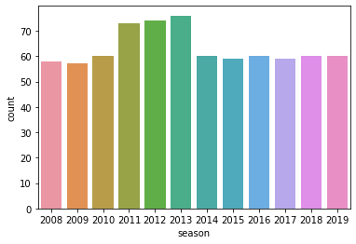
MATCHES PER SEASON

Slide 7
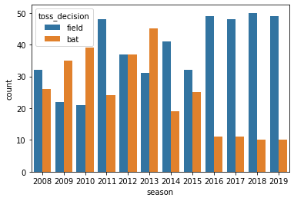
DECISION OF TOSS

Slide 8
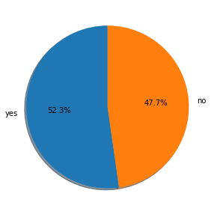
IMPACT OF TOSS ON MATCH RESULT

Slide 9
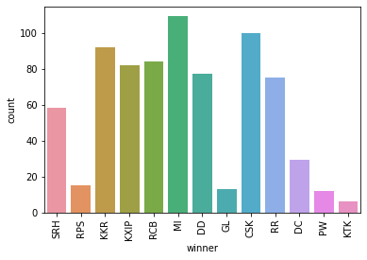
MATCHES WON BY EACH TEAM

Slide 10
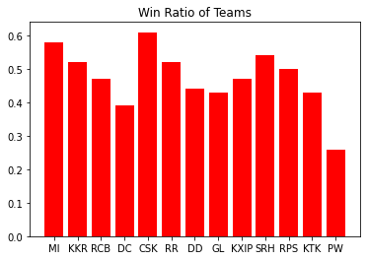
HIGHEST WIN RATIO

Slide 11
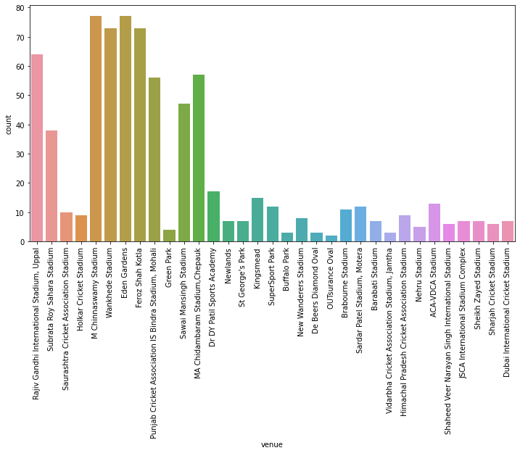
MATCHES AT EACH VENUE

Slide 12
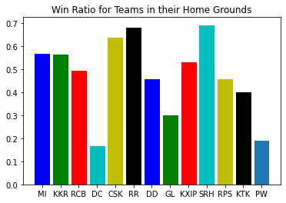
Win Ratio of Teams in Home Grounds

Slide 13
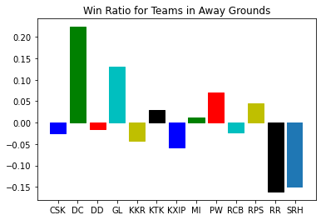
Win Ratio in Away Grounds

Slide 14
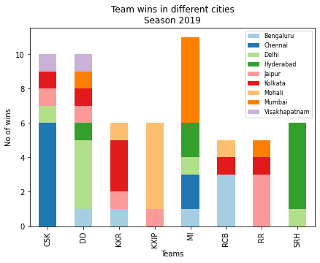
TEAM WINS IN DIFFERENT CITIES 2019 Season

Slide 15
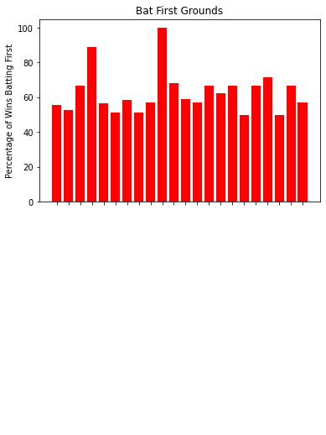
BAT FIRST VENUES

Slide 16
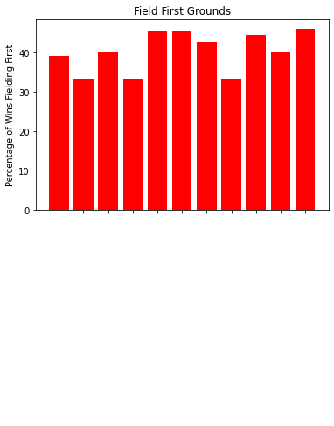
BOWL FIRST VENUES

Slide 17
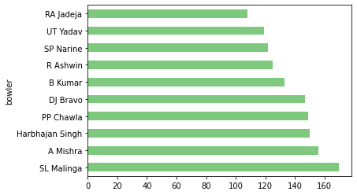
TOP BOWLERS IN IPL

