Slide 1

ACADEMY OF DATA
WELCOME TO
Title: Analyzing Data of Global Wealth Distribution

Slide 2
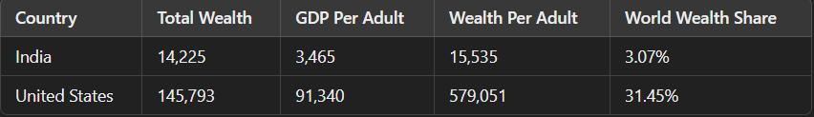
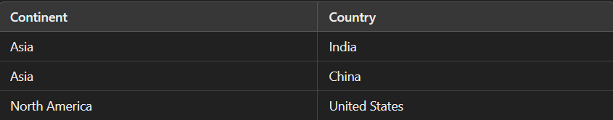
Project Use Case :
Objective : To study how wealth is spread across the world and understand the economic differences between countries and continents.
Source : Here is the Link to access the data sets
Example of the data set :

Slide 3
Project Objectives :
The Top 10 countries with the average Net-worth.
Create a new table with Countries and Continents.
Find the Continent with highest Net-worth.
The lowest 10 Countries with Average Net-worth.
Create a Pie-Chart with all Countries Net-worth.

Slide 4




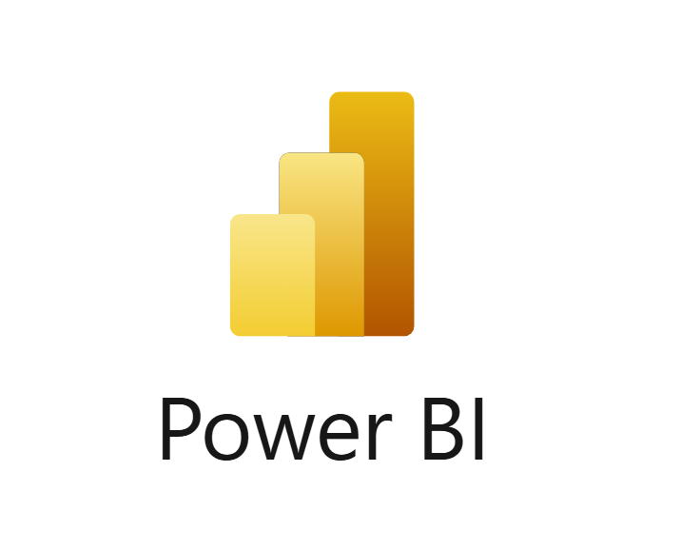

Technology Stack
Python
AWS
Snowflake
SQL
Power Bi

Slide 5
Using Medallion Architecture:
Objective: To Filter all the “NULL VALUES” from the given Data and uploading it to S3
Steps:
Import libraries (Pandas, boto3)
The file system we used is CSV file format
Remove all Duplicate and Null values using this Code.
Using boto3 upload file to S3.
Outcome: File has been successfully uploaded to the S3 bucket.

Slide 6
Using AWS for Credentials and Storage:
Objective: Leveraging AWS to get the credentials using IAM and giving access to S3
Steps:
Create IAM Role, give all access to S3.
Download the Credentials.
Outcome: Successfully created the IAM Role for S3.

Slide 7
Snowflake Setup
Objective: Set up Snowflake database and schema for data ingestion.
Steps:
Create a database (KPI_Analysis).
Create and use a schema (NETWORTH).
Define BRONZE_DATA & COUNTRIES_CONTINENTS table with required columns.
Outcome: Snowflake ready for data loading and analysis.

Slide 8
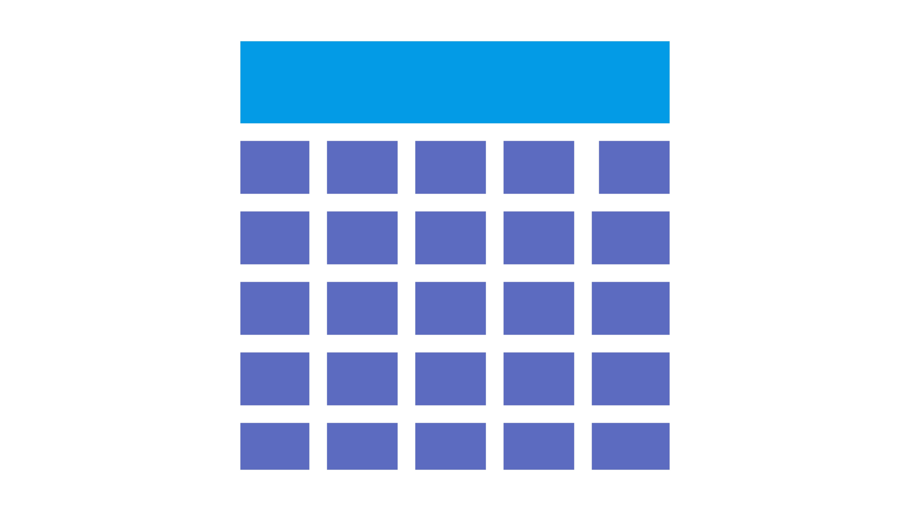


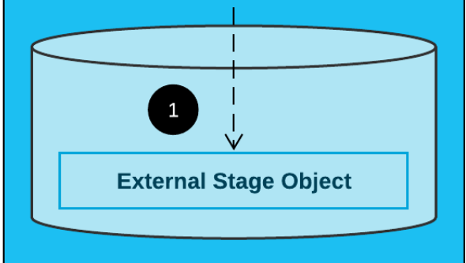

Design Architecture
Snowflake
Tbl-1
Python using medallion arch
S3
Tbl-2
RESULT

Slide 9
Workflow
Local Data Source (wealth_data.csv) → AWS S3 Bucket (Upload with Boto3) → Snowflake External Stage (External Stage Setup)
→ Staging Schema (Creating stage for wealth_data.csv) → Dimension Schema
↓
Table: average-net-worth-by-country(Country, Continent, TotalWealth2021, GDPPerAdult2021, WealthPerAdult2021, WorldWealthShare)
↓
Key Performance Indicators (KPIs):
├── 1. Top 10 Countries with Highest Average Networth
├── 2. New Table for Countries and Continents (Finding Continent with Highest Average Networth)
├── 3. Lowest 10 Countries with Average Networth
└── 4. Pie Chart for Country Networth Distribution
↓
Data Visualization
↓
Generate Insights and Report

Slide 10
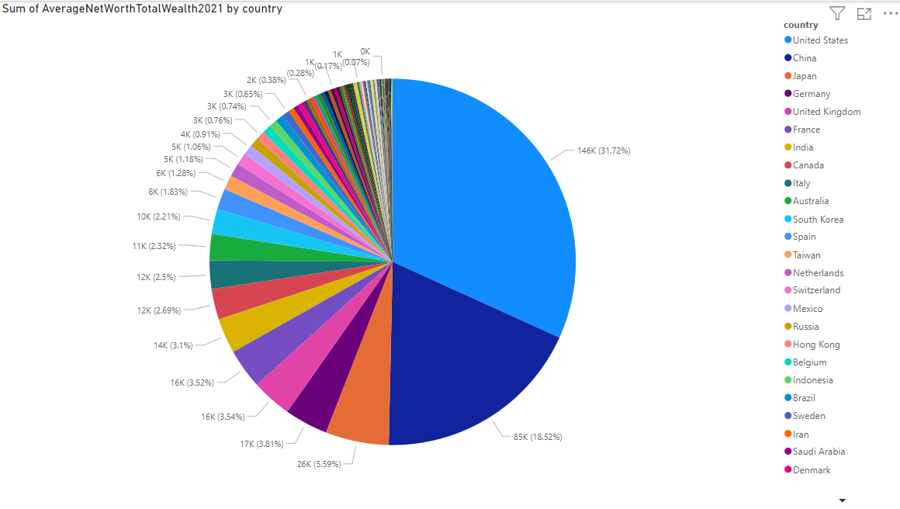
Pie Chart of Countries Net-wort

Slide 11


QUESTIONS & ANSWERS

