Slide 1
CYBER HACK
CYBERHACK || 2025
Problem Statement:
Saving accounts and current accounts are taken on rent, and cybercrime gangs use these accounts for committing financial frauds at a very large scale. What technical solution can be adopted by banks to avoid the use of such rented accounts?
Team Name: CyberPunk
Team Members:
Pruthviraj Janwade
Anshul Nandanwar
Shreyash Dalal

Slide 2

How Rented Accounts Are Used for Fraud
CYBER HACK
Introduction
Cybercriminals rent bank accounts to move illicit funds, making detection difficult. These accounts, often called "money mule" accounts, help fraudsters launder money and bypass security measures. Strengthening fraud detection and prevention is essential to curb financial crimes.
Account Acquisition
Money Transfer & Laundering
Withdrawal & Hiding Transactions
Criminals target students, unemployed individuals, or low-income people to rent their accounts..
Social media, job scams, and dark web forums are used to find account holders.
Stolen or illegal funds are transferred into rented accounts via phishing, fake loans, or scams.
Money is quickly moved through IMPS, RTGS, NEFT, or UPI to other accounts.
Criminals withdraw funds in small amounts or convert them into cryptocurrency to erase trails.
"Money mules" withdraw cash from ATMs or make fake purchases to launder money.

Slide 3
Proposed Solution – SPAI (Secure Path AI)
CYBER HACK
INTRODUCTION
02
Enhanced Multi-Factor
Authentication (MFA)
Our web app leverages AI to enhance the security of savings and current accounts, preventing cybercriminals from exploiting rented accounts. It features real-time fraud detection, behavioral analytics, and multi-layered authentication, ensuring secure transactions and proactive threat mitigation.
For flagged transactions, face recognition or fingerprint verification is required. Additionally, transactions above ₹100,000 will trigger a re-verification process to ensure security.
Example: If a transaction above ₹100,000 is initiated, the user will be asked for biometric verification..
01
Fraud Score Calculation &
Behavioral Analytics
Automated Account
Freezing & Alerts
03
The Web App tracks device usage, and transaction timing to calculate a fraud risk score. Accounts exhibiting abnormal behavior are flagged for review.
Example: If a user logs in from an unusual location or device and initiates a large transaction, the system will flag the activity and calculate a higher fraud score, triggering further investigation.
Once fraud is detected, the account is automatically frozen, blocking any further transactions. Alerts will be sent to the account holder for verification.
Example: If an unusual login attempt is detected from a new device or location, the system will freeze the account and notify both the bank and the account holder immediately.

Slide 4








Technical Implementation & Workflow
CYBER HACK
Builds an interactive user interface and admin
dashboard for seamless navigation.
TensorFlow and Scikit-learn work together to train models that detect fraudulent transactions by analyzing patterns like location, amount, and timing.
ReactJs
SciKit-Learn/Tensor
Provides structured storage for user and transaction data and Offers optional real-time transaction monitoring for faster fraud detection.
Ensures a clean and responsive design across devices.
TailwindCSS
MySQL/ Firebase
Handles API requests, including fraud detection logic and user management.
Enables real-time fraud alerts to the admin panel for immediate action.
NodeJs
Web Sockets

Slide 5
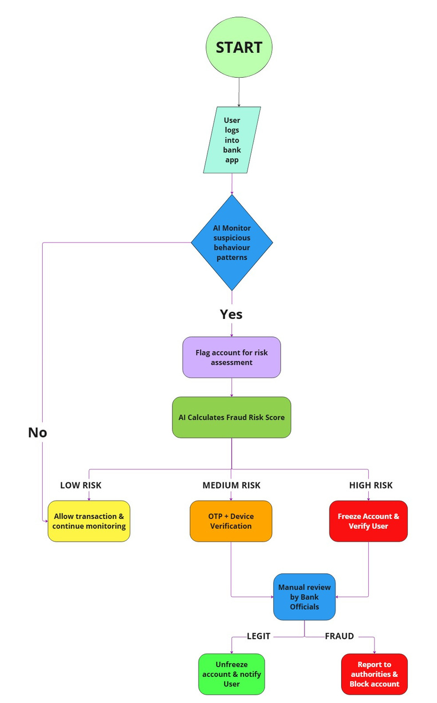
Fraud Detection Flow
User Login
The user logs into their banking app to perform transactions.
AI Monitors User Behavior
The system's AI engine analyzes user activity for suspicious behavior patterns.
Risk Assessment Trigger
If no suspicious activity is detected, the user can proceed with transactions.
If suspicious activity is identified, the AI flags the account for risk assessment.
Fraud Risk Calculation
The AI system calculates a fraud risk score based on user activity.
Risk Categorization
Low Risk: Transaction is allowed, and monitoring continues.
Medium Risk: Additional authentication via OTP & device verification is required.
High Risk: The account is frozen for further verification.
Bank officials manually review cases where the system is uncertain.
Final Decision
If the account activity is legitimate, the account is unfrozen, and the user is notified. If fraudulent activity is confirmed, the account is blocked, and authorities are informed.

Slide 6
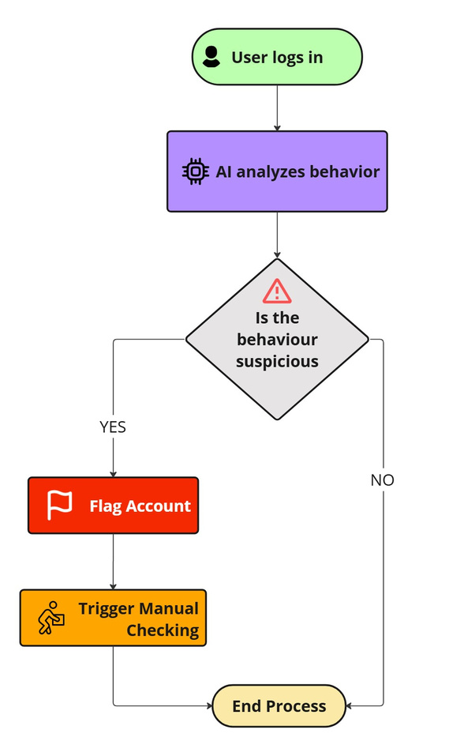
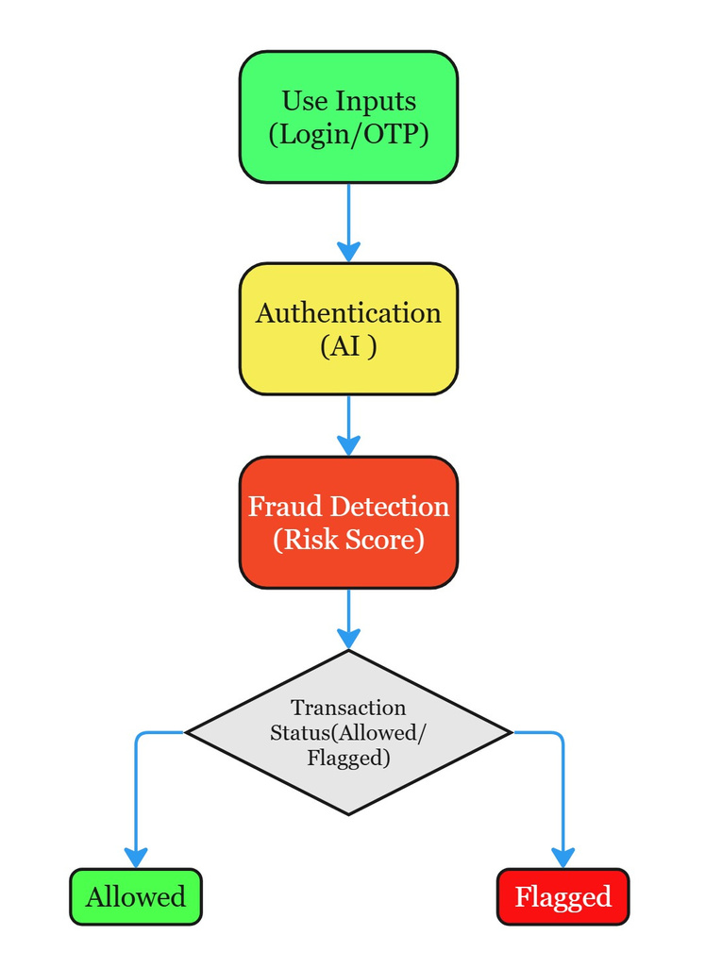
Technical Approach
CYBER HACK
Flowchart 1: Transaction Fraud Detection Process
User Input: Login credentials or OTP authentication.
Authentication: AI verifies user identity.
Fraud Detection: AI assigns a risk score to assess transaction legitimacy.
Decision Process:
Allowed: If the risk score is low, the transaction proceeds.
Flagged: If the risk score is high, the transaction is blocked for further review.
Flowchart 2: AI Behavioral Analysis for Account Security
User Logs In: AI starts monitoring user behavior.
AI Analysis: The system analyzes behavioral patterns for anomalies.
Suspicious Activity Decision:
No Suspicion: Normal user behavior, process ends securely.
Suspicious Detected:
Flag Account: AI marks the account as high-risk.
Trigger Manual Checking: A human review is initiated before further access.
Process Flow Diagram
Data Flow Diagram

Slide 7
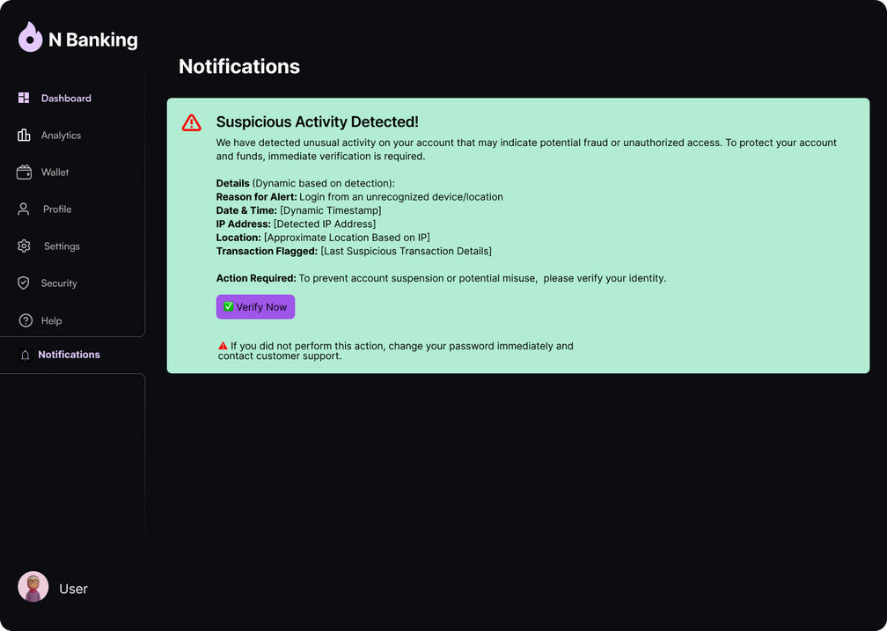
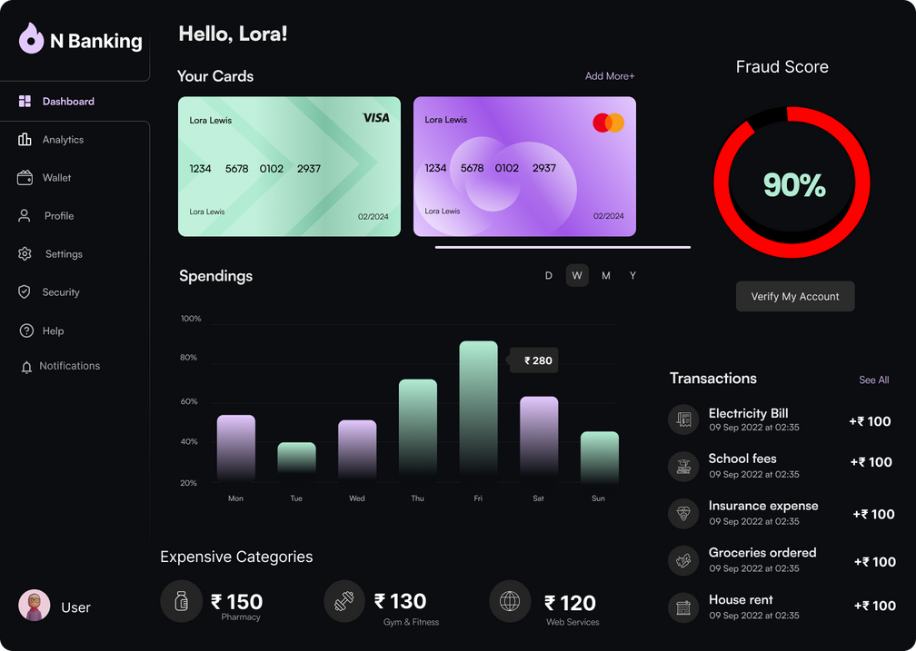
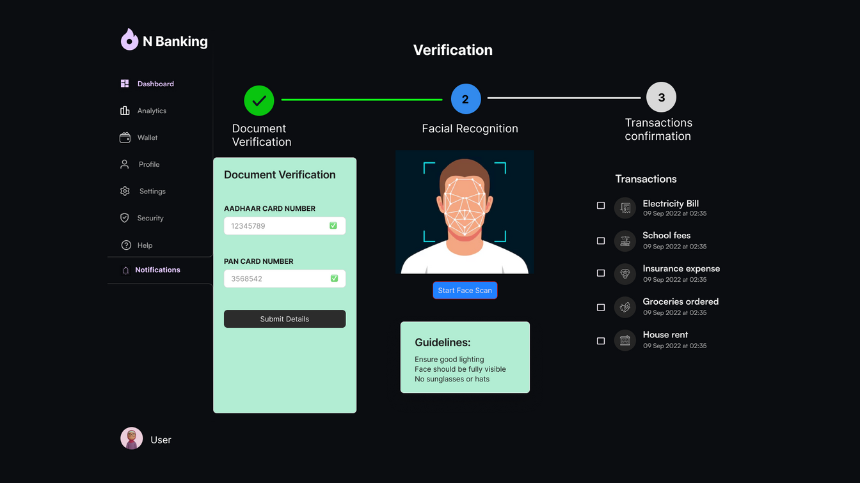
Concept design overview
Introduction
The design integrates a user-friendly dashboard for real-time monitoring of transactions, fraud alerts, and Fraud score.
Multi-layered verification ensures secure processing of high-value transactions, with alerts triggered for any suspicious activities.
Notifications are sent instantly to users and admins through SMS and notification, enabling immediate actions like account freezing if fraud is detected.

Slide 8
BENEFITS
IMPACTS
Prevention of Account Rental Frauds : Stops illegal account misuse.
Real-Time Fraud Detection : AI flags suspicious transactions instantly.
Enhanced Customer Trust : Secure banking builds user confidence Automated
Fraud Monitoring : Reduces manual intervention & improves efficiency.
Increased Banking Security : Multi-layer authentication prevents unauthorized access.
Reduced Financial Losses for Banks : AI-driven early detection minimizes fraud risks.
Improved Regulatory Compliance : Meets RBI’s fraud prevention standards.
Strengthened Financial Ecosystem : Reduces cybercrime and ensures safer transactions.

Slide 9
Expected Outcomes & Future Scope
CYBER HACK
Introduction
Our AI-powered web app enhances online banking security by detecting and preventing financial fraud in real time. By integrating advanced fraud detection models and multi-factor authentication, the system minimizes the risk of rented accounts being misused. Future enhancements will leverage blockchain for secure identity verification and collaborate with financial regulators to strengthen fraud prevention measures.
Expected Outcomes:
Future Enhancements:
Next Steps:
Enhanced Security for Online Banking
Reduction in Financial Frauds
Real-Time AI Fraud Prevention System
Increased Trust Between Banks & Customers
Blockchain-Based Identity Verification for Secure KYC
Advanced AI for Faster Fraud Detection
Integration with RBI & Other Financial Regulators
Prototype Development
Testing with Bank APIs
Pilot Implementation with Partner Banks

Slide 10
REFERENCES AND LINKS
CYBER HACK
AI-Powered Fraud Prevention in Digital Banking-https://www.appgate.com/blog/ai-powered-fraud-prevention-in-digital-banking-solutions
Cybercriminals Renting Bank Accounts for Fraud-https://www.hindustantimes.com/india-news/cybercriminals-renting-banks-accounts-to-park-fraud-money-in-mp-police/story-nImUp05awyAveilG88g2HK.html
RBI’s AI Tool ‘MuleHunter.AI’ to Reduce Digital Frauds-https://m.economictimes.com/wealth/save/rbi-acts-big-on-banking-frauds-new-ai-tool-mule-hunter-ai-by-rbi-to-help-reduce-digital-frauds/articleshow/116031245.cms
Fraud Detection with AI in Banking Sector-https://www.infosysbpm.com/blogs/bpm-analytics/fraud-detection-with-ai-in-banking-sector.html

Slide 11
CYBER HACK
THANK YOU!

