Slide 1


Olist Store Analysis

Slide 2
Agenda
Analytics Team
Project recap
Flow of work
Analysis
Conclusion

Slide 3
Analytics Team
1
Suhas K S, Data Analyst Project Trainee.
Pruthviraj Pandurang Jadhav, Data Analyst Project Trainee.
Naveen Nayak K N, Data Analyst Project Trainee.
Samir Ku. Barik, Data Analyst Project Trainee.
Shrusti Sanjiv Kotabagi, Data Analyst Project Trainee.
Mounika Gangavath, Data Analyst Project Trainee.
2
3
4
5
6

Slide 4
Project Recap
Olist connects small businesses from all over Brazil to channels without hassle and with a single contract. Those merchants are able to sell their products through the Olist Store and ship them directly to the customers using Olist logistics partners.
Need for analysis:
Client needs our help in identifying scope for improvement for the business to improve their operational efficiency, plan marketing activities to increase revenue and enhance customer engagement.

Slide 5
Flow Of Work
1
Data Gathering
2
Understanding of Data
3
Data Cleaning
4
Data modelling
5
Insight Generation

Slide 6
Analysis

Slide 7
Key Metrics
99.4k
Total orders
01
3.9k
Unique partners
02
16M
Total revenue
03

Slide 8
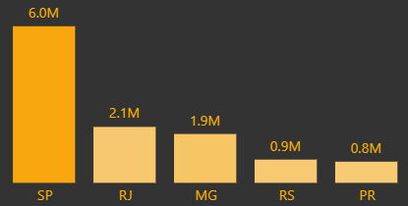
Top performing states
Top 5 market regions base on revenue generation
Accounting over 73% to overall revenue.
Sao Paulo (SP) is the state generating highest revenue of 37.5%.

Slide 9
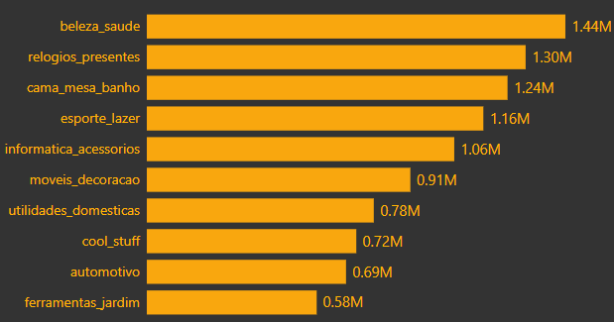
Top performing Categories
Top 10 performing categories.
Accounting over 57% of total revenue.
Top 5 accounts to sales over $1M

Slide 10
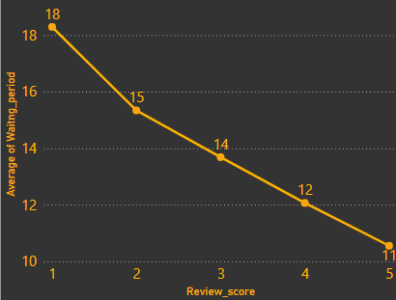
Effect of waiting period on customer rating
Visual represents relation between waiting period and customer satisfaction.
Highest rating is achieved for minimal waiting period.

Slide 11

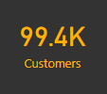
Total orders and unique customer are equal, which means business failed to achieve customer retention.

Slide 12
Conclusion
Top market regions requires more man power to enhance operations and customer satisfaction.
Reduction in waiting period can be considered to enhance customer satisfaction.
Informing partners to stock top category products to reduce waiting period.
Plan marketing activities to retain customers, which will result in developing loyal customers and increase in revenue generation.

Slide 13

Any Questions?

Slide 14
Thank you

