Slide 1


GPS BASED CELL PHONE TRACKING

Slide 2
Phase: 1 Abstract
GPS based Mobile phone tracking is the establishing of the position or location of the lost cell mobile phone. Localization occur via GPS.
In this project we would aim at creating a useful application that can connect remotely to a desktop which can track the location of your phone at any point in time. Also, we will be trying to send the location from the application on the phone to the computer.

Slide 3
Phase: 2 Building the Database
Following steps are followed to build the data base of the system
Identification of the entities.
Creating the entity relationship diagram
Creating the Use-Case Diagrams
Normalizing upto 3NF
E-R-Diagrams
Use CASE Diagrams
Normalizaton upto 3NF

Slide 4

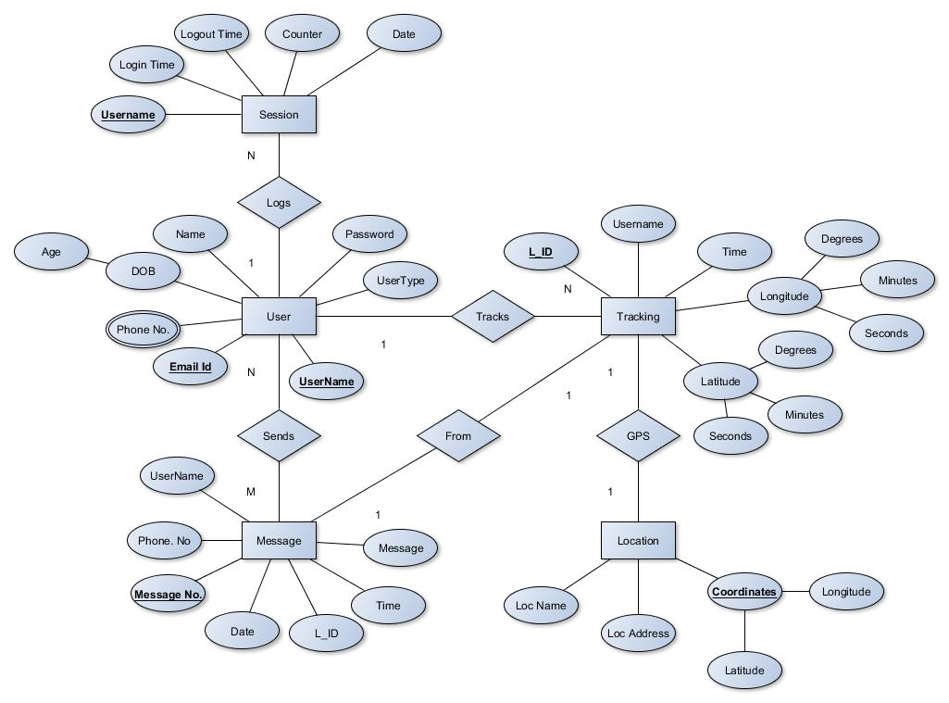
E.R Diagram
Connection of entities of the database

Slide 5
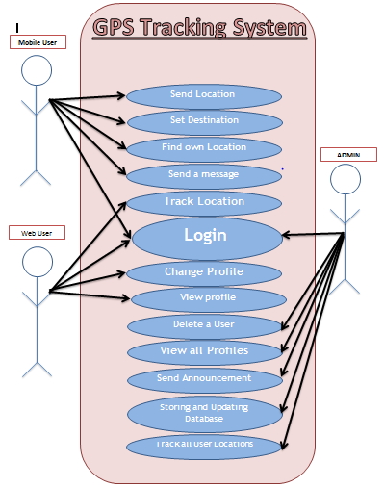
USE-Case diagram
Connection of entities of the database

Slide 6


Phase: 3 BUILDING THE APP
Softwares and Langusges used:
For the client side Scripting,
HTML5 and CSS is used.
For the cell phone app development, Android SDK is used.
For the server side scripting, PHP and Mysql is used. And the MariaDB of the Xampp server is used as the databse.

Slide 7
THE IMPACT
And the further development of the GPS based cell phone tracking

Slide 8
NEED FOR THE APP
The thought of losing or having a smartphone stolen is extremely worrisome to many people because...
.
Personal contacts, photos, videos, apps, emails, text messages smartphones today contain a plethora of personal information
Dependent on Cell phones in maximum situations
One who is missing can be found via GPS based cell phone
tracking

Slide 9
BRIEF EXPLAINATION OF WORKING OF THE APP
Users login to the Website to approach for the help and registering himself/herself in the website to ensure the protection for his/her cell phone.
The Cell phone sends its External IP address in every predefined intervals of time to the server.
The Server-side code finds the Latitude and longitude of the cell phone based on the IP address
The Latitude and the longitude found is used directly to find the location of the cell phone by using the google place Geo locator by using the Google maps’ API KEY.
Thus the Location found is finally displayed on the Google Maps indicating the approximante location of the cell phone

Slide 10
Credits
Special thanks to all the people who involved in organising this Hackathon
Presented by:
Pruthviraj Patil
Nikhilesh Prabakar
Vignesh Mohan
Nishanth T
Ajith S

Slide 11
😉
THANK YOU!
✋👆👉👍👤👦👧👨👩👪💃🏃💑❤😂😉😋😒😭👶😸🐟🍒🍔💣📌📖🔨🎃🎈🎨🏈🏰🌏🔌🔑 and many more...

