Slide 1
TRAFFIC MANAGEMENT SYSTEM (TMS )

Slide 2
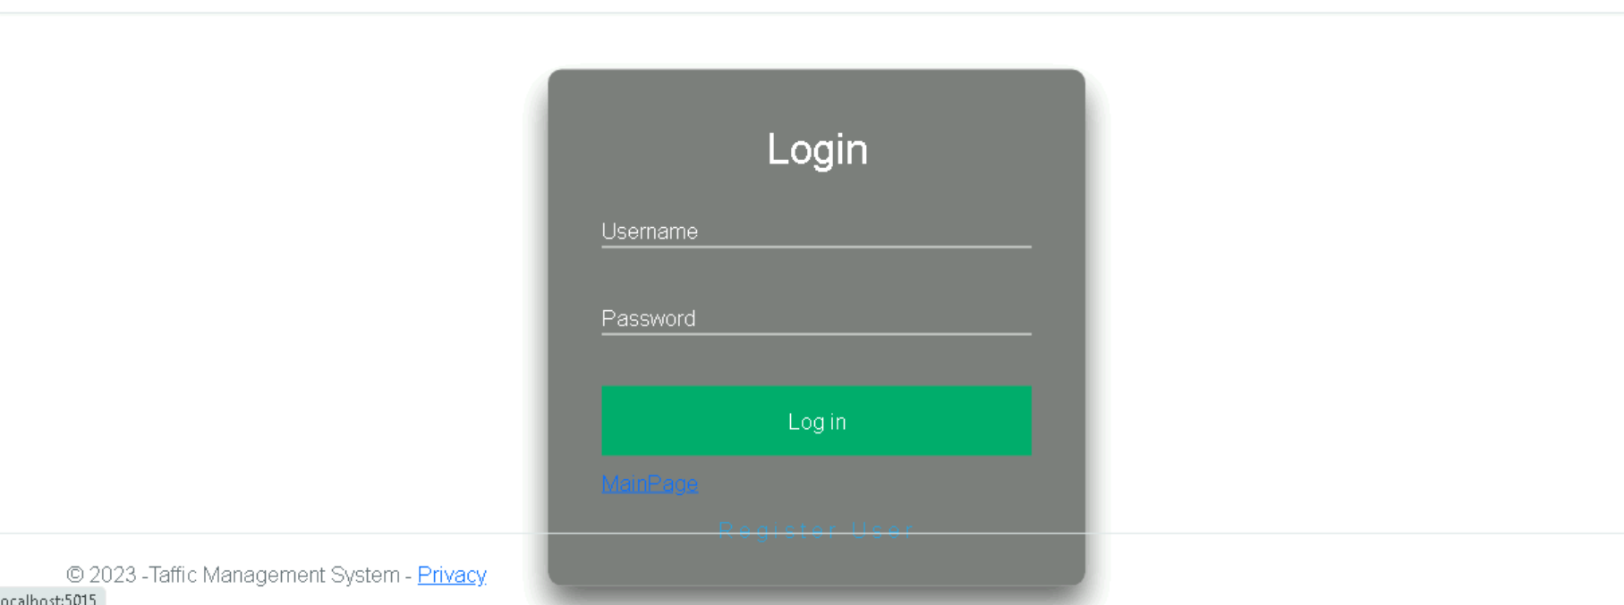
Login Page
To Login provide Username and Password which is already register.

Slide 3

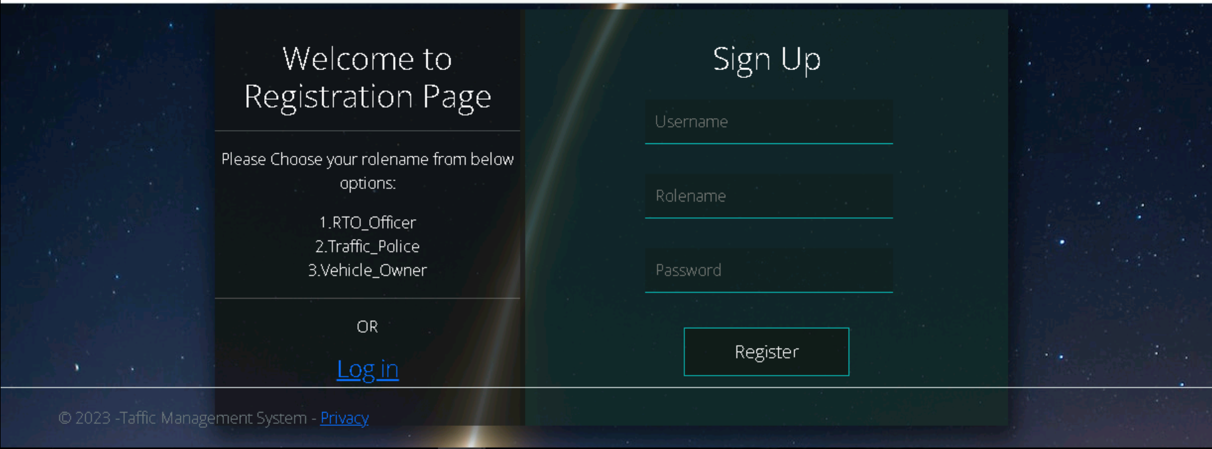
Registration Page
Register the user with desired Username, Password and choose the relevant Rolename .

Slide 4
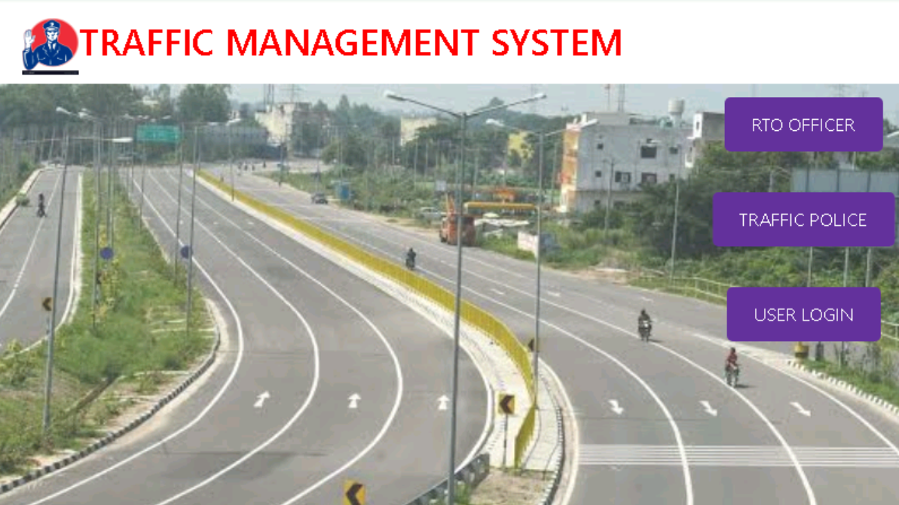
Home page
User(owner)Link
Traffic Police Link
RTO officer Link

Slide 5
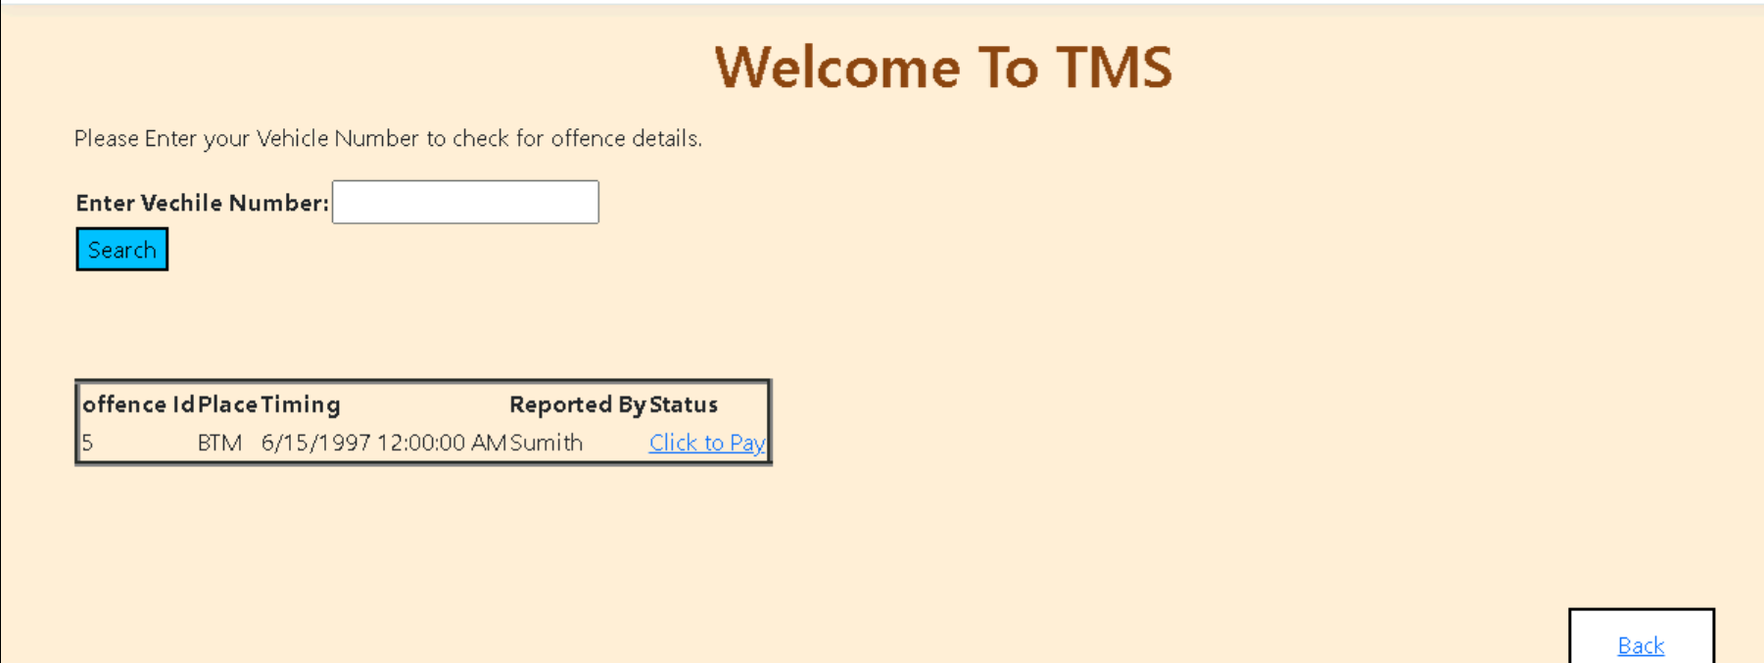
User Link
User should login by providing username and password.
If any Offence is claimed on his vehicle number he should make it as pay.

Slide 6
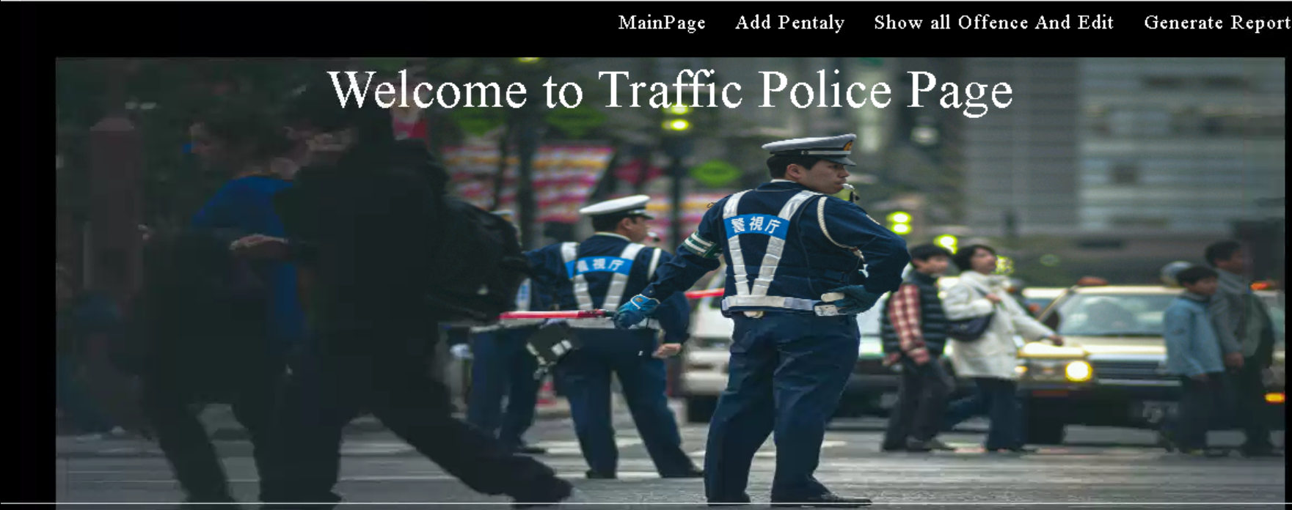
TRAFFIC POLICE Link
Traffic Police Man should be authorised to select a particular vehicle and add the offence details against it.
While adding the offence details the owner's details should also be displayed.
When the appropriate fine is paid the traffic police department should clear the offence by marking it paid.
The offence report generated only by commissioner will contain the complete offence history against a particular vehicle with its owner details.

Slide 7
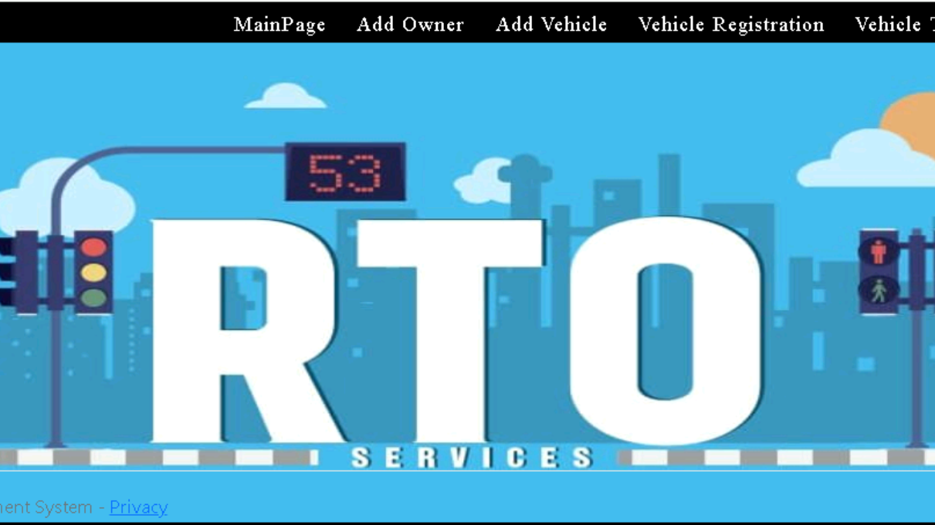
RTO officer Link
Data should be mapped to the database by RTO officer regarding information about new vehicle, old and new owner (in case of transfer of vehicle ownership) or scrapped vehicle.
RTO should be informed about the offence so that the vehicle is ceased.
The RTO report generated by RTO officer will contain details of owner and vehicle.

