Slide 1
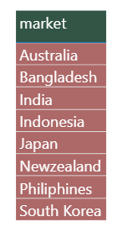
Q1. Provide the list of markets in which customer "Atliq Exclusive" operates its business in the APAC region.

Slide 2

Q2. What is the percentage of unique product increase in 2021 vs. 2020? The final output contains these fields, 1) unique_products_2020, 2) unique_products_2021 3) percentage_chg

Slide 3
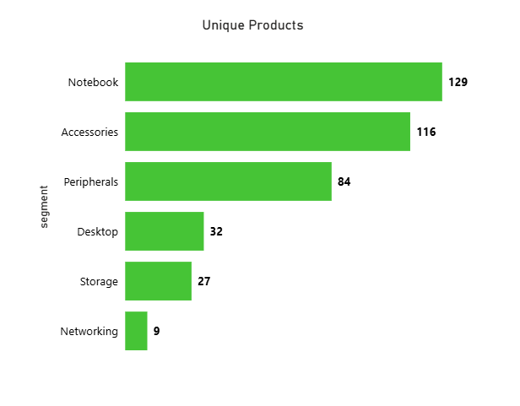
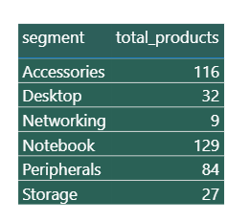
Q3. Provide a report with all the unique product counts for each segment and sort them in descending order of product counts. The final output contains 2 fields 1) segment 2) product_count

Slide 4
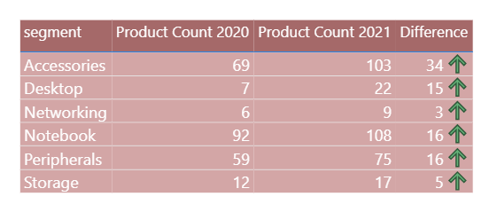
Q4. Which segment had the most increase in unique products in 2021 vs 2020? The final output contains these fields 1) segment 2) product_count_2020 3) product_count_20 4) difference

Slide 5
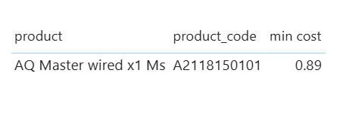
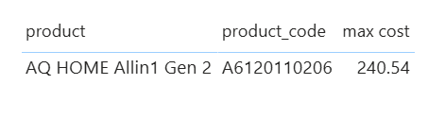
Q5. Get the products that have the highest and lowest manufacturing costs. The final output should contain these fields, 1) product_code 2) product 3) manufacturing_cost

Slide 6
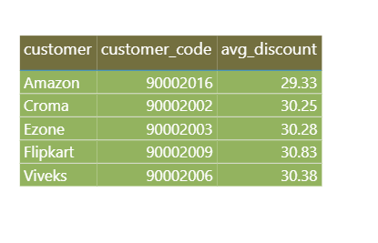
Q6. Generate a report which contains the top 5 customers who received an average high pre_invoice_discount_pct for the fiscal year 2021 and in the Indian market. The final output contains these fields, 1) customer_code 2) customer 3) average_discount_percentage

Slide 7
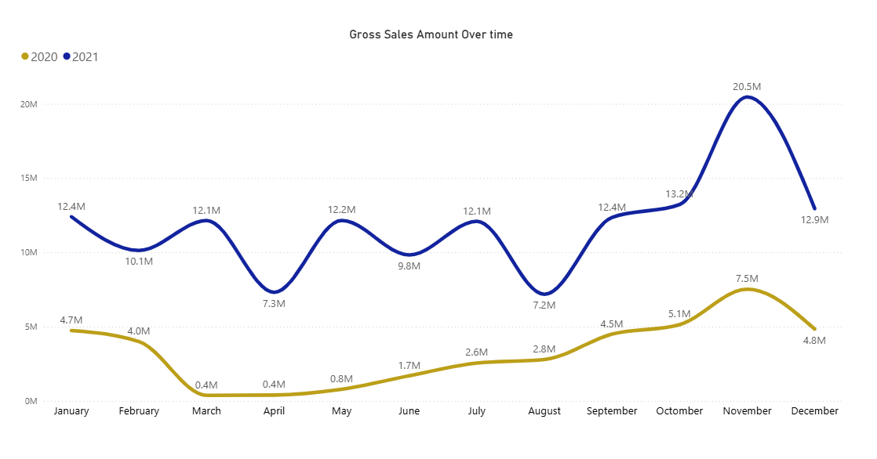
Q7. Get the complete report of the Gross sales amount for the customer “Atliq Exclusive” for each month. This analysis helps to get an idea of low and high-performing months and take strategic decisions. The final report contains these columns 1) Month 2) Year 3) Gross sales Amount

Slide 8
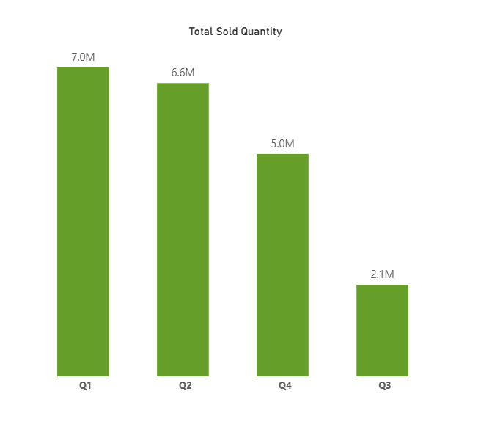
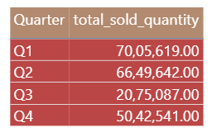
Q8. In which quarter of 2020, got the maximum total_sold_quantity? The final output contains these fields sorted by the total_sold_quantity 1) Quarter 2) total_sold_quantity

Slide 9
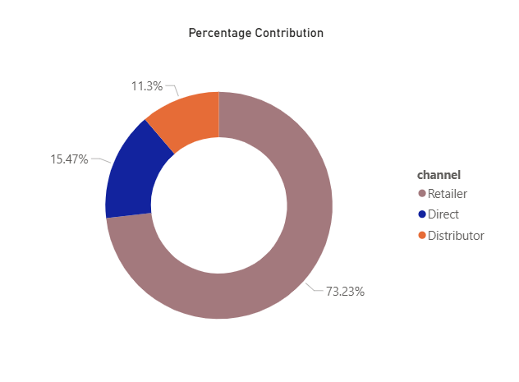
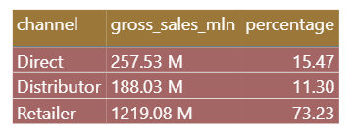
Q9. Which channel helped to bring more gross sales in the fiscal year 2021 and the percentage of contribution? The final output contains these fields 1) channel 2) gross_sales_mln 3) percentage

Slide 10
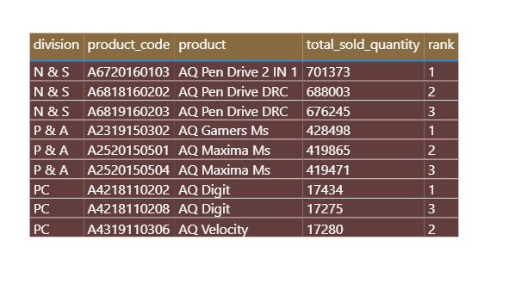
Q10. Get the Top 3 products in each division that have a hightotal_sold_quantity in the fiscal_year 2021? The final output contains these fields 1) division 2) product_code 3) product 4) total_sold_quantity 4) rank_order

