Slide 1
UE17CS303
Machine Learning
Harish P B PES1201701435
Pruthvish Eshwar PES1201701629
Ashrith Sridhar PES1201700649

Slide 2
Data Preprocessing
Dropped education column
Statistical Imputation with mean, median and mode
Divide the dataset into two dataframes based on label and perform the imputation on each dataframe and then concatenate the dataframes
Replace nan values with median in case of skewed data
Replace nan values with mean otherwise
Replace nan values with mode in case of categorical attributes

Slide 3
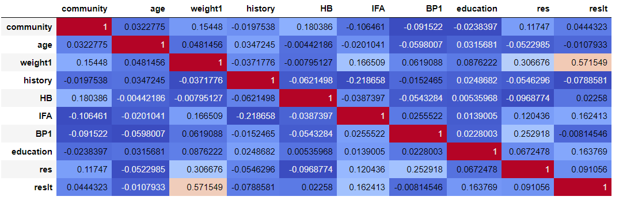
Choosing a Model
Weighted K- nearest neighbours
Assumes that similar things exist in close proximity
Elbow point k = 6
Weighing the features based on their correlation with the result

Slide 4
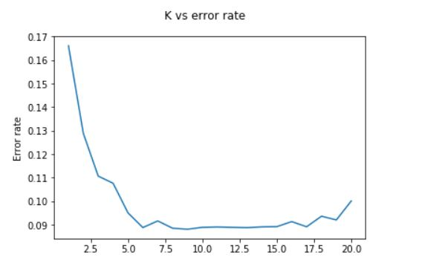
Choosing best value of k

Slide 5
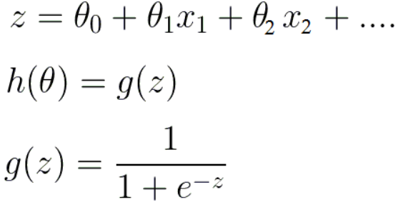
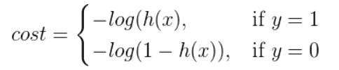
2. Logistic Regression
Logistic Regression is used when the dependent variable is categorical
Hypothesis for logistic regression -
Cost function -

Slide 6
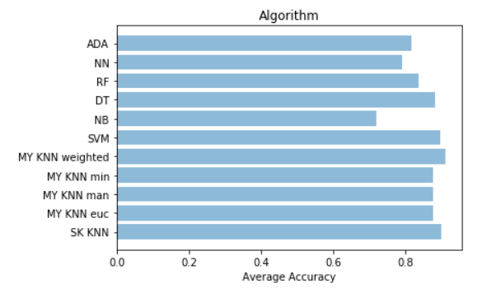
Comparison of classification models

Slide 7
Bagging
Combining various models to get better accuracy here we are using different neighbours to arrive at a better accuracy.

