Slide 1
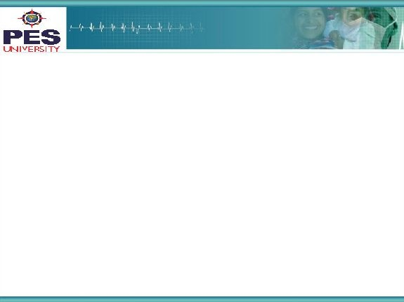

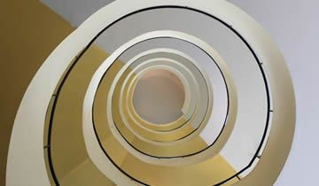
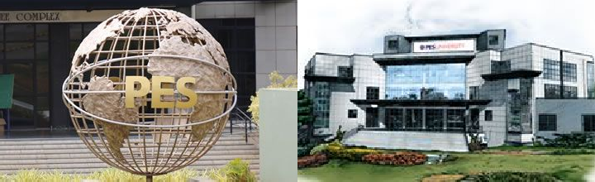
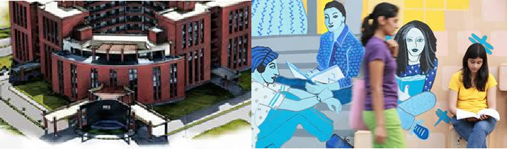

Project Presentation
(Final - ESA)
Project Title
: Self Driving Car Simulation
Project Team : Pruthvish E PES1201701629
Ashrith Sridhar PES1201700649
R Ananth PES1201700286

Slide 2
Project Abstract and Scope
Autonomous navigation and self driving cars are extensively researched and deep learning plays a crucial role in this area.
A self-driving car, also known as an autonomous vehicle, is a vehicle that is capable of sensing its environment and moving safely with little or no human input.
Controlling the steering wheel is one of the most important tasks while driving.
In our project we built a model using CNN that predicts the angle of the steering wheel while driving.
Based on only the image of the surrounding environment our model will predict the steering angle of wheel and simulates the steering wheel action in a real time test dataset of frames of images or videos.
Why have we chosen this problem
Positioning the steering wheel at exact angles in real time environment needs a lot of practice and should be completely accurate with very less margin of error as a lot of life's depend on it, so we chose this problem to accurately predict the steering angle in real time environment.

Slide 3
Project Scope -2
What is unique about our solution
Our CNN model is able to learn the entire task of lane and road following without manual decomposition into road or lane marking detection, semantic abstraction, path planning, and control. The system learns for example to detect the outline of a road without the need of explicit labels during training.
Our CNN is able to learn meaningful road features from a very sparse training signal from steering angle alone.
Comparisons of your solution with any other solutions existing
Our model learns to predict the steering angles with very little margin of error in just 30 epochs compared to other methods like reinforcement learning and sequential models like RNNs and LSTMs.
Our model compared to other CNN models attains convergence quicker as our model works on reduced dimensions of the variables and features and is more robust and predicts the steering angle accurately even when tested on other terrain and conditions of the environment (road).
3

Slide 4
Solution Architecture
Input Images
Preprocessing of the input image ,feature selection and resizing the image.
Segregating the images to train and validation sets
Preprocessed Image
Validation sample in batches
Training sample in batches
Validation of the learned weights and calculating MSE loss which is L2 normalized
CNN model
Initialized with truncated normal weights
Backpropagation
Adam optimizer
new learned weights
Loss

Slide 5
Solution-1
Algorithm
a) preprocessing : preprocessing of the image is done by cropping the top portion of the image, the sky as it does not contribute much to our steering angle and the processed image is resized to just 120*40*3.
b)Splitting the dataset to training and validation sets in the ratio 80:20.
c) CNN model
Convolutional layer 1
Convolutional layer 2
Input
40*120*3
Hidden-conv-1
19*59*24
Hidden-conv-2
8*28*36
Conv2d(S=2)+
relu
Filter-1
4*4*3*24
output
Conv2d(S=2)+
relu
Filter-2
4*4*24*36
output
Conv2d(S=1)+
relu
Filter-3
3*3*36*48
output
Convolutional layer 3
Hidden-conv-5
2*22*64
Hidden-conv-4
4*24*64
Hidden-conv-3
6*26*48
Filter-6
2*2*64*64
Conv2d(S=1)+
relu
output
Filter-5
3*3*64*64
Conv2d(S=1)+
relu
output
Filter-4
3*3*48*64
Conv2d(S=1+
relu
output
Convolutional layer 5
Convolutional layer 4
Convolutional layer 6

Slide 6
Solution-2
1*1344
1344
*
1500
1500
*
100
100
*
50
Hidden-conv-6
1*21*64
flatten
Matmul + relu
Matmul + relu
Matmul + relu
Fully-connected layer-3 50 neurons
Fully-connected layer-1 1500 neurons
Fully-connected layer-2 100 neurons
Matmul
+
relu
10
*
1
50
*
10
Y(output)
1
Matmul + atan
Fully-connected layer-4 10 neurons
Output(between –pi to pi)

Slide 7
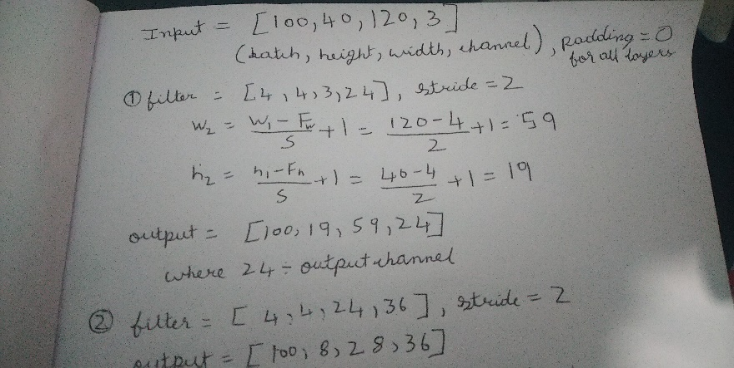
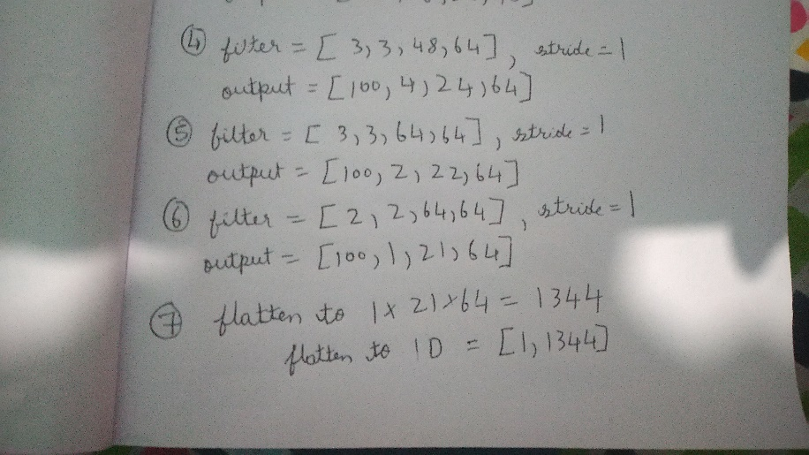
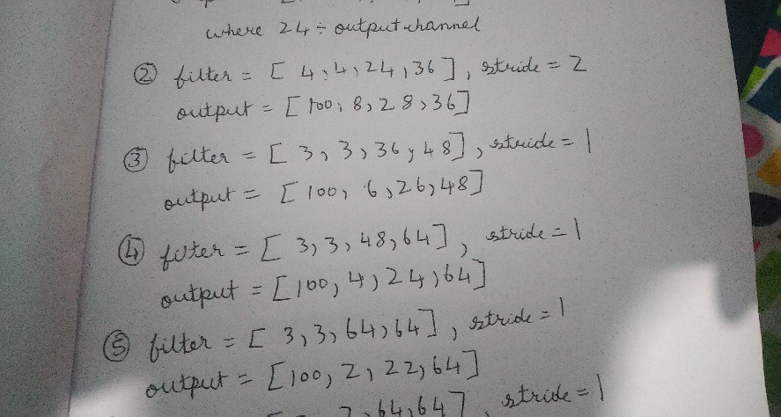
Solution-3
d)Backpropagation : using Adam optimizer and loss function as MSE with L2 normalization.
2)Math

Slide 8
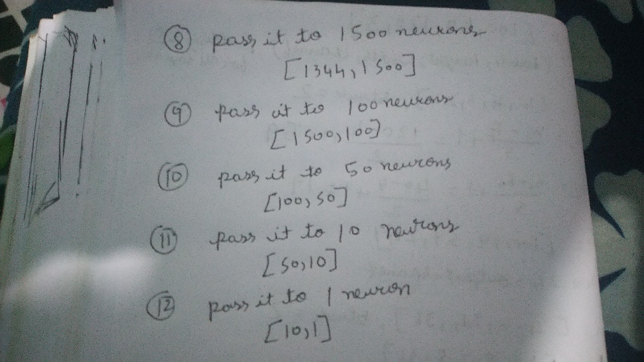
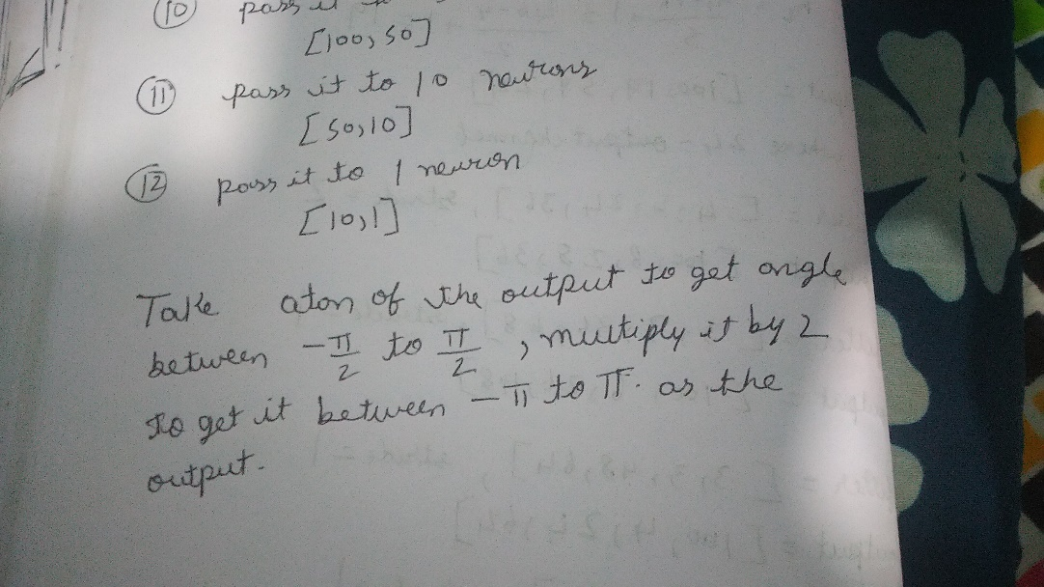
Solution-4
3)Testing Carried out
Our model was trained with a dataset of the roads of California and was tested in the roads of India under various circumstances like sudden obstacles in the way, the model does a good job predicting the steering angles.

Slide 9
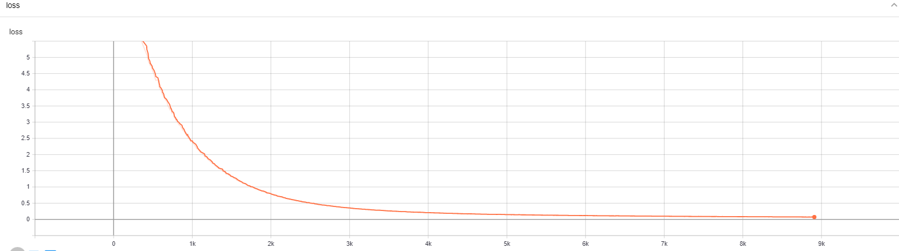
Solution-4
Loss vs epoch
4)Criteria for declaring our solution good
Our has a high accuracy ~95% , we trained our model on the images of California roads and tested it on the roads of Indian.
Our model performs better and attains convergence quicker than the one on https://arxiv.org/pdf/1604.07316.pdf

Slide 10
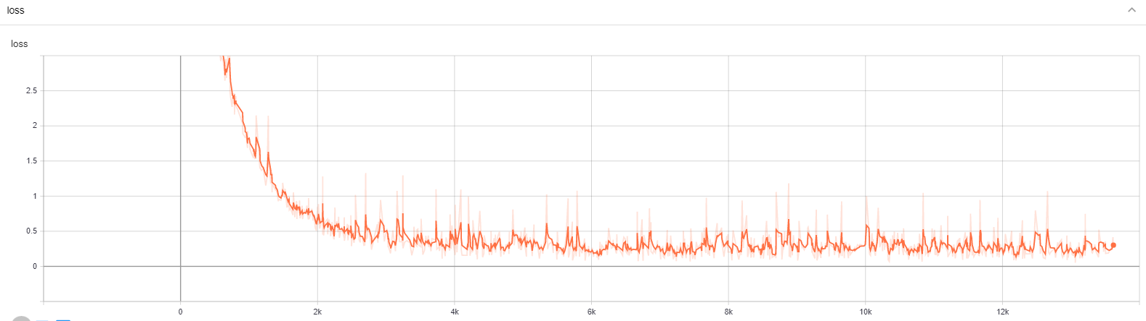
Solution-4
Model loss on the one implemented in the paper.
Time for Convergence on the same system :
Our model : 1 hr 37 min
Nvidia’s model : 2 hrs 42 min

Slide 11
Constraints, Assumptions & Dependencies
Constraints
Steering angle should be predicted from only a single image of the present surrounding , irrespective of the car’s history.
Assumptions
Image feed to the network should be taken from the center of the car’s present location.(camera attached to the center of the car).
Dependencies
TensorFlow
cv2
scipy

Slide 12
Future work plan
To train our model to predict with high accuracy the acceleration and braking required to autonomously drive the car with complete safety.
To use history of the previous decisions made to make the present decision , which will be useful when integrating steering angle with acceleration and braking.

Slide 13
References
[1] Mariusz Bojarski, Davide Del Testa, Daniel Dworakowski, Bernhard Firner, Beat Flepp, Prasoon Goyal, Lawrence D. Jackel, Mathew Monfort, Urs Muller, Jiakai Zhang, Xin Zhang, Jake Zhao, Karol Zieba. End to End Learning for Self-Driving Cars , 25 Apr 2016.
URL: https://arxiv.org/pdf/1604.07316.pdf.
[2] https://medium.com/@maxdeutsch/how-to-build-a-self-driving-car-in-one-month-d52df48f5b07
[3] https://github.com/SullyChen/Autopilot-TensorFlow

Slide 14
Thank You

