Slide 1

CHAITANYA
(DEEMED TO BE UNIVERSITY)
Department of computer Science
AI POWERED RESUME BUILDER AND ANALYZER
UNDER THE GUIDANCE OF
E. VARNIKA
Assistant professor
TEAM MEMBERS
T. ABHINAYA (122107103)
N. SUMANTH (122107104)
B. PRUTVIRAJ (122107111)
V. SHIVANI (122107151)

Slide 2
CONTENTS
Abstract
Introduction
Existing system
Proposed system
System requirments
System design
Technologies used
Acknowledgments
Scope of the project
Output
Advantages & Disadvantages
Future enhancements
Conclusion

Slide 3
Abstract
The AI-powered Resume Builder and Analyzer is a cutting-edge software application designed to assist job seekers in creating optimized resumes and analyzing existing ones.
The builder enables users to input their personal details, education, work experience, skills, certifications, and other relevant data in a structured format.
The system builds the resume based on the data provided by the user. The system will automatically populate these with the user’s data, ensuring a polished and consistent look
The system analyses the uploaded resume and gives the feedback in the form of rating out of 10 and gives suggestions based on the skill set.
This AI-powered resume builder and analyzer is built by using technologies HTML5, CSS3, JavaScript (ES6+) for frontend and Node.js , Express.js , JsON for backend .

Slide 4
INTRODUCTION
In today’s fast-paced and competitive job market, a well-crafted resume is a critical tool in securing employment opportunities. However, many job seekers find it challenging to create a resume that effectively highlights their skills, experience, and qualifications while adhering to industry standards and expectations. The task of formatting a resume, ensuring the correct use of keywords, and presenting achievements in a compelling manner can be time-consuming and often requires significant trial and error.
By using the AI-powered Resume Builder and Analyzer, job seekers can greatly improve their chances of standing out in a crowded job market. The tool eliminates much of the guesswork in resume writing, making it easier to create a document that not only highlights a candidate’s qualifications but also appeals to modern hiring algorithms used by many companies.
This tool represents a significant advancement in the way job seekers approach resume writing, empowering them to present themselves more effectively and confidently in the job market.

Slide 5
EXISTING SYSTEM
The existing system is manual resume builder and analysis. Job seekers create resumes manually using word processing software like Microsoft Word or Google Docs. Hiring managers and recruiters manually review resumes to identify relevant skills, experience, and qualifications. Manual resume writing and analysis are time-consuming and labor-intensive. Resumes are often unstructured and lack standardization, making it difficult for hiring managers to compare candidates. Manual resume analysis can be prone to bias and inaccuracy, leading to qualified candidates being overlooked. Job seekers often receive limited feedback on their resumes, making it difficult to improve.
Disadvantages of existing System:
• Time consuming and labor intensive
• Lack of standardization
• Prone to Bias and Inaccuracy
• Limited feedback for job seekers
• Inconsistent quality and content

Slide 6
PROPOSED SYSTEM
The AI-Powered Resume Builder and Analyzer is designed to address the limitations and inefficiencies of the existing manual system.
The AI-Powered Resume Builder will offer a guided, user-friendly platform to help job seekers create personalized resume.
Users can preview their resume in real-time and download it once it is complete.
The AI-Powered Resume Analyzer will analyze the resume and gives feedback according to the skillset mentioned in the resume
key features of the proposed system:
*User Authentication: Secure login and registration system to personalize user experience.
*Resume Templates: A variety of professionally designed templates to choose from.
*Real-time Preview: Instant preview of the resume as users fill in their details.
*PDF Export: Generate and download resumes in PDF format.
*Responsive Design: Optimized for both desktop and mobile devices.
*Resume Analysis: Provides feedback and suggestions to improve resume content.

Slide 7
SYSTEM REQUIRMENTS SPECIFICATIONS
HARDWARE REQUIRMENTS :
Device : HP PAVILLION
Processor : 12th Gen Intel(R) Core i5
Hard Disk : 512 GB
Ram : 16GB
SOFTWARE REQUIRMENTS :
Operating System : Windows 11 (64-bit OS)
Frontend : HTML, CSS, Javascript,
Backend : Node.js, Express.js
Database : MangoDB
Web Browser : Chrome
Code Editor : VS Code

Slide 8
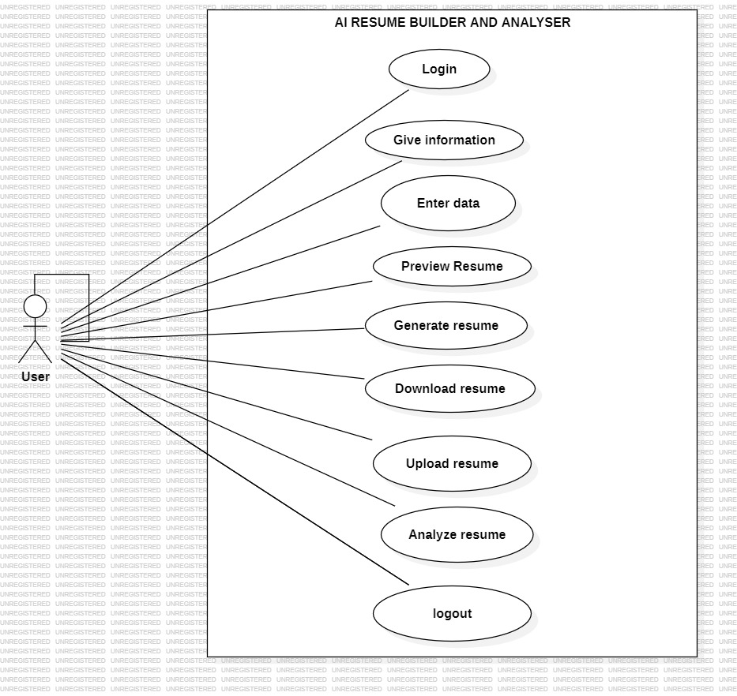
SYSTEM DESIGNS
Use case diagram :

Slide 9
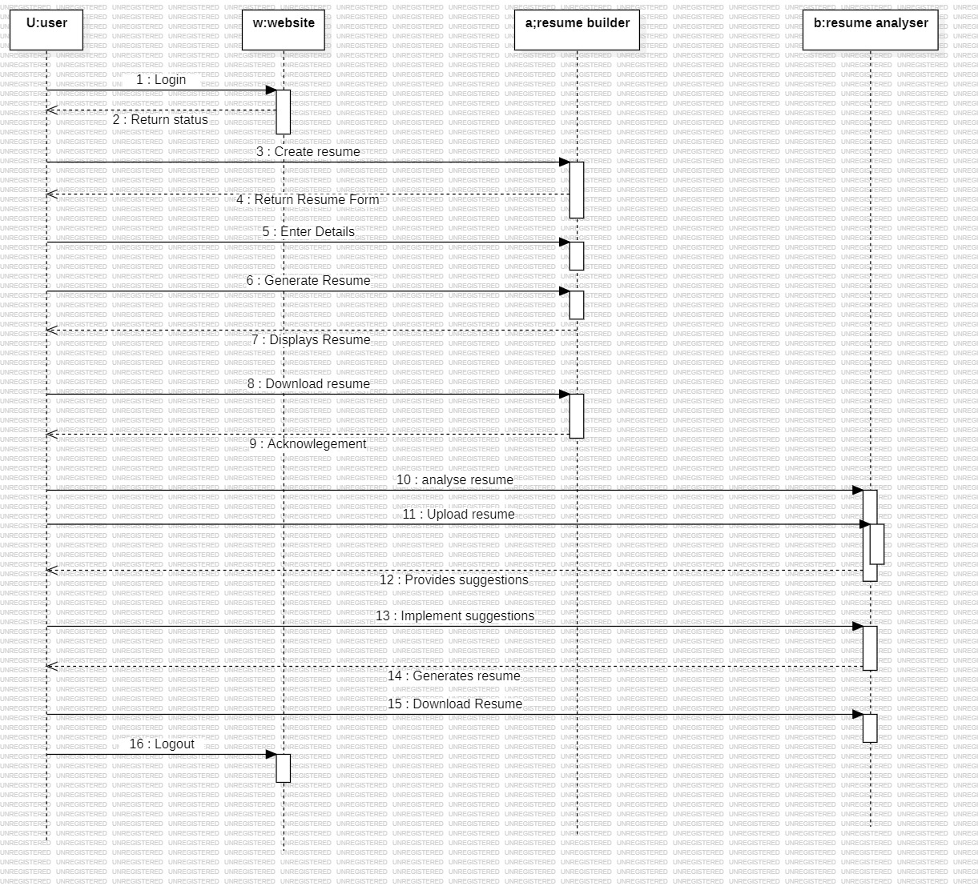
Sequence diagram :

Slide 10
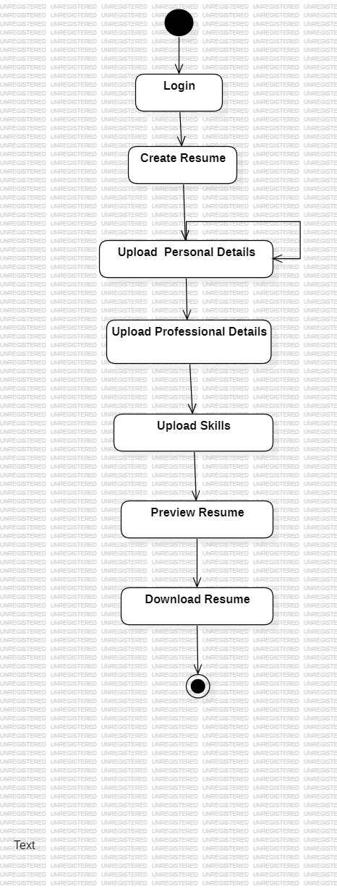
Activity diagram :

Slide 11
TECHNOLOGIES USED IN FRONTEND
HTML:
• HTML (HyperText Markup Language) is the standard language used to create and structure content on the web.
• It consists of a series of elements (tags) that define the structure and layout of web pages, such as headings, paragraphs, images, links, and forms.
• HTML provides the basic building blocks for web content, while CSS is used to style the content and JavaScript adds interactivity.

Slide 12
CSS:
• CSS (Cascading Style Sheets) is a stylesheet language used to control the look and feel of a web page.
• It allows you to style HTML elements by defining properties such as colors, fonts, spacing, and layout. CSS helps separate the structure (HTML) from the design, making web development more efficient.
• CSS is used to style the structure of web pages defined by HTML. It controls the presentation of elements on a page, such as layout, colors, fonts, spacing, and positioning.
Advantages of CSS:
Separation of Content and Design: CSS separates the content (HTML) from the presentation (style), making it easier to maintain and update the design without changing the HTML structure.
Faster Load Time: Since the style is stored in separate CSS files, browsers can cache these files, reducing the amount of data that needs to be downloaded on subsequent page visits, speeding up page loading.
Better Page Structure: CSS enhances the ability to create clean, organized, and structured layouts that are easier to manage and scale.

Slide 13
JAVASCRIPT:
JavaScript is a high-level, dynamic programming language primarily used to add interactivity and functionality to websites.
It runs in the browser, enabling web pages to respond to user actions, manipulate content, and interact with external data without reloading the entire page.
JavaScript is mainly used for client-side scripting, meaning it runs in the user's browser.
It allows you to create interactive web pages, such as forms that validate user input, dynamic content updates, and animation

Slide 14
TECHNOLOGIES USED IN BACKEND
Node.js:
Node.js is used to build web servers. Using the built-in http module, you can create a server that listens for incoming HTTP requests and responds with the necessary data.
Node.js is often used alongside frameworks like Express.js to handle routing, making it easy to map URLs to different backend logic. Express simplifies the process of creating routes, handling request methods (GET, POST, PUT, DELETE), and managing responses.
It consists of the package JSON (JavaScript Object Notation).
Express.js:
Express.js is a lightweight and flexible Node.js web application framework designed to build backend applications, including web servers and APIs. It is one of the most popular frameworks for Node.js, as it simplifies and streamlines the process of creating server-side applications.
Express makes routing simple by allowing you to define routes based on the HTTP request type (GET, POST, PUT, DELETE, etc.).
MongoDB:
It is widely used in web development, especially when working with Node.js and frameworks like Express.js. MongoDB is highly scalable, flexible, and well-suited for applications that require handling large amounts of unstructured or semi-structured data.

Slide 15
ACKNOWLEDGEMENTS
The VS Codes: For the development and maintenance of this project.
HTML&CSS: For creating and designing the web application.
Node.js & Express.js: For backend development.
MongoDB: For database solutions

Slide 16
SCOPE OF THE PROJECT
Generate customized resumes
Analyze existing resumes
Provide suggestions for skill optimization
Section customization
Easy-to-use Interface
Time saving
Personalized feedback

Slide 17
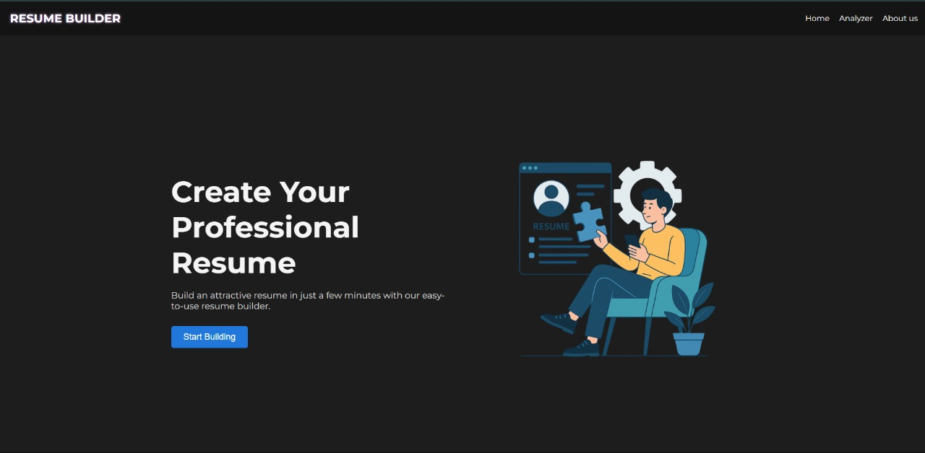
OUTPUT:
HOME PAGE

Slide 18
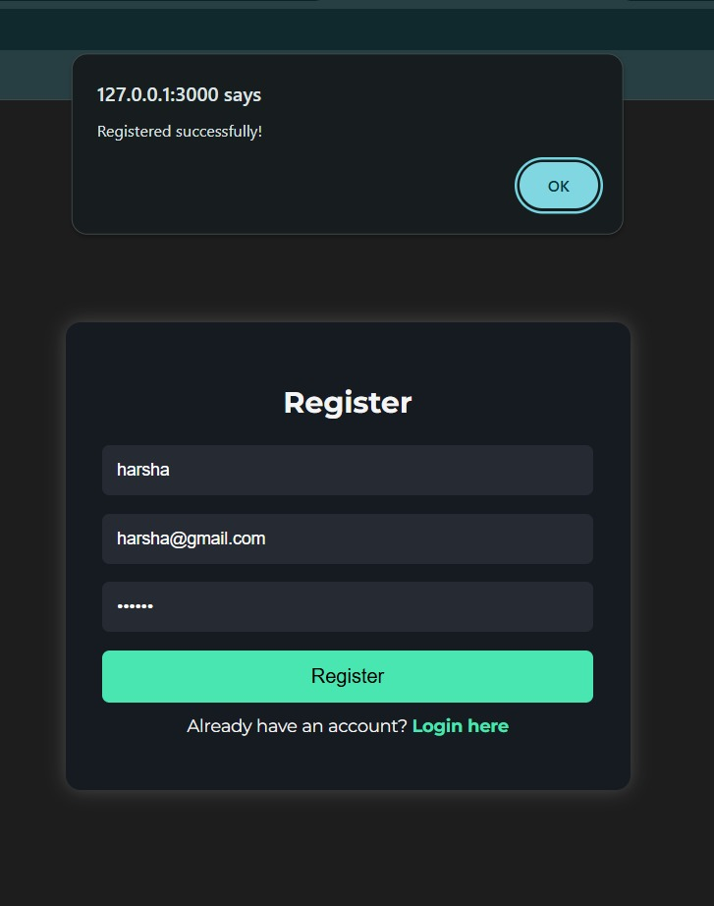
REGISTER PAGE

Slide 19
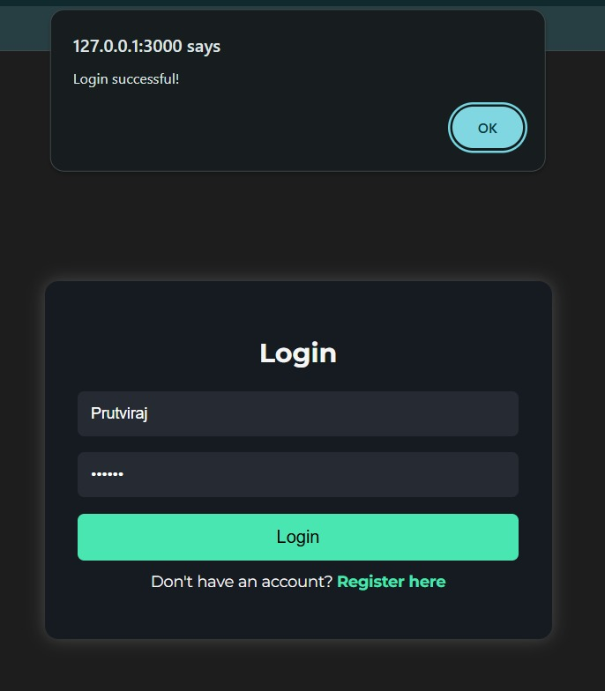
LOGIN PAGE

Slide 20
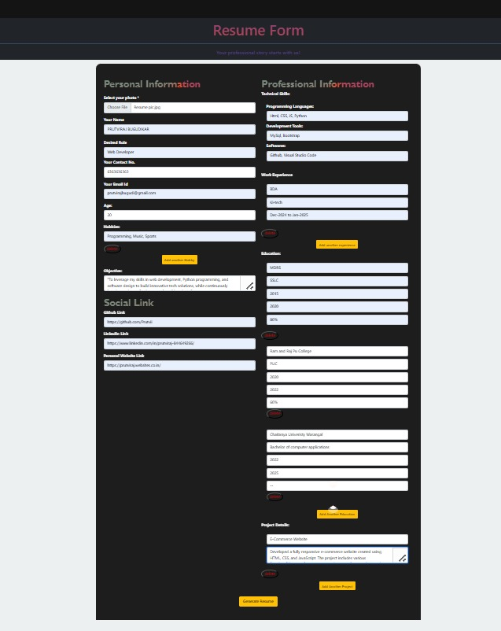
RESUME BUILDER

Slide 21
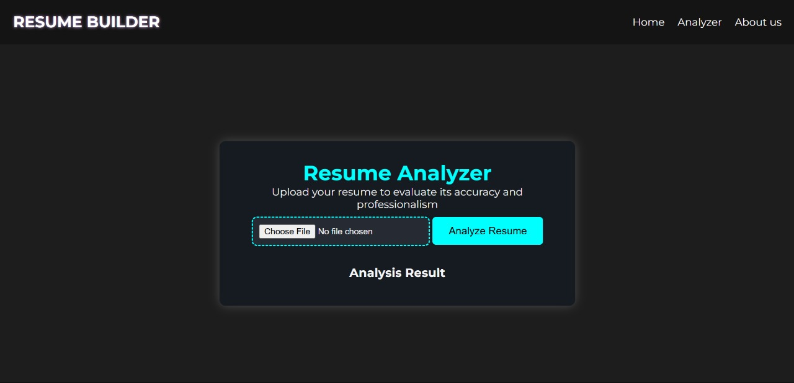
RESUME ANALYZER

Slide 22
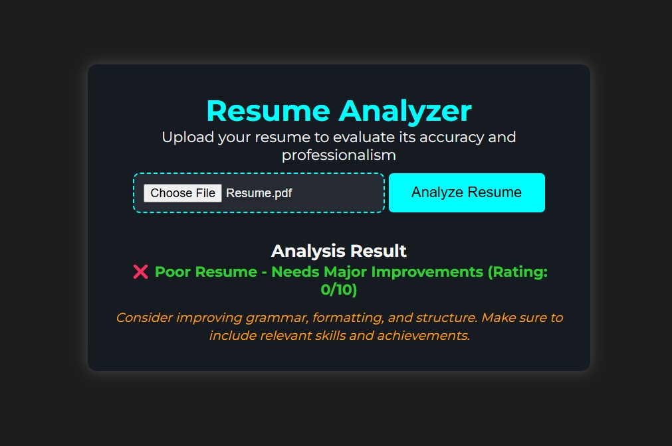

Slide 23
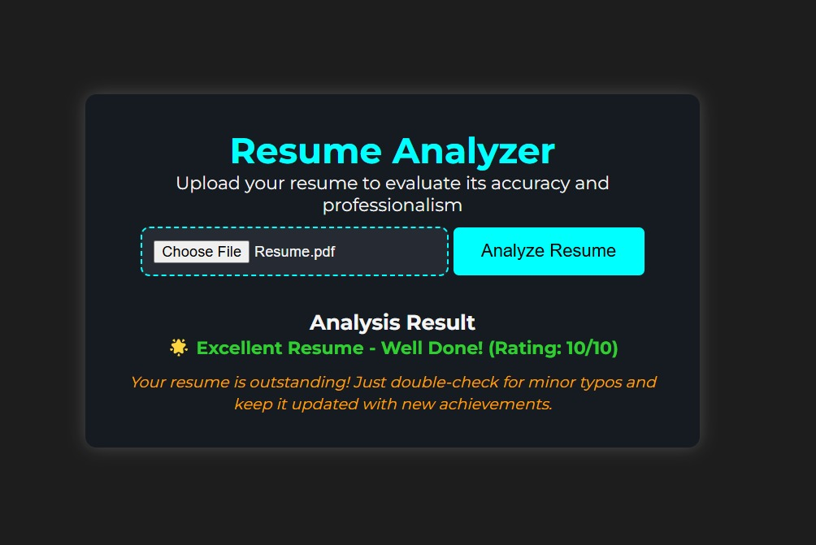

Slide 24
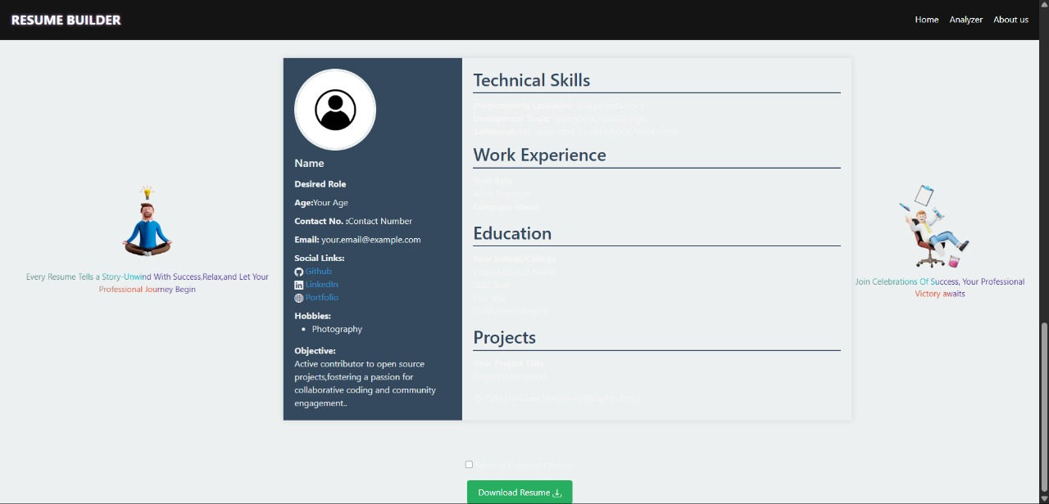
RESUME GENERATOR

Slide 25
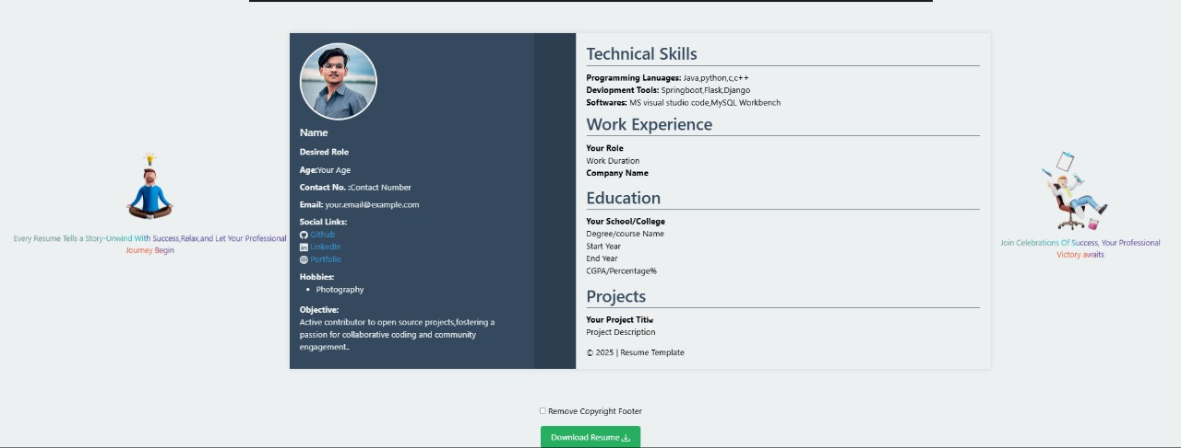

Slide 26
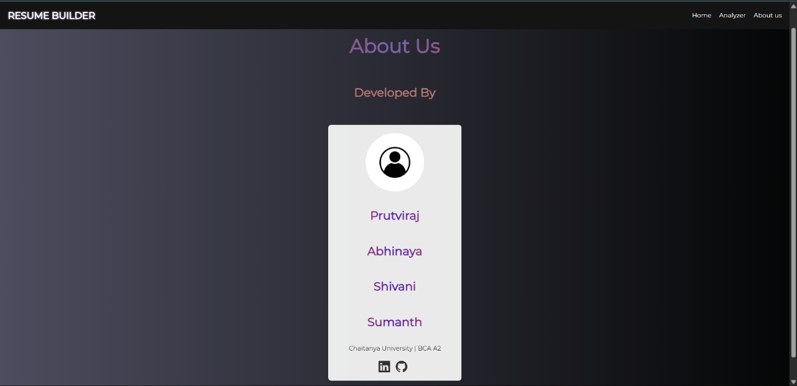
ABOUT US

Slide 27
ADVANTAGES
Faster Resume Creation: With pre-built templates and auto-filled sections, users can quickly create professional resumes without spending hours on formatting.
Instant Feedback: The real-time resume analyzer provides instant feedback, allowing users to make corrections and improvements instantly, saving time compared to traditional methods of revising resumes manually.
User-Friendly Interface: The application is designed to be intuitive, allowing even those with little technical knowledge to create and improve resumes effortlessly.
Guided Process: The step-by-step process in the resume builder ensures users know exactly what information to provide, making resume creation less intimidating for new job seekers.
Grammar and Language Check: The AI-powered analyzer can detect grammatical errors, awkward phrasing, and passive voice, ensuring that resumes are polished and professional.

Slide 28
DISADVANTAGES
Lack of Human Insight: While AI can analyze resumes based on data and patterns, it may not fully understand the context or nuance of a user’s experiences, leading to recommendations that might not perfectly align with a user’s career goals or unique professional experiences.
Generic Advice:.The recommendations might not be tailored enough to suit unique personal branding or career objectives.
Decreased Human Touch: While AI can suggest improvements, a resume is ultimately a personal document that reflects an individual’s experiences, strengths, and aspirations. Relying too much on AI might make the resume feel too mechanical or impersonal, potentially reducing its effectiveness.
Inability to Capture Soft Skills: AI may struggle to evaluate or recommend changes related to softer aspects like communication skills, leadership qualities, or creativity, which are crucial for certain job roles and can make a resume more compelling.

Slide 29
FUTURE ENHANCEMENTS
Future enhancements for an AI-powered resume builder and analyzer could focus on improving user experience, increasing accuracy, and adding advanced features to better match resumes with job requirements. Here are some potential enhancements:
• Advanced Data Analytics and Reporting
• Behavioral and Personality Insights
• Advanced Interview Preparation Features
• AI-Powered Career Coaching
• Cloud-Based and Collaborative Features

Slide 30
CONCLUSION
In conclusion, an AI-powered resume builder and analyzer represents a significant advancement in job application processes, offering numerous benefits for both job seekers and recruiters. By leveraging AI's capabilities, such tools can optimize resume creation, ensuring that it is tailored to the specific job description, industry standards, and recruitment algorithms.
For job seekers, this means faster, more efficient resume crafting, personalized suggestions for improvement, and increased chances of getting noticed by employers. For recruiters, AI-driven analysis ensures that candidates' qualifications are accurately assessed, streamlining the process.
Ultimately, the integration of AI in resume building and analysis not only enhances the quality of resumes but also improves the overall recruitment experience. As the job market becomes more competitive, AI will continue to be an essential tool for bridging the gap between job seekers and employers, ensuring a more effective, data-driven approach to recruitment.

Slide 31


