Slide 1
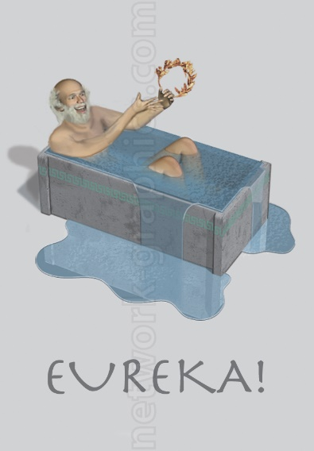



How I’ve Grown
Wait, this is awesome…
No, I’m awesome!
What the?
What have I done?!

Slide 2
Overview
Exercise Selection
I have selected the following exercises for evaluation:
Module 1, Exercise 1
Module 2, Exercise 4
Module 3, Exercise 3
Module 4, Exercise 8
Module 5, Exercise 1
Additional Work
I have also included work that I did for another class. Please consider using my paper for HIST2803 as further evidence of my commitment to data visualization as historical method.
Close Read of the text to determine dates.
Gantt Chart to express events over time.
Word Cloud to get a high level feel for subject’s mind and concerns.

Slide 3
Module 01 Exercise 01
Stated Purpose of the Module and Exercise
Learn how to use GitHub.
Use online tools for collaboration.
Set up a home base online.
Establish a workflow for publishing research on the web.
Initial Skillset
I had literally never heard of version control software prior to beginning this project. I had a very difficult time understanding it at first. I needed to schedule time with the professor just to understand the nature of GitHub.
I had never owned or administered my own website before. My social media skills were limited to having a sparingly used Facebook account.
My collaboration in workgroups has always involved plenty of face to face meetings, phone calls, and project management documents.
I have a lot of experience setting up and documenting work flows.

Slide 4
Module 01 Exercise 01
Observations of the Exercise
Learning Markdown was overall a useful exercise and easy to learn.
In principle, I agree that simple text files are the best way to store information long term.
The use of GitHub contradicts the principle of continuity of data, however. GitHub is managed by a third party, susceptible to data loss from version upgrades to GitHub, or to the host organization going out of business. Nothing lasts forever!
I did not purchase and create my own domain name, though I would very much have liked to. Firstly, it seemed surplus to requirements (based on discussions with Professor Graham). Secondly, I have to be very careful about my online activities as they can be monitored by my employer and financial regulatory bodies. I would have to disclose ownership of such a website to them. The hassle that this would represent simply wasn’t worth the effort.
Discussion about how one of the “true” purposes of the exercise was to learn how to take control of one’s online identity, or “brand” as a marketer might call it, was not revealed until the final lecture of the module, after I had already completed all of the exercises. Knowing this up front would have effected how I completed the exercises.

Slide 5
Module 01 Exercise 01
How I’ve Grown
The importance of gaining control of my online “brand” has been impressed upon me. I intend to do a far more thorough job of this going forward. Integrating the message across all social media for the presentation of a consistent image will be a priority for me over the next few months. I have been made aware of the existence of certain important sites such as www.academia.edu that would need to be integrated into this effort.
The fact that I have a Github page which is relatively well organized and documented should speak to my growth here. I have gone from not knowing what version control was to having a well organized and documented repository on GitHub.
My integration of graphics with mouse-over-text (for example on the “Who We Are” page) is something that I was not capable of doing prior to the beginning of the course.

Slide 6
Module 02 Exercise 04
Stated Purpose of the Module and Exercise
How to use wget to pull data and documents from web pages.
Learn how to webscrape.
Introduction to APIs.
Grab social media data.
Exercise 4 was employing the wget command.
Initial Skillset
I have previous experience manipulating large amounts of data in csv formats, and in using Microsoft Access to link and join large datasets.
I have previous experience using command line interface, but not in UNIX.
I had no previous experience with creating or capturing large amounts of data from the web. I have always had my datasets given to me in pre-defined formats.

Slide 7
Module 02 Exercise 04
Observations of the Exercise
I seem to have been the first student to attempt this module. As such, I was the lucky one to find difficulties in the documentation. I spent nine and a half hours working on this module trying to get it to work. There were a few problems with the documentation (a missing space from a file path, for example). Ultimately I had to resolve my difficulties by getting one-on-one assistance from the Professor.
This was my first introduction to the difficult environment of computing. Military thinkers would call it a “high friction” environment. Most of the software doesn’t work properly, or has counter-intuitive quirks that cause failure. For example, the Outwit software functioned fine if navigating to the page inside Outwit. However, if an address was pasted into the navigation bar in Outwit from a browser, Outwit would not function. Over the course of the semester I have lost many, many, many hours to this kind of idiosyncrasy.
Succeeding in the friction of a big data environment requires a computational mindset. Problems need to be broken down into component parts and scrutinized for extremely precise details. Also, a tenacious attitude is absolutely necessary. One can not simply throw up one’s hands and walk away at the first adversity. Most importantly, one needs to ask for help. The professor was always available, sometimes sending help via tweets at 11pm on a Sunday. It is not an admission of weakness to say publicly that you don’t understand something.

Slide 8
Module 02 Exercise 04
How I’ve Grown
Some of the tools in this exercise are extremely advanced (for me, at least), and remain “black box” even now. As can be seen from my repo, I attempted to decipher the flags on the wget UNIX script and to put into plain English what the script was doing. I would not have been able to execute such a script prior to this exercise, much less to understand it.
I could not write a script of this complexity even now after having completing the exercise. However, I would be able to muddle through a basic UNIX script to grab multiple documents from a website. Modifying the output would have to be handled as part of “wrangling” the data, rather than as handled proactively as part of the download process. I’m good at wrangling.
I took it upon myself to learn some Python this semester. Although I have no scripts that were written for my project to provide, my ability to comprehend the language has gone from zero to being able to write FOR and WHILE loops, connect Python to the web, etc. This would allow me to interact with website such as Canadiana or the National Archives in ways that would have been previously impossible for me. This makes me feel powerful!

Slide 9
Module 03 Exercise 03
Stated Purpose of the Module and Exercise
“Wrangle” Data
Basic XML and TEI
Basic RegEx
Open Refine
Initial Skillset
I have previous experience “wrangling” data in CSVs, plain text files, etc.
Previous text manipulation has been limited to creative use of find/replace combined with Excel formulae used to slice and concatenate fields.

Slide 10
Module 03 Exercise 03
Observations of the Exercise
The Open Refine tool was easy enough to use. Not much to say about the first part of the exercise. Impressed with the ability of the software to recognize, correlate, and clean the fields. Would have taken a long time to do this manually.
Used Palladio to create a network diagram. Had to reboot computer several times, changing very little. Finally got it to output without making any changes to the underlying data?!
I would like to be able to include a time field in this exercise in order to correlate the letters to particular time frames or to events. Showing the network evolving over time would be impressive. This would be particularly useful for social media such as TWARC / Twitter records.
When doing this exercise with a partner, she too had a very difficult time of making Palladio function. She had to abandon the attempt and use Gephi instead. I was unable to get Gephi to function on my computer at all.

Slide 11
Module 03 Exercise 03
How I’ve Grown
RegEx is a godsend. For years I have been using work-around techniques in Excel and text files. To be able to do this is absolutely invaluable. I wish that I had known how to use RegEx 12 years ago (assuming it even existed then.).
I would like there to be a simpler interface for using RegEx. I have a Python compiler on my computer now, and I believe that it could run RegEx expressions (is that a redundancy?).
No one that I have spoken to was able to get the Stanford Named Entity Recognizer (from Exercise 04) to function.
A significant amount of the time spent in the course has been on simply trying to get the various pieces of software to work. While it does force one to develop the computational thinking mentioned previously, it is not terribly valuable overall. A pre-packaged virtual machine with the tools installed would make the course much less intimidating and time spent significantly more productive. Please see screenshot on next slide for some perspective.

Slide 12
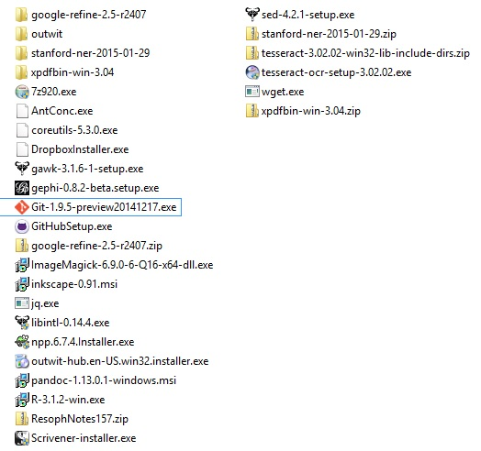
Module 03 Exercise 03
To the left I have included a screenshot of the folder on my computer where I have kept most of the software downloaded exclusively for the course.
The programs shown there are not comprehensive. Some were sent to other folders in my computer.
Anti-virus software detected malware in a few of the programs. These may have been false positives.
There are also a large number of websites that require logins and passwords (and sophistication!) to use. I have over 40 bookmarks generated, many of which were critical to completing assignments.

Slide 13
Module 04 Exercise 08
Stated Purpose of the Module and Exercise
Find holes in data.
Use tools for pattern recognition. Philosophically, we are trying to use data visualization as a method to find patterns, not just to express patterns of which we are already aware.
For my purposes, I selected mapping tools. My project is based on mapping, and this was the logical choice for me.
Initial Skillset
I had absolutely no experience creating maps or using them to express data.

Slide 14
Module 04 Exercise 08
Observations of the Exercise
I made multiple attempts with the fire insurance maps to rectify them. I did not want to use the one that we had already dealt with in class.
I was not able to find an easy way to rectify other maps in the fire insurance collection. One of them had no intersections labelled, for example. I eventually searched for an historical map of Halifax, knowing that I would be able to find both older and current maps with common points to rectify.
Rectification was relatively easy with Halifax. I was very impressed how accurately it overlaid on the modern map.
The Exercise contained no reference for outputting geo-coordinates. The tutorial that it reference did not have any explanation either. I reverse engineered the URL from the other institution, and found the exercise that was used there to create the coordinates. The method used there was hard coding. This is inadequate. Some automated way to generate them must exist. For the purposes of this exercise, it was also unnecessarily difficult. I ended up just making them up. This part of the exercise taught me very little that was valuable.

Slide 15
Module 04 Exercise 08
How I’ve Grown
I was overall very impressed with my ability to rectify an historical space with a modern one. This was very important for developing my skills.
My computational thinking skills had progressed nicely, allowing me to use a combination of skills to produce the required output for the exercise. Reverse engineering URLs, finding independent ways to create real latitude and longitude coordinates, and to have it all output so nicely was a bit of a moment of pride for me.
By the time I reached module 4 I had already started using ArcGIS on a 365 day free license acquired through the University library. The software is very impressive, incorporating not just mapping software but data directly into the files used to express the map. By this point I was able to produce a Choropleth map of the United States. I consider my ArcGIS work from the early stages of my project to exceed significantly the requirements of Exercise 09 on QGIS.

Slide 16
Module 05 Exercise 01
Stated Purpose of the Module and Exercise
Data vs Capta, Understand the Difference
Utilize Colour, Typeface, and other tools to best present Capta.
Initial Skillset
I am well versed (and strongly opinionated) on matters of epistemology. I have no argument with the terms of Data vs Capta.
I have very limited experience with image manipulation, primarily using Paint, with no experience using vector graphics.
I have no publishing experience and am new to the theory behind typefaces.

Slide 17
Module 05 Exercise 01
Observations of the Exercise
Inkscape posed little challenge in getting up and running.
Manipulating the graphs in stages, pulling the image apart into vectors, etc was not new conceptual terrain for me, but I had never actually done it before myself.
Inkscape is a wonderful free tool, but my wife has been using a professional version of Adobe Illustrator for years. While more difficult to use (and not free!), the output images are superior to Inkscape.
How I’ve Grown
My wife’s advanced use of Illustrator made her output look like magic. I am now significantly less intimidated.
For a “real” project, I would probably still use another tool for manipulating graphs and creating legends. Excel, for example. I may then use something like Inkscape to add the legend created in Excel to the image from another piece of software. Graphs I would simply create in Excel from the beginning.
Use of the right tool for the right job was impressed upon me by this module. When you have a hammer, everything should not appear to be a nail.

Slide 18
HIST2803A – War and Society Hulse Letters
I deployed data visualization methods for one of my other classes this semester.
I used a Gantt chart to express the duration of battles during World War One alongside the events of Captain Hulse’s letters. I did this so that some context for the letters would be provided, as I did not know what was going on around him as I was reading.
Many of the files, including the paper and Gantt charts detailing my methods have been posted to GitHub. Please read the markdown file first.
I did not know what I would find when I began my investigation. This is the spirit of discovery that we have discussed extensively in the course.
I discovered that Hulse was only at the front during intense battles for only a small handful of days during the war. I had not expected to find this. It formed the core of my thesis for the paper.
I received an “A+” grade on the paper and was invited by the professor to share my methods with her class by giving the first portion of one of the lectures this semester.

Slide 19
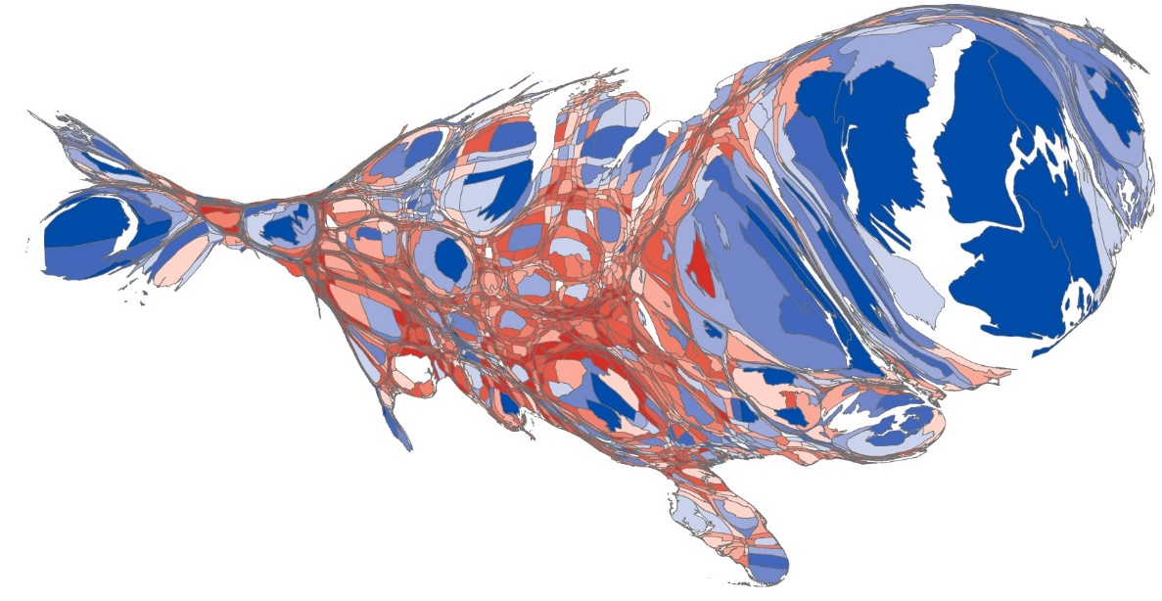
Major Project
Skills Used to Create the Cartogram
Exhaustive search finally yielded a “dream case” of data for election results.
Further search for population data found data that needed to be “wrangled” extensively in order to generate primary keys for linking tables in the mapping software.
Database skills had to be used to link population and election data.
ArcGIS and Scapetoad were used to render the initial map, then to deform it, then to re-render it.
Scapetoad was extremely difficult and time consuming due to idiosyncrasies in the software and some unfortunate coincidences.
Map contains “capta”; decisions were made altering the data in order to render it as it is shown here.
Computational thinking and tenacity were displayed “in spades” to get to this point.

Slide 20
Major Project
I have progressed quite far into my major project. I have been able to output a cartogram, displayed at left, of the US 2012 Presidential Election. Individual counties are shown coloured based on partisan election result. Counties have also been deformed in size based on the population size.
Urban centres are almost exclusively blue, for Democrats, and rural areas are mostly red for Republican.
I have succeeded in demonstrating my thesis that the Democratic / Republican divide in the US is not a matter of so-called Southern politics versus the rest of the country, but rather a divide between urban and rural environments.
Being able to output a map like this was one of my major goals for this class. I will likely be outputting a dozen or more. I am very proud of my progress this semester!

Slide 21
Future Use
Using methods very similar to my major project, I could create documents that would be very useful for marketing purposes.
For example, a shape file (a file defining the polygons of geographical areas) from Canada Post showing the geographical area of all postal codes could be used for Canada. Once the shape file was in ArcGIS (or QGIS!), any data that I like could be appended to it. Marketing results, for example.
Once done, output maps could be shown in many different ways. Who knows what would be discovered about a company’s marketing efforts?!
Detail maps can be quickly created and output (as I intend to show in my major project). For example, the GTA. Being able to “zoom-in” on an area can show a great deal of information about local behaviour.
To be able to show this to an employer is invaluable. One could run an entire consulting firm based purely on geographical analytics of this nature.
Should I find myself in working in marketing again, it is almost a certainty that I will be using many of the methods detailed in this course.

Slide 22
Conclusion
What I have learned to do this semester is massive. The tools provided are varied and vast.
My initial skill sets included almost no exposure to most of the techniques we were exposed to. Although I had previous experience with wrangling data, I was still exposed to new methods that I wish that I had known of earlier in my professional life.
I have completed coursework that I wouldn’t have dreamed being possible over the semester.
I have deployed the methodology to other classes—using it as a means of discovery and not just of display—and I have been handsomely rewarded for it.
I feel like I have historical superpowers not possessed by the majority of my peers!

