Slide 1
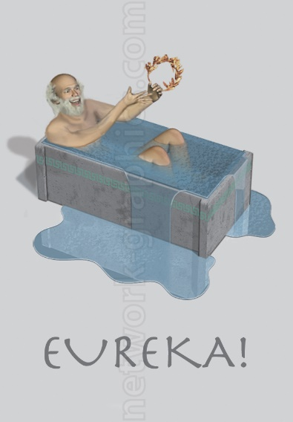



How I’ve Grown
Wait, this is awesome…
No, I’m awesome!
What the?
What have I done?!

Slide 2
Overview

Slide 3
Module 01 Exercise XX

Slide 4
Module 02 Exercise XX

Slide 5
Module 03 Exercise XX

Slide 6
Module 04 Exercise XX

Slide 7
Module 05 Exercise XX

Slide 8
HIST2803A – War and Society Hulse Letters

Slide 9
Major Project

Slide 10
Future Use

Slide 11
Conclusion

