Slide 1
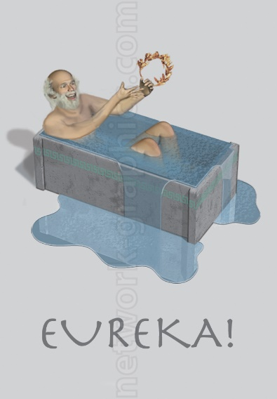



How I’ve Grown
Wait, this is awesome…
No, I’m awesome!
What the?
What have I done?!

Slide 2
Overview

Slide 3
Module 01 Exercise 01
Stated Purpose of the Module and Exercise
Learn how to use GitHub.
Use online tools for collaboration.
Set up a home base online.
Establish a workflow for publishing research on the web.
Initial Skillset
I had literally never heard of version control software prior to beginning this project. I had a very difficult time understanding it at first.
I had never owned or administered my own website before. My social media skills were limited to having a sparingly used Facebook account.
My collaboration in workgroups has always involved plenty of face to face meetings, phone calls, and project management documents.
I have a lot of experience setting up and documenting work flows.

Slide 4
Module 01 Exercise 01
Observations of the Exercise
Learning Markdown was overall a useful exercise and easy to learn.
In principle, I agree that simple text files are the best way to store information long term.
The use of GitHub contradicts the principle of continuity of data, however. GitHub is managed by a third party, susceptible to data loss from version upgrades to GitHub, or to the host organization going out of business. Nothing lasts forever!
I did not purchase and create my own domain name, though I would very much have liked to. Firstly, it seemed surplus to requirements (based on discussions with Professor Graham). Secondly, I have to be very careful about my online activities as they can be monitored by my employer and financial regulatory bodies. I would have to disclose ownership of such a website to them. The hassle that this would represent simply wasn’t worth the effort.
Discussion about how one of the “true” purposes of the exercise was to learn how to take control of one’s online identity, or “brand” as a marketer might call it, was not revealed until the final lecture of the module, after I had already completed all of the exercises. Knowing this up front would have effected how I completed the exercises.

Slide 5
Module 01 Exercise 01
How I’ve Grown
The importance of gaining control of my online “brand” has been impressed upon me. I intend to do a far more thorough job of this going forward. Integrating the message across all social media for the presentation of a consistent image will be a priority for me over the next few months. I have been made aware of the existence of certain important sites such as www.academia.edu that would need to be integrated into this effort.
The fact that I have a Github page which is relatively well organized and documented should speak to my growth here. I have gone from not knowing what version control was to having a well organized and documented repository on GitHub.
My integration of graphics with mouse-over-text (for example on the “Who We Are” page) is something that I was not capable of doing prior to the beginning of the course.

Slide 6
Module 02 Exercise 04

Slide 7
Module 03 Exercise 03

Slide 8
Module 04 Exercise 08

Slide 9
Module 05 Exercise 01

Slide 10
HIST2803A – War and Society Hulse Letters

Slide 11
Major Project

Slide 12
Future Use

Slide 13
Conclusion

