Slide 1
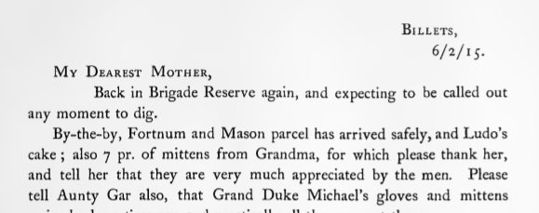
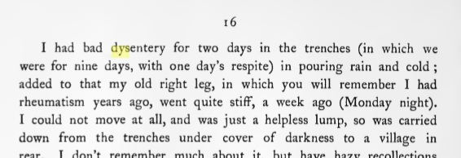
Hulse Letters Methods Gantt Chart
Hulse left some great markers in his letters.
Dates on Letter Headers
Dates referred to in body of text
Counts of days in text
Battle information was online.

