Slide 1
Comparison of Rectangle Expansion A* (REA*) algorithm and impact on multithreaded performance
Przemyslaw Tomczyk

Slide 2
Purpose of this research
Test a relatively new algorithm against the golden standard
New algorithm - REA* (Rectangle Expansion A*)
Golden Standard - A*
Compare the two algorithms
Show more real-world results
Benefits of REA*

Slide 3
Ways of Comparison
Single thread performance
1 start point and 1 end point
Large search space (1,000,000 tiles)
Multi threaded performance
Desired amount of NPCs
Small to medium search spaces
Distance difference

Slide 4
Researched
Multithreading
Boost library vs native C++ functionality
Went with Boost due to the amount of features and popularity
Each algorithm has their own use cases

Slide 5
Further Research
Further optimisation REA* algorithm
Beyond what author of REA* suggests
Optimisation of A*
Give the golden standard a boost
Fairer comparison by using newer alg.
Multithreading REA*
Split some workload

Slide 6
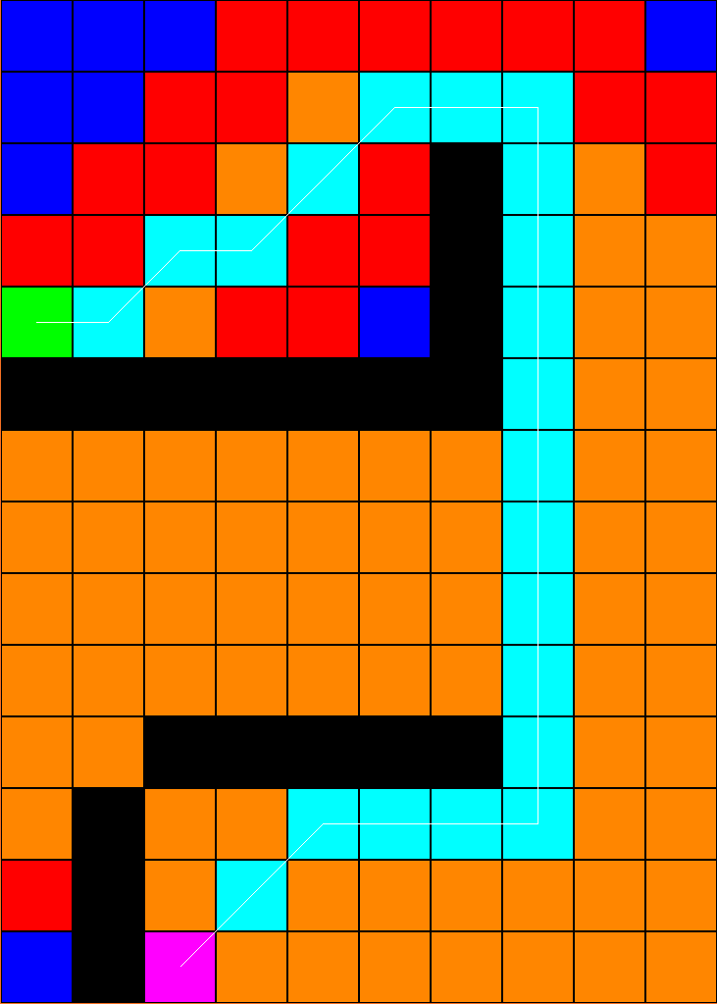
A*
Adopted as Golden Standard
Easy to find help
Optimisation tips
Efficient, fast and accurate
Big search space = less efficient
Not too complicated
May require pre-processing
A lot of derived algorithms

Slide 7
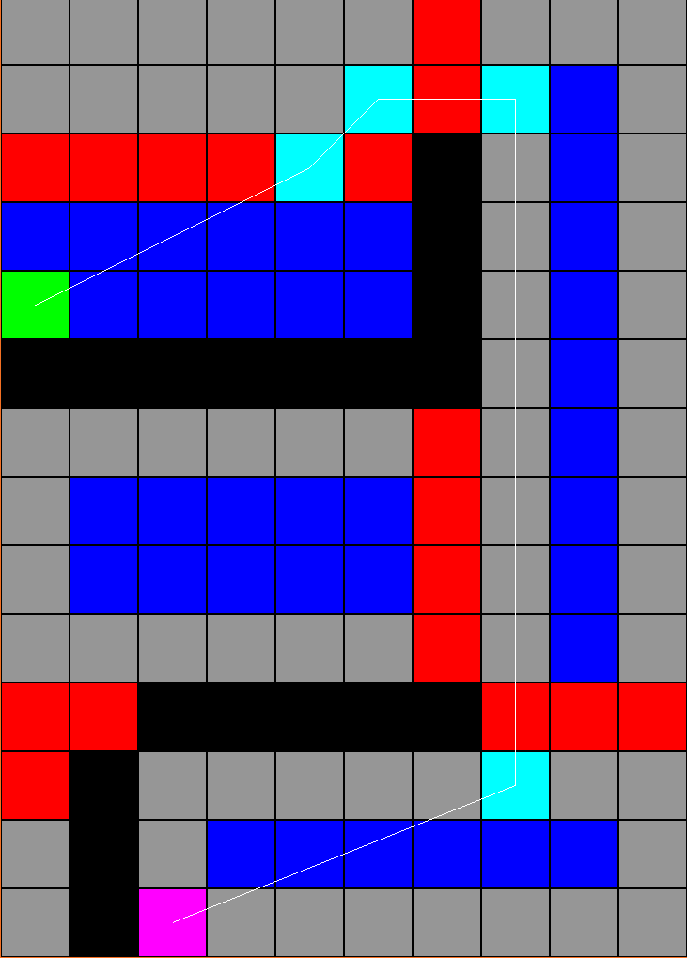
REA*
Paper published in 2016
Derived from A*
More efficient, accurate and faster
Even against highly optimised A*
At worst slightly worse performance
More complicated to implement
No pre-processing

Slide 8
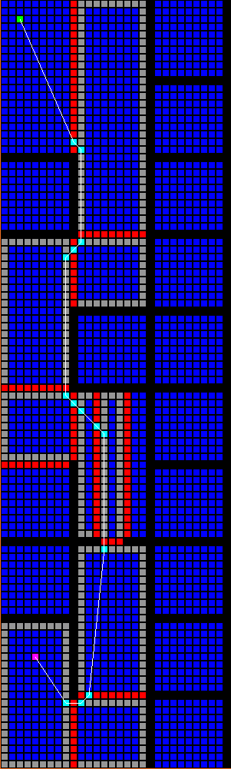
REA*
My implementation based on the paper
Same or shorter path
A* sometimes better
Underperforms in small search spaces
Microseconds
Hates diagonal obstacles
Worst use case
Outshines in 100² and larger grids
Most noticeable improvement

Slide 9
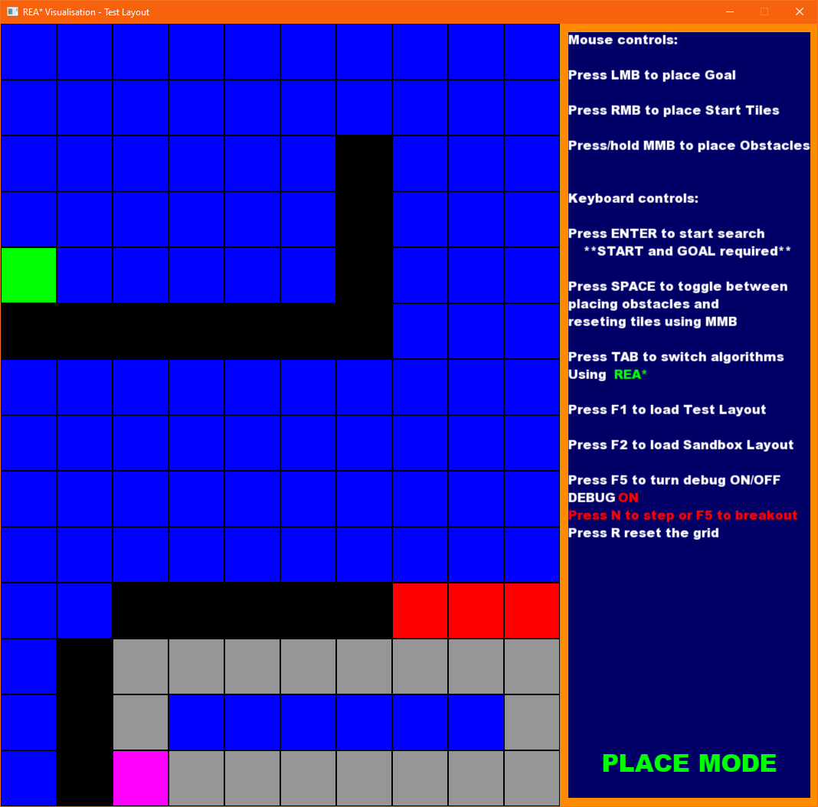
How REA* works
First rectangle expands in all fours
Get neighbours
Use intervals as rectangle origin
Loop until goal found

Slide 10
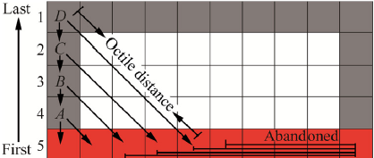
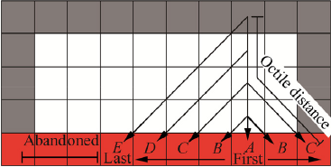
Uses octile distance
Side boundaries are setup differently to opposite
Side Boundary Eg
Opposite Boundary Eg

Slide 11
Get Current Best Node from Priority Queue
Repeat until Goal found

Slide 12
Methods
I will be comparing the algorithms using single thread performance
They will be compared by:
Time Taken
Path length
Same comparisons conducted using a Work Queue of NPCs

Slide 13
Results
Results will be used to determine whether implementing a relatively new algorithm is worth:
The time spent
The performance increase

Slide 14
Results
 | Path Length |  | Time Taken
 | REA* | A* | REA* | A*
Test | 23.27 | 24.07 | 18μs | 15μs
Small 100x100 | 990.50 | 998.61 | 770μs <1ms | 930μs <1ms
Medium 500x500 | 7192.21 | 7319.17 | 9863μs 9.8ms | 33856μs 33.8ms
Large 1000x1000 | 3700.91 | 3930.07 | 25581μs 25.5ms | 172074μs 172ms

Slide 15
Implemented Feature Set
Both algorithm require no pre processing of the grid
A* algorithm using octile distance
My recreation of REA* using Paper’s pseudo-code
4 grid types
Test layout shown in the paper
Small (100x100)
Medium (500x500)
Large (1000x1000)
Multiple NPCs using Work Queue

Slide 16
Implemented Feature Set Demonstration
Start Demonstration

Slide 17
Conclusions
What was achieved
2 path finding algorithms
No pre-processing
My take on REA* from pseudo-code
REA* is a promising algorithm
Has its own use cases
Both good and bad

Slide 18
Further Work
A* algorithm
Further optimisation
REA* algorithm
Optimisation from the paper
Optimisation beyond what’s in the paper
Bug fixes

Slide 19
Questions and Answers

