Slide 1
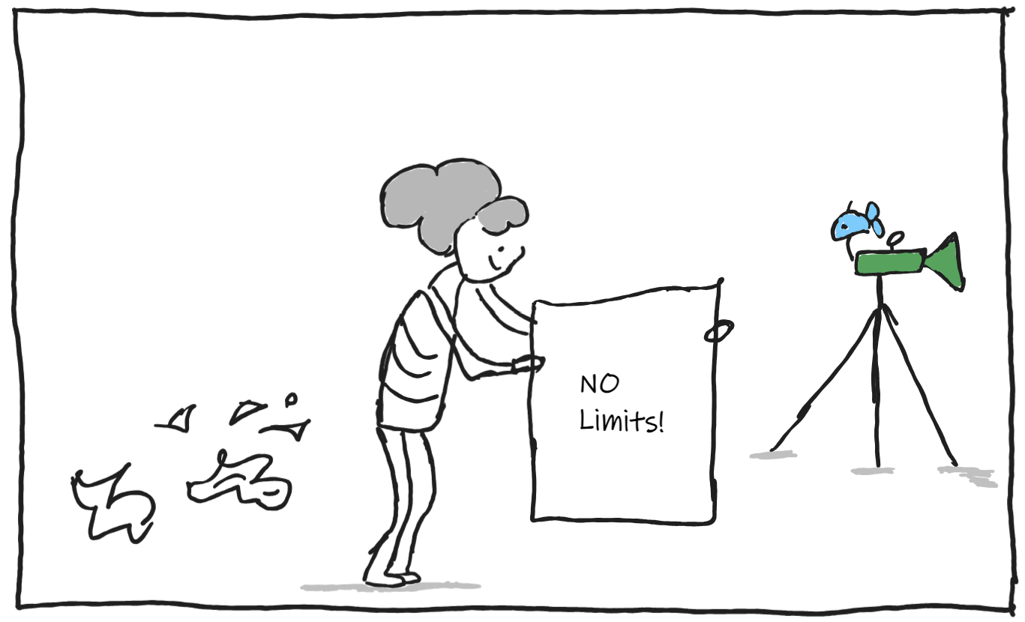
Buy High
Sell Low!
Diana Zhang
Tejesh Pattnaik
Prajwal Patnaik

Slide 2

Overview
PROJECT
The Idea!
Combining Portfolio Analysis, Trading Algorithms with Machine Learning, and Roboadvisor functionalities.
The Goal!
Empowers users with actionable insights for informed investing decisions. Facilitates as a one-step solution for portfolio management, algorithmic trading, and personalized investment recommendations.
What can it do?
Utilizes advanced analytics to evaluate portfolio performance and risk metrics.
Leverages machine learning algorithms for data-driven trading strategies.
Ensures a user-friendly interface for effortless navigation and decision-making.

Slide 3
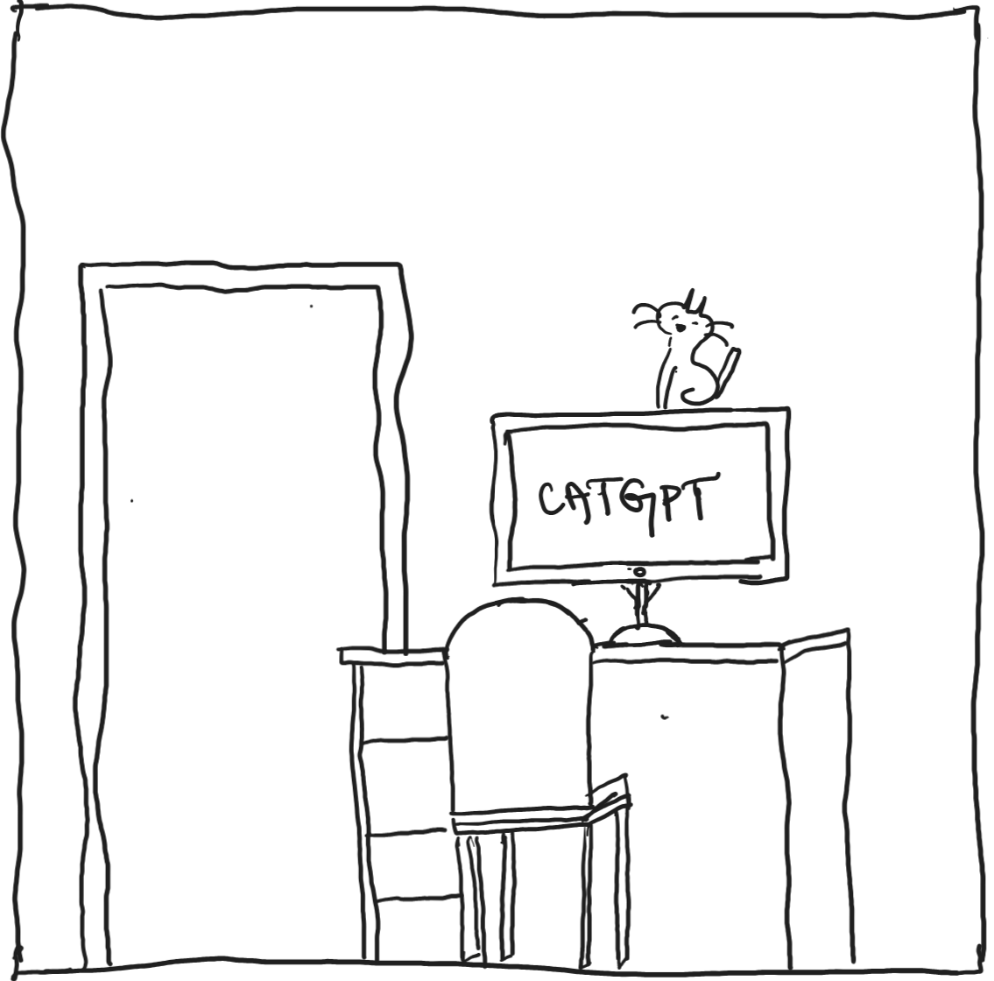
PROJECT
Components
01
Interactive Portfolio Builder and Analysis
Select dates, stocks for historical price analysis. Review the finance data and quantitative analysis of the portfolio (benchmarked against the S&P500)
Individual Stock Analysis with Trading Algorithms and Machine Learning
02
Select dates, trading algorithms, trading windows intervals, stop loss percentages, initial capital & share size for back-testing, machine learning models. Review metrics of algorithm and ML classification reports.
03
Chatbot using openAI
Use the previous two pages to frame questions to use advise or gain understanding of the analyses from the openAI chatbot.

Slide 4


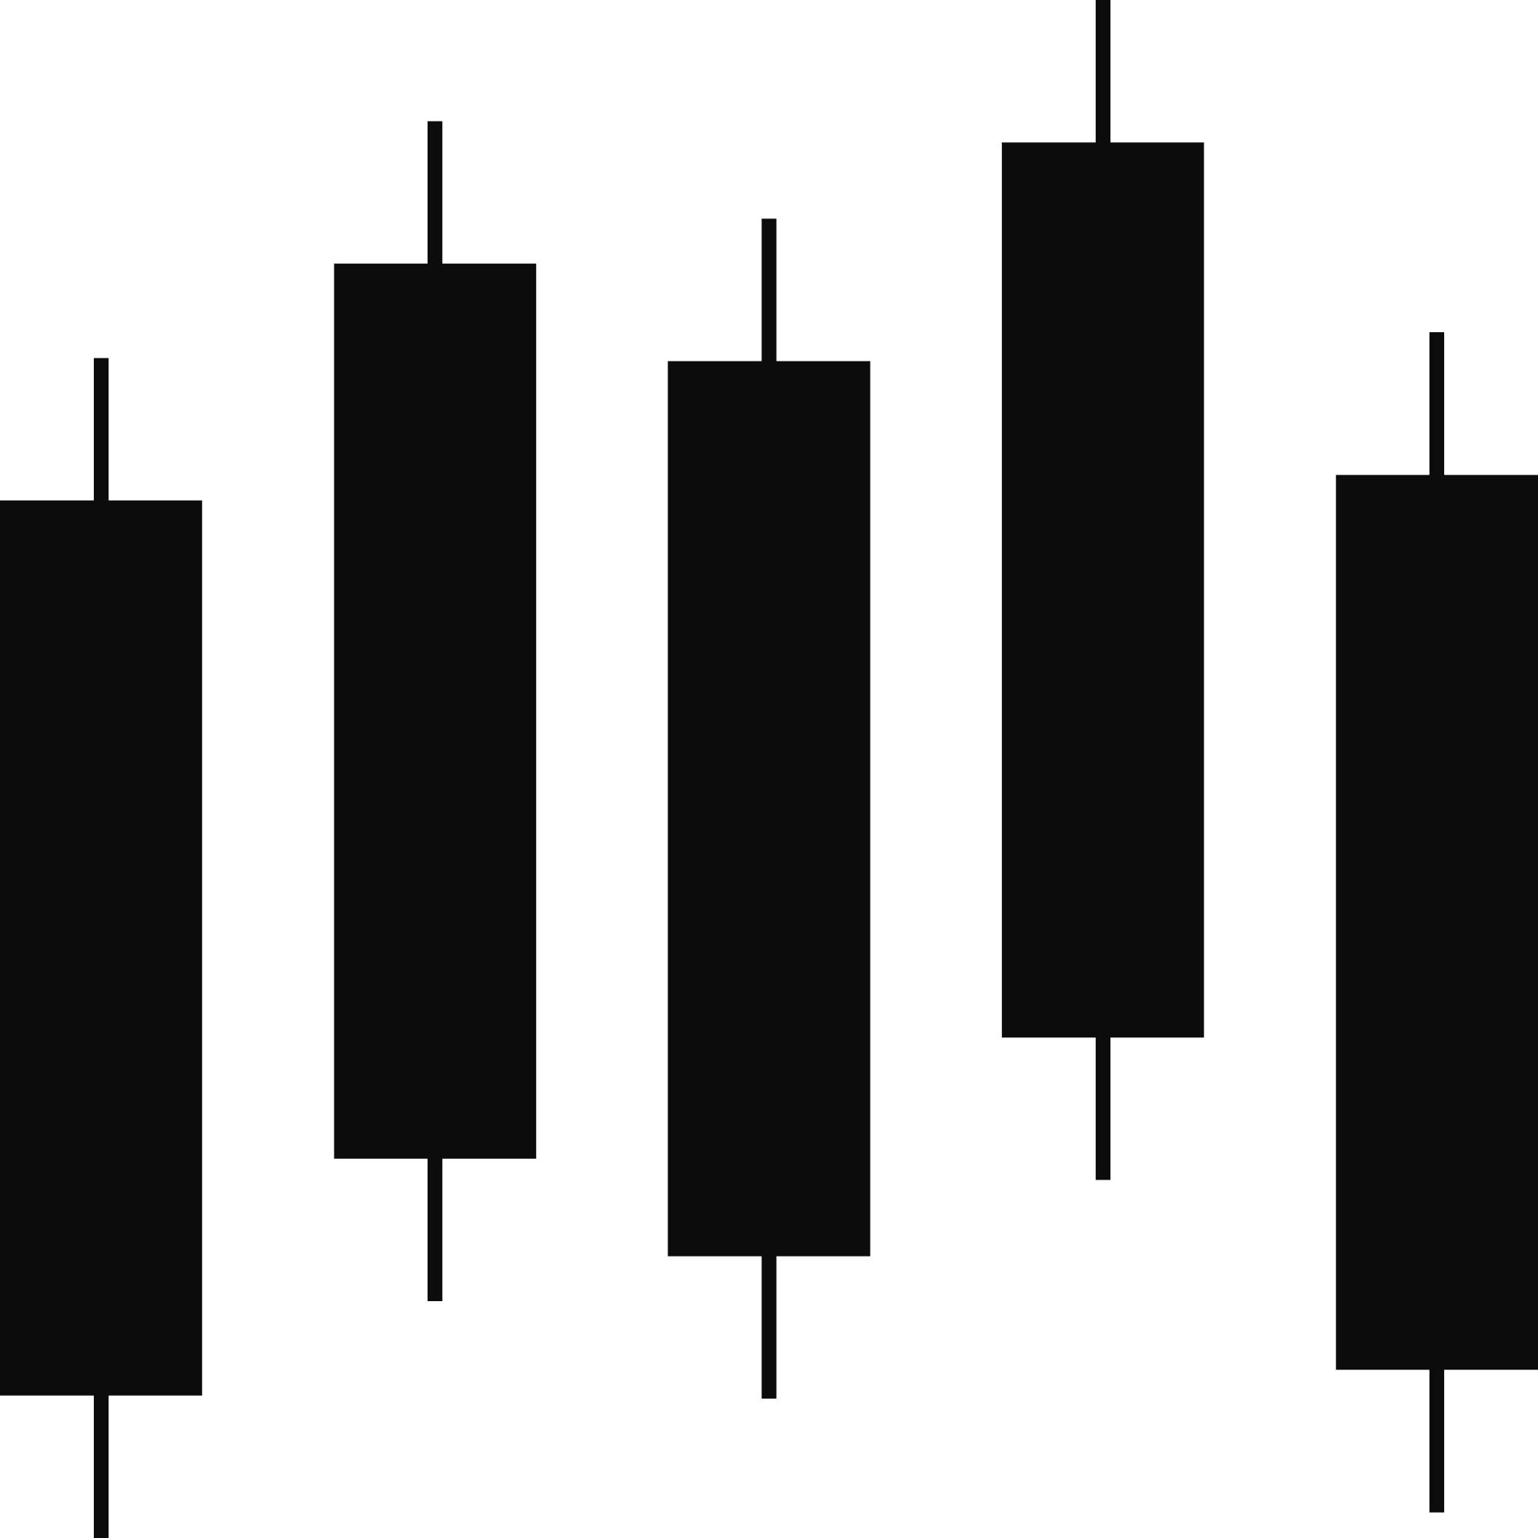
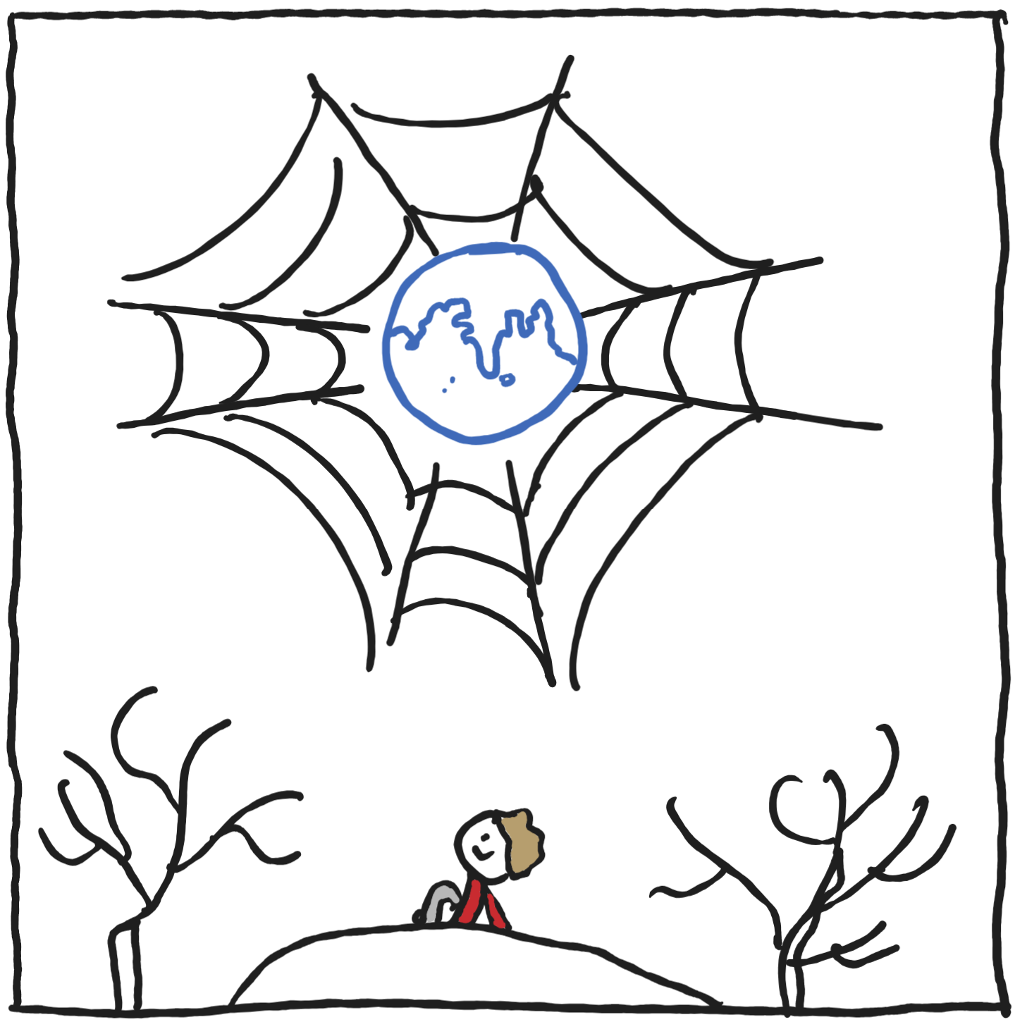




Customizable Dates
PROJECT
Application Segments
Select your own Stocks
Quantitative Analysis
Trading Algorithms
Multiple Options to Choose every stage
Machine Learning
ChatGPT

Slide 5
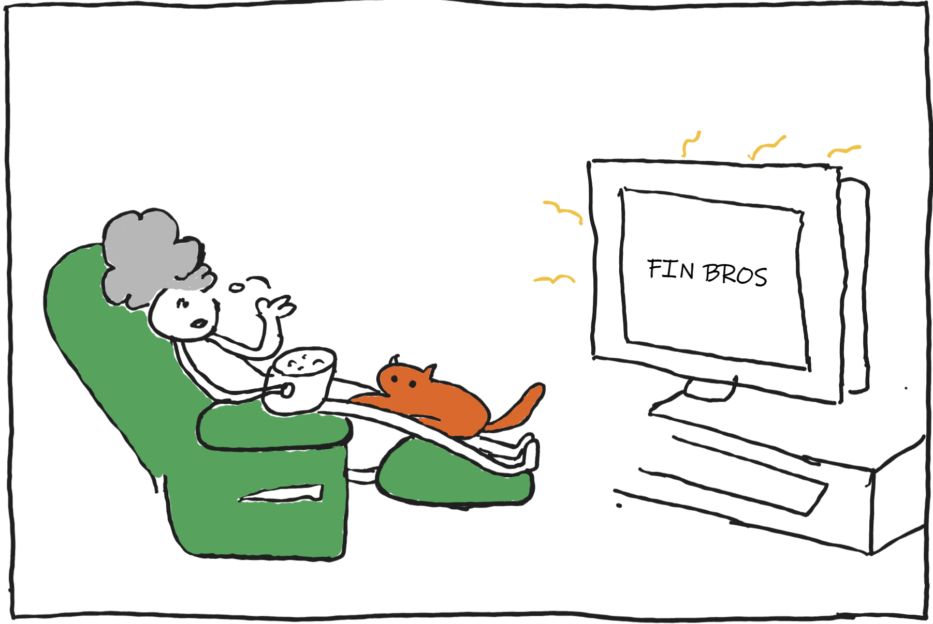

Demo
Powered by

Slide 6
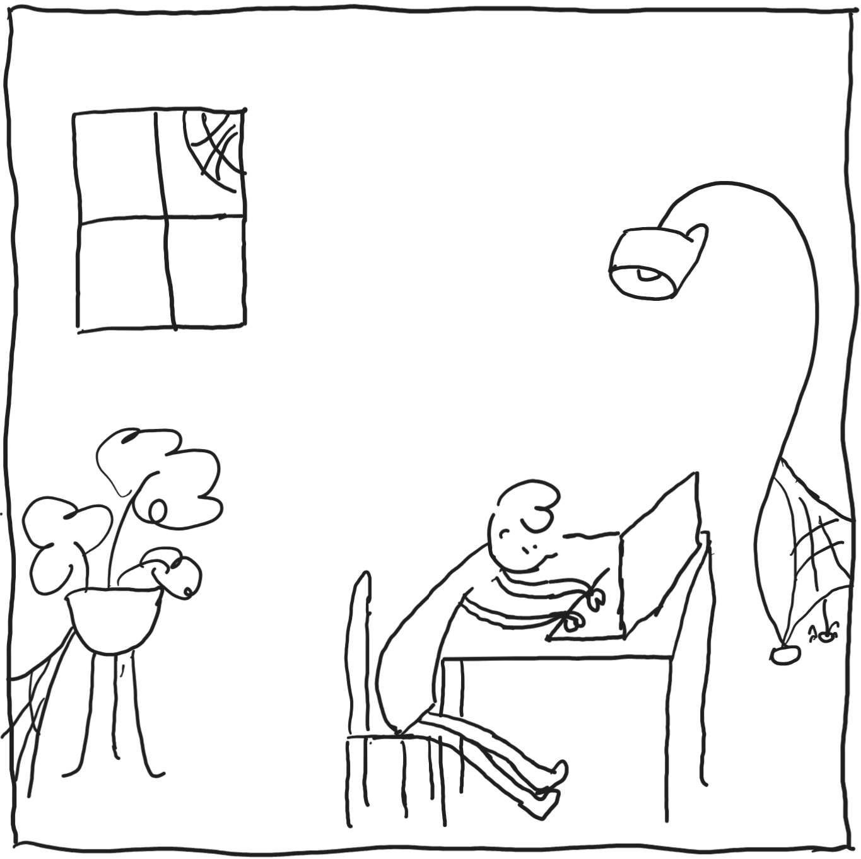
What Next!?
Improving the AI to directly buy, sell and hold stocks based on quantitative analyses.
Implementation of Alpaca API or similar.
Integrated chatbot speaking in multiple levels based to provide the user with succinct yet concise information.

Slide 7
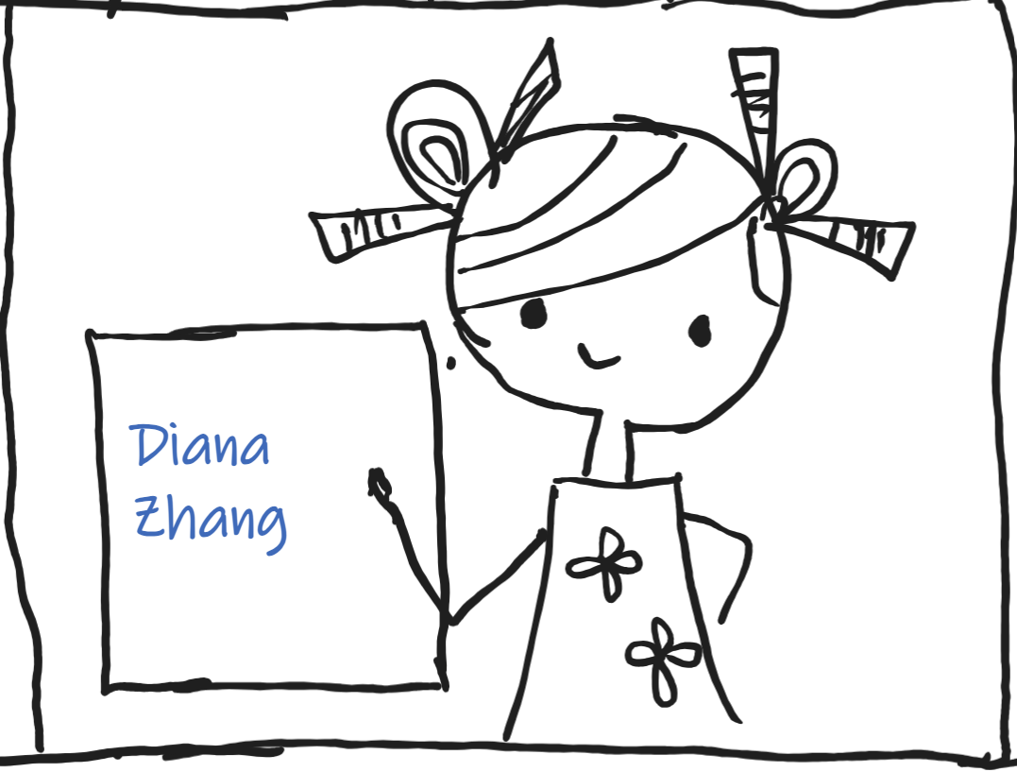
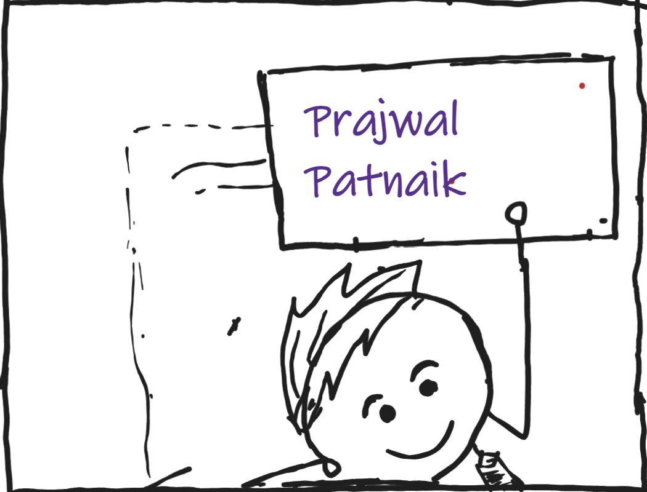
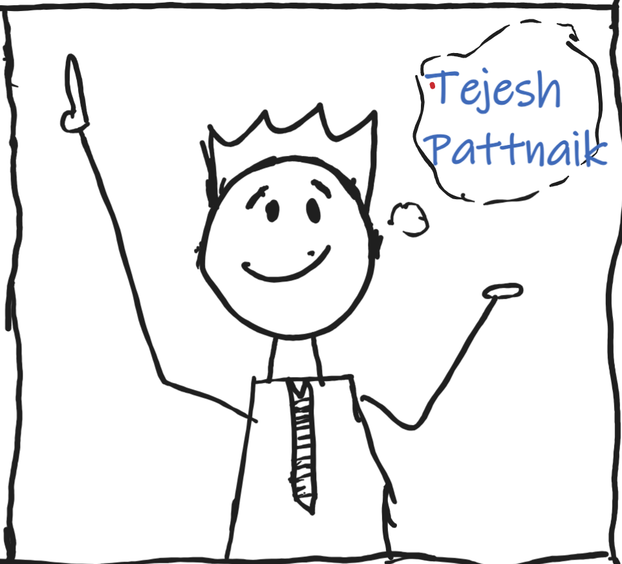


Thank You
Special Shoutout – Ivasic Bruno, Kerry Zhang

Slide 8


Shoutout to
Nicholas Creed

