Slide 1
Late Delivery Prediction and Analysis
in Blinkit Orders Dataset
By Priyanshu Singh
IIT Patna

Slide 2
Problem Statement
Online grocery deliveries often face delays due to traffic, inventory, and logistics issues.
Late deliveries affect customer satisfaction and operational efficiency.
Objective: Predict late deliveries using Blinkit order dataset.

Slide 3
Dataset Overview
Blinkit dataset with multiple features such as order date, delivery time, location, etc.
Contains thousands of rows with categorical and numerical variables.
Data cleaning and preprocessing required to handle missing values and inconsistencies.

Slide 4
Data Cleaning & Preprocessing
Handled missing values and duplicates.
Converted categorical variables into numerical using encoding.
Standardized features for model training.

Slide 5
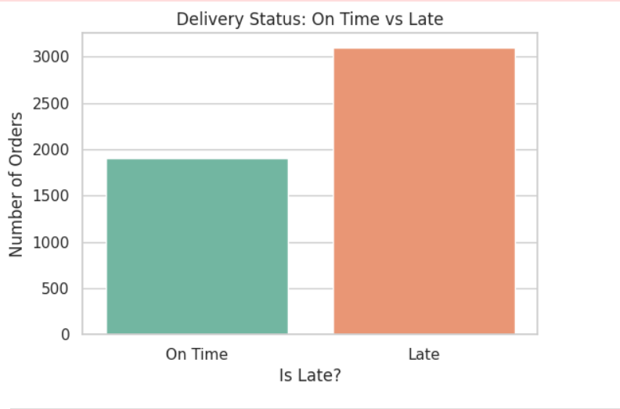
Exploratory Data Analysis (EDA)
Distribution plots and bar charts created for key variables.
Correlation heatmap used to identify relationships between features.
Found important factors influencing delivery times.

Slide 6
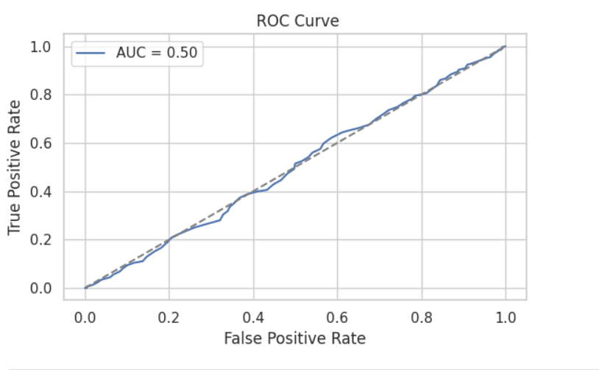
Feature Engineering
Created new features from date and time columns (e.g., day of week, peak hours).
Applied scaling and transformation for better model performance.
Prepared final dataset for training.

Slide 7
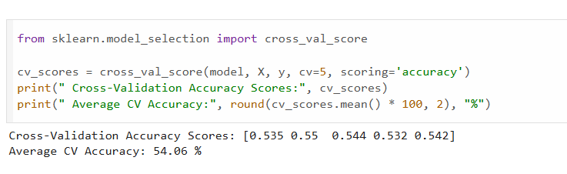
Model Building
Implemented Logistic Regression and Random Forest models.
Hyperparameter tuning performed for optimal results.
Compared models based on accuracy and F1-score.

Slide 8
Results & Performance
Achieved high accuracy in predicting late deliveries.
Confusion matrix and classification report used for evaluation.
Random Forest outperformed Logistic Regression in most metrics.

Slide 9
Conclusion & Future Scope
Key factors such as traffic hours, location, and order size strongly influence delays.
Machine Learning helps in proactive planning to reduce late deliveries.
Future work: Deploy real-time model for live prediction in Blinkit system.

