Slide 1
Financial Performance and Transaction Analysis
A fictional Nigerian fintech (synthetic dataset)
3,600 transactions | January 2025 – June 2026, plus 1 July 2026
Notes:
Opening slide. Stress that the company and the data are synthetic and prepared for a portfolio project.

Slide 2
The headline numbers
₦240.4M
₦1.52M
₦870.2K
91.2%
Transaction value
Fee revenue
Contribution
Success rate
Money customers moved. This is not company revenue.
What the company earned in fees.
Fees minus direct costs. Margin: 57.3% of fees.
3,284 of 3,600 transactions were successful.
Fees equal about 0.69% of the value of successful transactions (₦1.52M on ₦219.5M). Totals include the 11 transactions dated 1 July 2026.
Notes:
Distinguish transaction value (money moved) from fee revenue (company earnings). Fee revenue is about 0.63% of total value, or 0.69% of successful value.

Slide 3
Executive summary
Overall performance
Customers moved ₦240.4M. The company earned ₦1.52M in fees and kept ₦870.2K after direct costs (57.3% margin).
Trends
Over 18 full months, contribution stayed between ₦38.9K and ₦55.3K a month, with no clear growth. June 2026 had the lowest margin (54.0%).
Products
Transfers earn the most in total (₦237.2K). Loan Repayments earn the most per transaction (₦524). Savings earns the least (5.0% of contribution).
Reliability and regions
91.2% of transactions succeed; October 2025 was weakest (87.5%). Failed and reversed transactions (8.8%) earn no fees. Lagos produces 41.5% of contribution.
Recommendations
1) Review Savings pricing and purpose. 2) Investigate failed and reversed transactions. 3) Prioritise Loan Repayments and Merchant Payments, after checking capacity and risk.
Notes:
Full text version is in the report. Say clearly that the data is synthetic. About 185 words.

Slide 4
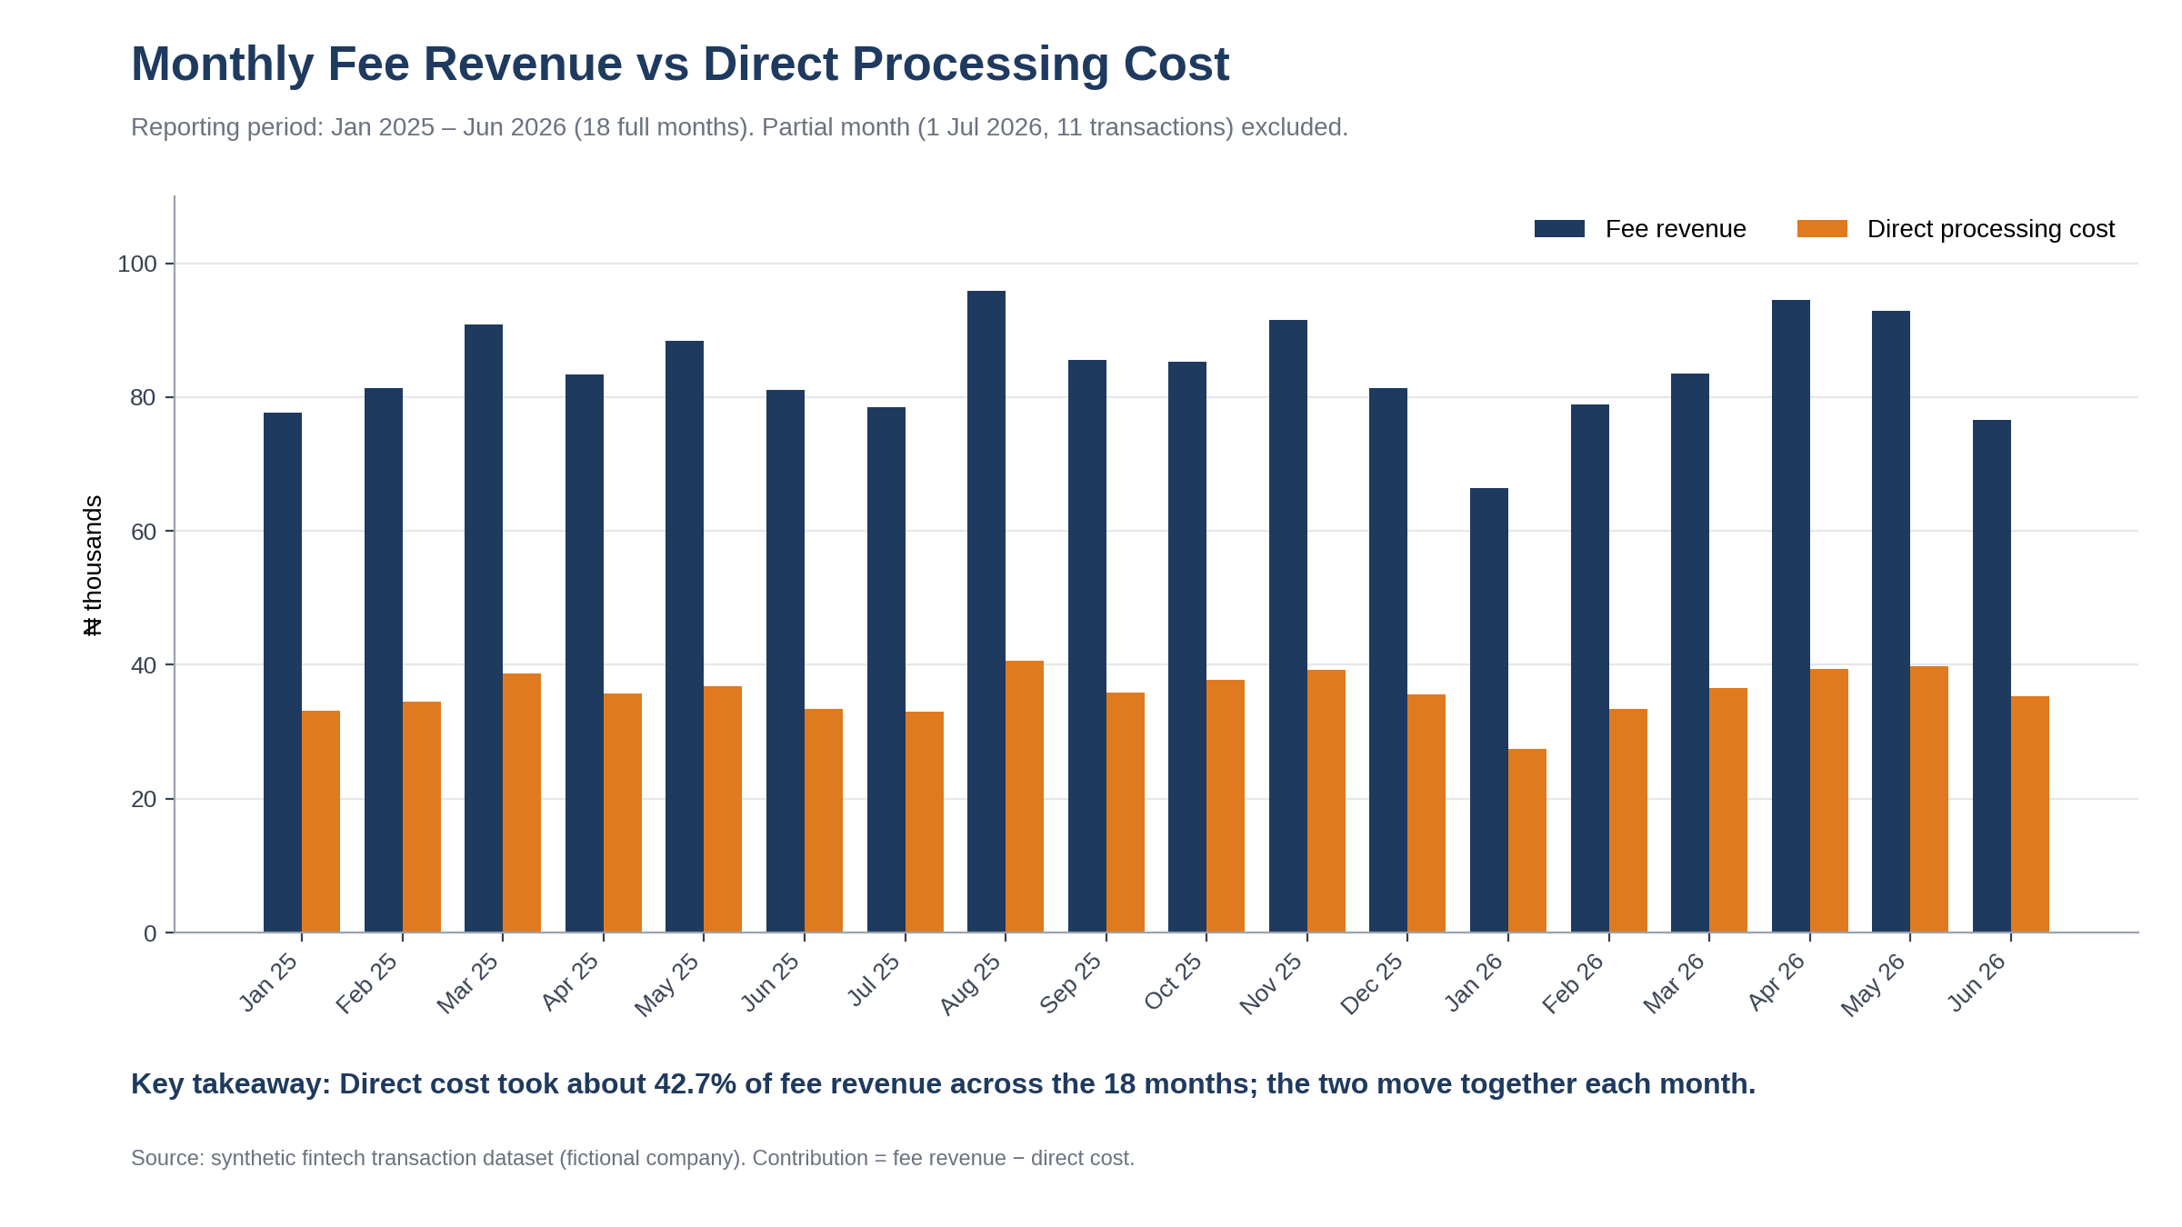
Fees and costs rise and fall together
What it shows
Monthly fee revenue and direct processing cost, Jan 2025 – Jun 2026 (18 full months).
Why it matters
Direct cost takes about 42.7% of fees over the 18 months, leaving a 57.3% margin.
Ready-to-insert file: charts/01_monthly_fee_revenue_vs_direct_cost.png (2400 × 1350 px)
Notes:
Suggested placement: slide after the executive summary, as the first evidence slide. Partial July 2026 is excluded.

Slide 5
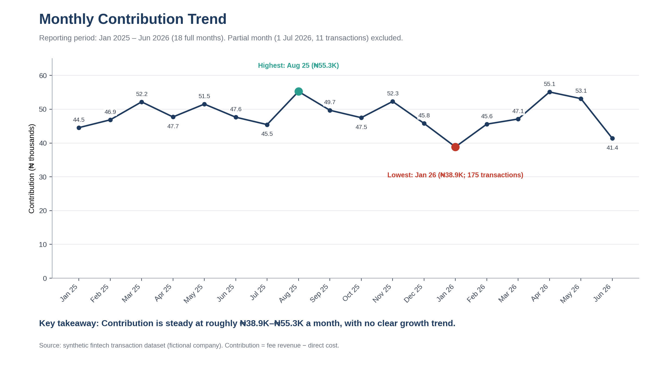
Contribution is steady, not growing
What it shows
Contribution each month (fees minus direct cost), 18 full months.
Why it matters
Range: ₦38.9K (Jan 2026) to ₦55.3K (Aug 2025). First half of 2026 was ₦281.2K vs ₦290.5K in 2025 (−3.2%).
Ready-to-insert file: charts/02_monthly_contribution_trend.png (2400 × 1350 px)
Notes:
Suggested placement: right after chart 1. Do not describe this as growth.

Slide 6
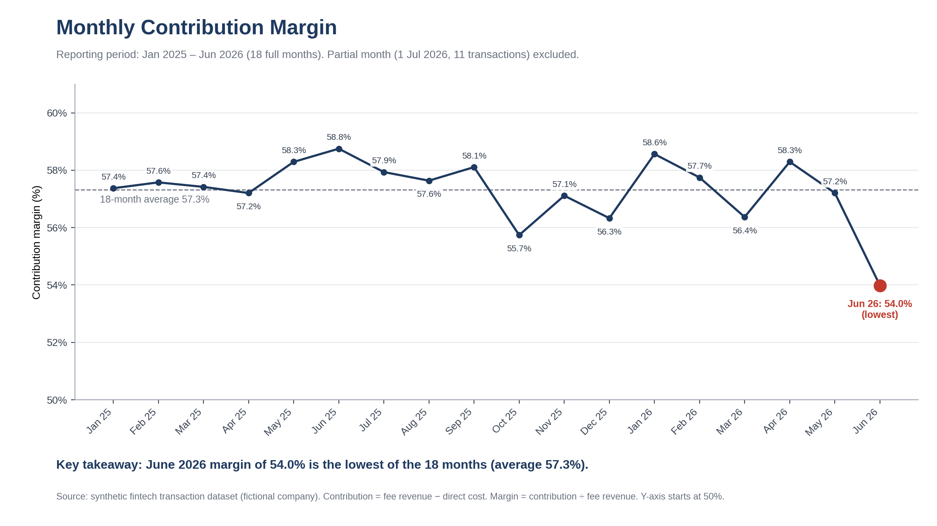
June 2026 margin dipped to 54.0%
What it shows
Contribution margin (contribution ÷ fee revenue) each month.
Why it matters
Lowest of the 18 months; the average is 57.3%. The dataset shows the dip but not the reason. A cost breakdown is needed.
Ready-to-insert file: charts/03_monthly_contribution_margin.png (2400 × 1350 px)
Notes:
Suggested placement: after chart 2. Y-axis starts at 50% (noted on chart).

Slide 7
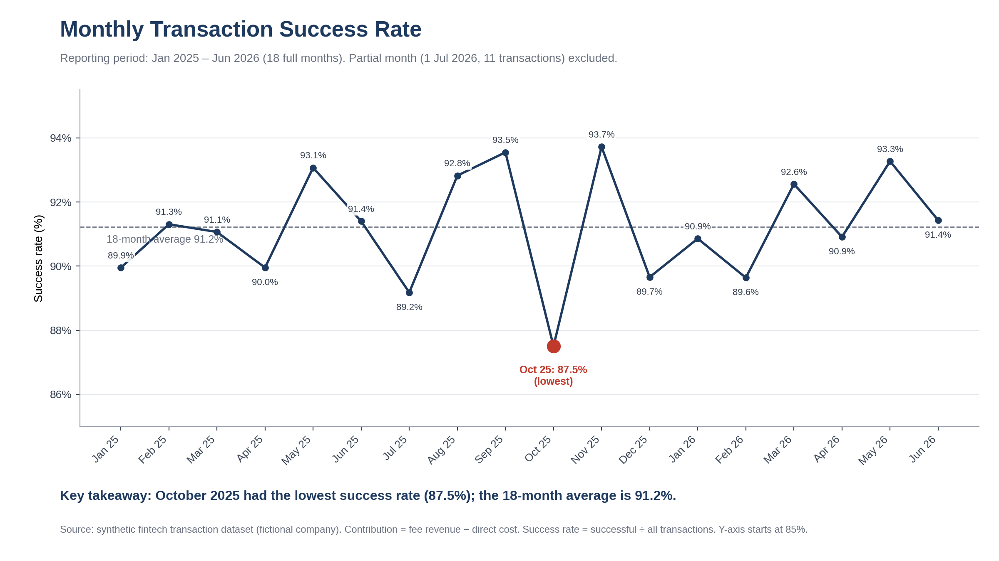
October 2025 had the weakest success rate
What it shows
Share of transactions that succeeded each month.
Why it matters
87.5% in Oct 2025 vs a 91.2% average. Failure reasons are not in this dataset, so the cause is unknown.
Ready-to-insert file: charts/04_monthly_success_rate.png (2400 × 1350 px)
Notes:
Suggested placement: reliability section. Y-axis starts at 85% (noted on chart).

Slide 8
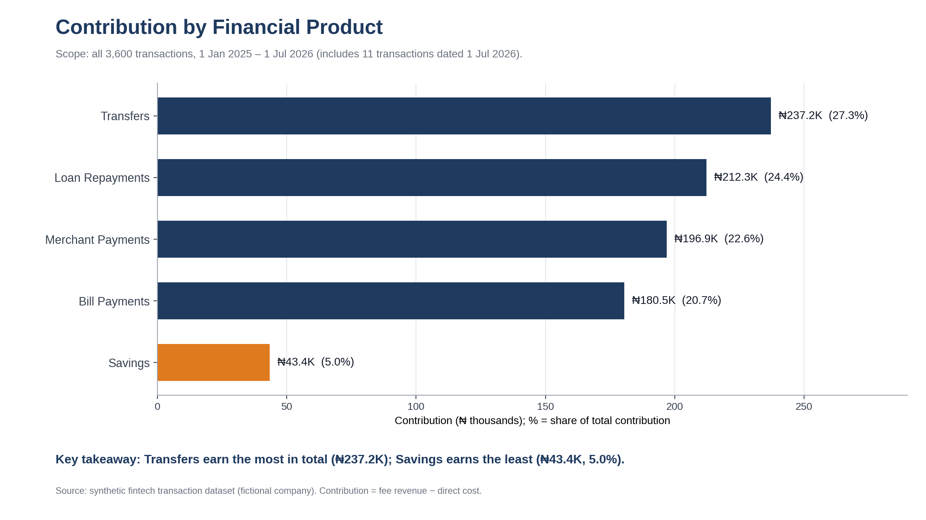
Transfers earn the most in total
What it shows
Total contribution by product, all 3,600 transactions.
Why it matters
Transfers: ₦237.2K (27.3%). Savings: ₦43.4K (5.0%), even though it is 19.9% of transactions.
Ready-to-insert file: charts/05_contribution_by_product.png (2400 × 1350 px)
Notes:
Suggested placement: product section, first slide.

Slide 9
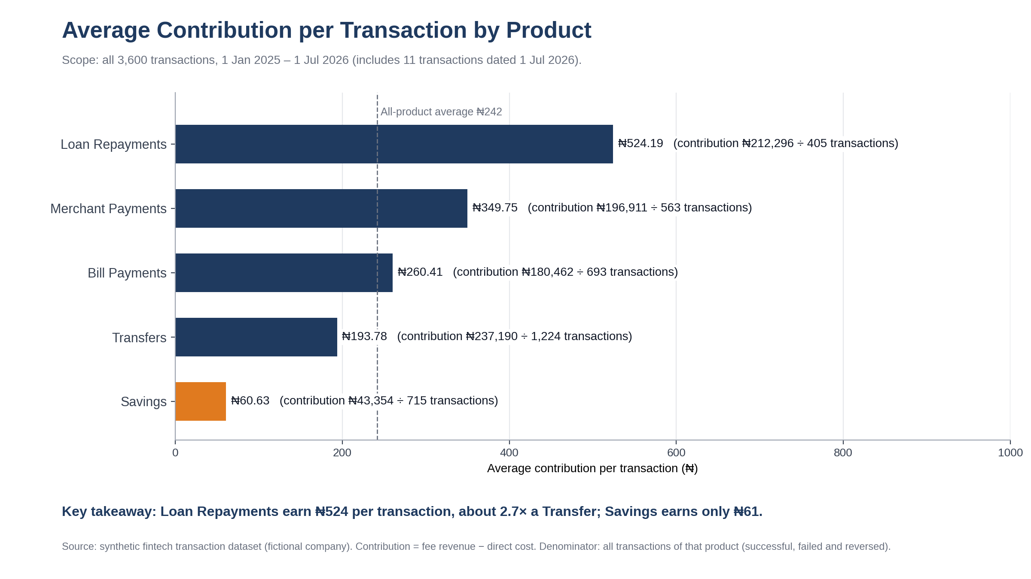
Loan Repayments earn most per transaction
What it shows
Contribution divided by all transactions of each product.
Why it matters
Loan Repayments earn ₦524 per transaction, about 2.7× Transfers (₦194). Savings earns ₦61.
Ready-to-insert file: charts/06_contribution_per_transaction_by_product.png (2400 × 1350 px)
Notes:
Suggested placement: right after chart 5. Denominator = all transactions of the product, including failed and reversed.

Slide 10
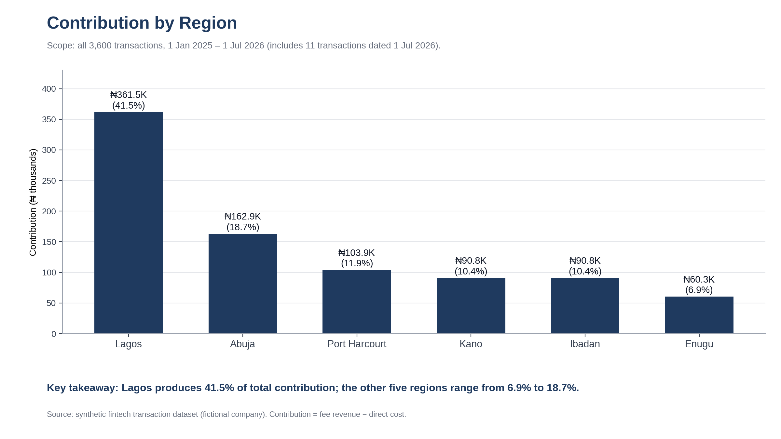
Lagos produces 41.5% of contribution
What it shows
Total contribution by region, all 3,600 transactions.
Why it matters
Regions differ in size, not margin: margins range from 56.7% to 57.9%.
Ready-to-insert file: charts/07_contribution_by_region.png (2400 × 1350 px)
Notes:
Suggested placement: regional section.

Slide 11
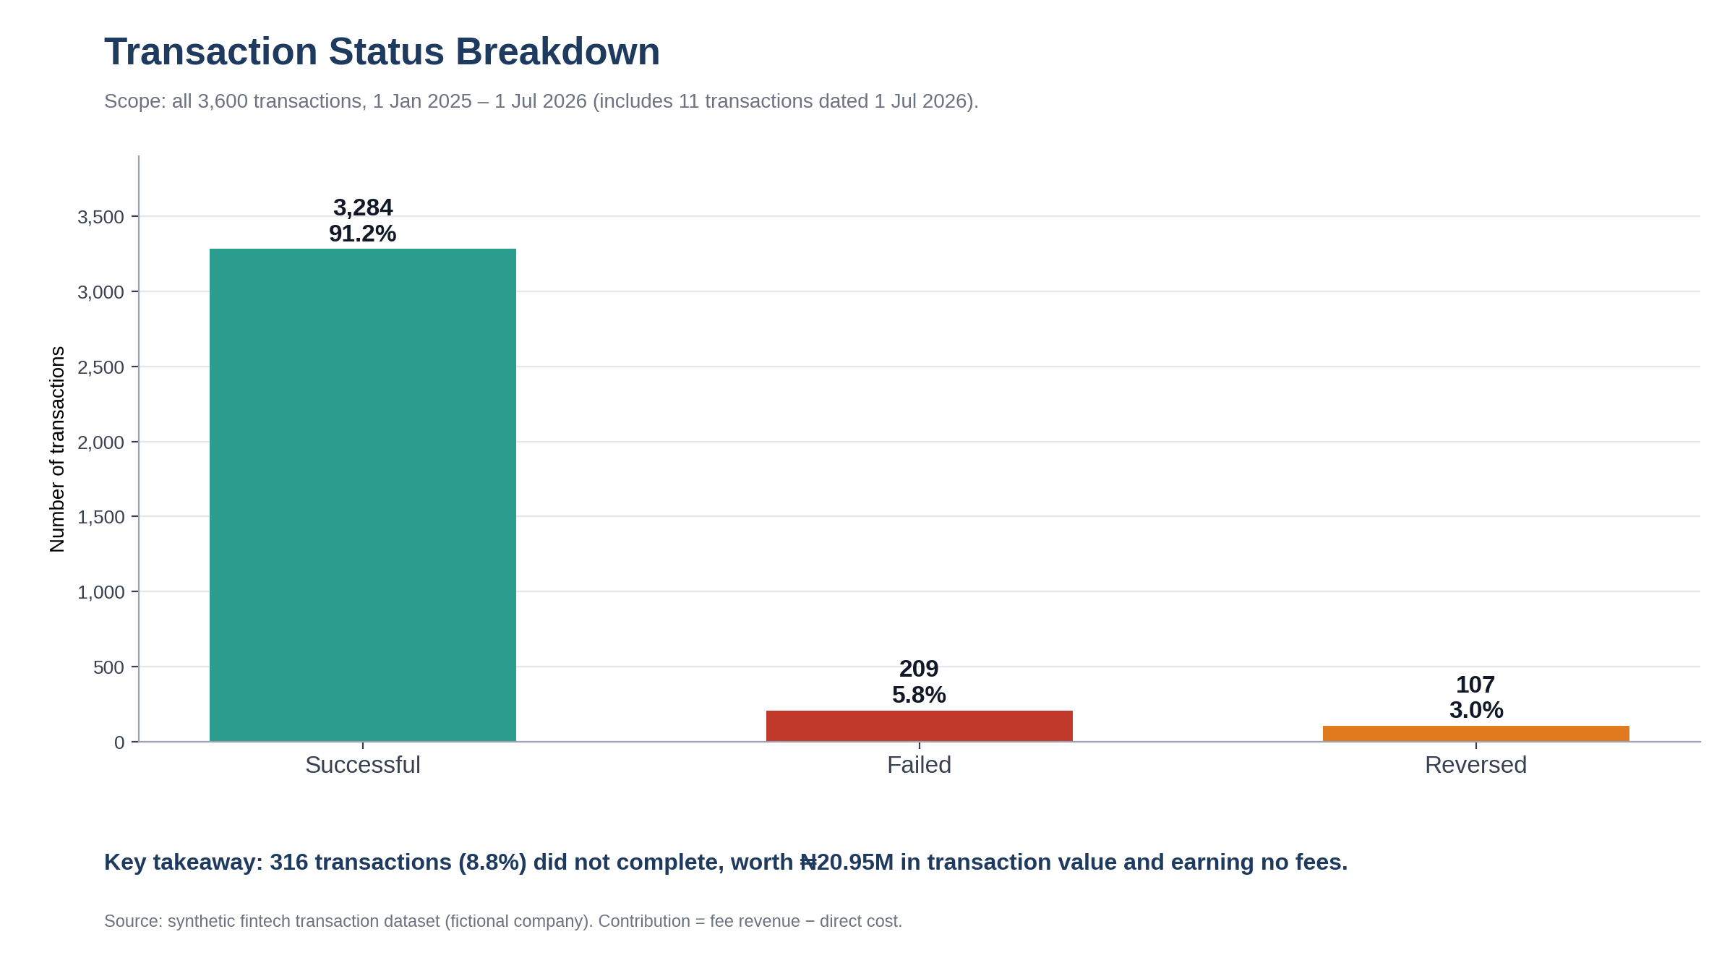
8.8% of transactions did not complete
What it shows
Transactions by status: 3,284 successful, 209 failed, 107 reversed.
Why it matters
The 316 incomplete transactions were worth ₦20.95M, earned no fees and still cost ₦2,608 to process.
Ready-to-insert file: charts/08_transaction_status_breakdown.png (2400 × 1350 px)
Notes:
Suggested placement: end of the charts section, leading into recommendations.

Slide 12
Recommendation 1: Review Savings
What to consider
Review whether Savings pricing and role fit the business goals. For example, test fee levels, or confirm it is a deliberate low-fee product.
Evidence from the data
Savings is 19.9% of transactions but 5.0% of contribution. Its fee rate is 0.2% vs 0.6%–1.1% for other products. It earns ₦61 per transaction vs a ₦242 average.
Expected business benefit
A clearer view of whether Savings justifies its processing effort, and a chance to raise contribution per transaction. No size of improvement is assumed.
Information needed before acting
Why Savings is priced low (strategy, competition, rules); how customers would react to fee changes; whether Savings customers also use higher-earning products; full cost to serve.
Notes:
Evidence: Product sheet in the Excel workbook; charts 5 and 6.

Slide 13
Recommendation 2: Investigate failures
What to consider
Investigate failed and reversed transactions, starting with October 2025 and the USSD channel.
Evidence from the data
316 transactions (8.8%) did not complete, worth ₦20.95M, and earned no fees. October 2025 success was 87.5% vs 91.2% average. Non-success was 10.7% on USSD vs 8.3% on the mobile app.
Expected business benefit
Fewer failures could let more attempted transactions earn fees and improve the customer experience. The amount is not estimated, because customers may retry.
Information needed before acting
Failure and reversal reasons; whether customers retry and succeed; timing and partner details; the cost of any fix.
Notes:
Evidence: charts 4 and 8. Channel non-success rates calculated from the Channel and Status fields: Mobile App 8.3%, Web 9.3%, USSD 10.7%.

Slide 14
Recommendation 3: Focus on top products
What to consider
Consider giving growth effort to Loan Repayments and Merchant Payments, while monitoring contribution margin.
Evidence from the data
Loan Repayments earn ₦524 per transaction and 24.4% of contribution from 11.3% of transactions. Merchant Payments have the highest fee rate (1.1%), the best success rate (92.9%) and ₦350 per transaction.
Expected business benefit
Each extra transaction in these products adds more than the ₦242 average, so a better mix could lift contribution. No uplift is predicted.
Information needed before acting
Customer demand and capacity to grow; the loan book and credit risk behind repayments; competitor pricing; whether fee rates hold at higher volume.
Notes:
Evidence: charts 5 and 6. Fee rate = fee revenue divided by value of successful transactions.

Slide 15
Data scope, definitions and checks
Scope
Synthetic data for a fictional company. 18 full months (Jan 2025 – Jun 2026) plus 11 transactions on 1 Jul 2026. Monthly trends use full months only; product, region and status charts use all 3,600 transactions.
Definitions
Contribution = fee revenue − direct cost. Margin = contribution ÷ fee revenue. Success rate = successful ÷ all transactions. Fee rate = fees ÷ value of successful transactions.
32 of 32
reconciliation checks passed. Counts, values, fees, costs and contribution agree across the monthly, product, region and status tables, and fee − cost = contribution on every row. No unresolved discrepancies. Figures are rounded for display only.
Notes:
Checks are on the Validation sheet of Fintech_Performance_Analysis.xlsx.

