Slide 1
MYEC · CULTURAL HERITAGE PROGRAMME ANALYTICS
Project Vogue
Engagement Across Cultural Heritage Events
A Power BI analysis of participation, retention and satisfaction across 16 Yoruba heritage sessions delivered between October 2024 and April 2025.
560
66
16
9.45
Participations
Unique participants
Sessions
Referral rating
Prepared by Samuel Babajide
Notes:
Frame this as a programme evaluation, not just a dashboard walkthrough. The headline story is retention: 66 people generated 560 attendances.

Slide 2
NAVIGATION
Project Vogue
Presentation Outline
01
Programme Context
02
Data & Preparation
What Project Vogue is and what the data captures
517 survey responses, five cleaning steps
03
Data Quality Findings
04
Engagement Findings
Two issues resolved before analysis
Participation, retention, demographics
05
Satisfaction Analysis
06
Dashboard & Interactivity
Referral scores and qualitative feedback
The Power BI report, live-filtered
07
Recommendations
Where the programme goes next
Notes:
Sections 04 and 05 carry the findings; section 06 carries the proof of interactivity; section 07 carries the value.

Slide 3
01 · INTRODUCTION
Project Vogue
Programme Context
Three programme strands
What the data captures
Storytelling
8 sessions · 300 attendances
Project Vogue delivers Yoruba cultural heritage sessions across three programme strands. Every attendee completes a short exit survey covering what they learned, what they would improve, and how likely they are to recommend the programme.
Folktales, proverbs, Aroko symbolic messaging and Yoruba greetings.
Rehearsal
7 sessions · 250 attendances
Analytical objectives
Performance preparation, costume, camera work and cultural practice.
Measure true reach by resolving duplicate identities
Quantify participation, retention and demographic spread
Assess satisfaction through referral scoring
Surface what participants value and what they request
Deliver an interactive report for programme decisions
Oral History
1 session · 10 attendances
Recorded testimony and heritage transmission. Newest strand.
Why this matters
Heritage programmes are usually evaluated on headcount alone. Because Project Vogue records the same participants across repeated sessions, this dataset can measure something more useful than reach: whether people came back.
Notes:
The three-strand structure matters because Oral History has only one session, which affects how its figures should be read throughout.

Slide 4
02 · DATA
Project Vogue
The Dataset
517
13
15
0
Survey responses
Fields captured
Sessions in extract
Missing values
One row per attendance
Identity, event, date, feedback
Oct 2024 to Apr 2025
Complete across all fields
Field | Description | Field | Description
Re_name | Corrected participant name | Attendance date | Session date
Gender | Male or Female | How likely to recommend | Referral score, 0 to 10
How would you describe yourself? | Young person, volunteer, trustee | What did you learn? | Free-text response
Which programme? | Storytelling, Rehearsal, Oral History | Categorized_Learnings | Standardised learning theme
Event_code | ST, RE or OH | Categorized_recommendation | Standardised improvement theme
Note: the analysis extract contains 517 responses. The published dashboard reflects a later refresh totalling 560 attendances across 16 sessions.
Notes:
Flag the extract-versus-dashboard difference openly. Headline KPIs quoted later come from the refreshed dashboard.

Slide 5
02 · METHODOLOGY
Project Vogue
Data Cleaning & Preprocessing
01
Name correction
02
Gender standardisation
03
Programme standardisation
Incomplete and misspelt participant names reconciled to a single canonical form, so unique participants could be counted reliably.
Misspelt and inconsistent gender values normalised to Male and Female.
Programme names aligned to three strands and mapped to short codes ST, RE and OH.
04
Date formatting
05
Response standardisation
06
Validation
Attendance dates converted to DD/MM/YYYY and session years verified against the delivery calendar.
Free-text learning and feedback responses grouped into consistent themes for aggregation.
Programme totals reconciled against the participation headline and referral scores confirmed within the 0 to 10 range.
Result
A clean attendance register in which every row is attributable to a known participant, every programme aggregates correctly, and free-text feedback is countable rather than merely readable.
Notes:
Step 01 is the one that changed the analysis most. Without it the unique participant count would have been badly wrong.

Slide 6
03 · DATA QUALITY
Project Vogue
Two Data Quality Findings
Finding 1 — Identity fragmentation
Participants wrote their names differently at each session. 169 distinct name strings resolved to 66 real people once spelling, partial surnames and spacing were reconciled. 177 of 517 rows needed correction.
Taken at face value, the register would have reported roughly 2.6 times more unique participants than the programme actually reached, and every retention measure would have collapsed.
Finding 2 — Session year recorded incorrectly
Eight of the fifteen sessions in the extract carry a 2024 year stamp for dates that fall in 2025: the two January Storytelling sessions and all six Rehearsal sessions from March and April. The delivery sequence makes the error clear, since Storytelling ran from October to December 2024 and continued into January 2025 before Rehearsal began that March.
Left uncorrected, the programme would appear to have run Rehearsal six months before Storytelling began, and any year-on-year comparison would be meaningless. The published dashboard reflects the corrected years.
Notes:
Both findings are worth stating plainly. Catching them is the analytical contribution; the charts would have rendered happily either way.

Slide 7
04 · ENGAGEMENT FINDINGS
The Headline Position
560
66
8.5
35.0
Total attendances
Unique participants
Attendances per person
Average per session
Across 16 delivered sessions
True reach after name correction
Average across the programme
Consistent across the run
9.45
0
93%
50%
Referral rating
Detractors
Are young people
Attended 10+ sessions
Out of a possible 10
No score below 8 recorded
Programme's core audience
33 of 66 participants
Read this first
560 attendances came from just 66 people. This is not a programme that reached a large audience once; it is a programme that reached a small audience repeatedly, roughly eight or nine times each. Retention, not reach, is what this data measures.
Notes:
This reframing is the most important point in the deck. Every subsequent finding follows from it.

Slide 8
04 · FINDINGS
Project Vogue
Participation Across the Three Strands
01
Storytelling leads on volume
02
Rehearsal matches it per session
03
Oral History is nascent
300 attendances across 8 sessions, 53.6% of all participation and the longest-running strand.
35.7 against 37.5 average attendance. The gap in totals is session count, not weaker draw.
A single session with 10 attendees. Too early to compare, and its figures should be read as a pilot.
Notes:
The per-session chart is the honest comparison. Rehearsal looks much smaller on totals only because it ran one fewer session and started later.

Slide 9
04 · FINDINGS
Project Vogue
The Retention Story
Half the cohort became regulars
33 of 66 participants attended ten or more sessions. Eight attended fourteen or fifteen of the sixteen delivered, which is close to perfect attendance across a seven-month programme.
A quarter attended only once
17 participants appear a single time. This is the clearest improvement opportunity in the dataset: the programme converts attendees into regulars very effectively, but a quarter of those who try it never return.
What this means for evaluation
Reporting 560 attendances as the headline overstates reach; reporting 66 participants understates impact. Both are true and they measure different things. A funder asking "how many people did you reach" should be told 66; a funder asking "how much cultural contact did you deliver" should be told 560. Presenting only one number invites the wrong conclusion.
Notes:
The single-visit group is where the actionable recommendation sits. Everything else about engagement is already strong.

Slide 10
04 · FINDINGS
Project Vogue
Who Attends
01
A consistent gender split
02
Overwhelmingly young people
03
Thin volunteer pipeline
Male attendance runs about 55% in every strand. The balance holds regardless of programme content.
479 of 517 attendances, roughly 93%. The programme is reaching its intended audience.
36 volunteer and 2 trustee attendances. Adult participation is minimal and worth attention.
Gender and audience-type figures are drawn from the 517-response analysis extract.
Notes:
The gender consistency across strands is worth noting: content type is not driving who shows up.

Slide 11
05 · SATISFACTION
Project Vogue
Satisfaction: An Unusually Clean Result
Nobody scored below 8
Across 517 responses on a 0 to 10 scale, the lowest score recorded was 8. There are no detractors in this dataset at all, which is rare enough to be worth stating explicitly rather than burying in an average.
Consistent across strands
Rehearsal 9.45, Storytelling 9.43, Oral History 9.80. Satisfaction does not depend on which strand a participant attends, so the result reflects programme delivery rather than one strong format carrying the average.
How to read this honestly
Exit surveys collected in the room from an audience that is largely made up of returning regulars will skew positive: the people most likely to give a low score are the seventeen who never came back, and most of them answered once at most. The score is a strong signal of how retained participants feel, and a weak signal of how the programme is received by those who tried it once. Both readings should be presented together.
Notes:
Do not oversell 9.45. Naming the selection effect is more credible than presenting it as an unqualified triumph, and it sets up the recommendation about the single-visit group.

Slide 12
05 · QUALITATIVE
Project Vogue
What Participants Say They Learned
Material culture leads
Traditional outfit styles is the most cited learning at 116 mentions, ahead of proverbs at 78. Tangible, visual heritage lands more memorably than oral heritage.
Language and symbol follow
Proverbs, Aroko symbolic messaging and formal greetings together account for 206 mentions, confirming that the language-based content is landing even though it ranks below costume.
Practical skills trail
Camera work draws only 14 mentions despite featuring in Rehearsal sessions, suggesting technical content is less memorable than cultural content.
Notes:
These are self-reported recall, not assessed learning. Worth saying so if asked.

Slide 13
05 · QUALITATIVE
Project Vogue
What Participants Ask For
The top requests are not complaints
Asked what could be improved, 128 participants said they wanted the next rehearsal and 109 cited new friends. The single largest body of feedback is a request for more of the same, which is an engagement signal rather than a criticism.
Hospitality matters more than expected
Food appears in 109 mentions across meals and appetizers, ranking above costume. Catering is functioning as a genuine driver of the experience, not an incidental extra.
The social finding deserves emphasis: 109 people described making new friends as what the programme should offer more of. For a heritage initiative aimed at young people, peer connection is doing as much work as the cultural content.
Notes:
The free-text question asked what could be improved, so answers like 'next rehearsal' are participants requesting continuation. Worth explaining that framing.

Slide 14
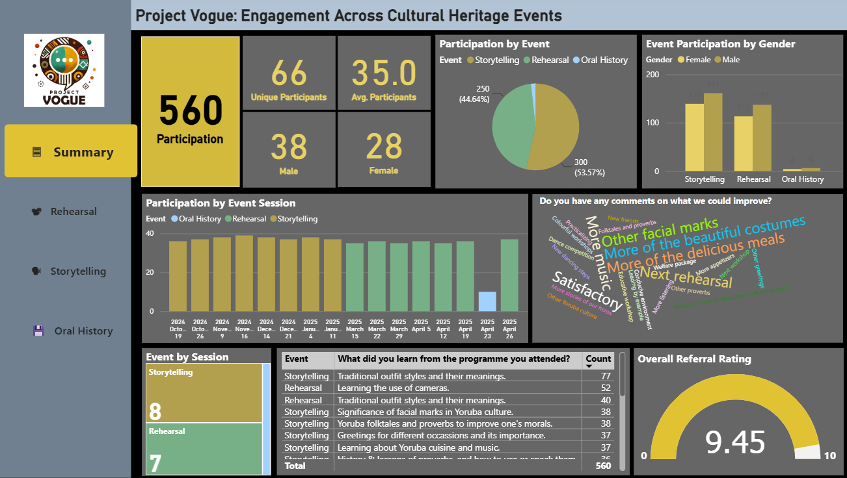
06 · DELIVERABLE
Project Vogue
The Power BI Report
Four-page report
A Summary page carrying programme-wide KPIs, plus one drill-through page per strand with its own participation, gender, feedback and referral views.
Colour identity per strand
Storytelling gold, Rehearsal green, Oral History blue. The mapping holds on every visual across all four pages, so a colour never means two things.
Weighted measures
The 9.45 referral rating is participation-weighted, not an average of the three strand averages, which would have returned a different figure.
The baseline state
Every session opens here: 560 attendances, 66 participants, 9.45 rating, 16 sessions. All nine visuals are live, and clicking any element cross-filters the rest. The slides that follow compare against this state.
Notes:
This is both the deliverable overview and the reference state the interactivity slides are compared against.

Slide 15
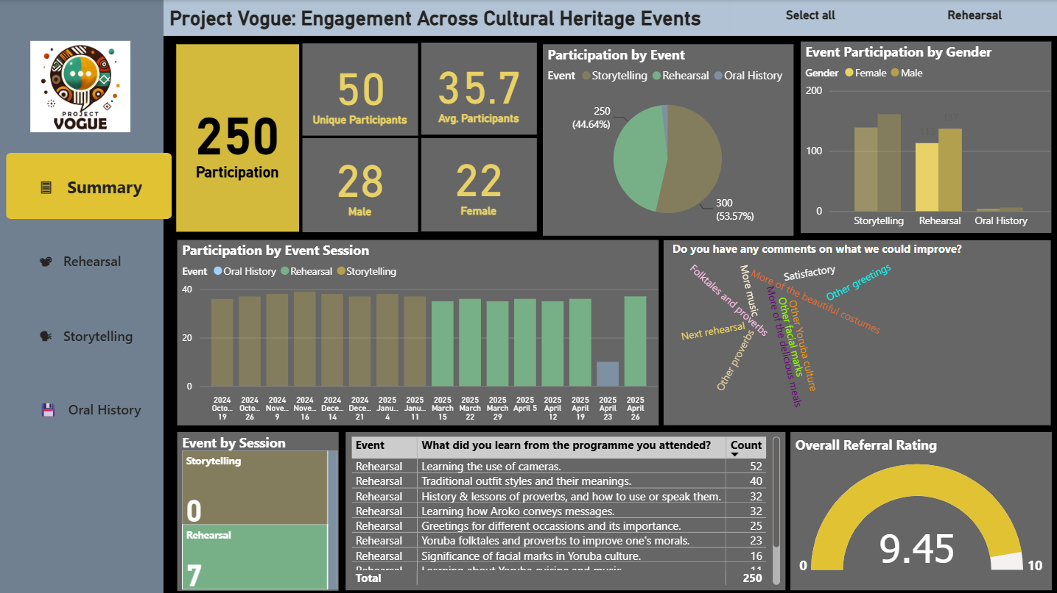
06 · INTERACTIVITY
Project Vogue
Cross-Filtering: Selecting Rehearsal
250
50
Participation
Unique participants
Down from 560 (44.6%)
Down from 66
9.45
7 / 0
Referral rating
Sessions shown
Unchanged from the overall figure
Rehearsal / Storytelling
What one click changed
A single click on the Rehearsal slice filtered the KPI cards, the session bars, the learnings table and the word cloud together. The new "Rehearsal" tag beside the title is the report's own confirmation the filter is active — every non-Rehearsal category is dimmed rather than removed, which is Power BI cross-highlighting exactly as intended.
Notes:
Point out the filter tag top-right as the clearest visible proof the interaction fired.

Slide 16
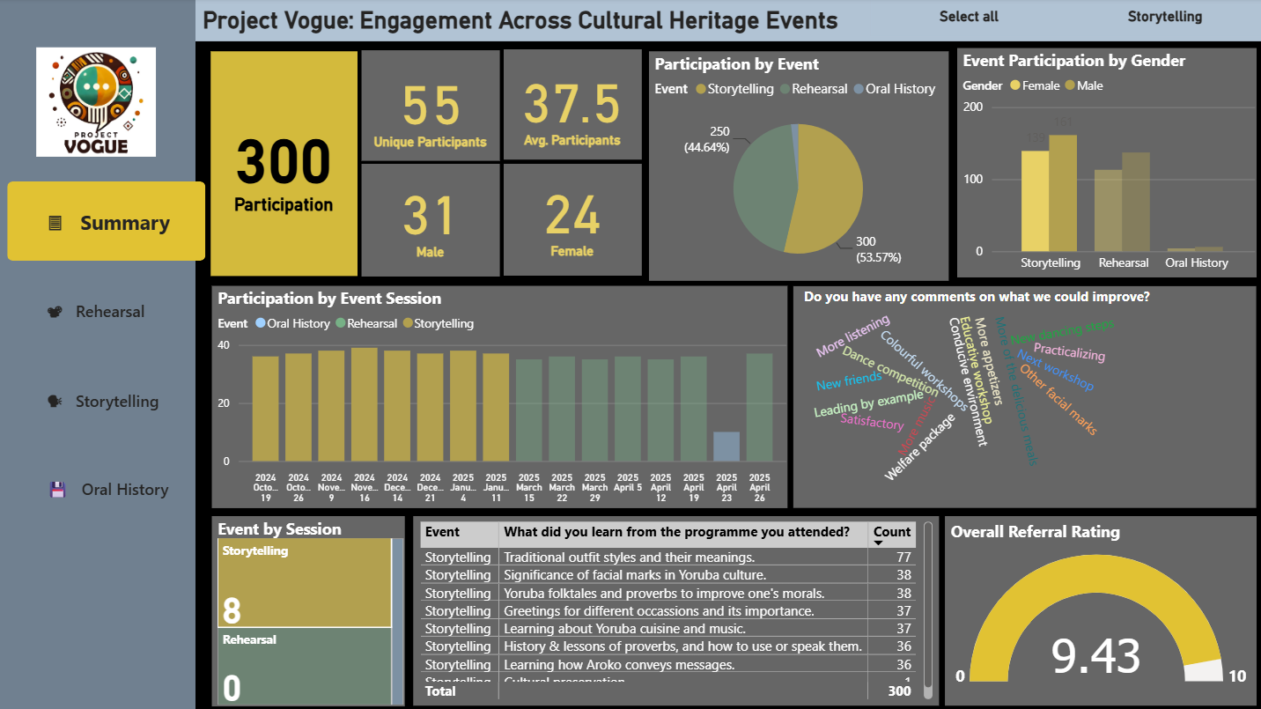
06 · INTERACTIVITY
Project Vogue
Cross-Filtering: Selecting Storytelling
300
55
Participation
Unique participants
53.6% of the total
Down from 66
9.43
8 / 0
Referral rating
Sessions shown
Marginally below the 9.45 overall figure
Storytelling / Rehearsal
What one click changed
The recommendation table recalculates rather than simply hiding rows: "Traditional outfit styles" remains the top learning at 77 mentions, now correctly scoped to Storytelling attendees only. The word cloud and the Event by Session panel update in the same instant, confirming every visual on the page reads from the same filter state.
Notes:
Same interaction, different strand — demonstrates the mechanism generalises rather than being a one-off.

Slide 17
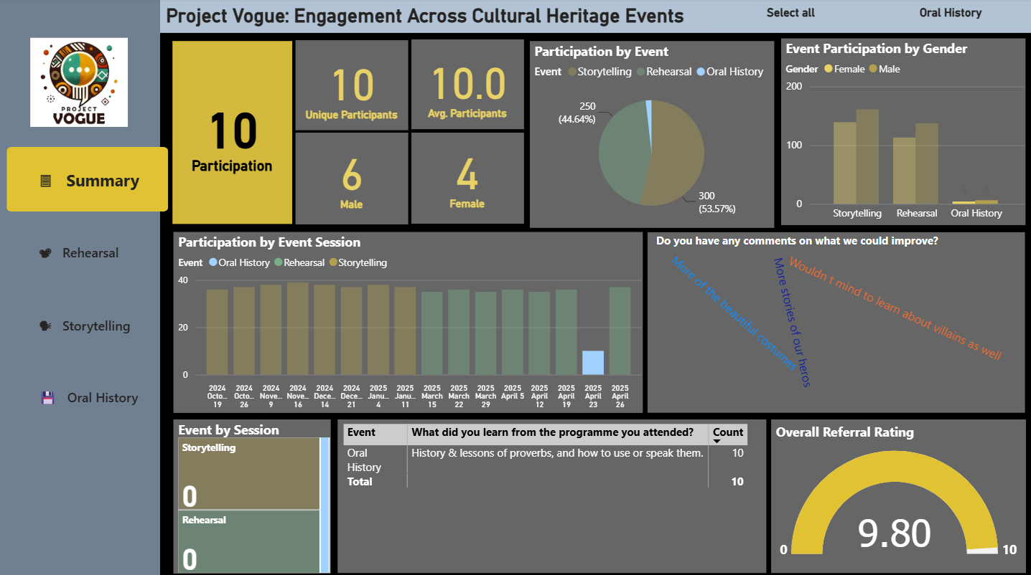
06 · INTERACTIVITY
Project Vogue
Cross-Filtering: Selecting Oral History
10
10
Participation
Unique participants
1.8% of the total
No repeat visits yet
9.80
3
Referral rating
Comments shown
Highest of the three strands
Now individually legible
What one click changed
At this scale the word cloud stops being a cloud: with only three comments remaining, each one is fully readable rather than overlapping. Filtering here does more than shrink the numbers — it changes what the visual is useful for, turning an aggregate impression into a readable transcript.
Notes:
Useful to show a reviewer who wonders whether filtering to a small subgroup breaks the report. It doesn't — it just changes the reading task.

Slide 18
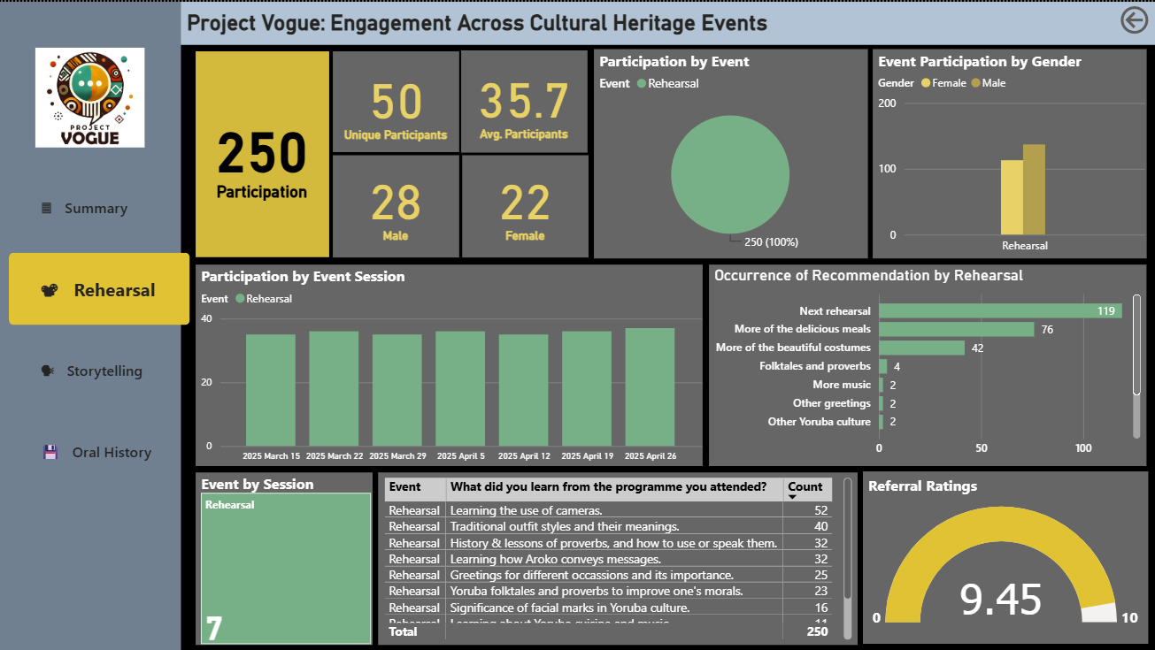
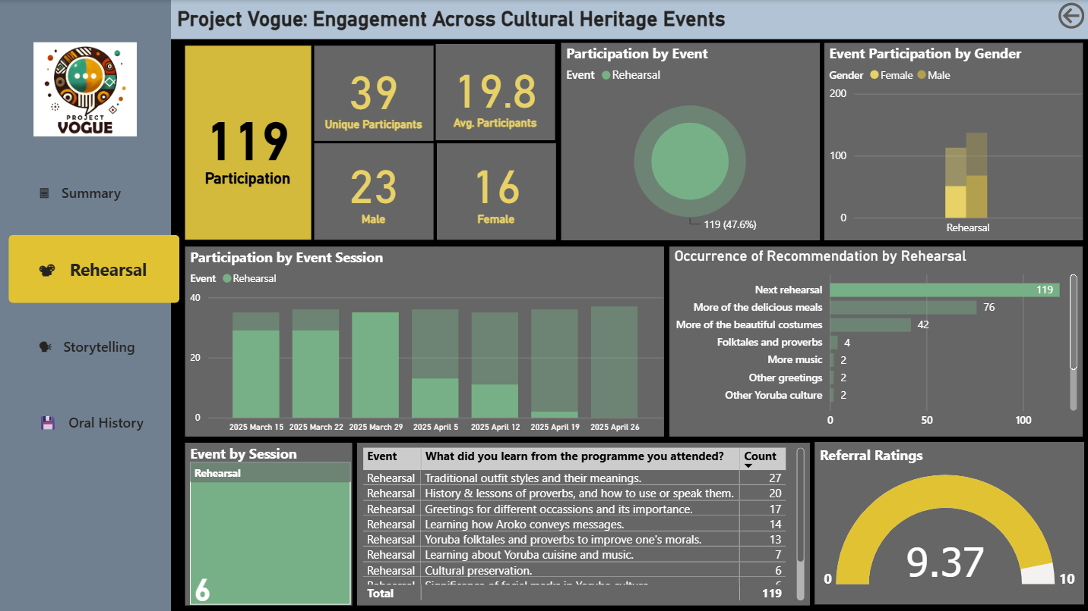
06 · INTERACTIVITY
Project Vogue
Drill-Through: Isolating a Single Recommendation
No filter · 250 attendances
"Next rehearsal" selected · 119 attendances
119
39
9.37
6 / 7
Requested it
Unique participants
Referral rating
Sessions represented
47.6% of Rehearsal's 250
Down from 50
Down slightly from 9.45
Every session, unevenly
Clicking a single bar inside "Occurrence of Recommendation" turned the donut into a ring showing the 47.6% selected share, and dimmed the un-selected portion of every session bar — showing exactly which sessions drove the request for a next rehearsal.
Notes:
The drill-through page proves a second filter layer works on top of the strand-level page itself.

Slide 19
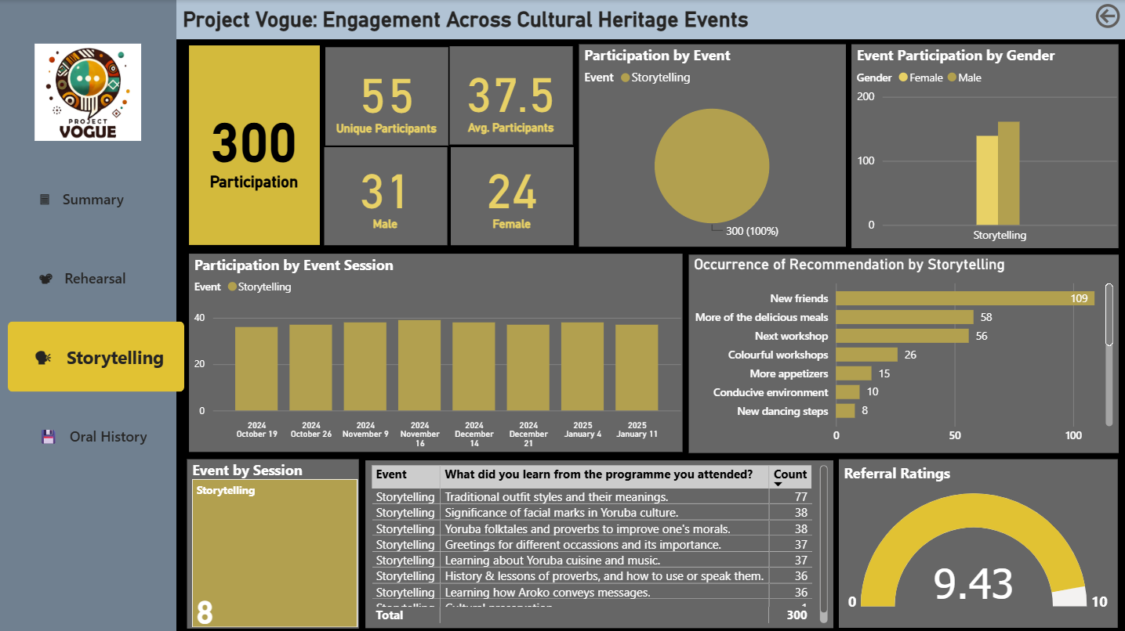
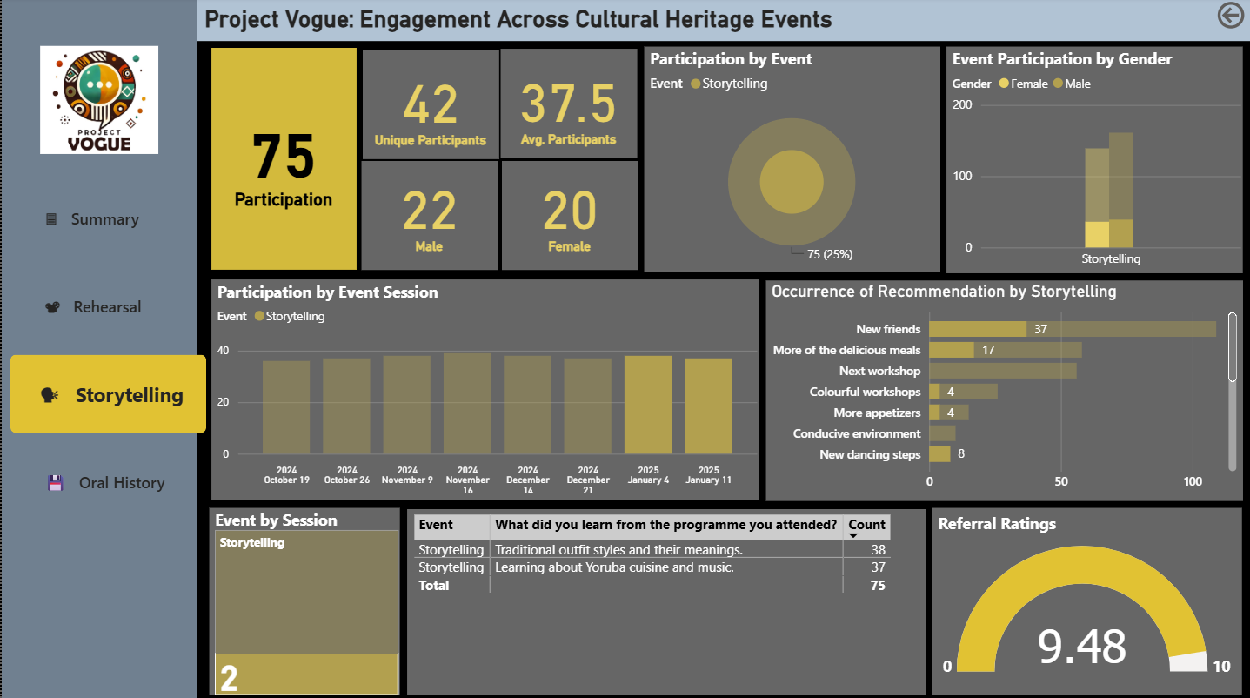
06 · INTERACTIVITY
Project Vogue
Drill-Through: Isolating the Final Two Sessions
No filter · 300 attendances
Last two sessions selected · 75 attendances
75
42
9.48
0
In final two sessions
Unique participants
Referral rating
"Next workshop" mentions
25% of Storytelling's 300
Down from 55
Up from 9.43 overall
56 overall, none in these two
The clearest read in the report: once the strand's final session passed, nobody asked for a next workshop. A recommendation falling silent on exactly the theme you'd expect, at exactly the point you'd expect it, is a strong sign the filter is behaving correctly.
Notes:
This is the strongest single piece of evidence that the interactivity is doing real analytical work, not just re-rendering the same shapes smaller.

Slide 20
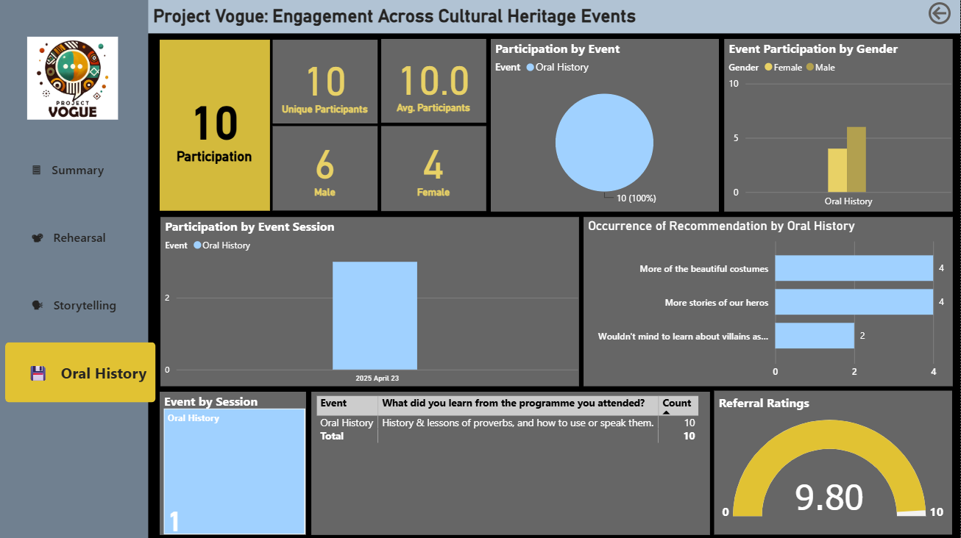
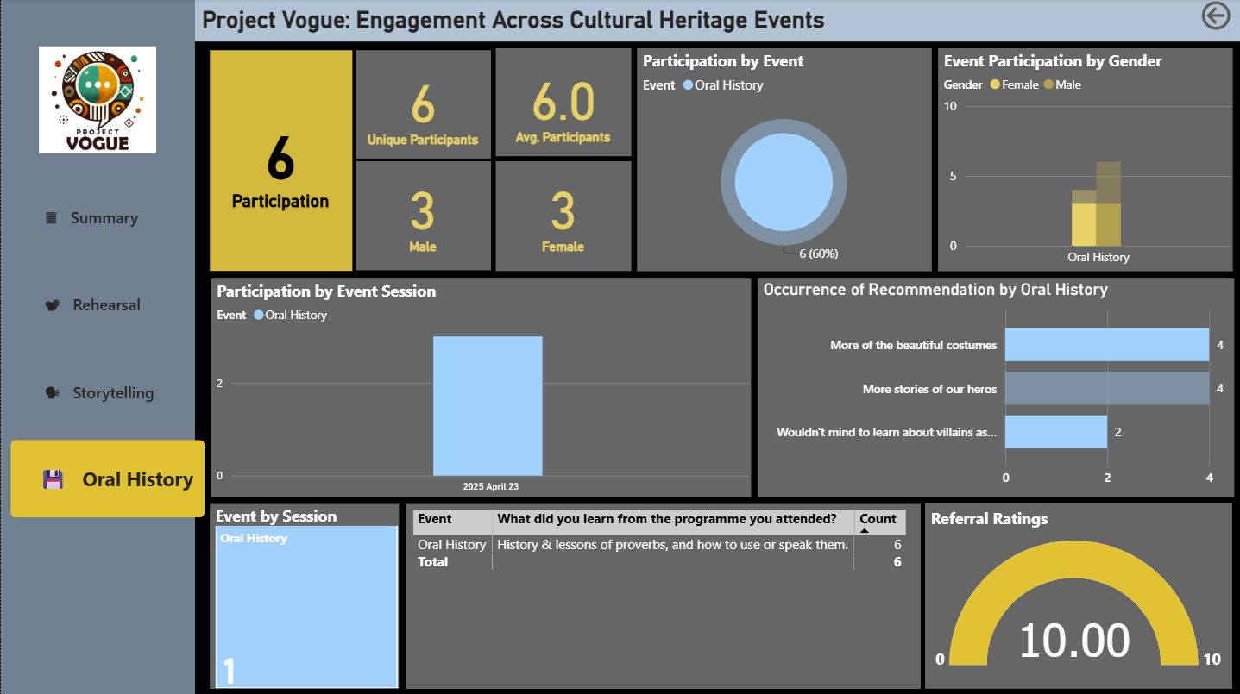
06 · INTERACTIVITY
Project Vogue
Drill-Through: A Perfect Score Emerges
No filter · 10 attendances
Costumes + villains selected · 6 attendances
6
6
10.00
2
In this subgroup
Unique participants
Referral rating
Themes selected
60% of Oral History's 10
Every one of the six
Up from 9.80 overall
Costumes and villain stories
Every participant who asked for more costumes or villain stories gave a perfect score; the four who asked for more hero stories are the only reason the strand average sits below 10. With a base this small the pattern is suggestive, not conclusive — a thread worth a follow-up question, not a settled finding.
Notes:
Flag the small-sample caveat explicitly if asked. This is the weakest evidential slide of the set and should be presented as such.

Slide 21
06 · INTERACTIVITY
Project Vogue
Two Interaction Mechanisms, One Coherent Report
Cross-filtering
Drill-through
Clicking any element on a page filters every other visual on that page instantly, with no navigation required. Demonstrated by selecting each of the three strands on the Summary page in turn.
The left-hand navigation moves to a dedicated page per strand, retaining the same chart types but scoped to that strand's own data, colour and referral score.
Compounding filters
Reading small subgroups carefully
The two mechanisms stack: a strand page can itself be cross-filtered further, as shown by selecting a single recommendation in Rehearsal and a specific pair of sessions in Storytelling.
Oral History's filtered views represent as few as six people. Patterns they show — a perfect referral score, for instance — are worth noting and following up, not treating as statistically settled.
Every screenshot in this section was captured live from the published Power BI report; no figure here was recreated or estimated.
Notes:
Closing note for the interactivity section before moving into recommendations.

Slide 22
07 · WHAT NEXT
Project Vogue
Recommendations
01
Follow up the single-visit group
02
Scale Oral History deliberately
17 participants attended exactly once; contact them to establish why they did not return
Their absence from the feedback pool is why the 9.45 rating should carry a caveat
This is the highest-value unanswered question in the dataset
One session and 10 attendees is a pilot, not a strand; its 9.80 rating is encouraging but rests on a very small base
Schedule three to four further sessions before drawing any conclusion about demand
03
Treat catering as programme design
04
Report reach and contact separately
Food draws 109 mentions, ranking above costume among improvement requests
Protect the catering budget rather than treating it as a discretionary extra
Publish 66 participants and 560 attendances as two distinct measures with their definitions attached
Build a volunteer and trustee pathway: adult participation stands at just 38 attendances
Notes:
Recommendation 01 is the one to lead with. It follows directly from the retention analysis and the satisfaction caveat.

Slide 23
08 · CONCLUSION
What This Analysis Establishes
01
Retention is the achievement
02
Cleaning changed the answer
66 people generated 560 attendances. Half the cohort came ten or more times across seven months.
169 name variants resolved to 66 people. Uncorrected, reported reach would have been 2.6 times too high.
03
Satisfaction is real but selective
04
Costume outranks oral content
No score below 8 across 517 responses, though the sample is weighted toward returning regulars.
Traditional outfit styles draws 116 mentions, ahead of proverbs at 78. Visual heritage is the most memorable.
05
Food and friendship drive return
06
The interactivity holds up under scrutiny
109 mentions each for catering and for making new friends, both ranking above cultural content requests.
Nine slides of live-captured filtering show every mechanism working as designed, including where the underlying sample is too small to over-read.
Project Vogue · MYEC Cultural Heritage Programme · October 2024 to April 2025 · Samuel Babajide
Notes:
Close on point 01 and point 06 if time is short: what the programme achieved, and that the interactive report is trustworthy on camera, not just live.

