Slide 1
SmartCart
A Product of the I(o)T-Designers Group

Slide 2
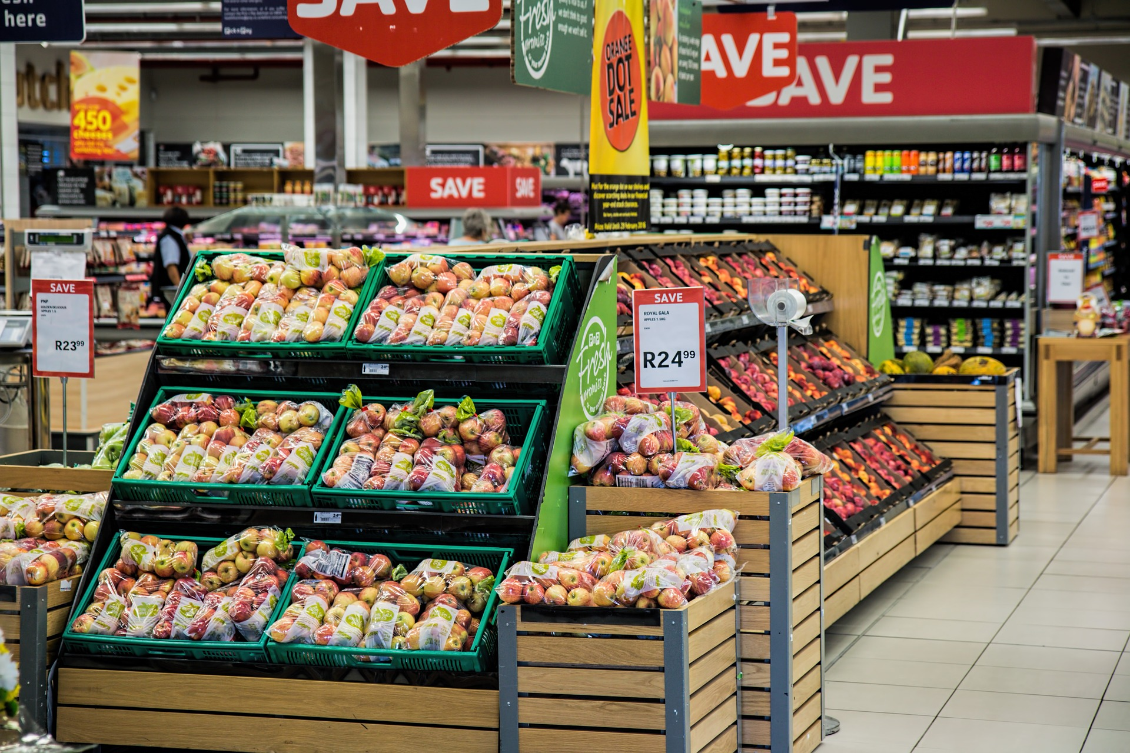

Shopping is stress, time consuming, ..
Where will I find the next thing on my list?
How find all the things on my list without walking back?
How to optimize shopping?
Reducing the time spent
Reducing the „stress“

Slide 3
SmartCart offers…
Ordering of an unodered shopping-list
Improves Your ways through the supermarket
Saves You time
Ordering based on
the recognition of the shop You‘re in (GPS)
Learning & automatically exchanging outcomes between the users
Simple control
One touch control (first POC)
Further possibilities
Speech Recognition to control the App (Microphone)
Motion control (acceleration sensor)

