Slide 1
SmartCart
A Product of the I(o)T-Designers Group

Slide 2
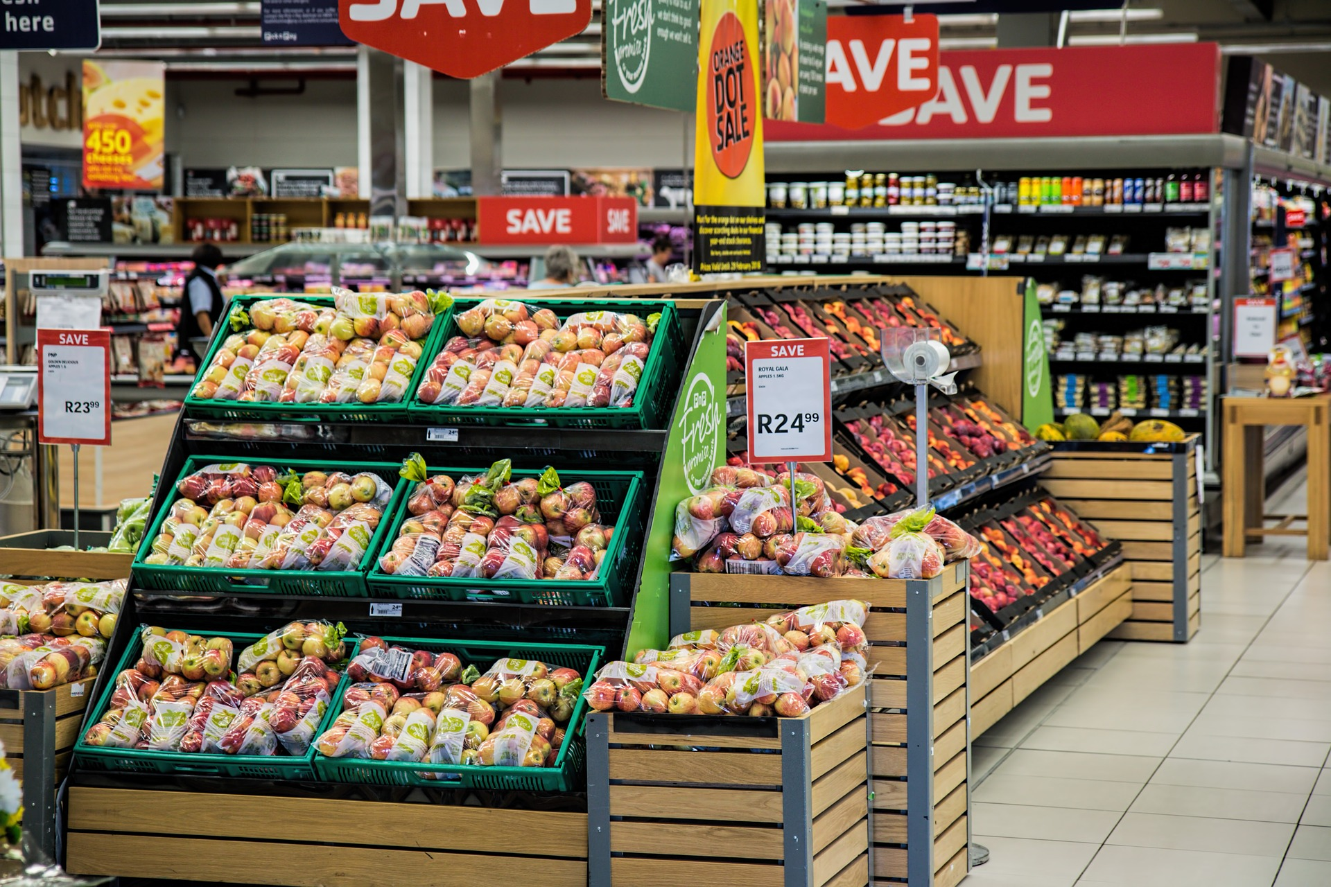

Shopping is stress, time consuming, ..
Where will I find the next thing on my list?
How find all the things on my list without walking back?
How to optimize shopping?
Reducing the time spent
Reducing the „stress“

Slide 3
SmartCart offers to its users…
A way of organizing themselves
A way of genious shopping

Slide 4
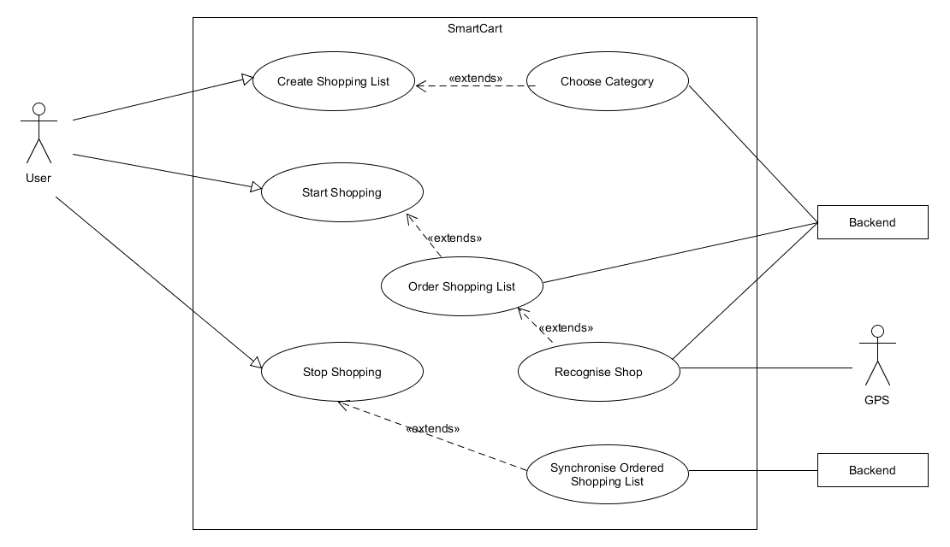
SmartCart – Technical Overview Use Cases

Slide 5
SmartCart – Technical Overview Use Cases

Slide 6


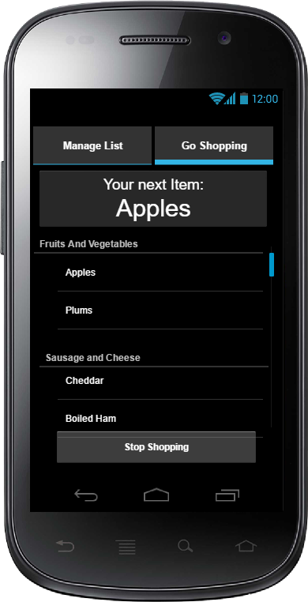




SmartCart – Big Picture

Slide 7
SmartCart – Business Model
Two main Phases:
Penetration of the market
Earning Money

Slide 8
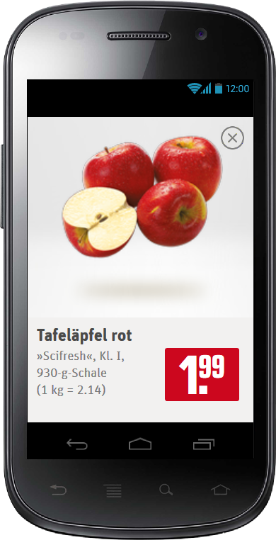
SmartCart – Business Model
Two versions of SmartCart
Basic Version (free)
Pro Version (1.99 €)
Basic Version will show ads of the grocery that is entered
First users will get a free Pro Version
First ad placements will be free, if the market contributes in collecting data

