Slide 1
SmartCart
A Product of the I(o)T-Designers Group

Slide 2
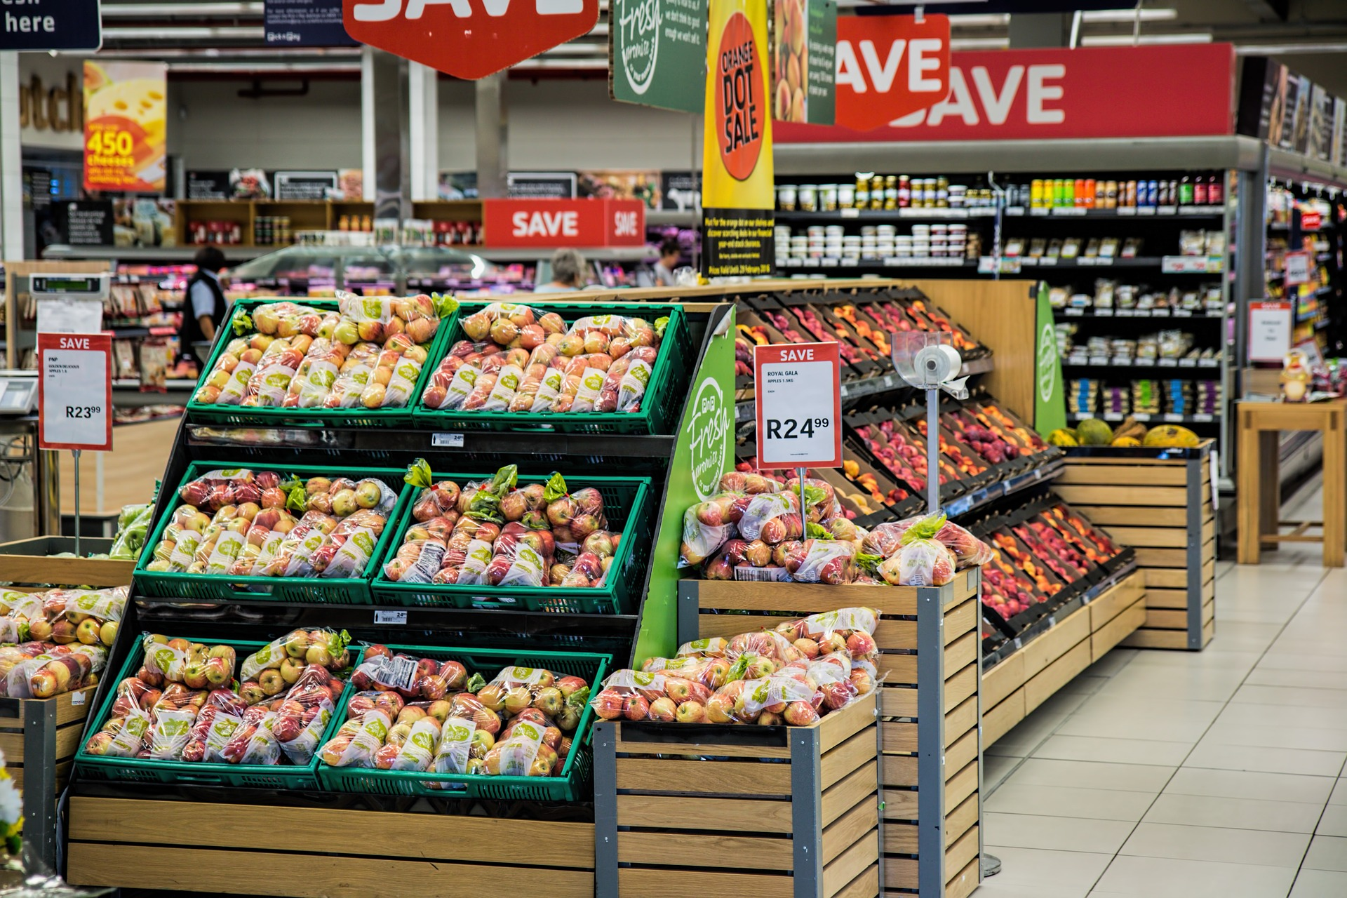

SmartCart – Agenda
Technical Overview
Use Cases
State Machine
Data Model
Business Model
Big Picture
Mock Up

Slide 3
SmartCart offers…
..to its users:
A way of organizing themselves
A way of genious Shopping
More time for the important Things in Life!
The Possibility to place Ads
A relaxed Customer that enjoys its Shopping Experience
..to the supermarkets:

Slide 4
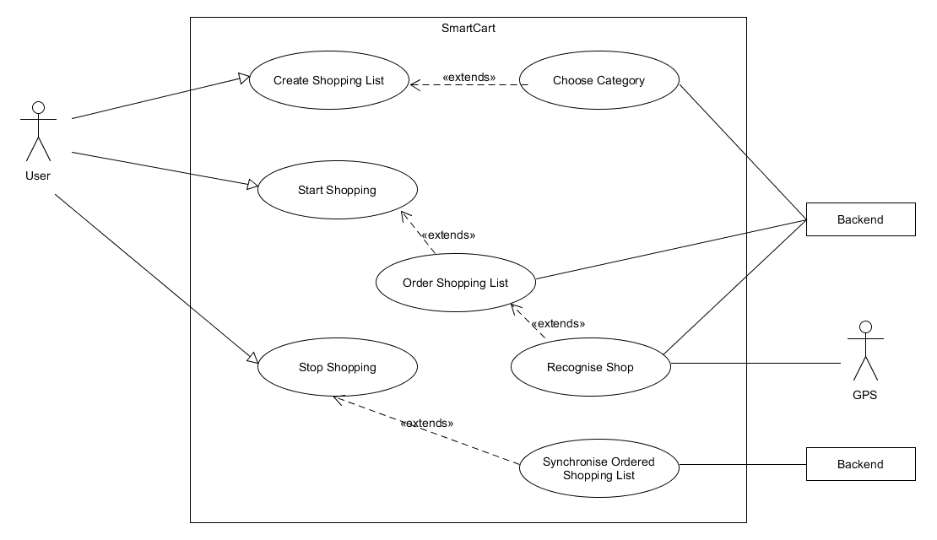
SmartCart – Technical Overview Use Cases

Slide 5
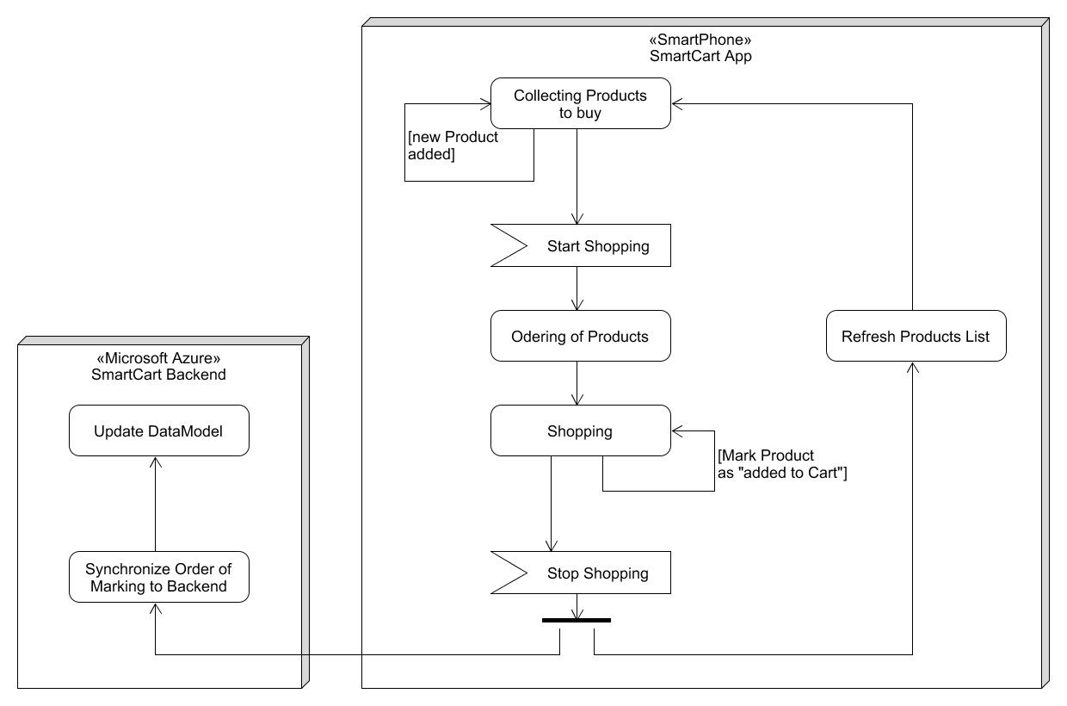
SmartCart – Technical Overview State Machine

Slide 6
SmartCart – Technical Overview Data Model
Initial Shopping List
Apples
Boiled Ham
Cheddar
Washing Powder
Plums
Pizza - 2 pcs
Ordered Shopping List
Apples
Plums
Cheddar
Boiled Ham
Washing Powder
Pizza - 2 pcs

Slide 7
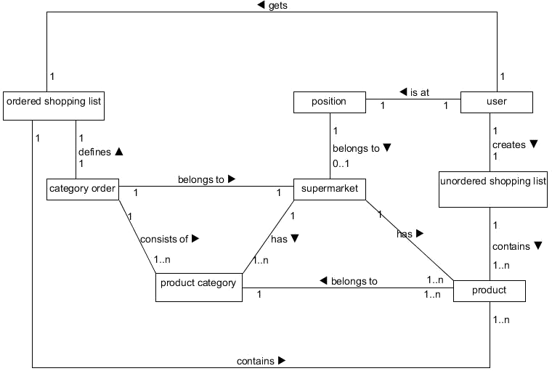
SmartCart – Technical Overview DataModel

Slide 8
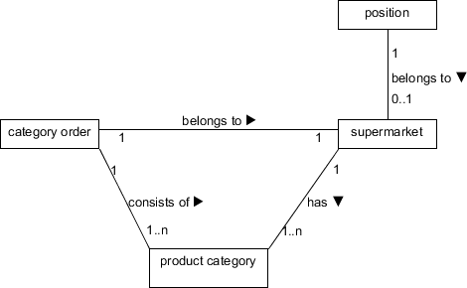
SmartCart – Technical Overview Data Model

Slide 9
SmartCart – Technical Overview Data Model
Predefined Data
Products | Product Categories
Apple | Fruit/Vegetables
Mincemeat | Meat
Salmon | Fish
Spaghetti | Pasta
Pizza | Frozen food
Toast | Bread
Yoghurt | Dairy products
Washing powder | Household items
Cheddar | Cheese/Sausage
Batteries | Electronics
Beer | Beverages
Canned mushrooms | Canned goods
Baking powder | Bakery products
Chewing gum | Cashpoint area

Slide 10
SmartCart – Technical Overview Data Acquisition
Collecting the order of marking the Products as „added to Cart“
Collecting the chosen Category of Product
Majority will decide
Naive Bayes regarding Shopping Time
Ordering of a market‘s department also derived from order of marking the Products as „added to Cart“
Initial Order…?

Slide 11
SmartCart – Business Model
Two main Phases:
Penetration of the market
Earning Money

Slide 12
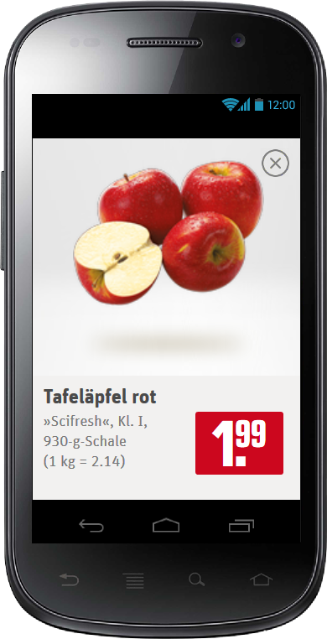
SmartCart – Business Model
Two versions of SmartCart
Basic Version (free)
Pro Version (1.99 €)
Basic Version will show ads of the grocery that is entered
First users will get a free Pro Version
First ad placements will be free, if the market contributes in collecting data

Slide 13


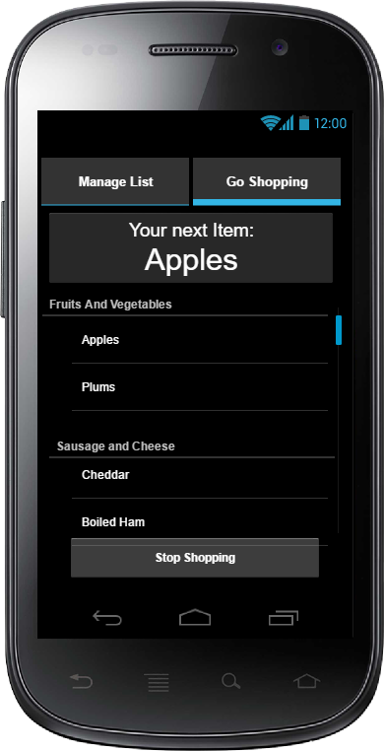




SmartCart – Big Picture

