Slide 1
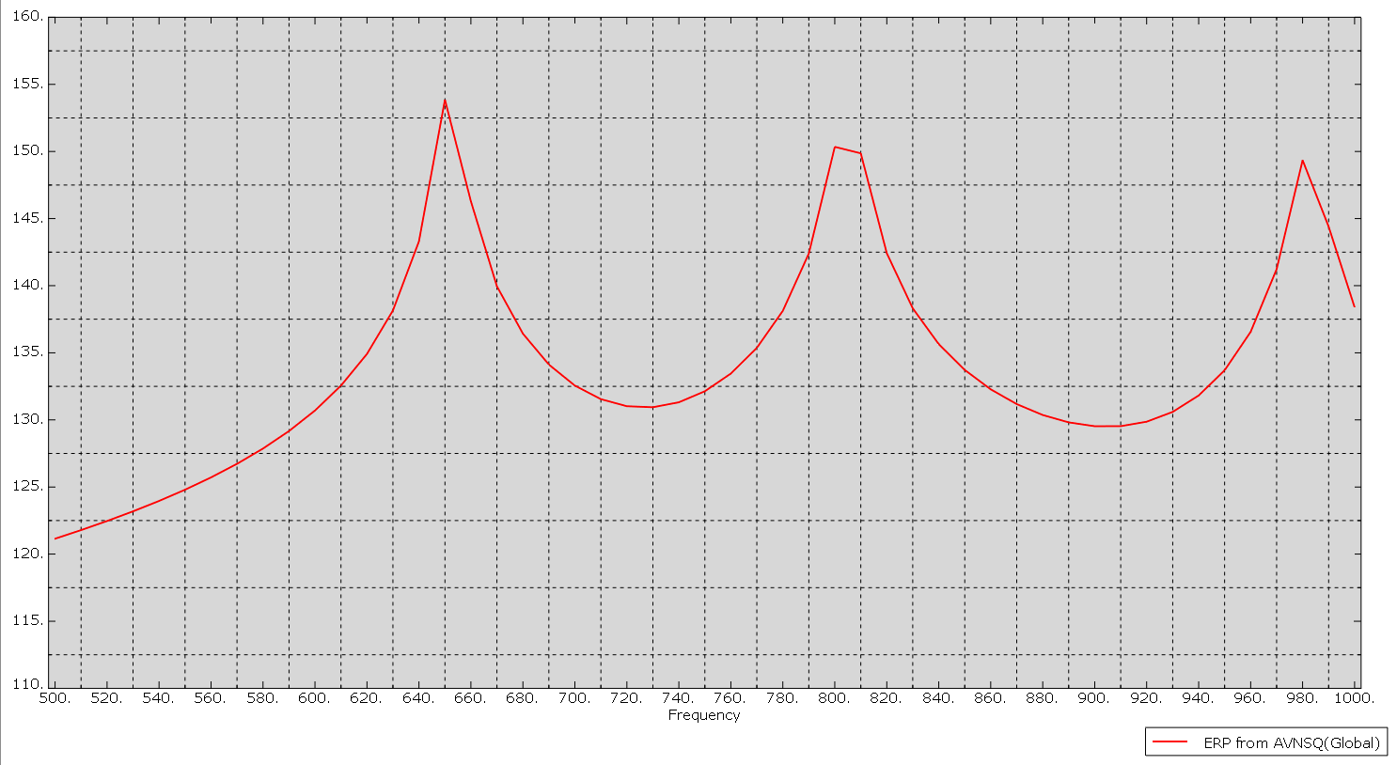
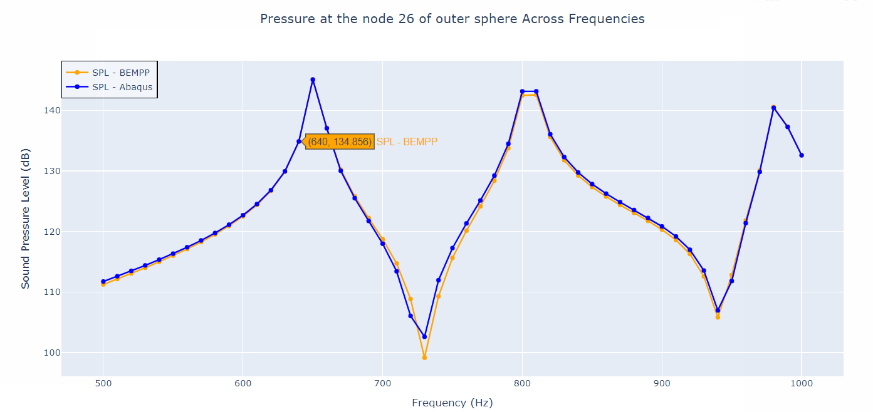

Slide 2
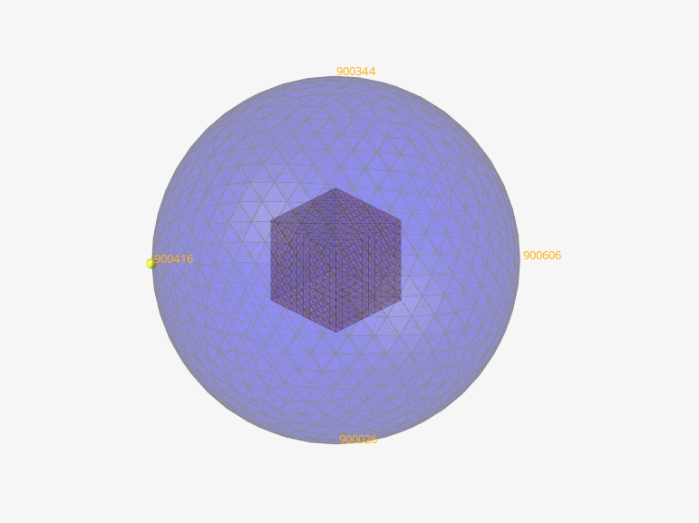
Cube and the Outer surface
All the elements are trias
Cube is 100*100*100 (mm)
Cube element size: 10mm
Outer sphere element size: 25mm
Radius of outer sphere is 200mm from centre of cube
6 elements per wavelength corresponding to highest freq: 1000 Hz ----343.55mm(lambda)----57 mm
With 25mm, frequencies upto 2000 hz can be calculated
Cavity Radius should be 1/4th of wavelength corresponding to lowest freq: 500 hz ----687.11(lambda)----171.7795 mm

Slide 3
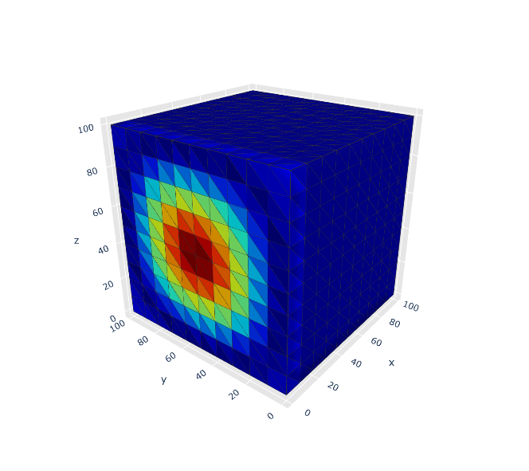

Slide 4
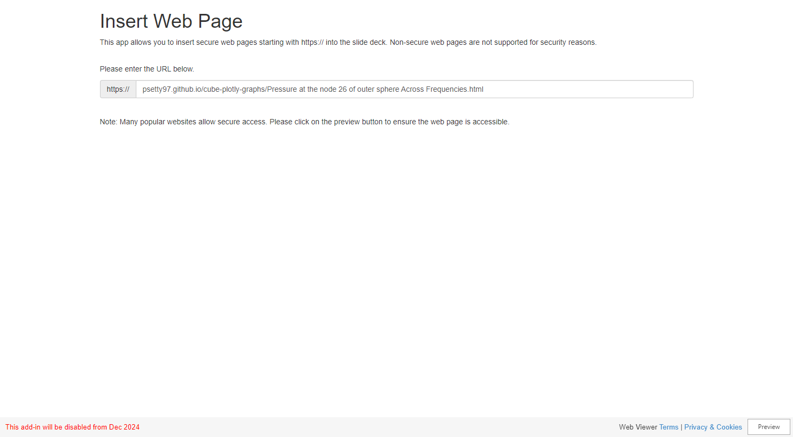

Slide 5
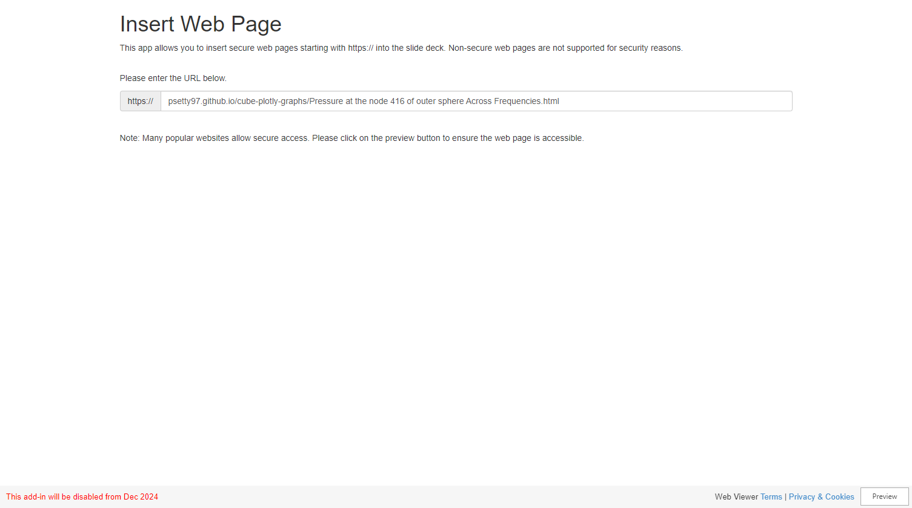

Slide 6
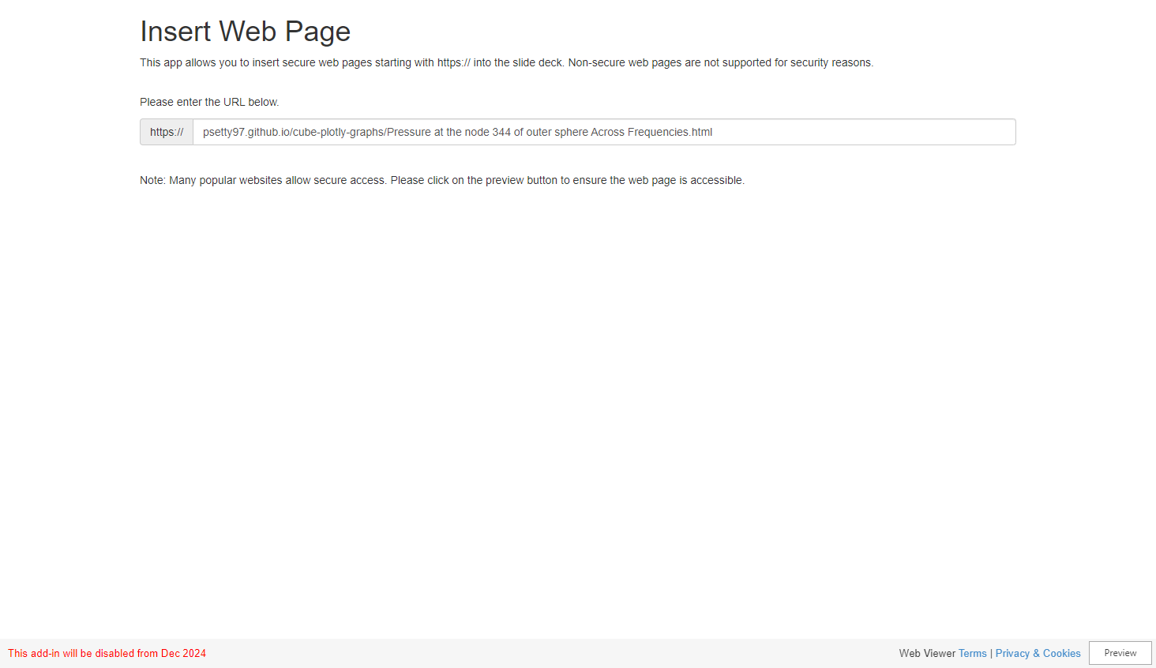

Slide 7


Slide 8
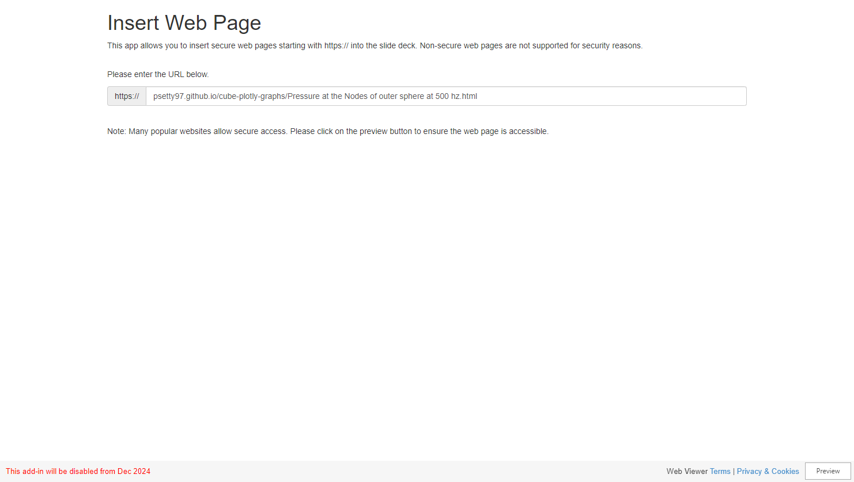

Slide 9
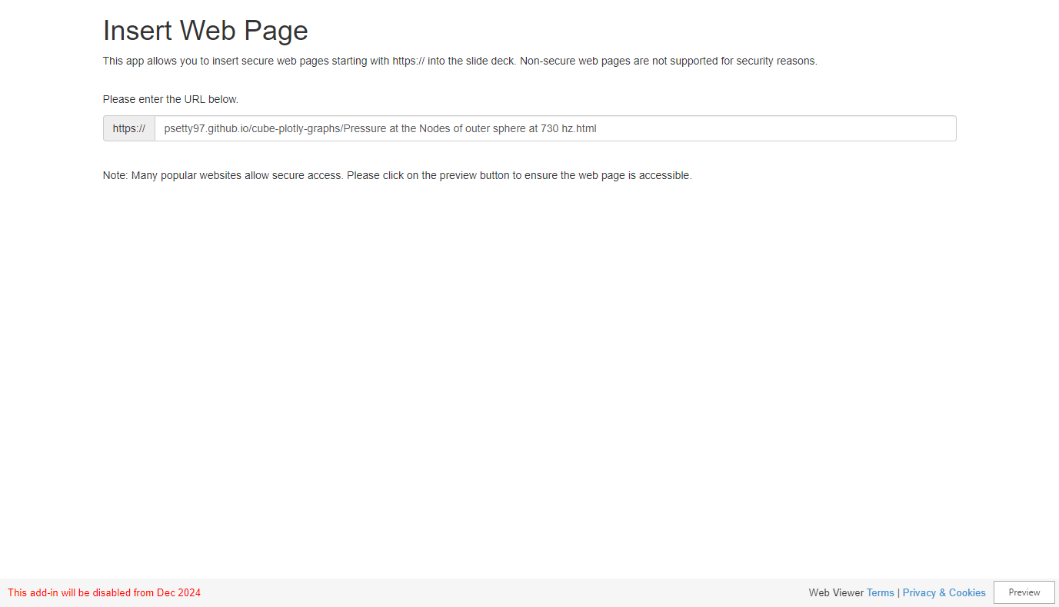

Slide 10


Slide 11
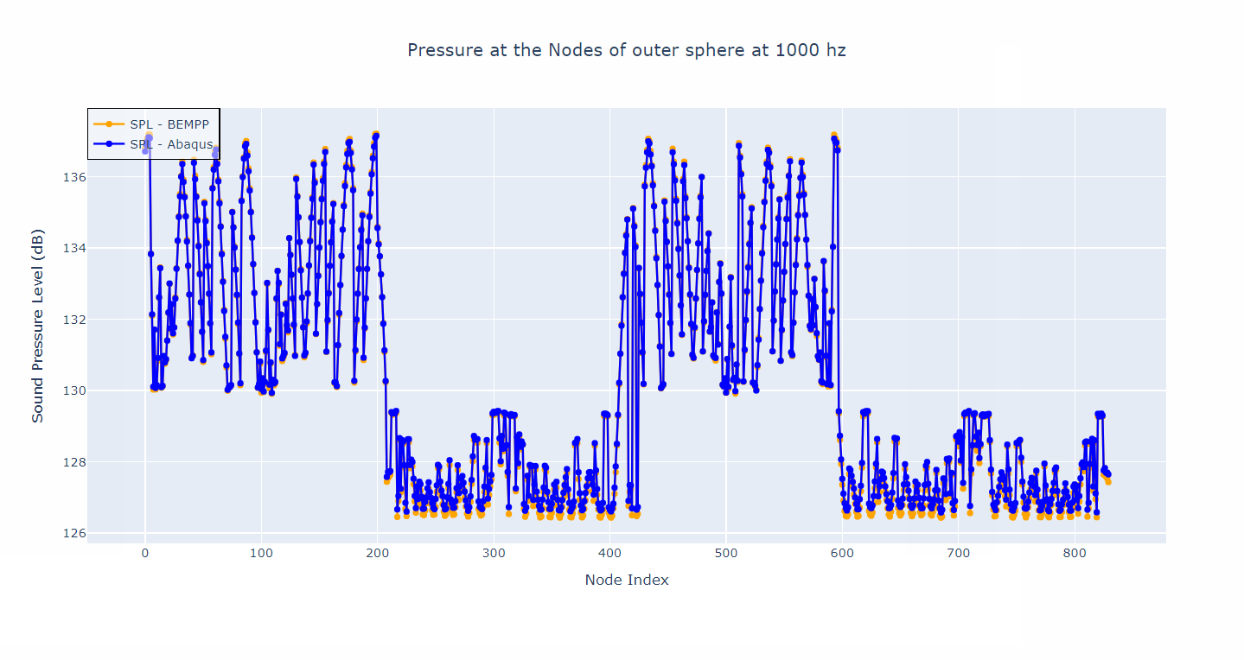

Slide 12
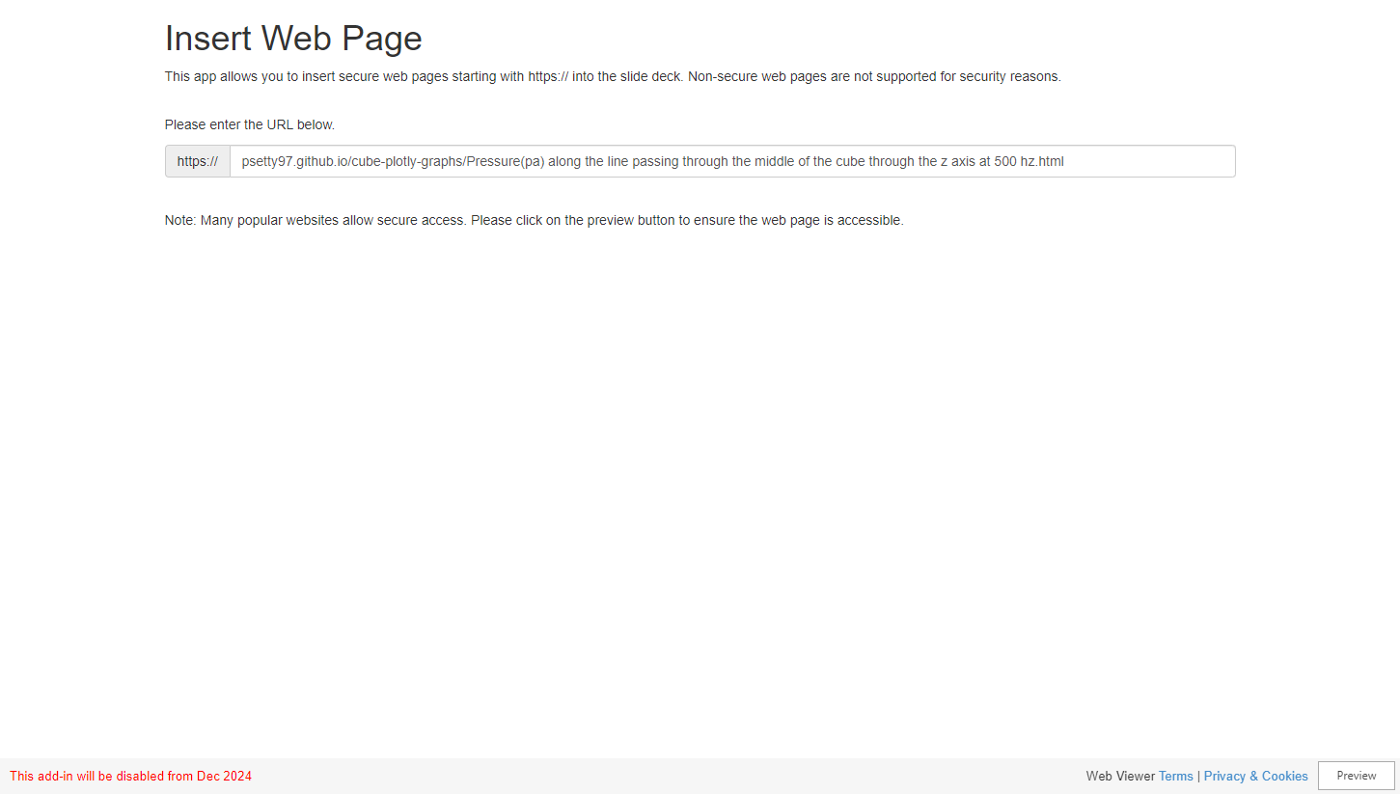

Slide 13
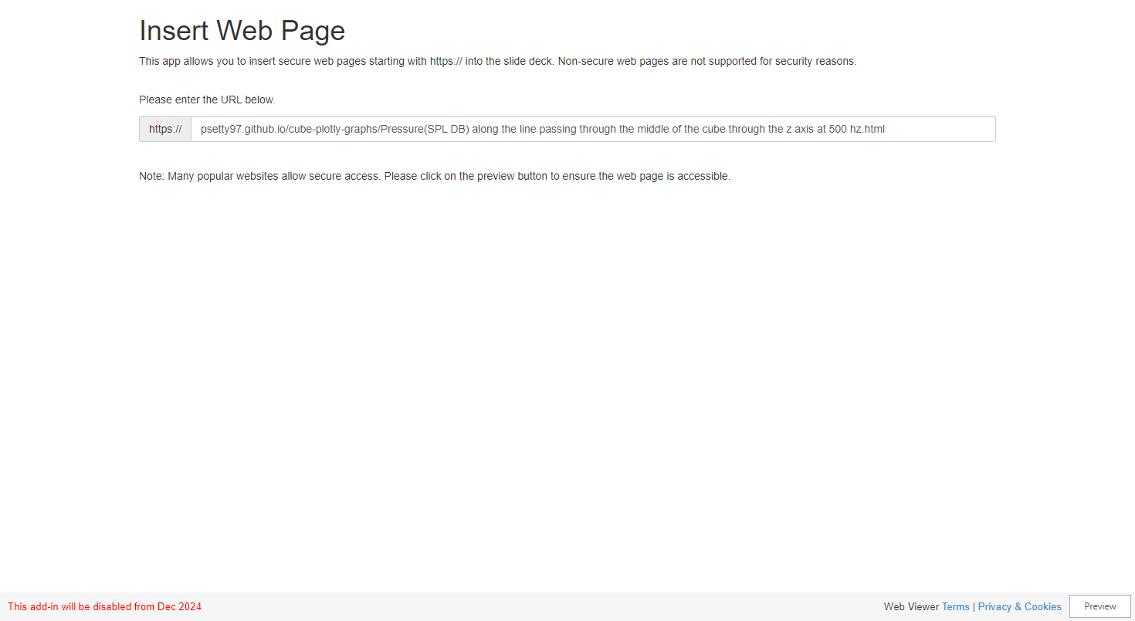

Slide 14
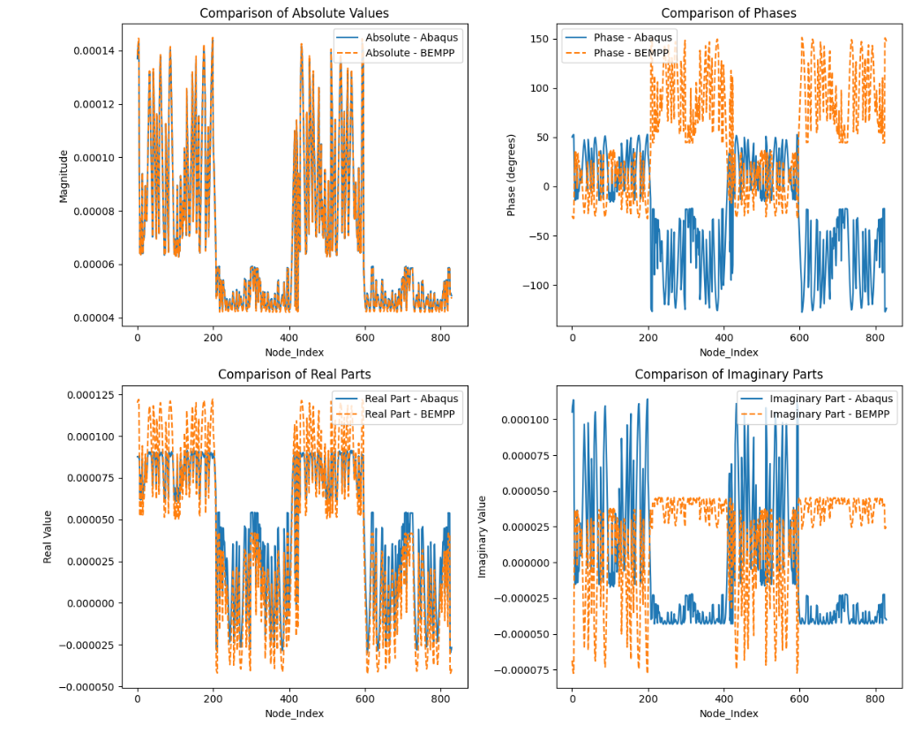
Wave number K is positive

Slide 15
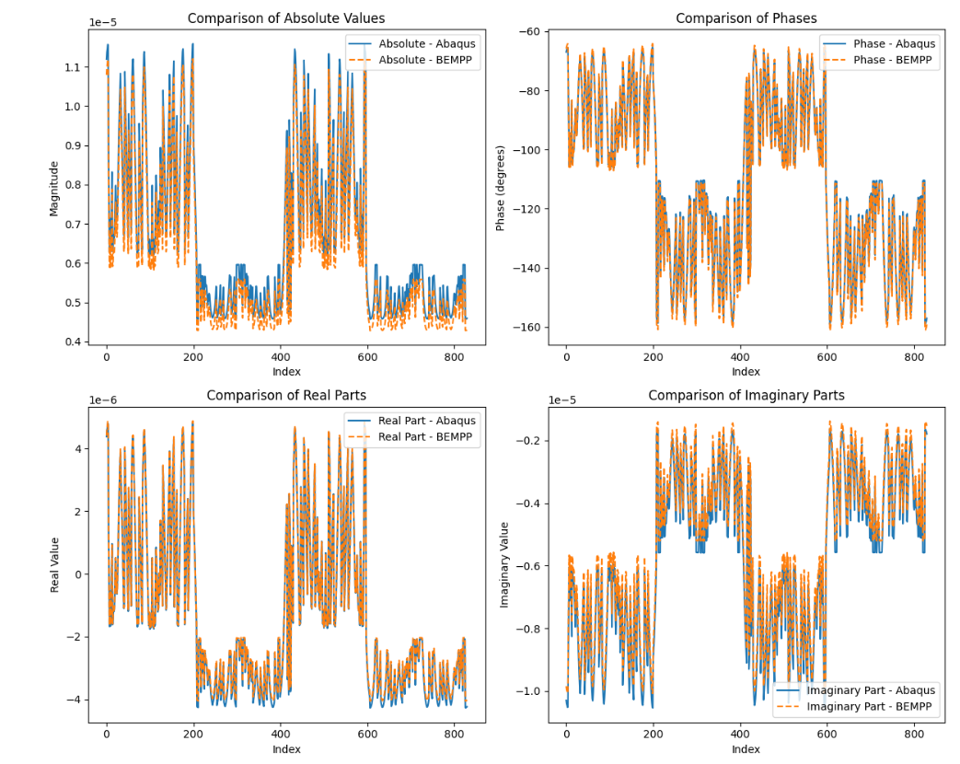
Wave number K is negative

Slide 16
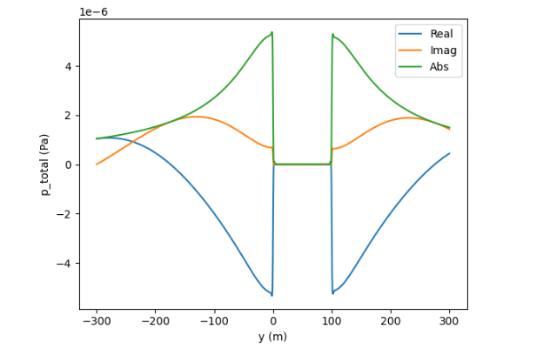
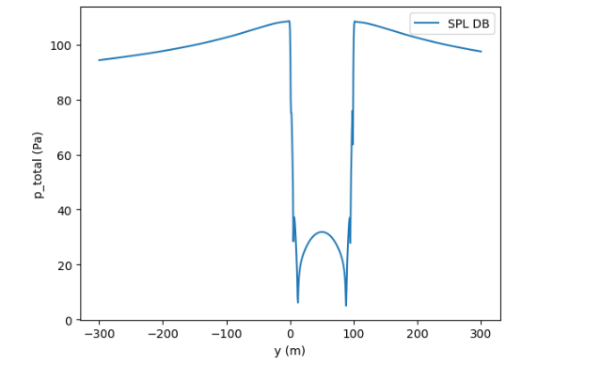

Slide 17
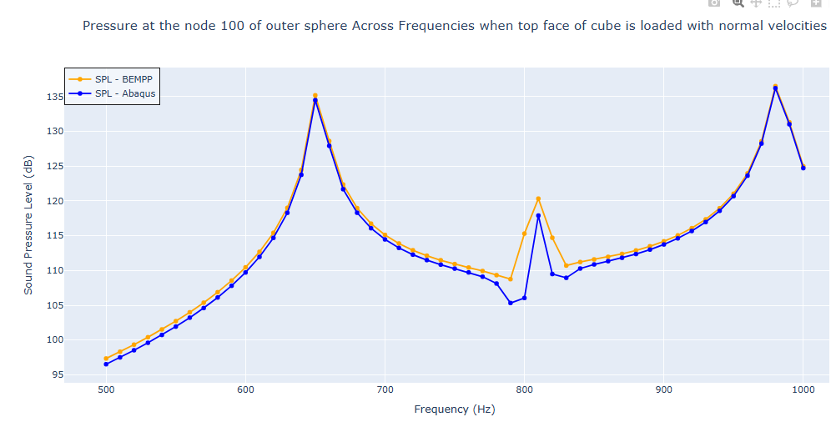

Slide 18
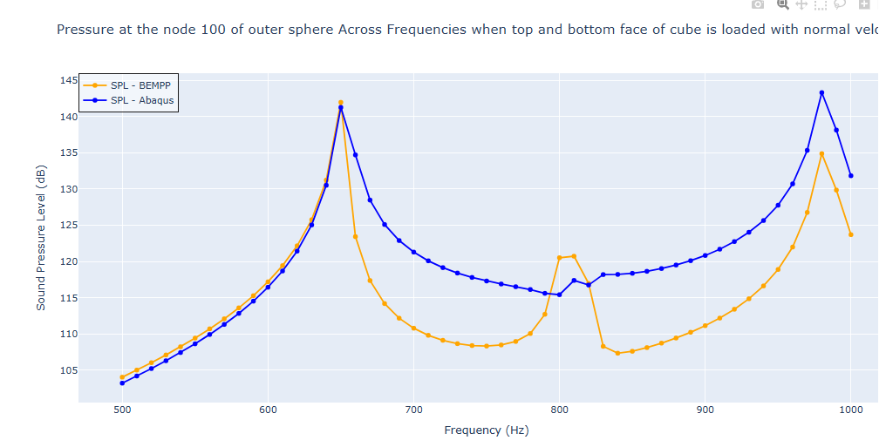

Slide 19
