Slide 1
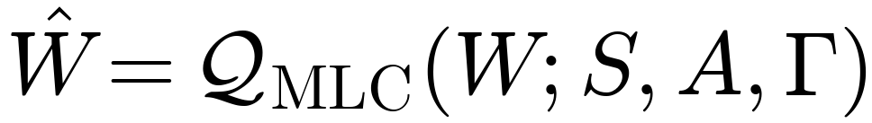
Multi-Lattice Calibration for Post-Training Quantization
Each weight learns which lattice spacing to use from a carrier-embedded family.
Each weight also learns a neighboring-point projection inside the selected spacing.
All parameters are optimized under one reconstruction-driven post-training objective.
1

Slide 2
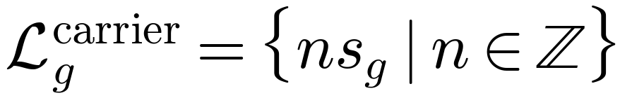
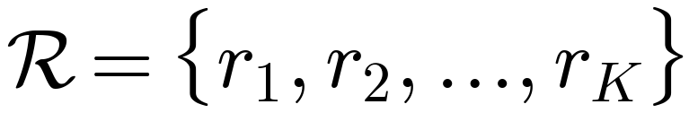
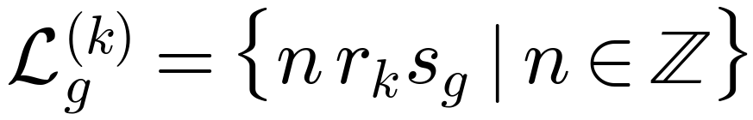
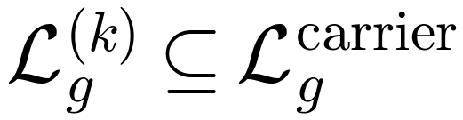
Carrier lattice and sub-lattice family
For each group g, define one carrier lattice and a family of allowed sub-lattice multipliers.
Examples of multiplier sets: {1,2,4}, {3,5,15}, {12,30,60}.
2

Slide 3
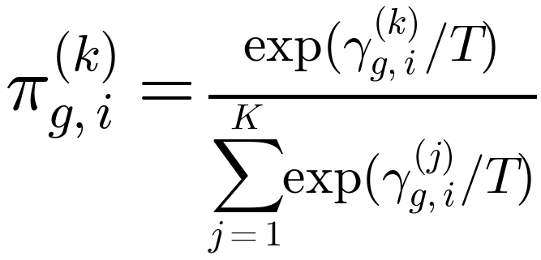
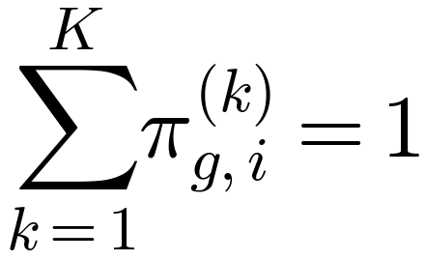
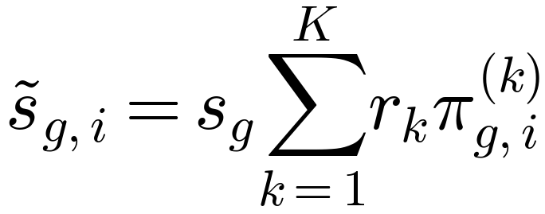
Per-weight lattice-family selection
Each weight learns a soft preference over the entire sub-lattice family.
The effective spacing is the carrier scale times the selected multiplier mixture.
3

Slide 4
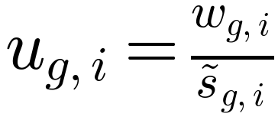
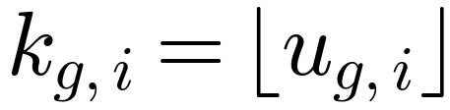
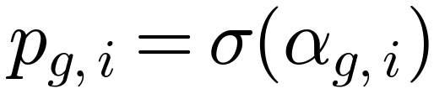
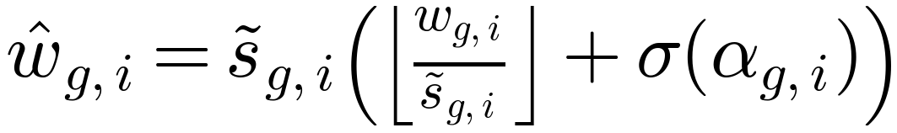
Neighboring-point projection inside the chosen lattice
After forming the effective spacing, each weight is projected between its two nearest lattice points.
The fractional projector determines the local position within that interval.
4

Slide 5
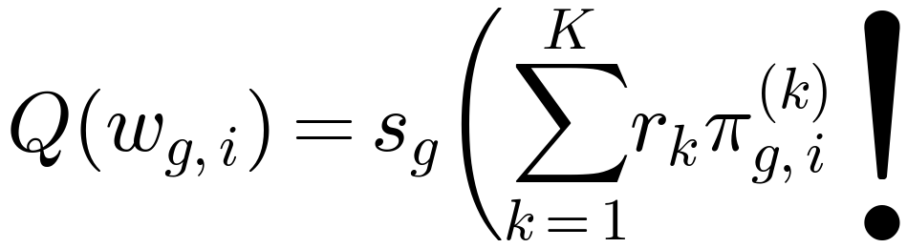
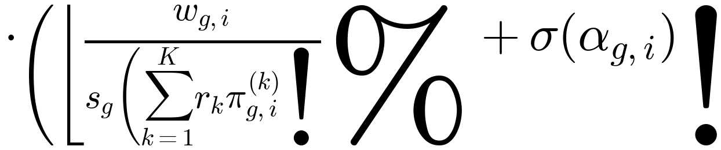
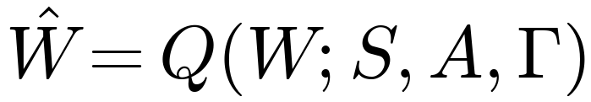
Unified multi-lattice quantization operator
Lattice-family selection and neighboring-point projection combine into one operator.
5

Slide 6
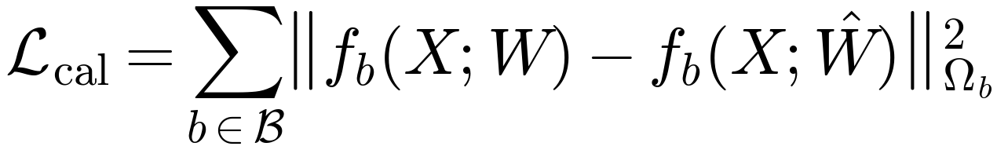
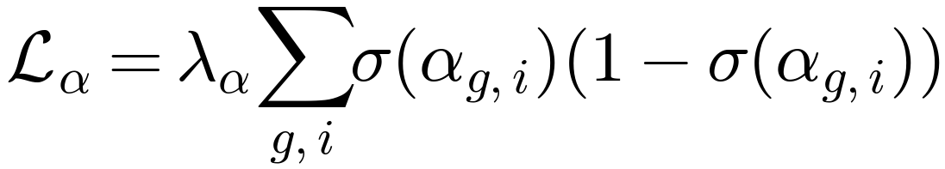
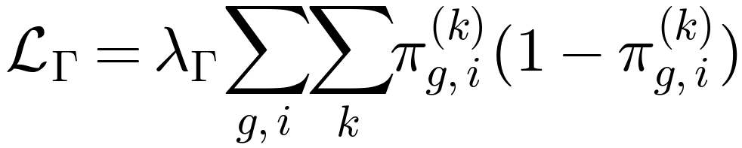

Single reconstruction-driven calibration energy
Calibration is block-wise, post-training, and uses frozen pretrained weights with unlabeled data.
Both lattice choice and local projection are learned under one objective.
6

Slide 7
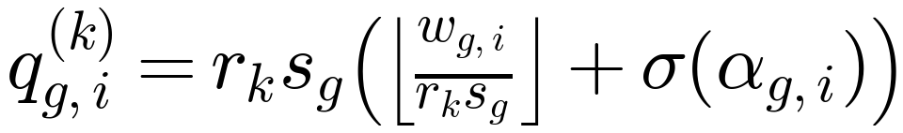
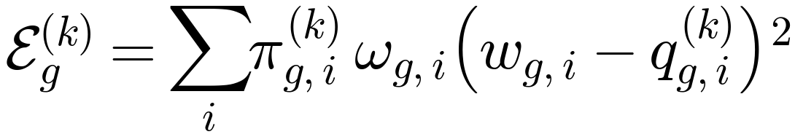
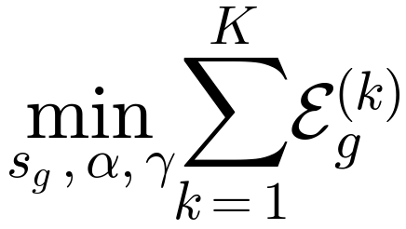
Partition-conditioned lattice calibration
Each candidate lattice is calibrated primarily by the subset of weights that prefers it.
The partitions and the lattice scales co-adapt during calibration.
7

Slide 8
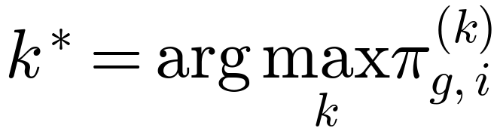
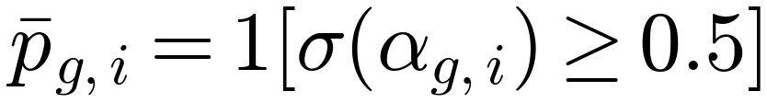
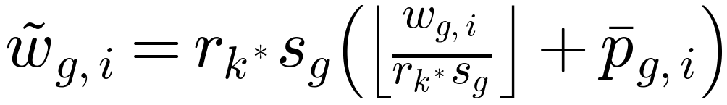
Hardening into the execution image
Continuous calibration variables are hardened for deployment.
The final deployed tensor is discrete and concrete.
8

Slide 9
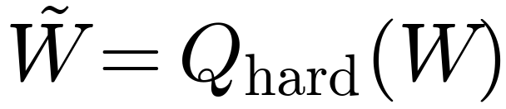
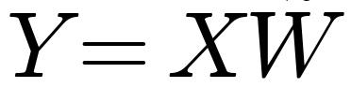
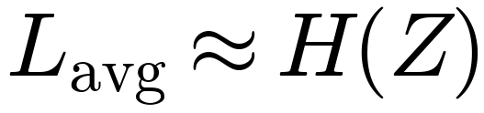
Execution image and entropy-coded deployment
The deployed model is emitted as one quantized object and one symbol stream.
Structured symbol occupancy can be compressed with entropy coding such as Huffman coding.
9

Slide 10
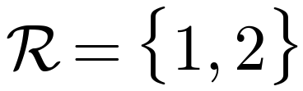
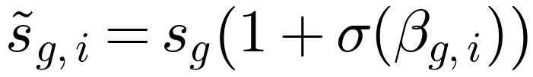
Simplified embodiment: two-lattice case
The two-lattice form is a constrained embodiment of the general multi-lattice framework.
Set the multiplier family to {1,2} and replace the family selector with one scalar modulator.
10

Slide 11
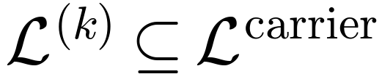
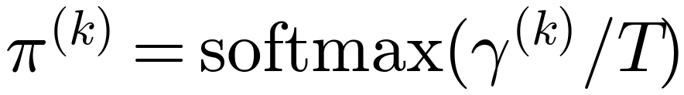
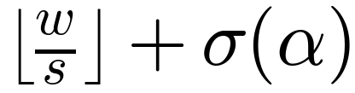

Claim-facing summary
A carrier lattice with a family of embedded sub-lattices.
A learnable lattice-family selector and a learnable neighboring-point projector.
Joint optimization under one reconstruction objective, followed by hardening into an entropy-coded execution image.
11

