Slide 1
Entropy Experiments and Compression Analysis
Understanding the Relationship Between Entropy and zstd Compression
Your Name & Date

Slide 2
Why Compute Entropy?
• Entropy measures randomness and affects compression efficiency.
• zstd is an entropy-based compressor, meaning **structured distributions** compress better.
• More zeros **do not always** mean better compression.
• Goal: **Understand how entropy impacts zstd compression**.

Slide 3
How zstd Relates to Entropy
• zstd uses **Finite State Entropy (FSE) coding** to compress data.
• Works best when data has **low entropy** (i.e., predictable patterns).
• **More zeros ≠ better compression** unless structured.
• Need to optimize quantization to **reduce entropy, not just increase sparsity**.

Slide 4
Entropy Metrics & Intuition
Metric | Purpose | Impact on Compression
Shannon Entropy | Measures randomness in weights | Lower entropy = better compression
Normalized Entropy | Compares entropy across layers | Useful for comparisons
Effective Alphabet Size (EAS) | Number of unique values in data | Lower EAS = better compression

Slide 5
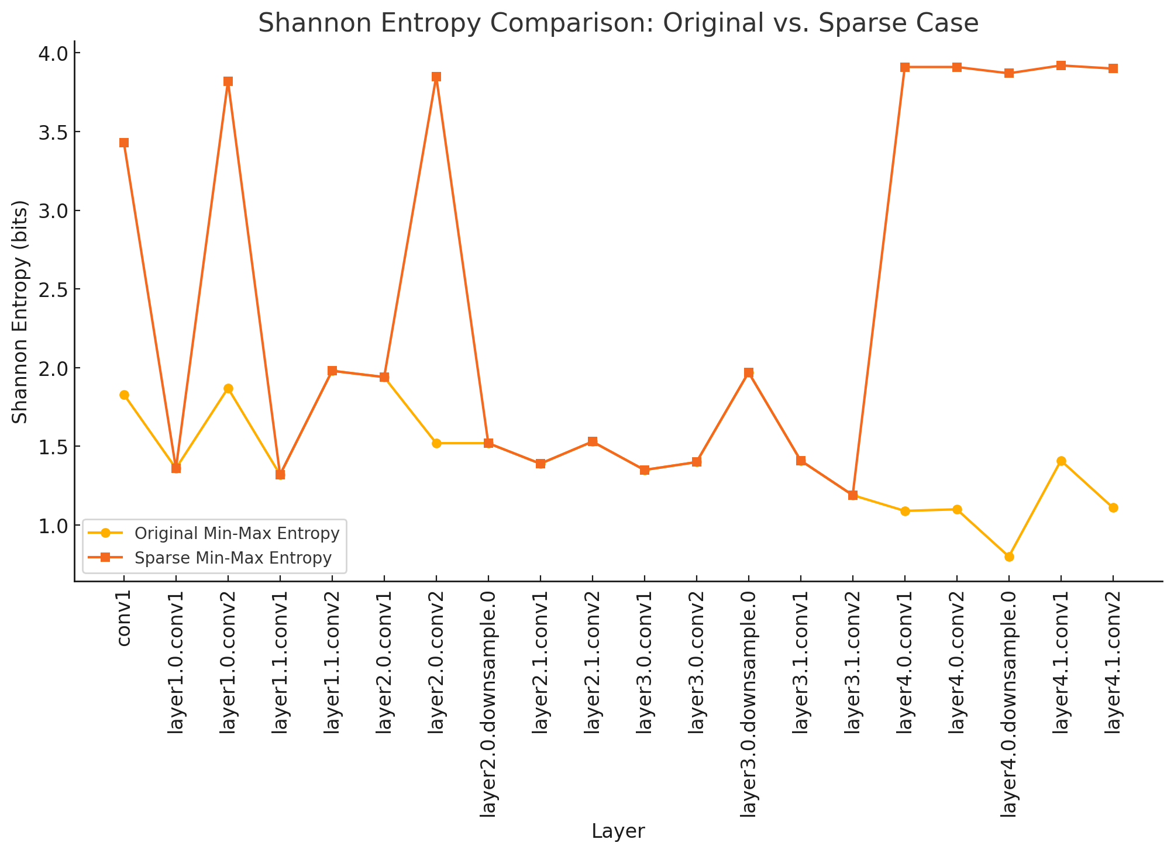
Experimental Results: Shannon Entropy Comparison

Slide 6
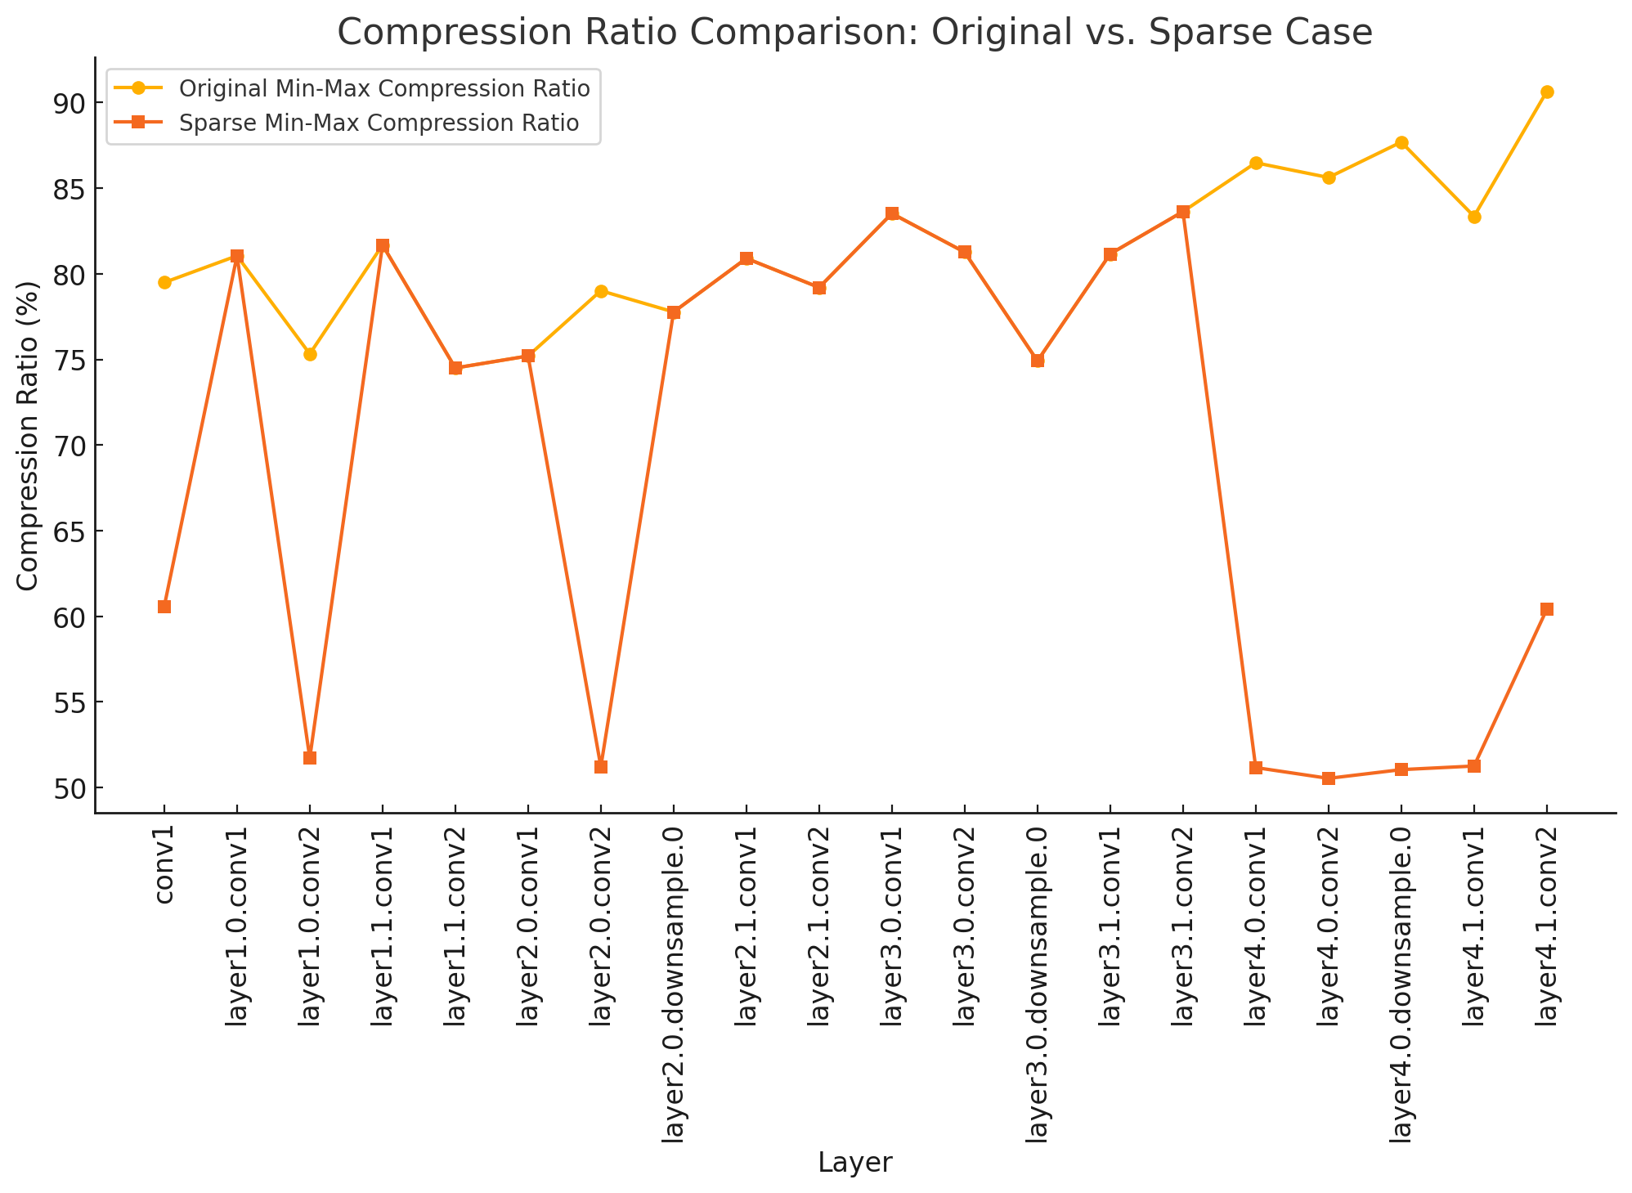
Experimental Results: Compression Ratio Comparison

Slide 7
Experimental Results: Effective Alphabet Size Comparison

Slide 8
Key Takeaways
•**Sparsity alone does not guarantee better compression.**
• **Entropy-optimized quantization is more important.**
• **zstd compression benefits from structured weight distributions.**
• **Next steps: Develop a quantization strategy to minimize entropy.**

