Slide 1
Hello!
Thank you for coming to read my presentation
HOME / ABOUT ME / HOBBIE / EXPERIENCE
CONTACT
This presentation will help you get to know me better. You will learn about my skills, experience, and interests. Even if I don't fit your requirements as a candidate, we can still communicate just for the sake of it :)

Slide 2
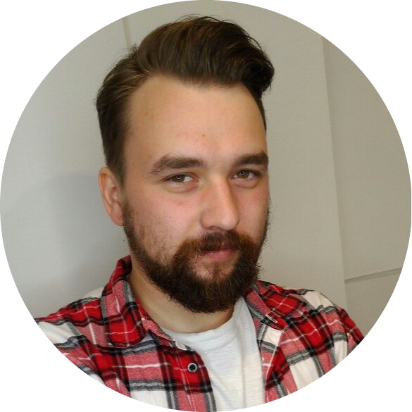
ABOUT ME
HOME / ABOUT ME / HOBBIE / EXPERIENCE
CONTACT
I am a technical writer skilled in Linux, Python, Git, Mark Down, HTML, PostgreSQL, FAST API, and documentation build systems like PyDoc.
I am adept at writing both marketing materials and technical documentation for developers and users. I quickly adapt, learn, and understand unfamiliar systems and processes.
Over the course of 5+ years, I've progressed from a basic copywriter covering tech-related topics to a technical writer, reviewer, and editor with strong technical skills.
I love challenging tasks and unconventional solutions. If something can be automated, I automate it using Python.

Slide 3


My hobbie and pet projects
HOME / ABOUT ME / HOBBIE / EXPERIENCE
CONTACT
HOBBIE
PET PROJECTS
I'm passionate about music and technology: I compose instrumental music on the guitar and design various power assemblies in Fusion 360.
I also enjoy working with single-board computers and debugging boards, such as the ESP32f and Arduino Nano.
I don't neglect sports either – I'm into hiking and kettlebell training. I've visited all the most famous and highest mountains in Georgia.
FPDG (Fake Person Data Generator) is a versatile package crafted to generate realistic yet fictitious data.
1cloud ict is a terminal utility for managing 1cloud servers, deploying project code to servers, and setting up environments on them
1CT
SeaWolves is an experience-sharing portal and social network where seasoned sailors share their expertise with young sailors.

Slide 4


Experience
HOME / ABOUT ME / HOBBIE / EXPERIENCE
CONTACT
Technical writer
11.08.2023 – present time
Cloud provider
At Yandex (YDB team), I was responsible for all documentation for the YDB product, both internal and external, in Russian and English. I participated in testing new product features and assisted developers in writing documentation for the features they developed. I also took part in the development of content roadmaps.
Services and tools I used
Arc, Git, GitHUB, Python, YDB, PostgreSQL, YQL, PSQL, Docker, Linux

Slide 5

eXperience
HOME / ABOUT ME / HOBBIE / EXPERIENCE
CONTACT
Technical writer | Python developer
09.02.2021 – 31.05.2023
Cloud provider
At 1cloud, I developed a terminal utility for working with 1cloud VPS via API. I collaborated with developers, maintained the API documentation section, resolved technical issues for clients, and wrote technical articles for the blog, as well as manuals and user guides for customers.
Services and tools I used
Python requests, YAML, JSON, Pydantic, 1cloud API, pydoc, MD, HTML, Pytest.

Slide 6

exPerience
HOME / ABOUT ME / HOBBIE / EXPERIENCE
CONTACT
Technical writer | Linux admin
10.09.2020 – 25.01.2021
Hosting provider
At Beget, I was responsible for the company's blog and wrote technical articles dedicated to its products, such as VPS and domains. I also developed scripts for technical support and wrote user manuals to help users solve their technical problems related to VPS operations. Another task I had was managing the development backlog and implementing new features into the control panel.
Services and tools I used
Linux terminal, HTML, MD, SSH, VNC, Confluence, Jira.

Slide 7

expErience
HOME / ABOUT ME / HOBBIE / EXPERIENCE
CONTACT
Copywriter | Confluence manager
01.02.2019 – 31.07.2020
IT-event provider
At Jug ru group, I worked as a copywriter. I wrote posts for social media, composed emails, and was responsible for the content plan. Additionally, part of my responsibilities included working with Confluence, where I managed marketing department materials. During the pandemic, I wrote instructions for television station operators who streamed conferences online.
Services and tools I used
Confluence, Jira, MD, HTML, social webs.

Slide 8

expeRience
HOME / ABOUT ME / HOBBIE / EXPERIENCE
CONTACT
Technical writer
15.11.2018 – 10.12.2018
Hosting provider
At FASTVPS, my primary responsibility was managing the knowledge base. I updated existing materials and wrote new ones. Both support line workers and users utilized the knowledge base materials. I assisted in answering questions on social media and oversaw marketing email campaigns. I participated in testing new features of the WEB Control Panel and wrote bug reports.
Services and tools I used
Confluence, Jira

Slide 9

experIence
HOME / ABOUT ME / HOBBIE / EXPERIENCE
CONTACT
Copywriter | Confluence manager
21.05.2018 – 22.08.2018
IT-consulting
At Clever bros., I was responsible for curating content for corporate social networks, participating in the release of the corporate magazine, and maintaining the knowledge base in Confluence. I managed the scheduling of material releases to the media, brainstormed ideas for advertising campaigns and promotional videos, and wrote scripts for weekly meetings between the CEO and the sales department.
Services and tools I used
Confluence, social webs, MailChimp.

Slide 10
My credo
HOME / ABOUT ME / HOBBIE / EXPERIENCE
CONTACT
“
There are no complex or impossible tasks, only poorly defined assignments. If something is unclear — ask; if you don't know something — go and learn it.
Life is simpler than it seems.
“

Slide 11
THANKS
HOME / ABOUT ME / HOBBIE / EXPERIENCE
CONTACT
You're welcome! It was my pleasure to assist you. If you have any more questions or need further help in the future, feel free to reach out.
Have a great day!
“Please keep this slide for attribution”

