Slide 1

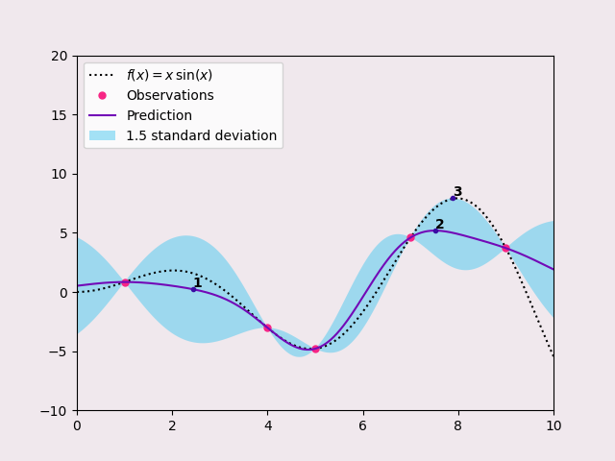
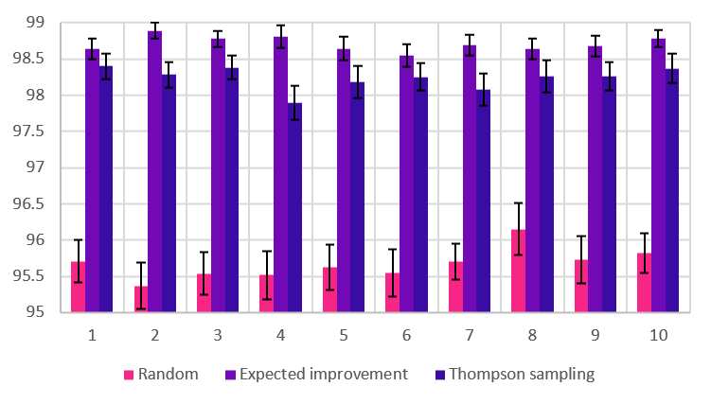
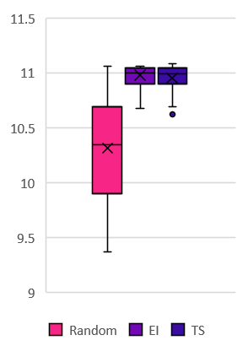
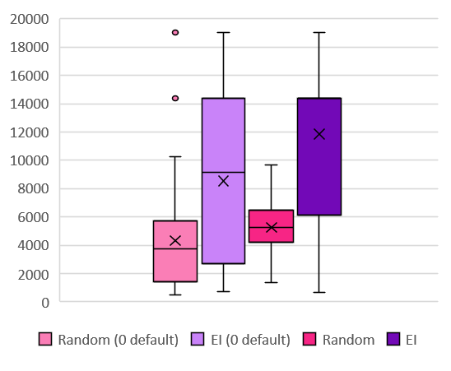
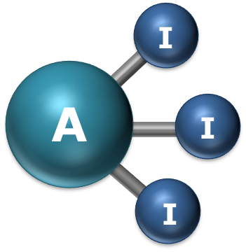


<<Poster Title>>
<<Poster Author & Affiliation>>
<<Email Address>
Leave blank for sponsor logos
1) Intro to Bayesian Optimisation
2) Suzuki reaction yield dataset
From initial observations, construct statistical model. Then choose new observation based on acquisition function:
Max uncertainty
Max mean
Max mean + uncertainty
In practice a balanced approach like 3 is preferred.
Original paper that designed the EDBO optimiser. Tested on Suzuki yield dataset with 50 random initialisations per configuration. Aim was to determine dependence on batch size. Results indicate stable performance.
3) Harvard Clean Energy
4) Nanomole-scale high-throughput screening
5) Conclusions
Organic photovoltaic data tabulating molecular structures and power conversion efficiency. Global max c. 11.1%. Able to learn structure-PCE relationship.
Optimising Area Count (LC-MS). Initial domain had “holes” due to disallowed combinations, so gave 0 as default.
Produced poor results! Subsequently these combinations were excluded – performance markedly improved.
Bayesian optimisation is a promising technique with the potential to be used across a wide variety of problems, with minimal tuning required. Future work could explore noisy objective functions, ‘generative’ optimisation, other potential problems.
AI³ Science Network⁺

Slide 2
<<Poster Title>>
<<Poster Author & Affiliation>>
<<Email Address>
Leave blank for sponsor logos
1) Intro to Bayesian Optimisation
2) Suzuki reaction yield dataset
From initial observations, construct statistical model. Then choose new observation based on acquisition function:
Max uncertainty
Max mean
Max mean + uncertainty
In practice a balanced approach like 3 is preferred.
Original paper that designed the EDBO optimiser. Tested on Suzuki yield dataset with 50 random initialisations per configuration. Aim was to determine dependence on batch size. Results indicate stable performance.
3) Harvard Clean Energy
4) Nanomole-scale high-throughput screening
5) Conclusions
Organic photovoltaic data tabulating molecular structures and power conversion efficiency. Global max c. 11.1%. Able to learn structure-PCE relationship.
Optimising Area Count (LC-MS). Initial domain had “holes” due to disallowed combinations, so gave 0 as default.
Produced poor results! Subsequently these combinations were excluded – performance markedly improved.
Bayesian optimisation is a promising technique with the potential to be used across a wide variety of problems, with minimal tuning required. Future work could explore noisy objective functions, ‘generative’ optimisation, other potential problems.
AI³ Science Network⁺

Slide 3
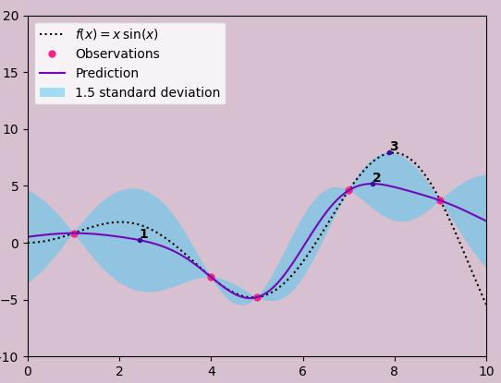
1) Intro to Bayesian Optimisation
From initial observations, construct statistical model. Then choose new observation based on heuristic:
Max uncertainty
Max mean
Max mean + uncertainty
2) Suzuki reaction yield dataset
Original paper that produced EDBO optimiser. Tested on Suzuki yield dataset with 50 random initialisations per configuration. Aim was to determine whether increasing batch size reduced performance significantly. Results indicate this is not the case – performance roughly stable.
3) Harvard Clean Energy
4) Nanomole-scale high-throughput screening
Organic photovoltaic data tabulating molecular structures and corresponding power conversion efficiency values. Global max around 11.1%. EDBO optimiser performed well– able to learn relationship between structure and physical property.
Yield here measured by Area Count (LC-MS). Initially, domain had “holes” due to certain disallowed component combinations, with a default of 0 – produced poor performance. Subsequently these were excluded from consideration, which improved average output.

