Slide 1
Realization of a mobile virtual loudspeaker setup for the playback of multi-channel audio content
Pranav Sharma, Syed Muhammad Ahmed

Slide 2
“LOUDSPEAKERS TO GO”
Pranav Sharma, Syed Muhammad Ahmed

Slide 3

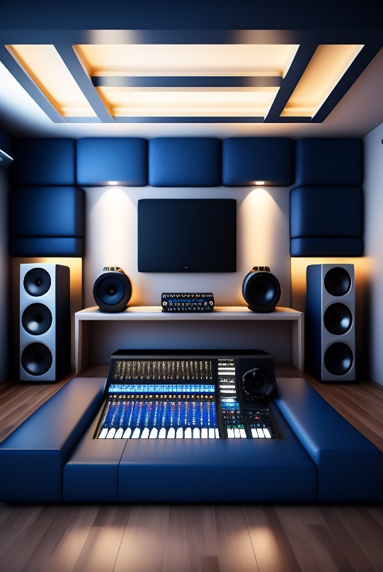
Motivation
Multi-channel speaker require significant physical space
Headphones lacks spatial cues
Use dynamic binaural synthesis system
Create immersive and realistic audio
Greater convenience and accessibility
Revolutionizing Industries like Gaming, Music, Film production

Slide 4
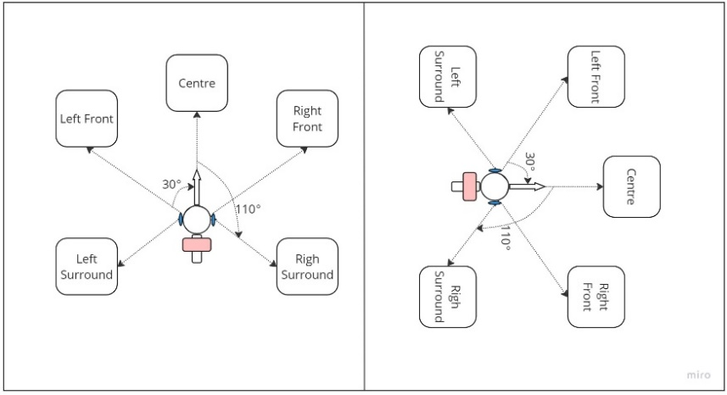
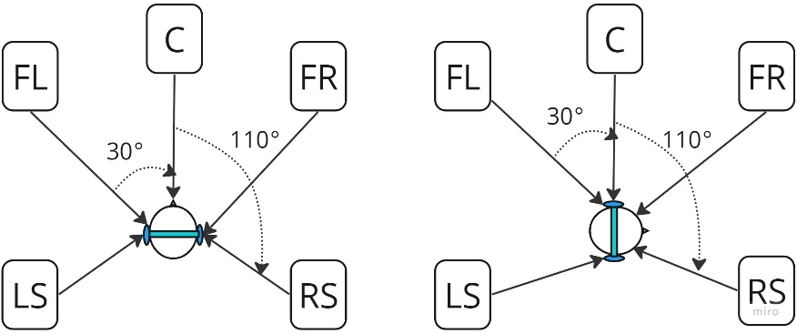
AIM
Development and Evaluation of a complete system
Portable/partially mobile PC platform
Head and Body sensors required
Head rotation horizontal & vertical directions
Virtual loudspeaker positions remain stationary
Ability to change virtual surrounding
Fig : Head Orientation Change ONLY
Fig : Body Orientation Change ONLY

Slide 5
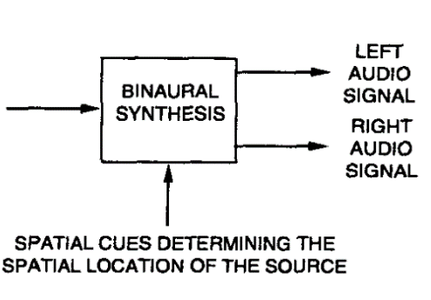
Dynamic Binaural Synthesis via Headphones
Create virtual 5-channel 3D sound field for headphones
HRTF-based Binaural Synthesis : KEMAR data set from Aachen
Synthesized BRIRs using SDM
Accurate capture of sound field in the room
Realistic reproduction of acoustic characteristics
Precise sound localization cues for listener
Saved SDM Rendered RIRs in .mat files, variable for each channel
5 Channel
Audio Content

Slide 6
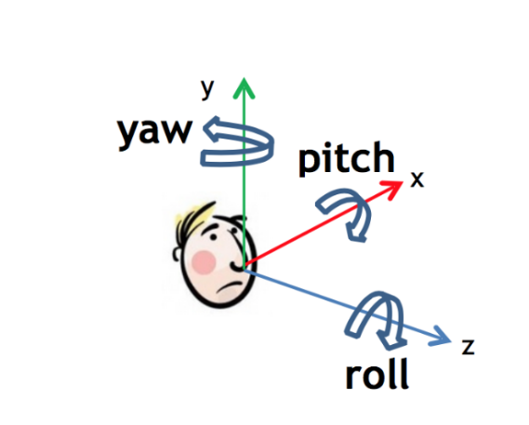
PyBinSim
Real Time Binaural processing in python
Using Open Sound Control (OSC) protocol
Powerful tool for creating immersive binaural Audio Experience
Track listener/source position and orientation
Tools for reading RIRs, manipulating and processing
Use this tool as spatializer for this project
Fig: Yaw, Pitch and Roll

Slide 7
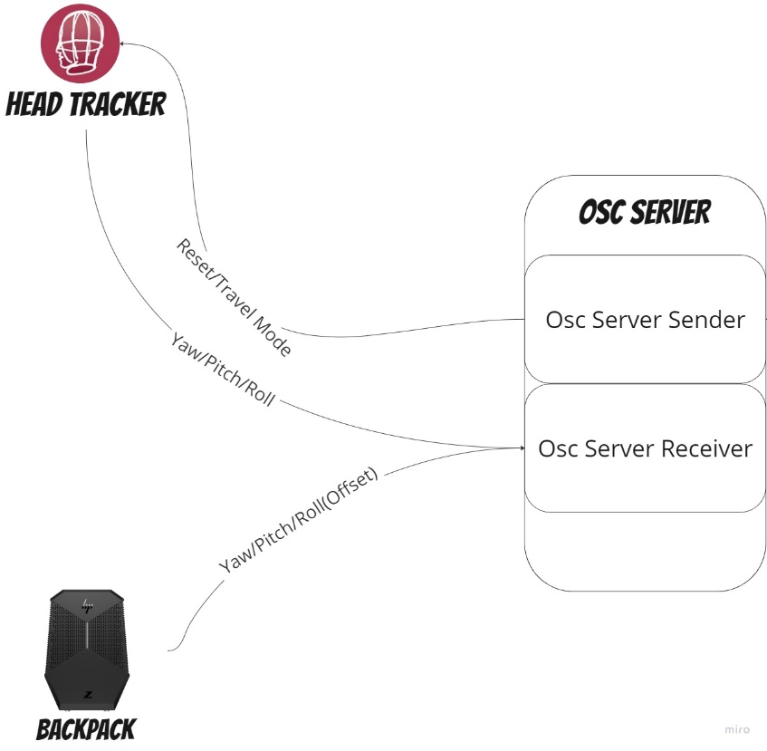
Open Sound Control (OSC)
Protocol for exchanging messages in multimedia applications
Send and receive OSC messages in Python
Message includes string identifier for desired filter
Maps OSC addresses to functions
Updates ds_filters, early_filters, late_filters
Fig: OSC flow diagram

Slide 8
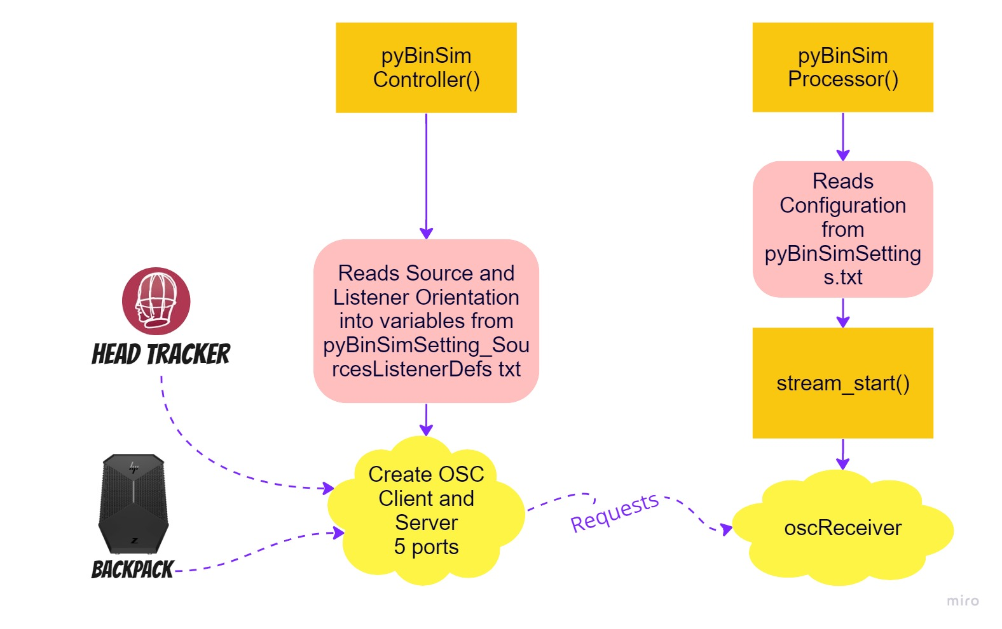
System Architecture
Divided in two parts
Controller
Processor
Controller acts remote to control PyBinSim
Processor controls signal flow
OSC acts as request handler

Slide 9
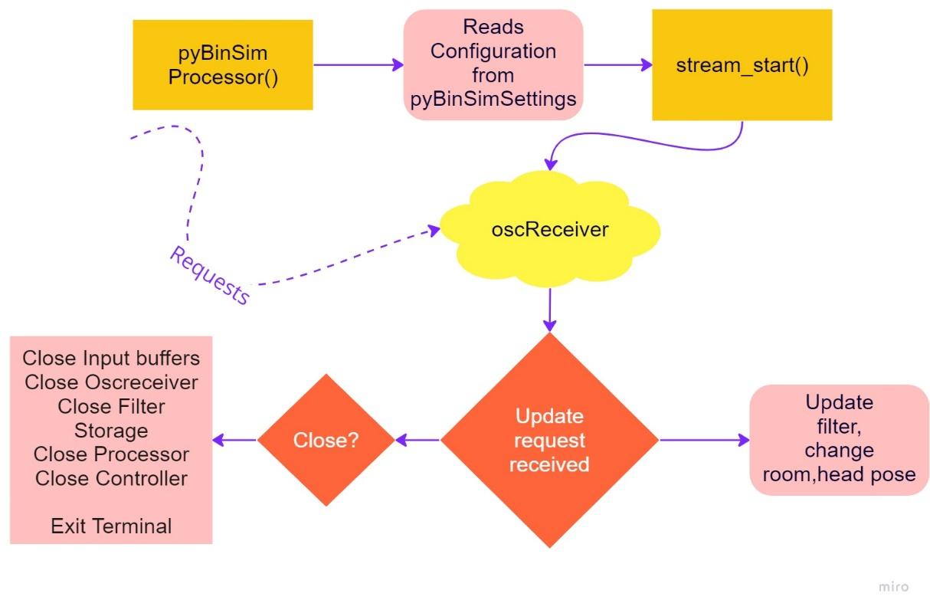
PyBinSim Processor
Central hub for binaural audio rendering
Utilizes OSC library for real-time control
Parse and load discrete filters for synthesized BRIRs
Real time convolution and sound buffering based on pose values
Fig: PyBinSim controller flow

Slide 10
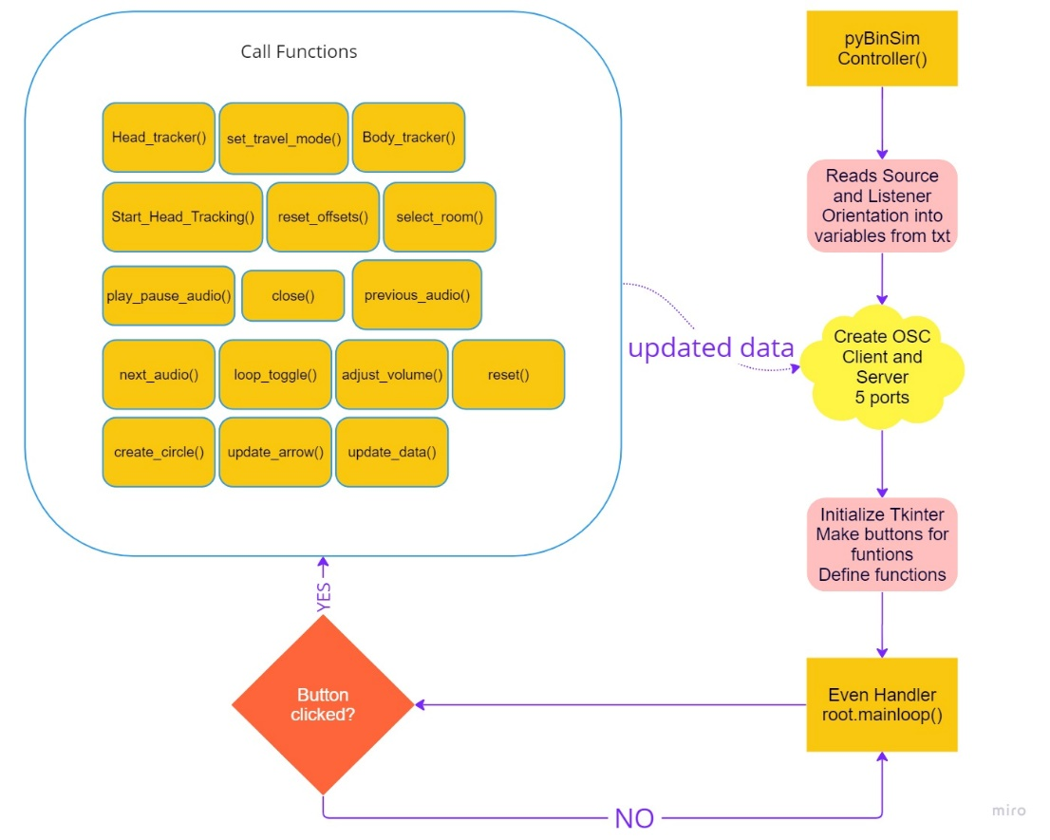
PyBinSim Controller
Remote Control to pyBinSim
Handles sensor data, sends updates via OSC
Uses Tkinter for a simple, interactive User Interface
Button presses trigger OSC messages to processor

Slide 11
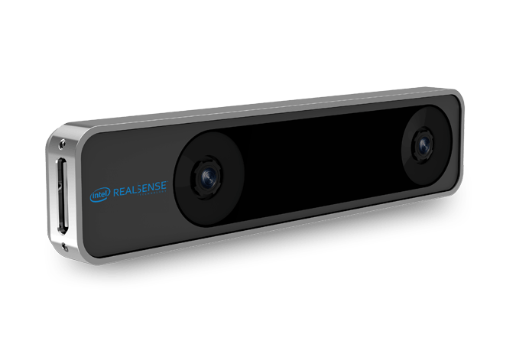
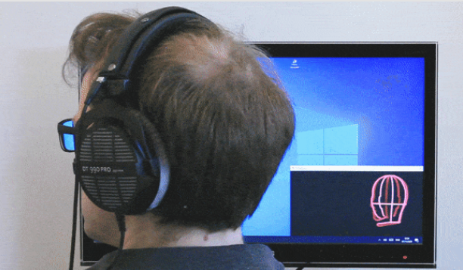
Sensor Data Handling
Head sensor (Bridgehead tracker)
Body Sensor (RealSense t265)
Fast sensor inputs from head and body handled
Body pose data acts as an offset for head tracking data
Calculated offsets are transmitted to the pyBinSim processor
Fig: Reasense T265
Fig: Bridgehead tracker

Slide 12
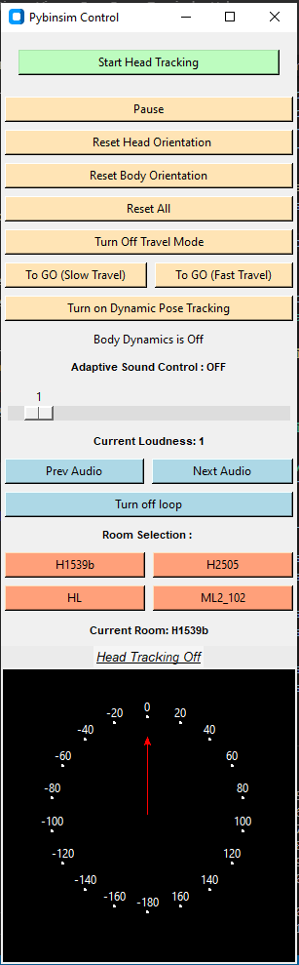
User Interface
Audio adjustments, orientation resets, tracking
Button-specific functions, OSC messages
Used Multiprocessing
Run UI and PyBinSim together
Close both together

Slide 13
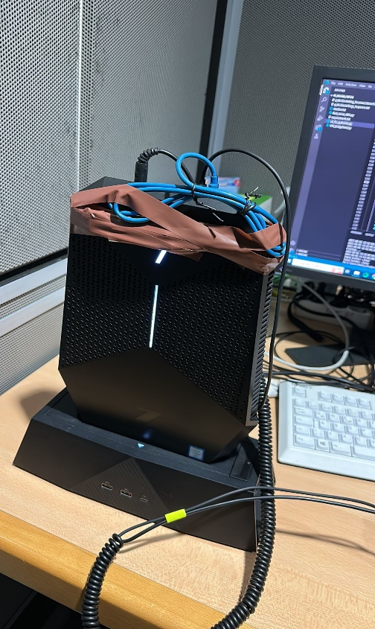
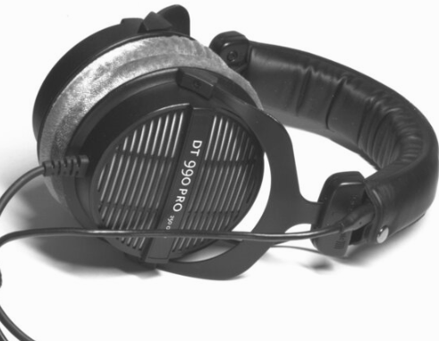
Experimental Setup
Developed in Listening lab
Attached body tracker with backpack
Block size (1024),Processing power trade-off
Room database used in project
Listening Lab (HL): RT 0.255s
Editorial Room Media Lab 2 (ML2-102): RT 0.52s
Seminar Room (H2505): RT 1,2s
Audio/Video Lab (H1593b): RT 0.28s
Divided into stages (Standing, Head motion, Overall motion)

Slide 14
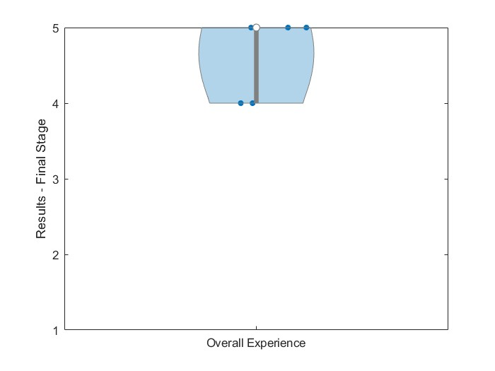
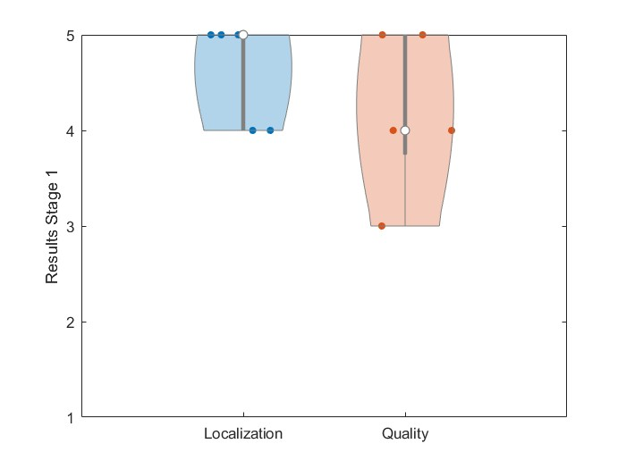
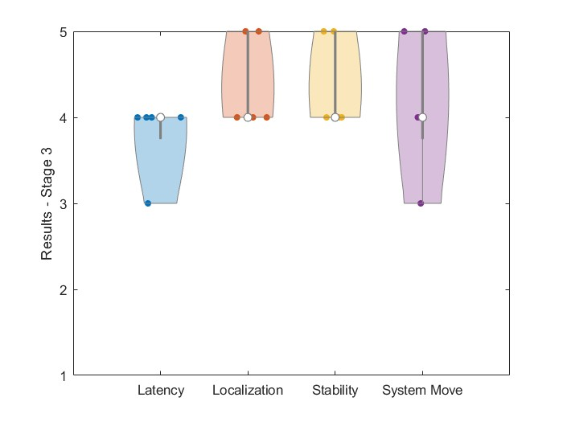
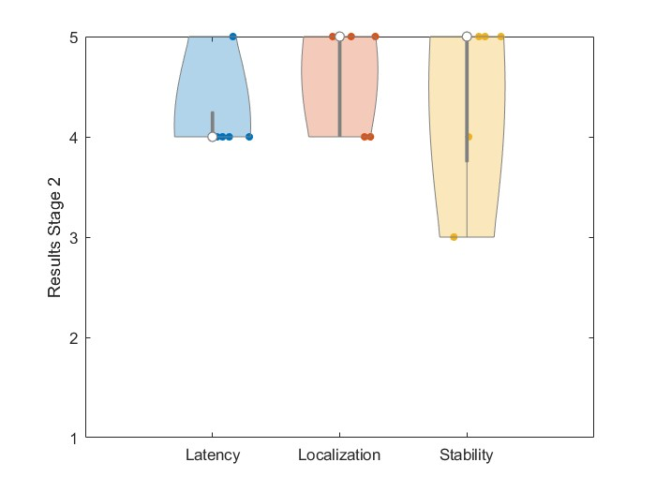
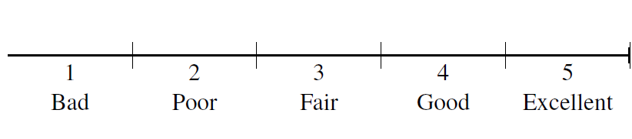
Results
5 Subjects participated
Everyone could feel room change
Sound coming within the room
Good stability and Localization of sources
Good experience rating
Notes:
Stage Question Type Percentage scores Mean values
------------------------------------------------------------------------------------------------------------------------------------------------------------------------
Stage 1 Question 2 (1-5) Quality 84 4.2
Question 3 (1-5) Localization 92 4.6
-----------------------------------------------------------------------------------------------------------------------------------------------------------------------
Stage 2 Question 4 (1-5) Stability 88 4.4
Question 5 (1-5) Latency 84 4.2
Question 6 (1-5) Localization individual sound 92 4.6
Question 7 Externalization Outside the head Outside the head
-----------------------------------------------------------------------------------------------------------------------------------------------------------------------
Stage 3 Question 8 (1-5) Stability 88 4.4
Question 9 (1-5) Latency 76 3.8
Question 10 (1-5) System move with you 84 4.2
Question 11 (1-5) Localization 88 4.4
Question 12 (a,b and c) Externalization Outside the head Outside the head
Question 13 (1-5) Overall Experience 92 4.6
----------------------------------------------------------------------------------------------------------------------------------------------------------------------------

Slide 15
Discussion and Outlook
Successfully Developed a dynamic binaural synthesis system
Enhanced user interface for interactive sound control and visualization
Real-time tracking of head and body movements
Potential improvements
Sensor optimization
Wireless capability
Integration of smaller, wearable sensors

Slide 16
Future Scope
There is scope for further research
Spatial Cognition and Localization
Virtual room environments' influence on sound perception
Personalized HRTFs
Auditory Scene Analysis
Integration with Visual Stimuli

Slide 17
Summary
Headphones not reproduce spatial cues, Binaural Synthesis plausible solution
SDM rendered BRIRs for spatial accuracy
Our project divided in PyBinSim controller and processor
Validated the system to go application
Good localization and envelopment, bit latency issues, overall good ratings
System can be optimized and used for further research purposes

Slide 18
QnA

