Slide 1
Interactive Data Analysis with Apache Spark and Apache Zeppelin
Pitt Fagan
@bigdatamadison
7 June 2016

Slide 2
Presentation Layout
Overview of the Apache Zeppelin project
Zeppelin interactive notebook
  - Data analysis example using City of Milwaukee Property Assessor data (2005 and 2007 data. ~160,000 rows, 91 columns).
Spark Internals Performance Dashboard

Slide 3
A Bit About Me
BS Geology from Rice University. MS in Statistics, MS in Soil Science from UW-Madison.
V.P. of Data Engineering at Earthling Interactive, a Madison-based software development company. Focus on data engineering, analysis and management.
Involved in the BigDataMadison meetup from its inception 4.5 years ago. Organizer of the meetup for the past 3 years.

Slide 4

Apache Zeppelin
https://zeppelin.incubator.apache.org/
Multi-Purpose Web Interactive Notebook
  Multiple language support
  Automatic Spark integration
  Built-in data visualization
  Collaboration and publishing through website, note exports in JSON or Github raw file formats

Slide 5
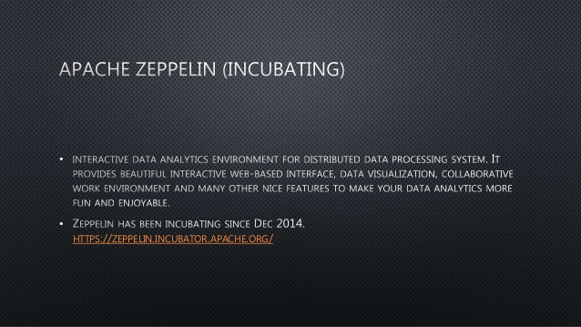
Apache Zeppelin
Top level ASF project (06/2016)

Slide 6
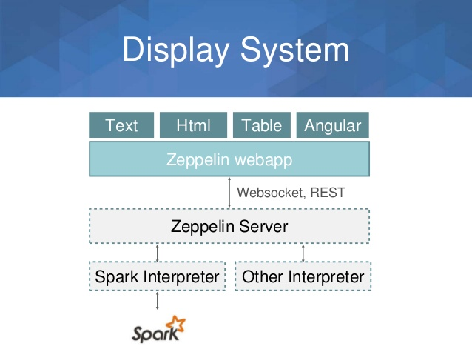
Apache Zeppelin

Slide 7
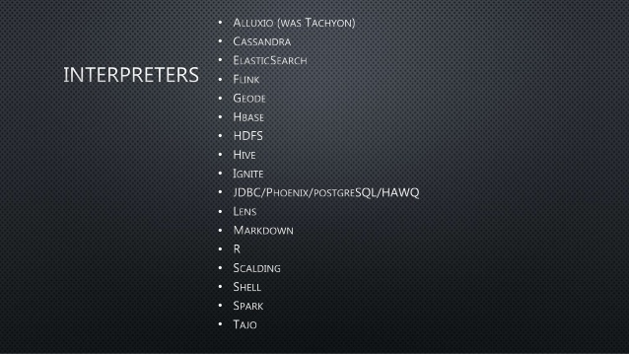
Apache Zeppelin

Slide 8
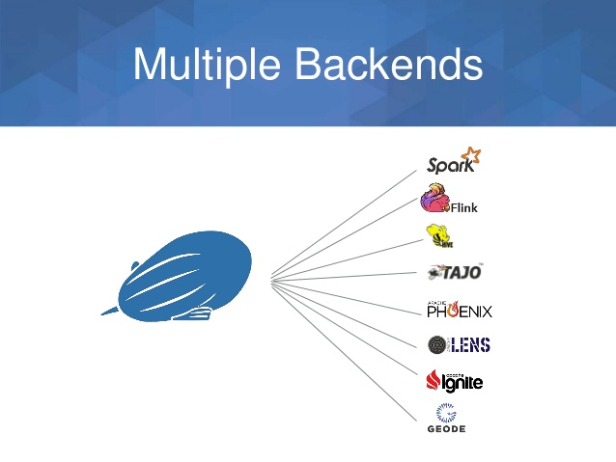
Apache Zeppelin

Slide 9
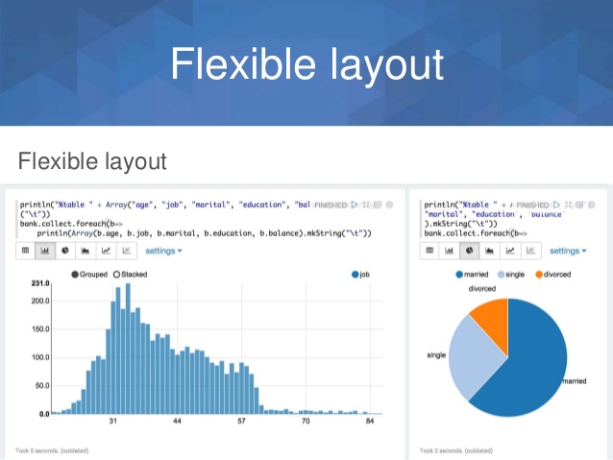
Apache Zeppelin

Slide 10
Live Demo with Zeppelin
Quick tour through Zeppelin notebook functionality
A couple of examples of SparkSQL and MLLib on Milwaukee City resident property data
Quick tour of the Spark Admin Panel, looking at the jobs run through Zeppelin as part of the analysis

