Slide 1




Spark Core Overview, Interactive Notebooks and Spark SQL
Pitt Fagan
www.pittfagan.com
@bigdatamadison
29 March 2016
  Meetup sponsors:

Slide 2

Presentation Layout
Overview of Spark and Spark Core concepts
- RDDs
- Lifecycle of a Spark program
- Ways to run a Spark program
Anatomy of a typical Spark job
Apache Zeppelin interactive notebook
  - Spark SQL

Slide 3
A Bit About Me
BS Geology from Rice University. MS in Statistics, MS in Soil Science from UW-Madison. Lived here for 16 years.
V.P. of Data Engineering at Earthling Interactive, a local software development company, for the past 12 years. Focus on data engineering, modeling and analysis.
Involved in the BigDataMadison meetup from its inception 4 years ago. Organizer of the meetup for the past 2.5 years.

Slide 4

Why Spark?
Most popular open source project in the Big Data / Data Science ecosystem
  Over 800 contributers from many companies
2016 StackOverflow developer survey
  Over 56,000 developers surveyed
  Spark the second highest/positive trending tech in the US
  Spark tied for first as the highest paying tech in the US

Slide 5
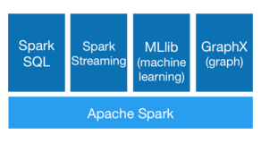
General Spark Architecture
http://spark.apache.org/
  Speed and Ease of Use
  General Purpose and Runs Everywhere
  Large Community and Widespread Adoption
  Source: Databricks

Slide 6
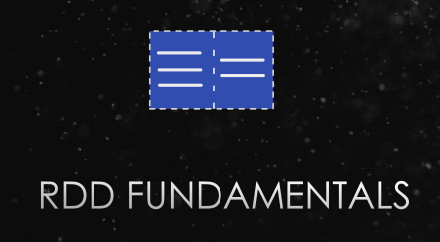
Spark – RDDs
RDD (Resilient Distributed Dataset)
  Stored in memory across multiple nodes
  Ordered collection of records split into partitions
  Stored redundantly and immutable
  Source: Databricks

Slide 7
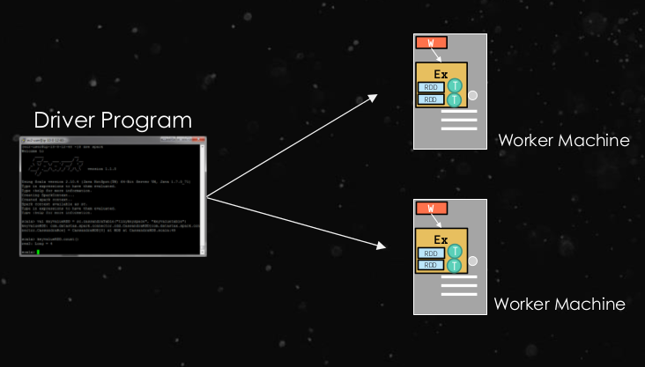
Spark – Driver/Worker Architecture
Jobs originate on the driver, sent to the workers
Executors on the workers calculate the planned computations, send results back to the driver
  Source: Databricks

Slide 8
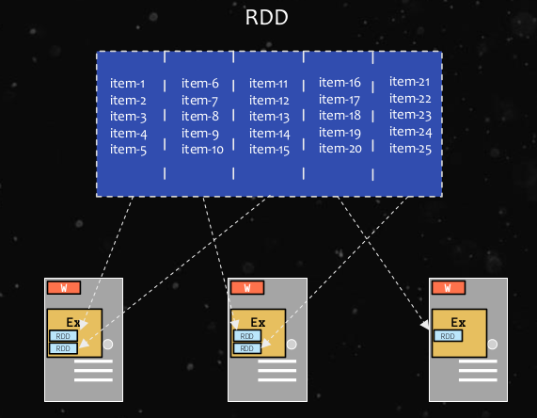
Spark – Data stored on workers
Spark is a large scale data processing engine
Optimized to take advantage of distributed data, workflows and computation
  Source: Databricks

Slide 9
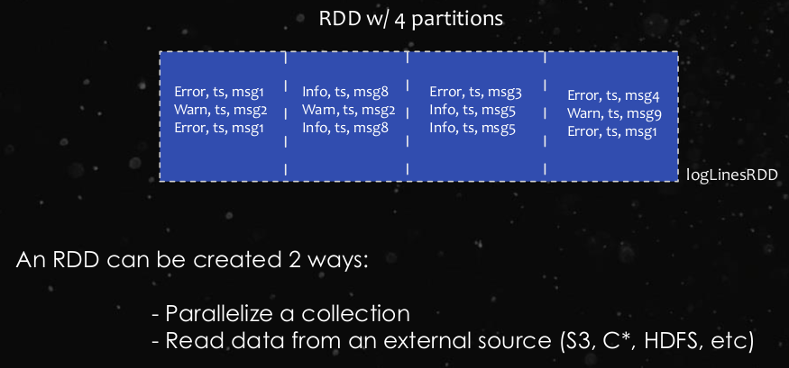
Spark – How to Create an RDD
First way only used in development
Spark has libraries and connectors to many applications and can handle multiple file formats
  Source: Databricks

Slide 10
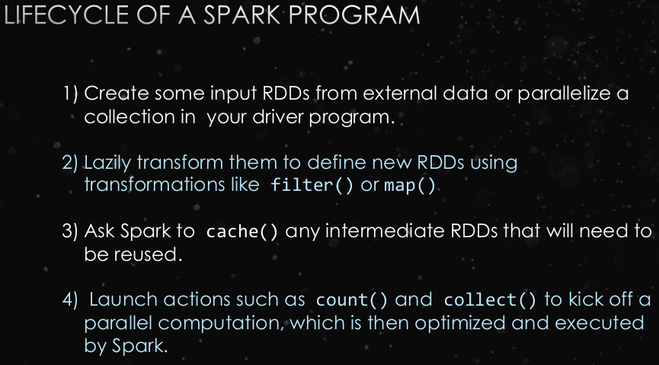
Spark – Lifecycle of a Program
Developers define a “recipe” for dealing with the data, from ingestion, transformation, calculation and export to external systems
  Source: Databricks

Slide 11
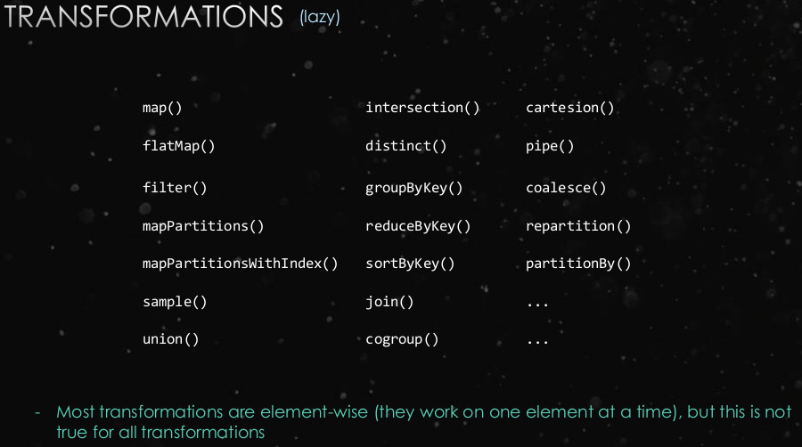
Spark - Transformations
Lazy evaluation (only enacted when action called)
Not all RDD types support all transformations
  Source: Databricks

Slide 12
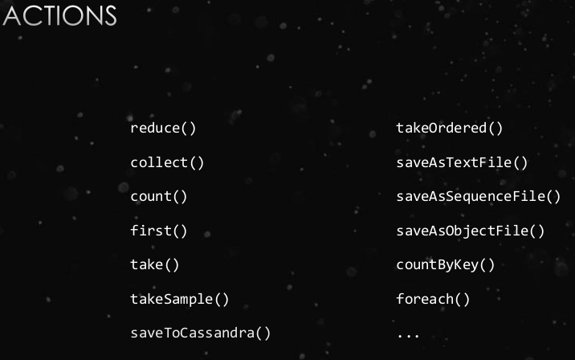
Spark - Actions
At end of a series of transforms
When called, DAG created and executed
  Source: Databricks

Slide 13
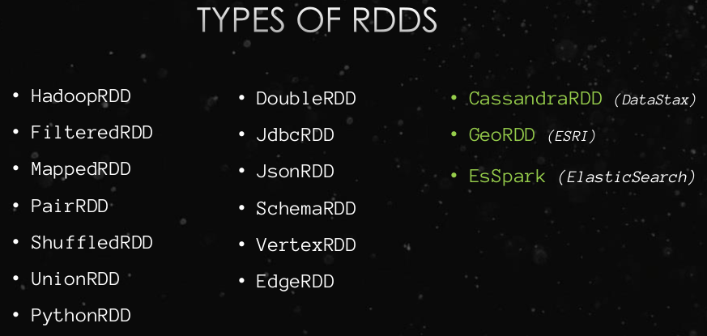
Spark – Types of RDDs
RDDs defined by the type of data or the transform that created them
Third party companies have defined RDDs that specially interface with their system
  Source: Databricks

Slide 14
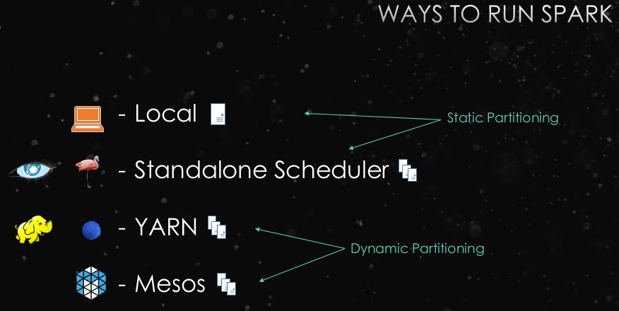
Spark – Ways to Run an Application
Spark driver and its executors are an application
Several ways to run Spark, depending on need
  Source: Databricks

Slide 15
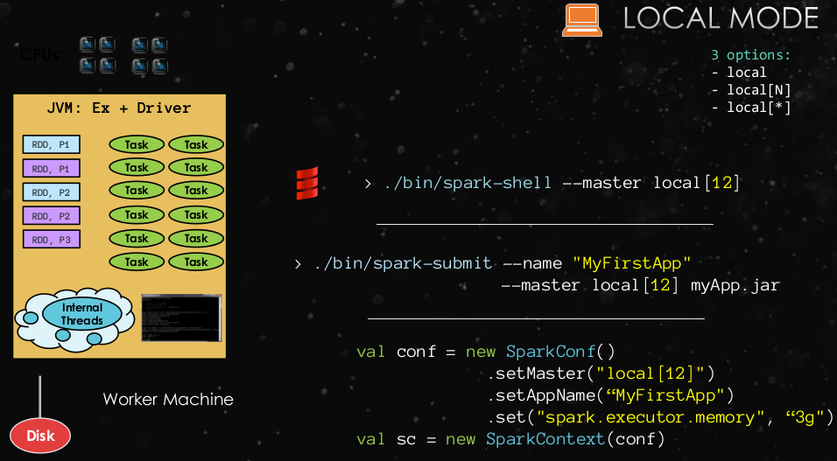
Spark – Local Mode
Single machine, can specify settings to control the resources on the machine Spark can use
  Source: Databricks

Slide 16
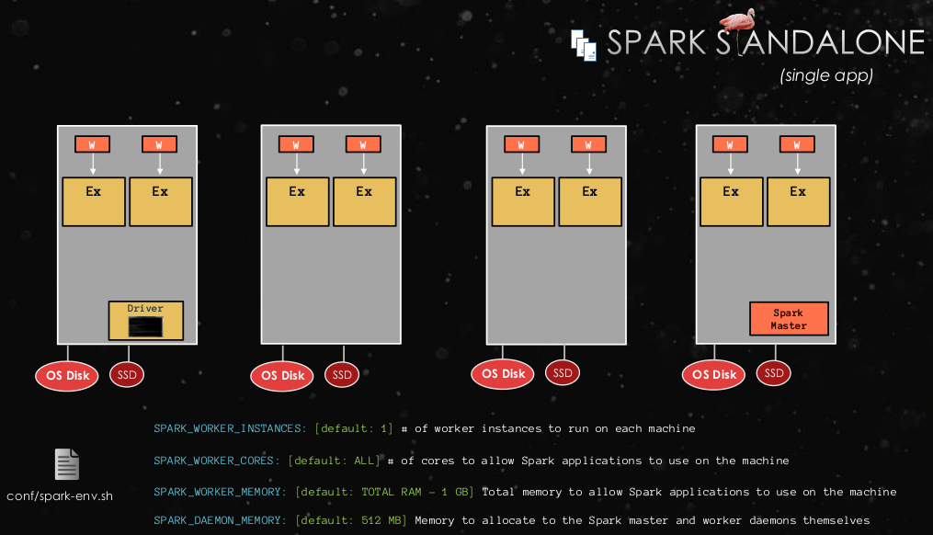
Spark – Standalone Mode
Sparks own cluster manager
For use when Spark is the only distributed application running on a cluster
  Source: Databricks

Slide 17
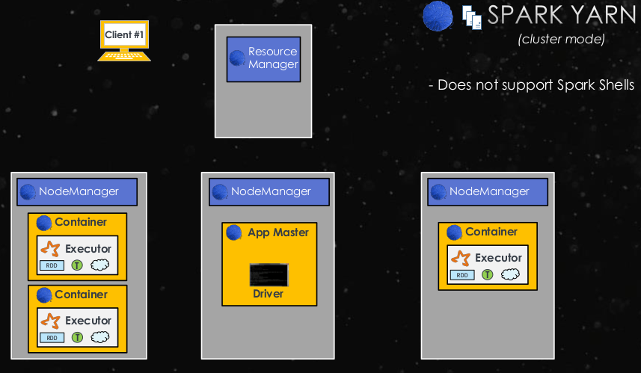
Spark – YARN Cluster Manager
Yarn/Mesos are two open source cluster managers
Different data processing frameworks use a shared resource pool
  Source: Databricks

Slide 18
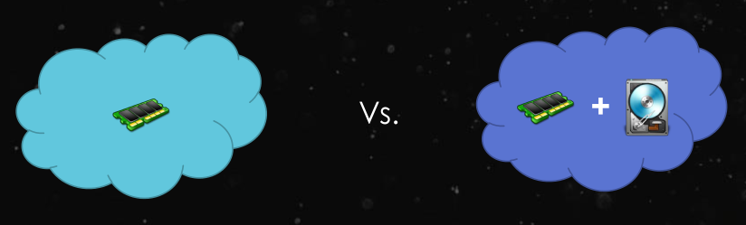
Spark – Memory Persistence
Can define data persistence to control memory in a Spark application
cache()
memory_only and memory_only_ser
memory_and_disk and memory_and_disk_ser
  Source: Databricks

Slide 19
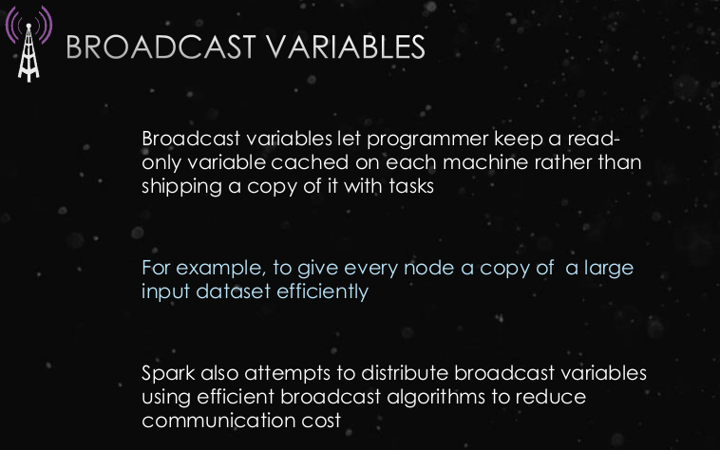
Spark – Broadcast Variables
Shared variable type to optimize application performance
  Source: Databricks

Slide 20
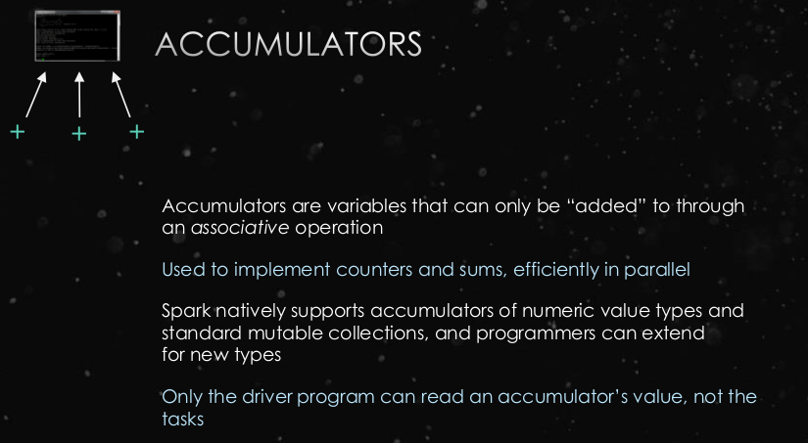
Spark - Accumulators
Shared variable type to optimize application performance
  Source: Databricks

Slide 21
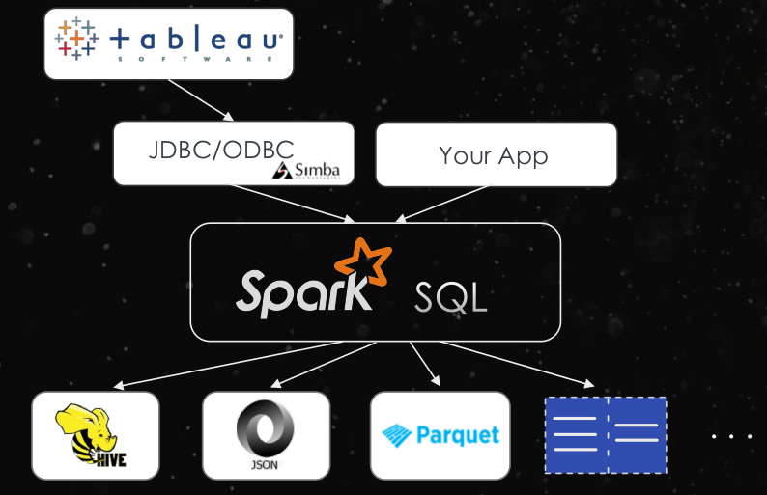
Spark – Spark SQL
Provides a SQL interface, through Spark, to query data stored in numerous applications and formats
  Source: Databricks

Slide 22

Apache Zeppelin
Incubating ASF project
https://zeppelin.incubator.apache.org/
Multi-Purpose Web Interactive Notebook
  Multiple language support
  Automatic Spark integration
  Built-in data visualization
  Collaboration and publishing through note exports in JSON or Github raw file formats

Slide 23
Spark – Resources for Learning
Several good books out there
  Learning Spark
  Advanced Analytics with Spark
Online Courses (Spark focused or tangential)
  Udemy - self-paced
  Coursera – self-paced
  EdX – 5 course Spark series starting in May. Considering organizing a local study group, depending on demand.
Tutorials/videos online
  Youtube, BrightTalk

Slide 24
Live Demo with Spark
Live Demo with Zeppelin
Quick exploration of typical job
  Madison Property Assessor Information
Quick tour through Zeppelin notebook functionality
A couple of examples of SparkSQL on Madison dataset
  Madison Metro public dataset
Quick tour of the Spark Admin Panel

