Slide 1
Moving Data with Apache Airflow at Zendesk
An overview of Airflow and how we use it at Zendesk for data engineering
Pitt Fagan
21 September 2017
Resources and Guidelines

Slide 2
Today’s agenda
MadPy meetup, 21 Sept, 2017
1. Introductions
2. Overview of Airflow (components, architecture, etc.)
3. Demo of the GUI
4. Using Airflow at Zendesk
5. Questions

Slide 3
A bit about me …
Education
- B.A. Geology from Rice University
- M.S. Soil Science from UW-Madison
- M.S. Statistics from UW-Madison
2. Work history
- Scientist at US Geological Survey
- V.P. Data Engineering at Earthling Interactive
- Senior Data Analyst at Zendesk
3. BigDataMadison Meetup
Organizer, 2012 - present
4. BigDataWisconsin Conference
Co-Organizer, 2016 - present

Slide 4
Apache Airflow
Provenance
Development began in 2014
Open-sourced by AirBnB in 2015
Accepted into Apache Software Foundation (ASF) Incubator in 2016
Current version 1.8.1
100% Python!

Slide 5
Apache Airflow
Activity on GitHub
URL: https://github.com/apache/incubator-airflow
300+ committers
4000+ commits
6000+ stars

Slide 6
Apache Airflow
What does it do?
Task-based data orchestration platform
Create, schedule and monitor workflows
Workflows consist of DAGs of tasks
DAGs control WHEN something happens, and under what conditions
Tasks control WHAT happens

Slide 7
Apache Airflow
General Architecture – Two main building blocks
DAGs - Directed Acyclic Graphs
- a collection of all the tasks you want to run for a job, organized in a way that reflects their ordering, relationships and dependencies.
DAGs aren’t concerned with what its constituent tasks do;
It’s job is to make sure that whatever they do happens:
at the right time,
in the right order,
with the right handling of any unexpected issues

Slide 8
Apache Airflow
General Architecture – Two main building blocks
Operators - a single task in the workflow
Many types:
SqlOperator
PythonOperator
BashOperator
HTTPOperator
AWS and GCS operators
plenty more, including community supplied and custom

Slide 9
Apache Airflow
General Architecture – Major Components
Auth - authentication protocols (password, Kerberos, LDAP, Google)
Hooks – interface/connect to external platforms and databases
Sensors - wait for files, change of state, db rows, etc.
Executors - control scheduling/how the DAGs are run (local, sequential, Celery, Mesos are defaults available)

Slide 10
Apache Airflow
General Architecture – Controlling the DAG
Linear DAGs are the simplest variant
Branching logic - using the BranchPythonOperator
Sub-dags - useful for repeated patterns (where the subdag is returned from a function
SLAs (Service Level Agreement) - time-based checks on task success

Slide 11
Apache Airflow
Running Airflow
Command line interface - full suite of commands: DAG operation, scheduling
GUI - Lots of functionality here (live demo coming up)
Scheduling
Dig into code
Administration
Activity history

Slide 12

LIVE DEMO!

Slide 13
Apache Airflow
Why we use it at Zendesk
Populate BigQuery (GCS data warehouse) with information from multiple third party applications used throughout company
NetSuite
HEAP
Zuora
Salesforce
Bizible
MySQL
Hadoop

Slide 14
Apache Airflow
Cloud implementation
Use a custom executor for Kubernetes*, to scale up in a cloud environment
Container spawner
Uses Kubernetes and Docker** instances to spin up each task (sequentially or in parallel) in separate containers
* A system for management/deployment of containers in a cluster
** Container software

Slide 15
Apache Airflow
General Implementation Pattern at Zendesk
Use hooks to extract datafile to GCS buckets, employing a consistent nested folder construct
Pick up the file and load the data to a stage table
Sensor detects new file(s)
Container spawner fires up new container to process the first task in the DAG (KubeExecutor).
Once finished spins down and launches new one (if necessary)
Perform quality checks on the data, notify via Slack
Move data to the production table using an SCD type 2 pattern
Share data out between the separated datasets using views, to avoid exposing underlying source tables

Slide 16
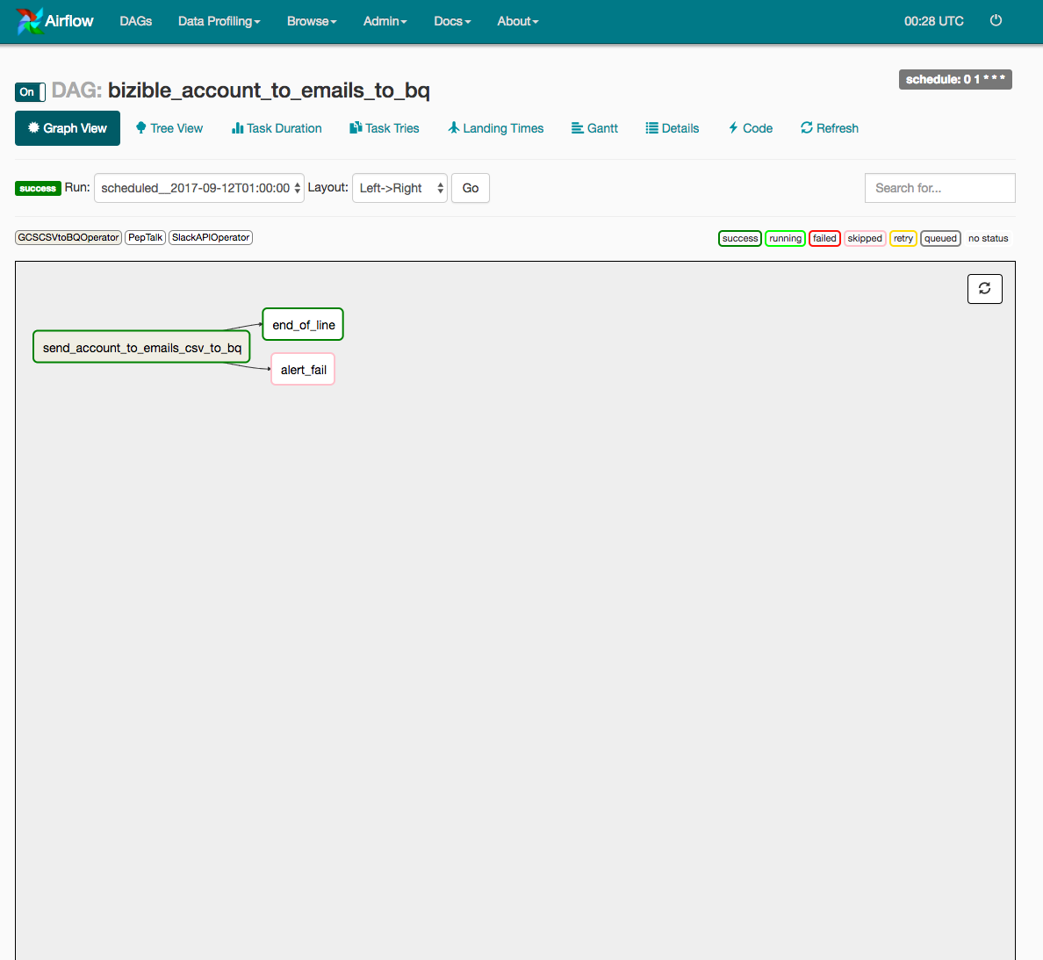
Apache Airflow
How we use it at Zendesk
Graph View simple DAG
Failure vs Success

Slide 17
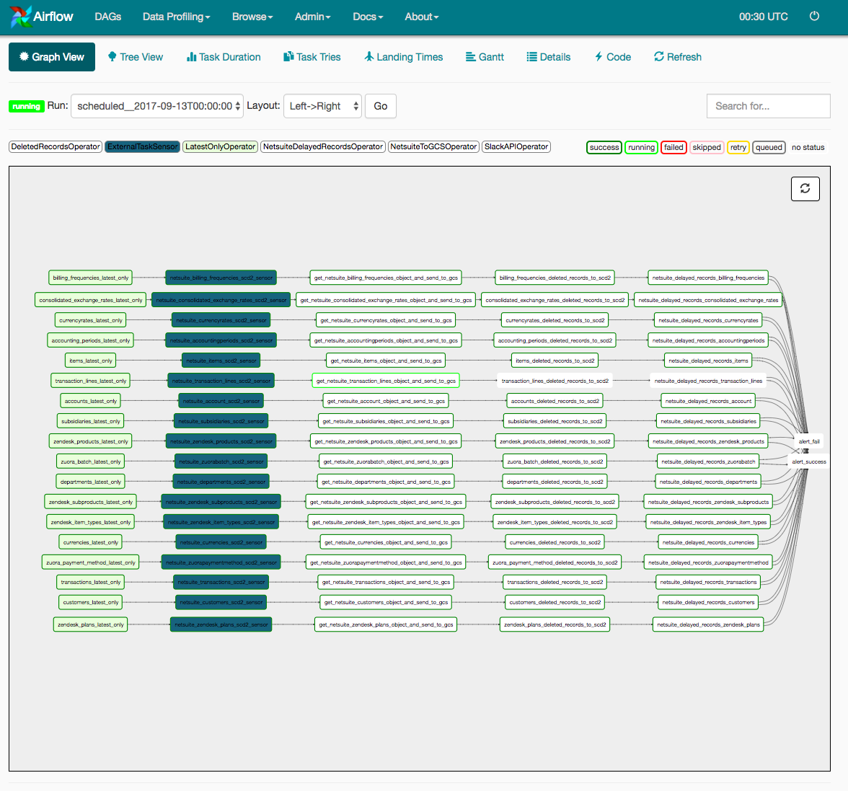
Apache Airflow
How we use it at Zendesk
Graph View – complex DAG
A series of linear DAGs tied together and dependent on one another for success or failure

Slide 18
Apache Airflow
Where to find more information on Airflow
Documentation - http://pythonhosted.org/airflow
Repo - https://github.com/apache/incubator-airflow
Community: https://gitter.im/apache/incubator-airflow

Slide 19

Apache Airflow
Questions
Pitt Fagan
http://www.pittfagan.com
https://www.linkedin.com/in/pittfagan/
https://www.meetup.com/BigDataMadison/
Thanks for coming!

