Slide 1
Apache Spark and PySpark
Pitt Fagan
MKEPython meetup
28 April 2017

Slide 2

A bit about me …
Graduate of Rice University and
UW-Madison
Senior Data Analyst @ Zendesk
Organizer of BigDataMadison
>5 years old
Largest tech meetup in Wisconsin
Co-organizer of
BigDataWisconsin Conference

Slide 3

Speaking of the conference ...
First conference held last year. ~250 attendees
Second conference to be held on Tuesday, 22 August in Madison.

Slide 4
Presentation Outline
A little bit about Big Data
Introduction to Apache Spark
Presentation of the data challenge and live demo of solutions in standard Python and PySpark

Slide 5
Big Data Definition
Big data is high volume, high velocity, and/or high variety information assets that require new forms of processing to enable enhanced decision making, insight discovery and process optimization (Gartner).
Basically, too much data, in different formats and coming too quickly, to fit on one machine!
Notes:
Distributed computing

Slide 6
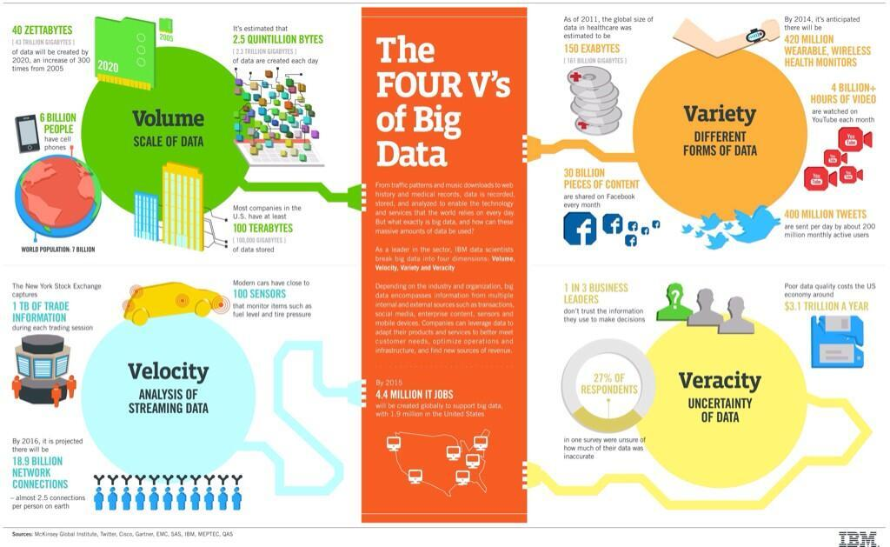
Big Data Characteristics
Notes:
Slide 5 – This busy graphic illustrates an important concept of Big Data, namely the four V’s. Common layman’s definition of Big Data

Slide 7
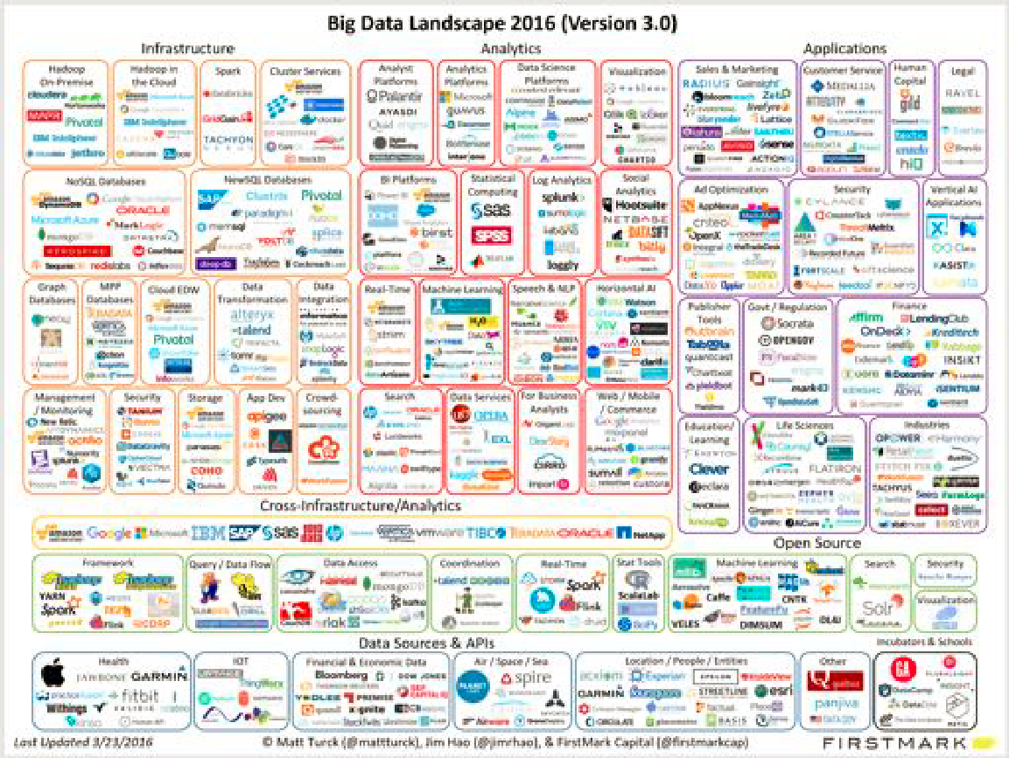
Big Data – Lots of Activity!

Slide 8

Apache Spark
Where does Spark fit into the landscape?
Spark is a fast, scalable cluster processing platform
Incredible adoption/support
Support for four languages: Scala, Java, R and Python
Data engineering/analysis functionality in one (free) application!
Data read/write to dozens of backend systems
Interactive shells in Scala, R and Python

Slide 9
Apache Spark - Popularity
Over 1000 developers have contributed to this open source project
Core contributors from 19 large companies in data space (Cloudera, IBM, etc.)
Top level Apache Software Foundation project
Dozens of third party packages spark-packages.org

Slide 10
Apache Spark - PySpark
Executable used to run Spark interactively in an interpreter
Can also submit Python scripts to Spark via the spark-submit process.
This will pass the script to the workers to process the data.

Slide 11
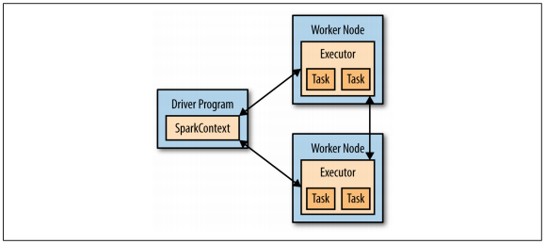
Apache Spark - Core Concepts
Driver program launches parallel tasks on the data stored on the worker nodes
PySpark or SparkSubmit is the driver program
SparkContext object defines the connection to the cluster computing platform
Lazily evaluated
Transforms
Actions

Slide 12
Quick Example of Interactive Shell
Done in Scala Shell, but look/feel are very similar to Python shell.
Jupyter notebooks provide a much better experience, so let’s show one!

Slide 13

PySpark using Jupyter Notebooks
Easy to install and link to Spark
Full access to Python packages
Visualization with MatPlotLib, ggplot and/or Seaborn
Capabilities to create pipelines to
ingest
clean
transform
analyze
export

Slide 14
A bit about the data challenge
Employee comments
Quarterly assessment
Free text entry
2016 manually classified into 11 categories
Naive Bayes Classifier
supervised
probabilistic
ideal for classification when the samples are independent

Slide 15
Live demo
Naive Bayes Classifier
Implemented in Jupyter Notebooks
Pure Python
Use NLTK library
Naive Bayes Classifier
Implemented in Jupyter Notebooks
PySpark v2.1
Use ML library and Pipelines

Slide 16

Email: pittfagan@gmail.com
Site: www.pittfagan.com

