Slide 1


Modern Big Data
Lowering the barriers for POCs
Pitt Fagan
Vice President of Data Engineering
Earthling Interactive
Notes:
Introduce myself.
Introduce EI as a Madison-based software development company.
Introduce the BigDataMadison meetup group.
Growth over the past 3 years from 12 members when we started to 725 and counting.
Cavinda asked me to come and speak to you about the changing landscape of the Big Data ecosystem in the past couple of years.

Slide 2
Presentation Overview
Brief recap of corporate Big Data business goals
Barriers to evaluation and adoption have been lowered due to technical advances across two fronts.
Infrastructure (AWS)
Programming/BI (Spark)
Notes:
Overview of the presentation structure.
Start with a recap of a Wall St. Journal Survey or CIOs discussing their Big Data goals, strategies and project statuses.
Then discuss how a rapidly changing industry have really opened up the floodgates for Big Data projects by lowering the technical barriers to some of the most difficult areas of Big Data projects, so companies can more easily engage in POCs or pilot projects.

Slide 3
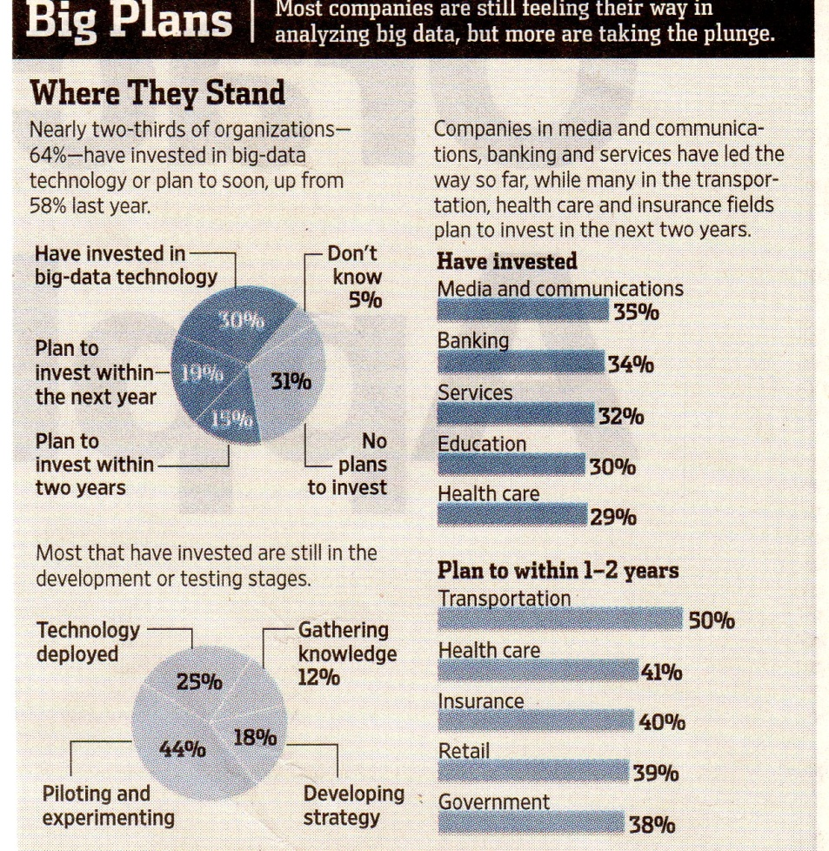
Big Data Business Projects
In 2010, data management /analytics industry forecast to be worth 100 billion and to grow 10% a year.
Notes:
Big Data is Big Business. Data management/data analytics are forecast to grow at 10% a year, which is double the rate of any other segment of the IT industry. Certain industry sectors (banking, communications) have embraced big data more readily, though, as you can see from this chart, there is still plenty of opportunity for expansion since 74% of companies with Big Data strategies are still formulating or rolling out their plans.

Slide 4
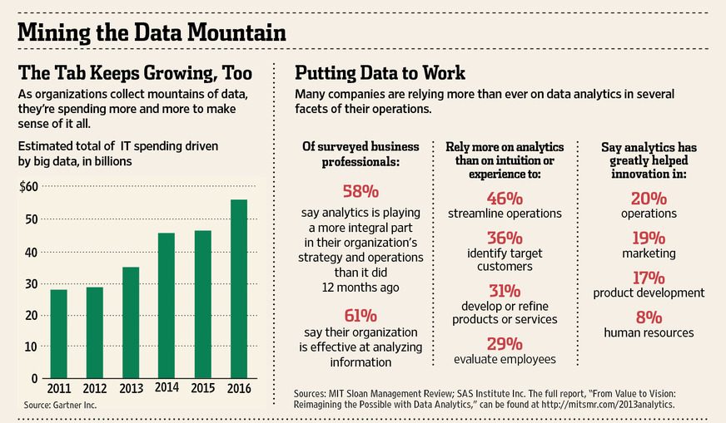
Big Data Business Projects
Notes:
The chart on the right show the increasing adoption of a data-driven business culture. Operations and operational efficiency are where the majority of the focus has been.

Slide 5

Big Data Business Projects
The most common goals and problems?
Notes:
This graphics shows some of the expectations for Big Data strategies that exist out there across all industries. Given the rise of the Internet of Things, I would expect machine/sensor data to increase in prevalence over time. The bottom graph shows the top five challenges in working with Big Data, or folding it into an existing data strategy. We will touch on these again when we discuss Spark.

Slide 6
At the Beginning, High Barriers
Distributed computing was in it’s infancy
High technical skill (hardware and software) to set up clusters and run MapReduce jobs
Most work done at the command line
Past few years these barriers have been falling
Big Data’s growth across industries have led to a need to “democratize” access and knowledge, so more people can be involved
Notes:
Prior to several years ago, the hurdles to getting started with Big Data projects were higher. Distributed computing expertise was harder to find than it is now, and the focus was on adding functionality rather than expanding the user base.
In the past few years, the technical barriers to more widespread adoption have been lowered across two fronts, allowing more companies to cost-effectively explore big data as a route for efficient BI processes. Also, increasing awareness and use cases for Big Data in many industries generates awareness of the limitations and best practices for Big Data projects.
Companies used to have to make significant, up-front investments in hardware and labor to spin-up Big Data projects. The popularity of cloud-based computing solutions minimizes the requirement to do this.

Slide 7

IaaS with AWS
AWS – remote computing services
AWS Pricing Tenets
Pay as you go pricing
No capital expenditures
EC2 Spot Instances
bid on spare instances
~ 85% lower costs than on-demand pricing
Only suitable for specific types of tasks
Notes:
The big player in the infrastructure as a service (IaaS) arena is AWS. AWS has dozens of hosted products/services. One of the main goals of these products, collectively, is to ease the pain of management, administration and capital expenditures for hardware projects.
The main thrust of the pricing is that you pay for what you use, when you use it.
Prices range from $ 0.013 / hour for a single CPU, 1 GB RAM all the way to $6.82 / hour for a 32 core, 244 GB memory with 8 SSDs. Many options in-between.
Depending on your needs, spot pricing can work. Bid on spare, unused instances of a specific type, according to marketplace. Jobs run if bid is “accepted”. Job can be terminated under certain conditions.

Slide 8
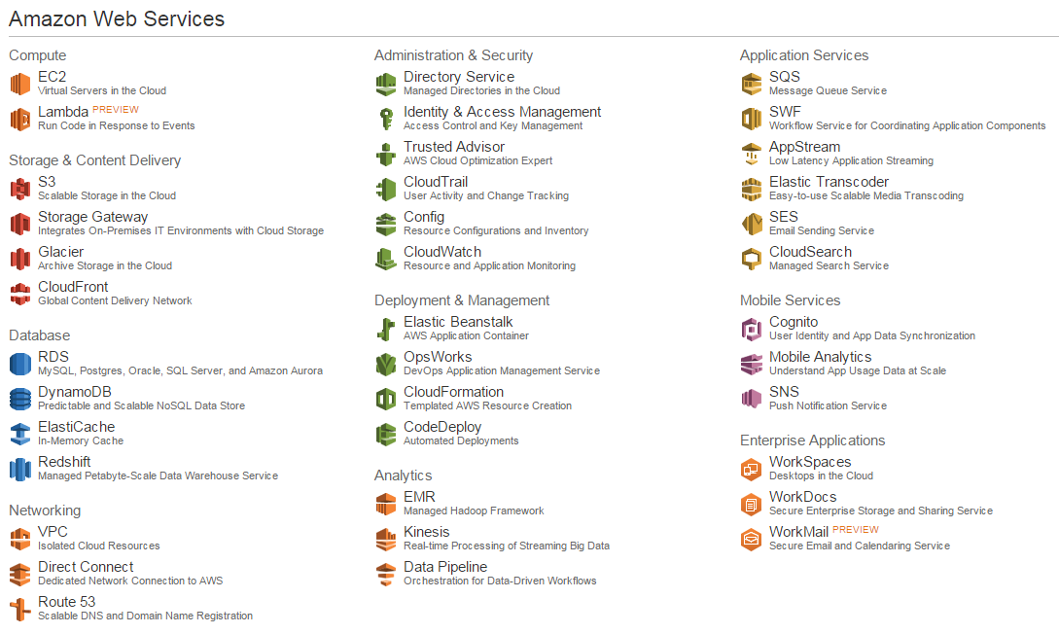
AWS - Product Groups
Notes:
Brief overview of AWS products. These are the official offerings from Amazon. There is also a marketplace for third party vendors to offer products. The segments most germane to this audience and topic, and that we will cover in more depth, are:
Compute
Storage
Database/Analytics

Slide 9
AWS - Compute
Fully managed computers
Managed load balancing
Auto-scales up/down to handle the needs of your application
Wide selection of computer instances and locations
Managed Hadoop instances
Notes:
EC2 - Compute summary (aws.amazon.com) a variety of cloud-based computing services including a wide selection of compute instances which can scale up and down automatically to meet the needs of your application, a managed load balancing service as well as fully managed desktops in the cloud.

Slide 10
AWS - Storage
High Availability guarantees
Flexible expansion via EBS
Managed and configurable backup, archiving, disaster recovery
Higher cost for immediate availability
Notes:
Storage summary (S3, Glacier and EBS). provides low-cost data storage with high durability and availability. Pay-as-you-go pricing with no commitment means greater flexibility and agility. With AWS, high security is available at no extra cost. AWS offers storage choices for backup, archiving, and disaster recovery, as well as block, file, and object storage.
Mention client that has 15 TB of data on S3 for about $12,000 a month.

Slide 11
AWS – Database and Analysis
Variety of remotely hosted database options
NoSQL
in-memory
relational
data warehouse
Streaming data
Workflows and message queues
Notes:
Analytics (SQS, SWF, EMR, DynamoDB and Redshift). provides cloud based analytics services to help you process and analyze any volume of data, whether your need is for managed Hadoop clusters, real-time streaming data, petabyte scale data warehousing.

Slide 12


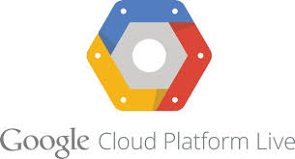

AWS – alternatives
Microsoft Azure
Google App Engine
Digital Ocean
Rackspace
Notes:
AWS not the only game in town, but it is the market leader (37% of the $9 billion IaaS industry). These are just some of the other companies and products in this space. Competition continues to drive prices down. Google Compute just announced on Monday they are lowering prices by 30%, for example.
Hopefully this brief introduction demonstrates some of the increasing ease with which companies can scale up their operations without significant hiring or capital investments. Now let’s discuss Spark, and how this relatively new Apache Foundation project has many people in the Big Data space very excited.

Slide 13

Apache Spark
What is it?
A general purpose engine for large-scale data processing and cluster computing
Defining characteristics:
Increased speed
General execution model
Multiple platform support
Ease of use
Notes:
What is it?
Increased speed over traditional MapReduce
General execution model to handle a wide variety of use cases
Runs on multiple platforms (stand-alone, remote, different cluster managers)
Comparative ease of use (support for Scala, Java, Python, R programming languages)

Slide 14
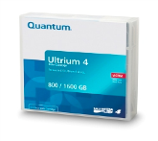


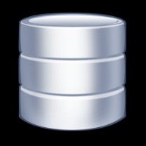





Common Data Analytics Architecture
Offline data can’t be analyzed easily
TAPE ARCHIVE
Can’t explore original high fidelity data
BI REPORTS
&
INTERACTIVE APPS
STORAGE ONLY GRID
(ORIGINAL RAW DATA)
RDBMS
(AGGREGATED DATA)
ETL COMPUTE GRID
Moving data to compute doesn’t scale
DATA COLLECTION
DATA SOURCES
Source: Cloudera
Notes:
So, where does Spark fit into the Big Data ecosystem? The ETL Compute Grid (highlighted) part of the workflow is where Spark comes in. Apache Spark is a cluster computing framework. Spark still sits on top of HDFS (the storage grid), as well as other data storage formats (databases, S3, regular file systems, etc).
The major use case with Spark is to easily pull data from disparate sources, run transforms and analysis on this data in a single framework, and easily export the resulting data to numerous formats or BI applications.

Slide 15
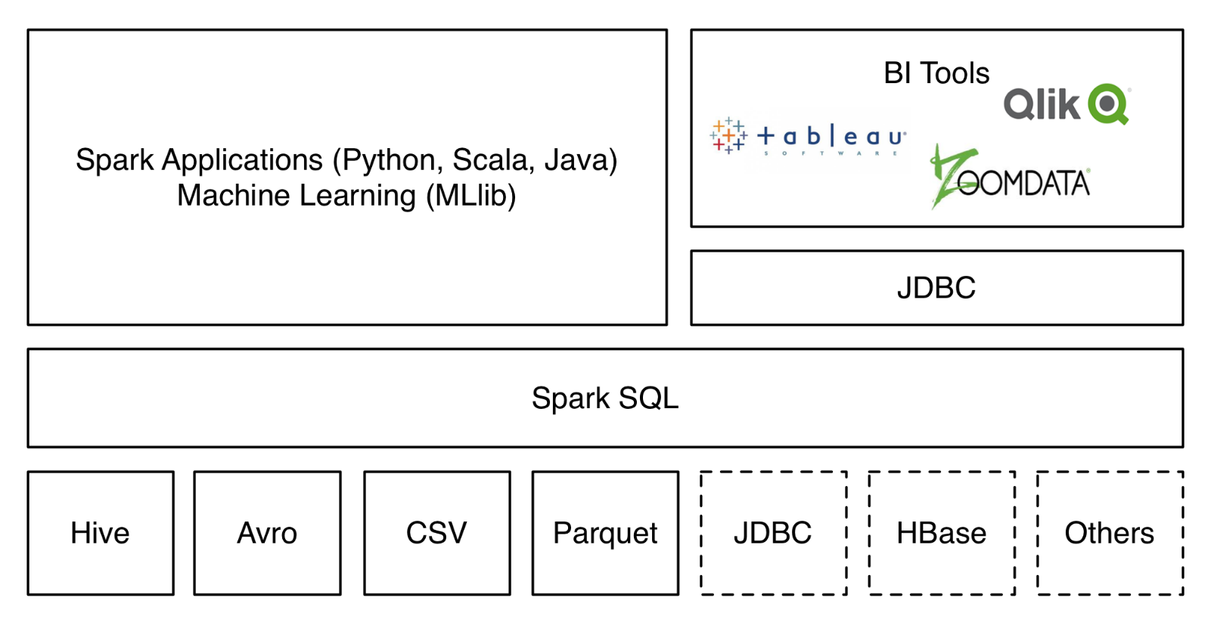
Data Sources for Spark
Cassandra
Kafka
AWS S3
Redshift
Mongo
Postgres
MySQL
Raster/
Vector
Source: Data Bricks
Notes:
Spark is positioning itself at the nexus of data activities. The Spark Core modules allow for ingestion of data from numerous formats into an RDD (Resilient Distributed Dataset). Multiple vendors have created official APIs and connectors to their systems. Spark applications work on data from these various formats, which can then be exported out to files, databases or BI tools using JDBC. Many vendors (DataStax for Cassandra, TenGen for Mongo for example) have created official connectors supporting Spark.

Slide 16
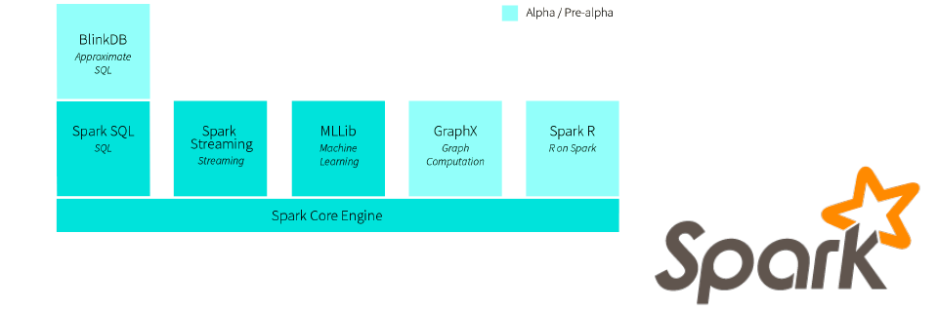
Apache Spark Community
Single unified engine covering
all data sources, workloads, environments
Serving needs of two groups
data engineers
data scientists
Notes:
So, who is the Spark community?
One engine for all data sources, workloads, environments.
Spark aims to have a single cluster computing framework that meets the needs to two main groups: Data Engineers (data pipelines and integration) and Data Scientists (analysis/reporting).
Mention about Spark Summit East a couple of weeks ago. 900 attendees. Sold out. Tremendous excitement.

Slide 17
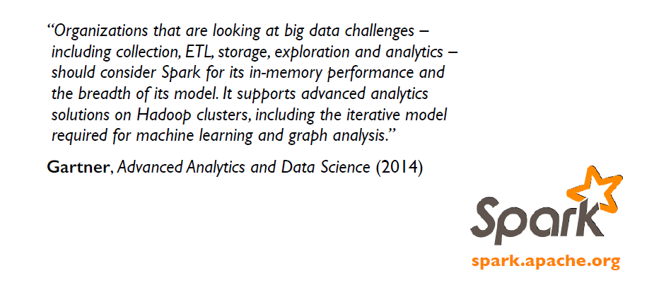
Justification for Using Spark
Notes:
Why such a hot technology? I think Gartner, the information technology research firm, says it best here.
Keep in mind that Spark is not limited to Hadoop, and can operate on data that is stored in dozens of formats.
Important to note that Spark is not the only project out there aims to improve compute with Big Data.
Out of Europe is another Apache project called Flink. Twitter open-sourced Storm. So, Spark is not the only option out there.

Slide 18
Rapid Adoption of Spark
Developed in 2009 at UC Berkeley
Contributors from over 50 organizations
One of the most active open-source projects
Survey of >2000 industry developers:
13% using Spark
20% planning to implement Spark 2015
31% evaluating Spark
Notes:
Rapid adoption in many industries. Spark makes accessing and analyzing data stored in typical Big Data formats or backend systems easier to handle. Wider array of supported technologies and languages makes it easier for more developers to get onboard.
The screenshot is from GitHub, which is a distributed Version Control System that is very popular with open source projects and as a collaborative platform between developers. You can get an idea of the popularity of the Spark project given the number of contributors, stars/forks, and code commits.

Slide 19
Final Thoughts
Big Data is here to stay
Big Data provides a valuable addition to an existing BI strategy; it is not a replacement to more conventional data warehouses
Barriers to entry being lowered
Increasing adoption as companies make the transition from storing the data to analyzing and deriving value from the data
Notes:
Salient take-away point.
Big Data will provide a valuable addition to an existing BI strategy, and is not a replacement to more conventional data warehouses.
More companies have embraced a data driven culture to decision-making. The first step there is to be in a position to capture and store much of the data that is being generated. As companies train BI on this big data, more people in the process need to be able to work with this data, and that has driven the marketplace in the past couple of years by lowering the technical barriers to working with big data.

Slide 20
Questions?
fagan@earthlinginteractive.com
@pittfagan
https://www.linkedin.com/in/pittfagan
www.earthlinginteractive.com
Notes:
Thank you for your attention. Please ask me any questions.

