Slide 1
Real World Examples of Big Data/Data Science
Pitt Fagan
8 October 2016
Notes:
Slide 1 – Hello. Thanks for inviting me to speak to the IMA/IIA chapters. My name is Pitt Fagan and I am the Vice President of Data Engineering for Earthling Interactive, a locally owned web and mobile application development firm founded in 1999. I am also the co-organizer of the Big Data Madison meetup group, which holds monthly meetings attended by between 50-100 people on a variety of topics in the Big Data ecosystem. Tonight I will give you a brief overview of Big Data: what is it, how did it come to be, where is it trending and what are some of the challenges in implementing it at your companies. I will be followed by Brian Baillod, a Sales Engineer at Cloudera, who will present a couple of case studies illustrating the power of Big Data.

Slide 2
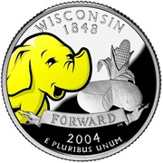

A bit about me …
MS, Statistics from UW-Madison
VP, Data Engineering @ Earthling Interactive
Organizer of BigDataMadison
4.5 year old meetup
Largest tech meetup in Madison (~1400 members)

Slide 3
Presentation Outline
Definition of Big Data
Distributed computing
Increase in amount of data (internet, iot)
Rise of Data science
Analysis at scale
Combining disparate datasets (more data available) for insights
Examples of these technologies in action

Slide 4
Big Data Definition
Big data is high volume, high velocity, and/or high variety information assets that require new forms of processing to enable enhanced decision making, insight discovery and process optimization (Gartner).
One of the original drivers of new techniques was the amount of data being generated.
This has shifted recently to where the main driver of new techniques is the ability to analyze vast and complex data.
Notes:
Slide 2 – Here is a commonly accepted definition of Big Data – “Big data is high volume, high velocity, and/or high variety information assets that require new forms of processing to enable enhanced decision making, insight discovery and process optimization”. Originally, the main driver for new techniques in dealing with data was the sheer amount being generated. This is the “Big” part of Big Data. More recently, even though the volume and variety of data is still increasing at a rapid pace, the innovation has moved to new ways to analyze the vast and complex data out there. This is the “Data” part of the moniker.

Slide 5
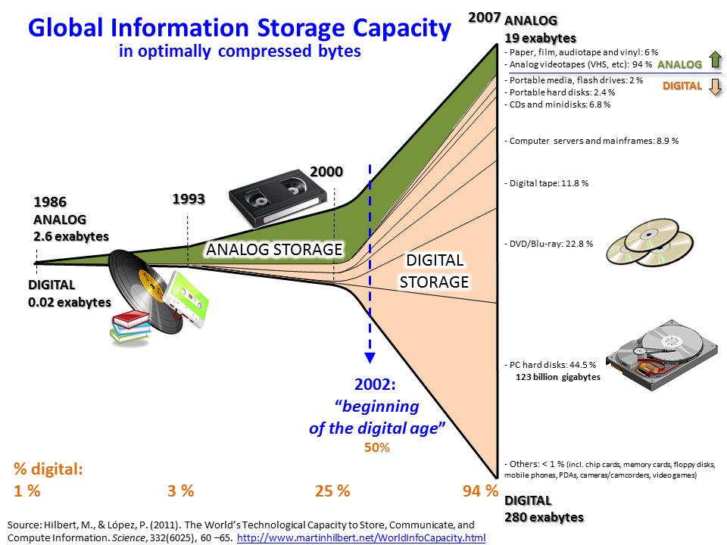
Explosive Data Growth
Notes:
Slide 3 – This image shows the explosive growth of digital data. Notice that the year 2002 is marked as the beginning of the Digital Age.

Slide 6




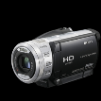







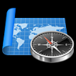

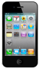




Explosive Data Growth
10,000
1.8 trillion gigabytes of data was
created in 2011…
More than 90% is unstructured data
Approx. 500 quadrillion files
Quantity doubles every 2 years
5,000
GIGABYTES OF DATA CREATED (IN BILLIONS)
0
2005
2010
2015
Source: IDC 2011
STRUCTURED DATA
UNSTRUCTURED DATA
Notes:
Slide 4 – This image shows the explosive growth of unstructured data, (text, images, etc). It is dealing with this sort of data that traditional storage and analysis techniques have deficiencies, and it is with this form of data that much of the innovation has occurred recently in terms of data analytics.

Slide 7
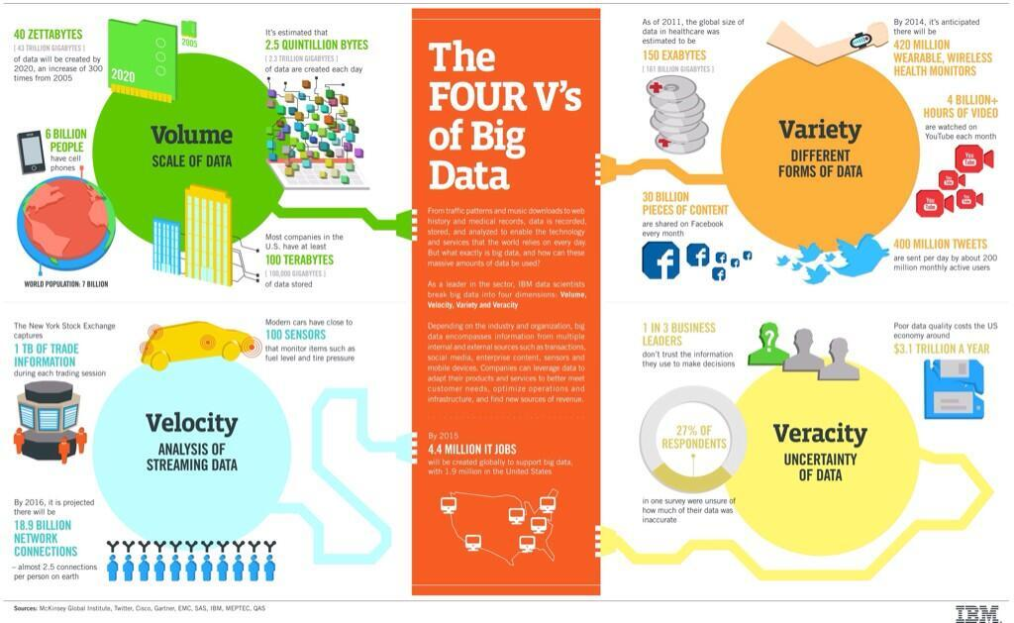
Big Data Characteristics
Notes:
Slide 5 – This busy graphic illustrates an important concept of Big Data, namely the four V’s.
Volume - the sheer amount of data being generated and captured.
Velocity – the speed at which data is both generated and needs to be analyzed.
Variety – the increasing multitude of data sources, much of it unstructured.
Veracity – the messiness of the data, as opposed to the structured form of data in a data warehouse, for example.

Slide 8
Big Data as a buzzword
Why is this such a popular concept?
Cost-effectively managing the volume, velocity, variety and veracity of data
Deriving value across both structured and unstructured data
Flexible to integrate new data sources and types
The ability to parse more info, faster and deeper, to understand the world in new ways.
Notes:
Slide 8 – So why is Big Data so popular? Succinctly, it allows a company to cost-effectively manage data and derive value across structured and unstructured data while flexibly integrating new data sources. Given the rapidly increasing volume and variety of data that is accessible to companies now, the ability to employ tools that enable new ways to derive intelligence from this data is alluring.

Slide 9
Big Data – Lots ofActivity!

Slide 10
Real World Examples of Big Data / Data Science in Action
Now that companies have collected and stored the data, now what?
Companies/governments have applied data science techniques to get insights
Wide range of use cases

Slide 11
Tackling Food Waste
Optimizing logistics with Big Data
Real-time data collection in stores
Surplus food
Expiring soon
Real-time data collection in food stores
Match available food to charitable need
Predictive patterns
Notes:
750 million people lack enough food to keep themselves healthy
30% of food produced goes to waste

Slide 12
Credit Card Fraud
Analyzed billions of credit card transactions
Used semantic analysis to develop a “signature” of typical transactions
Transactions with odd syntax a red flag (i.e. anomaly detection)
Notes:
Used to thwart multi-million $ electronic bank heist from Bangladesh earlier this year due to a mis-spelled word

Slide 13
Fighting Deforestation
Use scientific variables from variety of data sources
Score forests for high carbon potential
Identify forests with low carbon/biodiversity potential
Steer industry to harvest these low potential forests
Notes:
Collaboration between Greenpeace and Indonesian industries. Time tracking of forest health. Timber tracking.

Slide 14
Real-Time Traffic Monitoring
Two way connection between connected vehicle and cloud
Process vehicle metrics. Other vehicles and third party data (weather, police, ambulance)
Like an automated Waze?
Passive data collection through app
Crowdsourced notification of traffic problems
Notes:
According to Gartner, by 2020 there will be an estimated 250 million connected vehicles on the road

Slide 15
Predicting Dementia
Goal of early detection and preventative treatment of dementia
Analyzing billions of lab test records, combined with in-office cognitive test
Scoring patients on likelihood of developing early onset memory loss
Intervention / therapy recommended
Notes:
Dementia set to increase dramatically with aging population. Estimates of cost to health insurers is $215 billion, greater than cancer and heart disease

Slide 16
Reducing Recidivism
Government initiative
Data-Driven Justice Initiative
Risk assessment scoring
Goal to reduce the low risk offenders in jail awaiting trial
Reduce costs and break cycle of incarceration
Notes:
~ 450,000 people nationally on any given day held in jail prior to trial, meaning prior to any conviction. Large number there b/c they cannot post bail.

Slide 17
Data Security
Automated fingerprinting of malware
Detection of new versions of malware, based on incremental changes to file contents
Pattern recognition of typical data access habits. Anomaly detection for security breaches
Notes:
Malware huge problem. Kaspersky Labs identifies 325,000 new malware files every day.

Slide 18
Artificial Intelligence & Gaming
AlphaGo from DeepMind
March 2016 beat grandmaster at the game of Go
Thought to be years away
Achieved using AI methods (deep learning)
Deep neural networks to mimic expert players (lots of intuition in Go)
Feedback loop to learn from games played against itself.
Notes:
Go is an ancient Chinese game. More complex than chess (number of available moves).
Deep learning – extract patterns from masses of data with little human interaction (unsupervised learning)

Slide 19

Email: fagan@earthlinginteractive.com
Twitter: @pittfagan
Meetup: http://www.meetup.com/BigDataMadison

