Slide 1
Project Presentation
Personal AId
Name_1-: Priyanshu Singh
18BET1057
Name_2-: Sagar Kumar
18BET1024

Slide 2
Content
Introduction
System Requirements
Project Explanation & Working
Innovation in Project

Slide 3
Introduction
An all-in-one personal assistant which helps the user in day-to-day activity.
The front-end is made responsive so can be used in any kind of device.
The project is made using python, flask, JS, Html, and CSS.

Slide 4
System Requirements
Currently tested on Windows OS
Minimum Ram Requirement 2GB
Hard drive space 1GB
Internet connection required
Latest Browser requred
Pycharm latest version

Slide 5
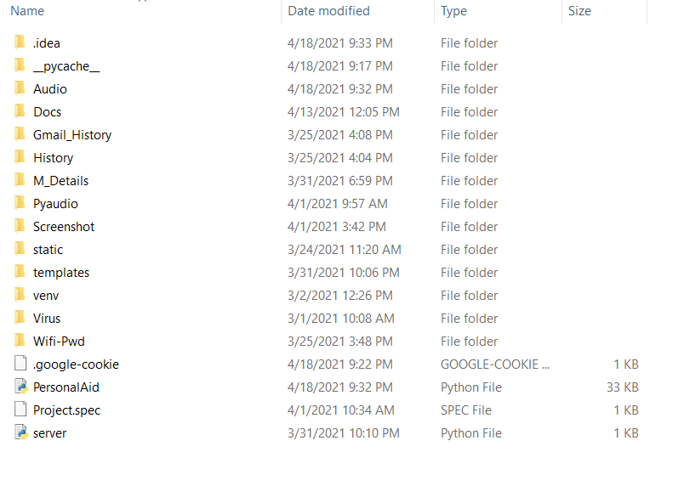
Project Explanation & Working
Folder Information
The Project consist of two python file-:
Server
Personal Aid
Static
Style & Video
4. Templates
Index file

Slide 6

Project Explanation & Working
Front-Page
It consist of a mike and background spectrum
The mike button is responsive like scalling and hovering.

Slide 7
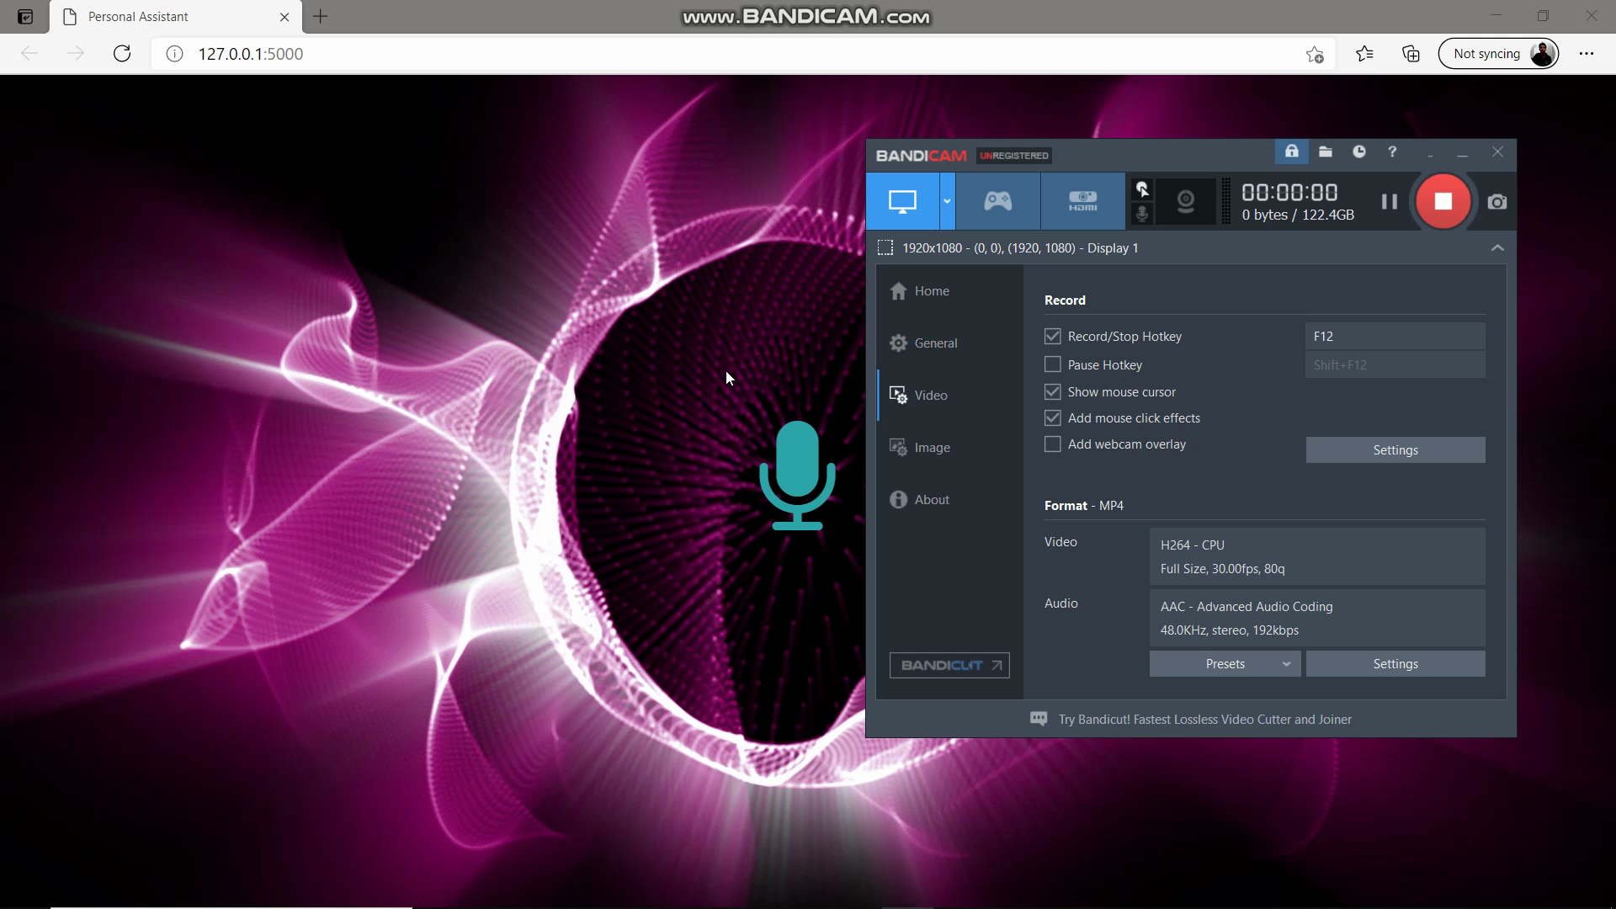
Project Explanation & Working
Video

Slide 8
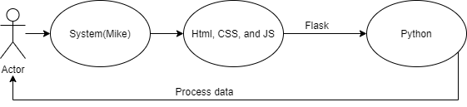
Innovation in Project
The innovation in project is it’s implementation part

Slide 9
Thank You

