Slide 1

Udyam Digital
Small businesses discover, buy and activate Accel Business in one sitting, on their phone, in their language
YTL Hackathon 2026 · Enterprise Track A · Business case
Notes:
Udyam Digital: a digital-first acquisition and onboarding journey for Accel Business. All figures are from the synthetic dataset provided (smb_leads.csv, Apr-Jun 2026).

Slide 2

THE PROBLEM
Only 7.4% of leads activate; the quote is the biggest leak
17.6 days
3 calls
lead to activation
customer chases status
₹15,053
9.6% / 2%
acquisition cost per activated SMB
activation with / without GSTIN
32% of all drops are caused by visits, slow or confusing quotes and paperwork, which a self-serve journey removes.
Leads reaching each stage, Apr–Jun 2026. Needs assessed → quote accepted converts at just 44%.
Notes:
Funnel from smb_leads.csv. Drop reasons removed by a digital journey: owner had no time for a visit (531), visit not scheduled (296), quote too complex (206), quote too slow (179), paperwork too long (79), missing GST/Udyam doc (94), signatory not available (53), document mismatch (47) = 1,485 of 4,632 drops.

Slide 3
WHO FIRST
Lead with offices; win micro retail on low-cost channels
Months of revenue to repay acquisition cost
Segment | Share | Activ. | ₹/mo | GSTIN | Churn | Wave
Professional offices | 25% | 11.1% | 6,575 | 86% | 13.8% | 1 · digital
Micro retail & services | 55% | 4.1% | 2,470 | 53% | 22.7% | 1 · digital + partner
Small multi-site | 15% | 11.0% | 28,080 | 98% | 10.8% | 2 · hybrid
Small manufacturers | 5% | 12.8% | 15,910 | 99% | 8.1% | 2 · field-led
Why: offices pay back acquisition cost in 1.6 months and 86% already have a GSTIN, so instant KYC works on day one. Micro retail is the volume (55%) but pays back in 8 months at today's ₹20k cost per activation, so it must come through WhatsApp, referral and partner-assisted journeys (₹4–6k).
Notes:
Per segment from analysis/funnel.py: activation rate, median monthly bundle value of activated leads, cost per activation (sum of acquisition_cost_inr / activations), GSTIN share and 6-month churn. Payback = cost per activation / median monthly bundle value.

Slide 4
BUNDLES & PRICING
Four bundles, one transparent monthly price each
Dukaan Digital
Office Pro
Multi-site Connect
Factory Line
Kirana, salon, pharmacy
Clinic, CA firm, coaching
3–10 outlets
Units with 10+ staff
₹1,448/mo
₹5,254/mo
₹36,710/mo
₹26,375/mo
Biz Fibre 100 + 1 business SIM
Add: POS & UPI billing ₹749, CCTV, guest Wi-Fi, WhatsApp*
Fibre 300 + 2 postpaid lines + email, backup & security for 6 users
Fibre + 4G failover + SD-WAN per site, POS, CCTV, 10 lines (5 sites)
Leased line 20 Mbps, managed firewall, machine IoT, email & security
12 mo · no GSTIN needed
12 mo · ₹4,564 on 24 mo
Setup ₹63k or 6 EMIs
GSTIN required
Pricing rule: price falls inside each catalogue range with commitment (12 mo = mid, 24 mo = floor). GST is always shown, setup can be paid in 6 EMIs, and the advisor trims optional add-ons to fit a stated budget. *WhatsApp, SMS and leased lines unlock once a GSTIN is added.
Notes:
Prices are generated by the prototype's rules engine and pricing module from product_catalogue.csv (examples: kirana 2 staff tier-2 no GST; clinic 6 staff tier-1; restaurant chain 5 sites 40 staff; auto-parts unit 30 staff). Activation: 5 days for fibre bundles, 14 days multi-site, 21 days leased line.

Slide 5
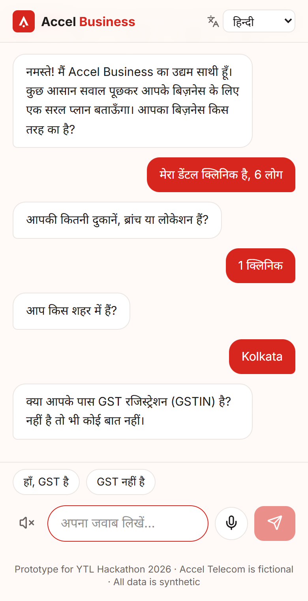
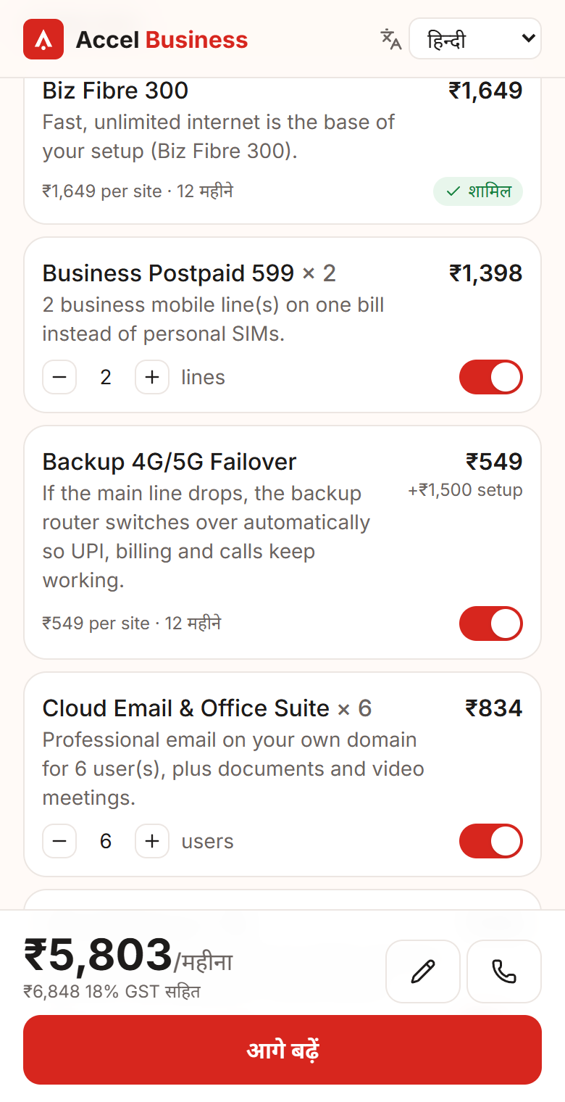
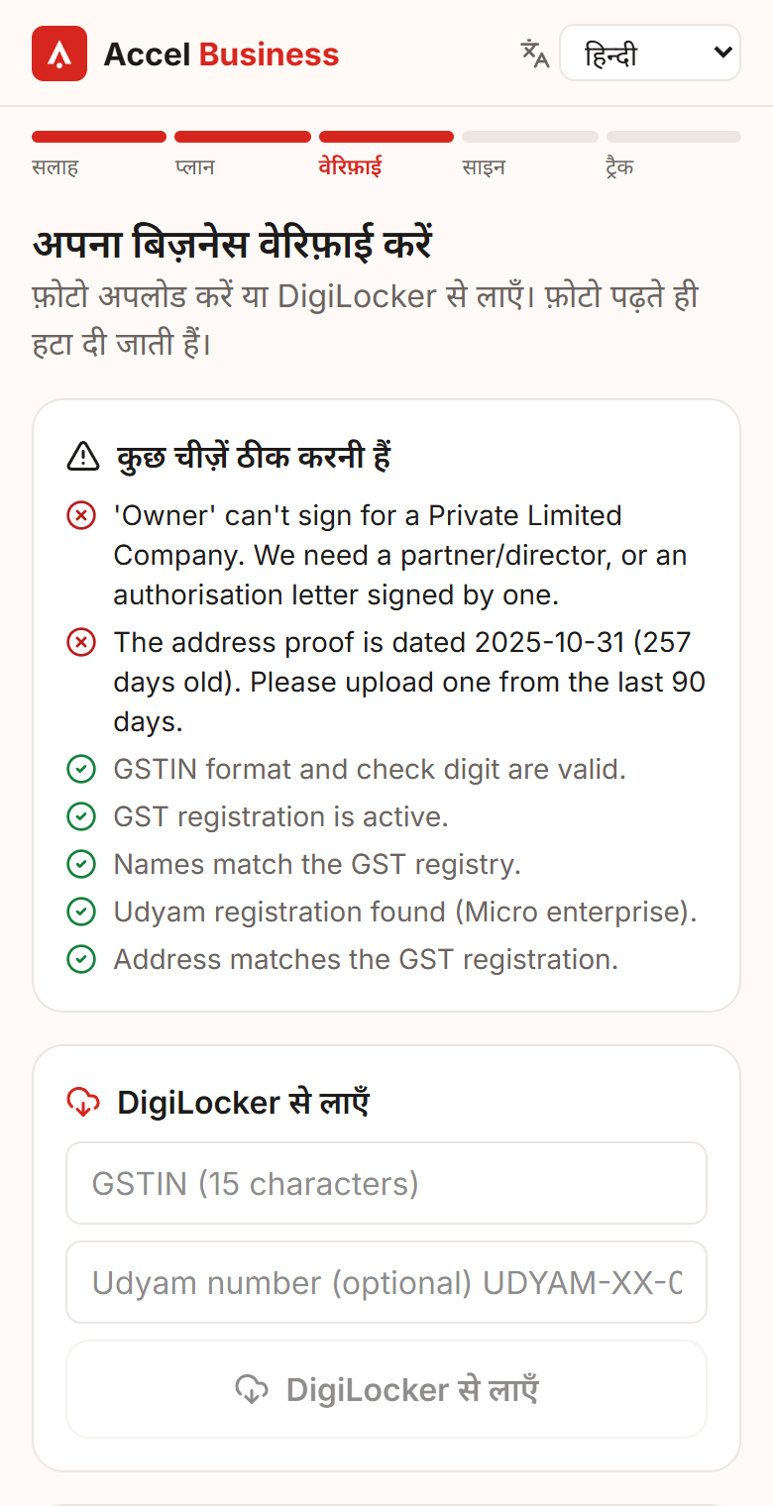
THE JOURNEY
One sitting: advise, quote, verify, sign, track
1
Advisor
Chat or voice in 10+ languages; 6 questions; deterministic bundle with plain-language reasons
2
Quote
One monthly price; toggle add-ons, quantities, 12/24 months; dependencies auto-added
3
Smart KYC
DPDP consent, DigiLocker or photo, GSTIN/Udyam lookup, 15 automatic checks
4
e-Sign & track
OTP e-sign, install slot, live tracker and WhatsApp updates instead of calls
Hindi advisor
Live quote
KYC issues explained
Notes:
Screens are from the working prototype (React PWA). Demo shows: Hindi voice advisor, add-on toggle, consent, K07/K11/K02 specimen KYC, e-sign, tracker, back-office.

Slide 6
ARCHITECTURE
The LLM talks; deterministic code decides prices
Phone · PWA
FastAPI + LangGraph
Groq ModelRouter
Data
Advisor chat + voice
Journey graph · interrupts
Prompt Guard 2 (input)
Neon Postgres: checkpoints, consent, orders, audit
Quote & checkout
Advisor: parser + LLM slots
gpt-oss-120b → qwen3-32b → llama-3.3-70b
Consent & KYC upload
Rules engine & pricing
Llama 4 Scout vision
CSV: catalogue, GSTIN & Udyam registries, leads
e-Sign & tracker
Smart KYC checks
Back-office
Tracker · propensity
Whisper speech
LLM talks, code decides
the LLM fills slots and explains; products and prices come from the catalogue rules
Model rotation
a rate-limited model is parked until its reset; the next model answers
Always works
regex parser, scripted advisor and local OCR run with no API key
Guarded
Prompt Guard screens input; PII is redacted before any LLM call
Notes:
Stack: React + Vite PWA on Vercel; FastAPI + LangGraph on Render (Docker); Neon Postgres; Groq for chat, vision (Llama 4 Scout), prompt guard and Whisper. 55 automated tests including advisor scenarios and model-rotation tests.

Slide 7
SMART KYC & PRIVACY
Smart KYC catches the planted problems and keeps no images
K01 | Blocked | GSTIN cancelled in registry; Udyam number blank
K04 | Retake | GST certificate photo too blurry to read
K06 | Fix | GSTIN check digit wrong: altered number
K07 | Blocked | Legal name differs from GST registry
K11 | Fix | Bill 257 days old; 'Owner' can't sign for a Pvt Ltd
K05, K10 | Fix | 'Owner' isn't a signing role for an LLP
K02, K03, K08, K09, K12 | Verified | incl. skewed scan and O/0 OCR auto-repair
Consent by purpose
verify · activate · marketing (opt-in), versioned ledger, withdraw anytime
Minimise
images read in memory and deleted; only fields + SHA-256 kept; DigiLocker preferred
Mask & redact
GSTIN/ID masked in UI and logs; PII stripped before LLM calls
Retain & purge
pending KYC 30 days, abandoned journeys 90 days, audit log of every action
Offline result on all 12 specimen applicants (scripts/kyc_batch.py), no LLM needed.
Notes:
Checks: GSTIN mod-36 checksum and PAN structure, registry status, name and address fuzzy match against registry, Udyam vs GST trade name, signatory role by constitution, ID expiry, bill age (90 days from 2026-07-15), blur score, document type. DPDP Act 2023: notice + purpose-wise consent, purpose limitation, data minimisation, retention.

Slide 8
FIELD FORCE & PARTNERS
Digital adds to field sales and partners instead of competing
Cost per activation by lead source
Owner, self-serve
Micro & offices with GSTIN: WhatsApp, QR and web links open the advisor directly
Partner-assisted
Partner runs the same journey on the owner's phone with a partner code: earns commission, helps with GST, documents and install
Field sales
Multi-site and manufacturers, plus back-office leads ranked by propensity (AUC 0.72) with a next best action
Every lead keeps its source and partner code for 90 days, so the partner who brought it is paid even if the owner finishes alone.
Notes:
Cost per activation by source from smb_leads.csv. Hand-offs from the advisor (callback, tier-3 city, blocked KYC, consent declined) appear live at the top of the back-office list.

Slide 9
MEASURING SUCCESS
Five metrics, with targets for the first digital cohort
Metric
Today
Target
Why it moves
Per quarter of 5,000 leads
+382
activations (368 → 750)
≈ ₹3.2 cr
added annual revenue at ₹6,900 median/mo
₹10 L
less acquisition spend
Lead → activation
7.4%
15%
instant, plain quote fixes 385 'too slow / too complex' drops
Days to activate
17.6
≤ 6
KYC in minutes; fibre installs in 5 days
Cost per activation
₹15,053
≤ ₹6,000
digital sources cost ₹4–6k vs ₹24k field
Status calls / customer
3.0
≤ 0.5
tracker + WhatsApp updates
6-month churn
15.2%
≤ 10%
churn is 6% at 1 follow-up vs 28% at 5
Targets are set for 6 months after launch in pilot cities, measured on leads that start in the digital journey vs the field-led baseline.
Notes:
Value estimate: 750 activations x Rs 6,000 = Rs 45 lakh vs today's 368 x Rs 15,053 = Rs 55.4 lakh; 382 extra activations x Rs 6,900 median monthly bundle x 12 = Rs 3.16 crore annualised. Indicative, synthetic data.

Slide 10
ROLLOUT & RISKS
Pilot in four cities, scale in nine months
1
Months 0–2 · Pilot
Pune, Bengaluru, Jaipur, Lucknow. Offices + GST micro retail. Web and WhatsApp links, 50 partners
Risk → mitigation
Wrong advice: rules engine decides; 12 scenario tests; human hand-off
2
Months 3–5 · Expand
10 languages with voice, all channel partners onboarded, live DigiLocker and e-sign
Forged documents: registry + checksum + cross-document checks; DigiLocker first
Channel conflict: partner attribution and commission on assisted journeys
3
Months 6–9 · Scale
All tier-1/2 cities; multi-site and manufacturers on a hybrid flow; propensity routing for field sales
Install capacity: slot booking; 5G AirFiber in 2 days where fibre is late
Price-sensitive micro: 24-month price, starter bundle, setup in EMIs
Notes:
Pilot cities are in the dataset's tier-1 and tier-2 lists. 'Installation delayed beyond 21 days' caused 98 drops after KYC; 'price too high' 414 and 'competitor cheaper' 207 at the quote stage.

